Slide 1
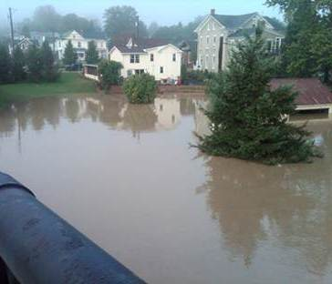
2011 Storm impacts on nutrients and sediment in the Susquehanna River Basin
Presentation for the
Impacts of Tropical Storms
Irene and Lee on the Hudson River
Hudson River Environmental Society
Cary Institute of Ecosystems Studies
Wednesday September 19, 2012
Kevin McGonigal
Environmental Scientist
Susquehanna River Basin Commission

Slide 2
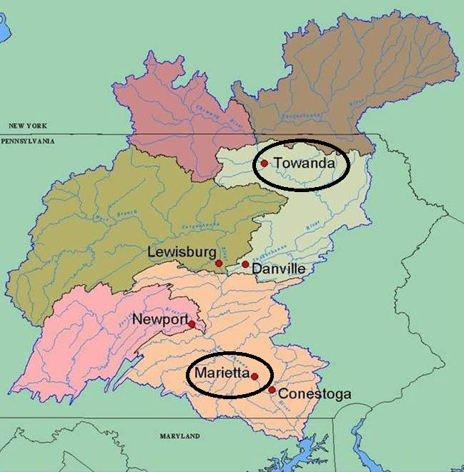
Site Location | Drainage Area (Sq. Mi.) | Water/ Wetland | Urban | Ag | Forest
Towanda | 7,797 | 2 | 5 | 22 | 71
Marietta | 25,990 | 2 | 7 | 19 | 72
Where
Towanda – Mostly NY
Marietta – Above Dams
What
Precipitation
Flows
Loads
Average Concentrations
When
September
6-day peak flow period
How
Estimator

Slide 3
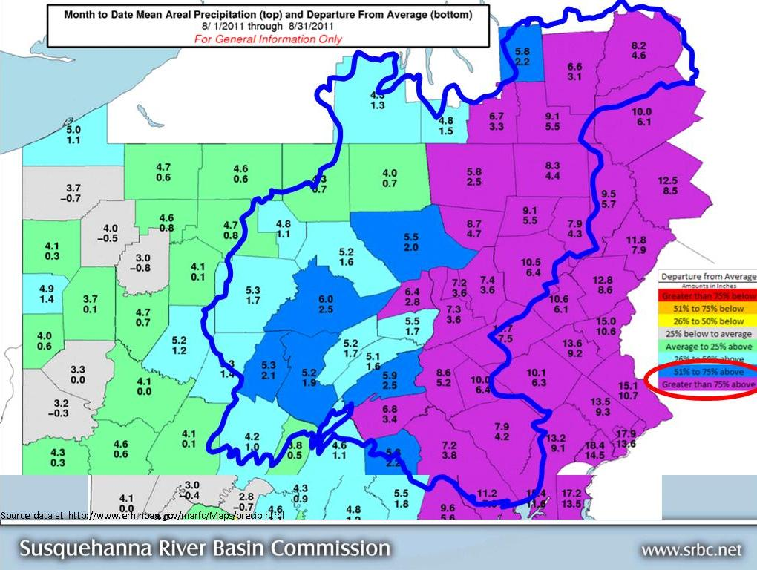
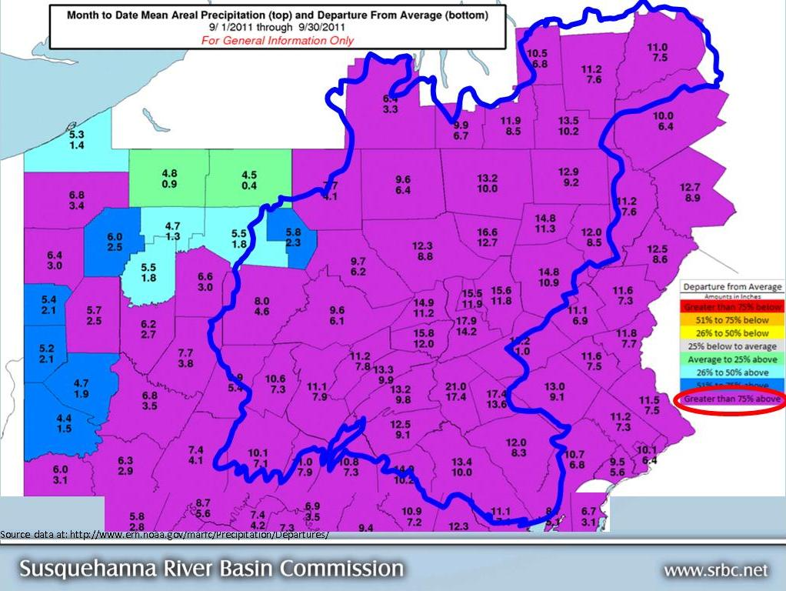
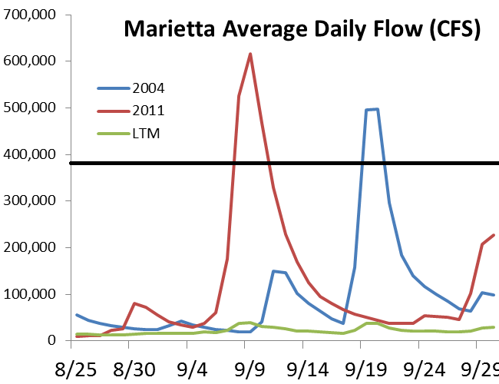

Slide 4
Precip Inches | September 2004 |  | September 2011
 | Precip | Departure | Precip | Departure
NY | 4.15 | 1.28 | 10.55 | 7.13
PA | 5.85 | 2.52 | 12.60 | 9.07
Source data at: http://www.erh.noaa.gov/marfc/Precipitation/Departures/
September Flow | Daily High | 2011 Monthly Average | Monthly % of LTM
Towanda
2004 | 154,000 | 27,943 | 491%
2011 | 250,000 | 36,785 | 647%
LTM |  | 5,687
March 2011 | 124,000 | 47,732 | 202%
Marietta
2004 | 390,000* | 110,893 | 465%
2011 | 664,000 | 137,867 | 578%
LTM |  | 23,610
March 2011 | 434,000 | 162,713 | 217%

Slide 5
September Loads in Tons
Towanda | Daily High | Ave Mon Q | TN | TP | SS
2004 | 154,000 | 27,943 | 1,975 | 489 | 1,588,205
2011 | 250,000 | 36,785 | 2,361 | 816 | 5,020,671
LTM |  | 5,687 | 407 | 77 | 295,844
March 2011 | 124,000 | 47,732 | 4,033 | 367 | 578,135
Marietta |  | Ave Mon Q | TN | TP | SS
2004 | 390,000* | 110,893 | 14,203 | 3,459 | 7,333,922
2011 | 664,000 | 137,867 | 15,242 | 4,712 | 12,014,186
LTM |  | 23,610 | 2,878 | 431 | 830,628
March 2011 | 434,000 | 162,713 | 18,854 | 1,650 | 2,342,749

Slide 6
September Average Concentrations mg/L
Towanda | Ave Mon Q | TN | TP | SS
2004 | 27,943 | 0.87 | 0.216 | 703
2011 | 36,785 | 0.79 | 0.274 | 1,688
LTM | 5,687 | 0.89 | 0.168 | 643
Marietta | Ave Mon Q | TN | TP | SS
2004 | 110,893 | 1.58 | 0.386 | 818
2011 | 137,867 | 1.37 | 0.423 | 1,078
LTM | 23,610 | 1.51 | 0.226 | 435

Slide 7
Focus on Suspended Sediment
SS Tons 2011 | Towanda |  | Marietta
 | 2011 | LTM | 2011 | LTM
March | 578,135 | 214,944 | 2,342,739 | 517,595
April | 818,977 | 348,303 | 2,363,189 | 586,536
September | 5,020,671 | 81,079 | 12,014,186 | 364,647
3 Mo Total | 6,417,783 | 644,326 | 16,720,114 | 1,468,777
Annual | 6,848,659 | 1,660,532 | 19,071,838 | 3,888,205

Slide 8
6-Day loads over peak of storm events
2011 6-day totals | Towanda
 | Ave Flow | Daily High |  | SS Tons
March 10-15 | 77,850 | 124,000 |  | 182,501
April 25-30 | 81,033 | 128,000 |  | 294,713
Sept 7-12 | 115,717 | 250,000 |  | 3,158,767
2011 6-day totals | Marietta
 | Ave Flow |  | High Daily Ave |  | SS Tons
March 10-15 | 292,833 |  | 434,000 |  | 816,043
April 25-30 | 225,667 |  | 370,000 |  | 720,619
Sept 7-12 | 390,167 |  | 664,000 |  | 6,800,111

Slide 9
September Towanda
Year | Days | Ave Flow | High daily Ave. | SS Tons | Ac-ft
2004 - Ivan | 18-23 | 71,216 | 127,000 | 809,553 | 627
2011- Lee | 7-12 | 115,717 | 220,000 | 3,158,767 | 2,447

Slide 10
Historical High SS Comparison At Marietta 25 years
Time Periods (Months) | % Flow | TN | TP | % SS
Top 10% flow | 10.09% | 10.06% | 18.17% | 28.73%
1993+2004+2011 (top 3 SS) | 3.95% | 4.03% | 11.83% | 23.75%
2004+2011 (September) | 2.03% | 1.81% | 8.17% | 19.90%
2011 (March, April, September) | 3.70% | 3.03% | 7.92% | 17.20%
2011 (September) | 1.12% | 0.94% | 4.71% | 12.36%

Slide 11
Take home
The “bad”
Individual high flow events versus sustained high flows
Increases in sediment due to scour of reservoirs
The “good”
Timing of storms
At end of summer

Slide 12
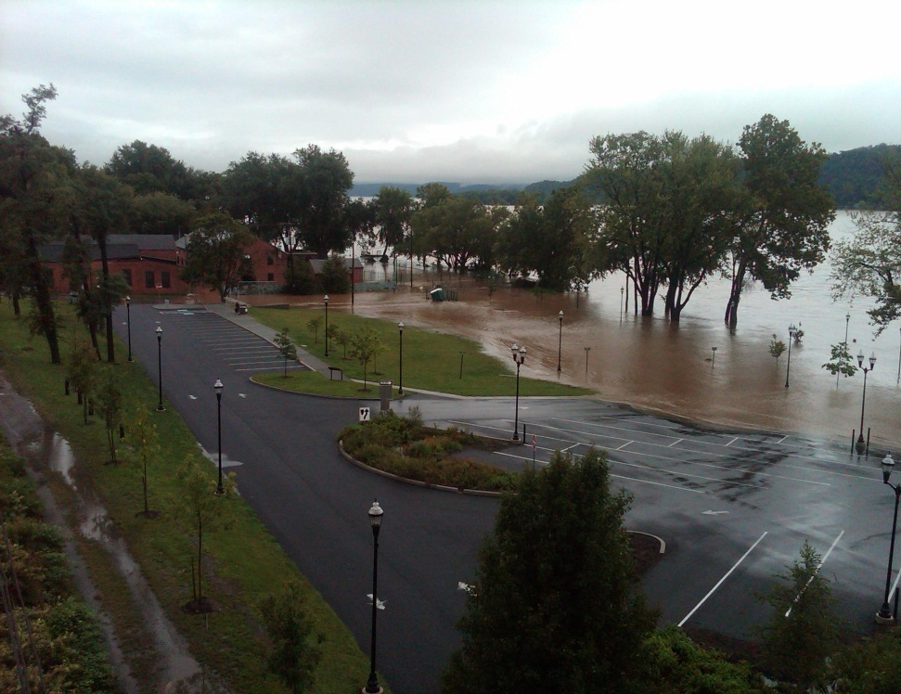
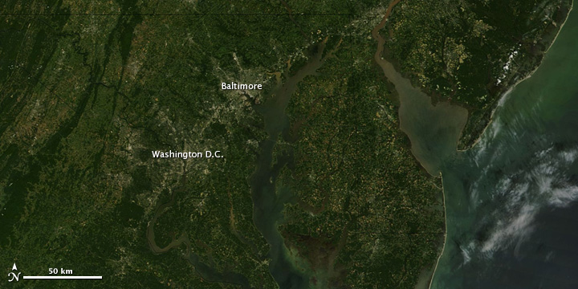
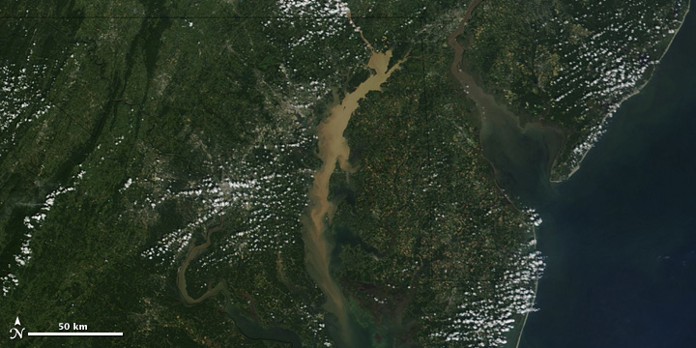
??Questions/Comments??
Image taken August 30
8/30/11 max 83,500 cfs
Image taken September 13
9/9/11 max 778,000 cfs
(>390,000 cfs = scour - USGS)
Columbia, PA South of Route 462
aka Marietta Site 9/10/11
Satellite Image Source
http://earthobservatory.nasa.gov

