Slide 1
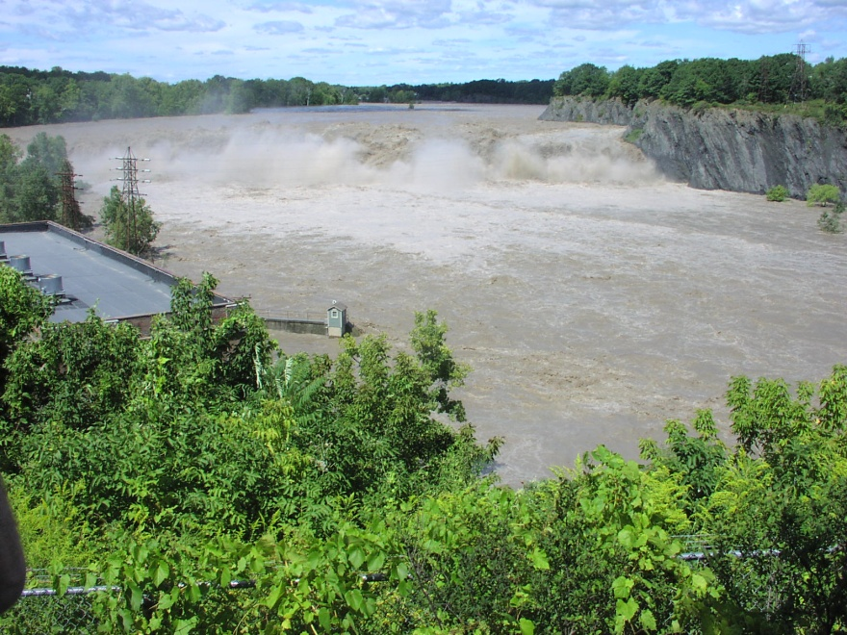
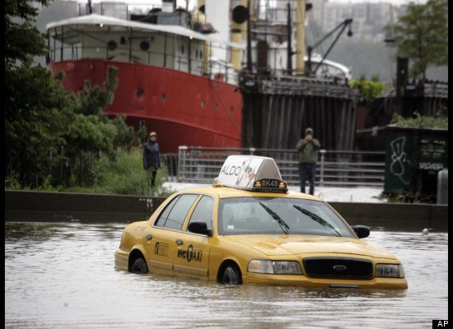
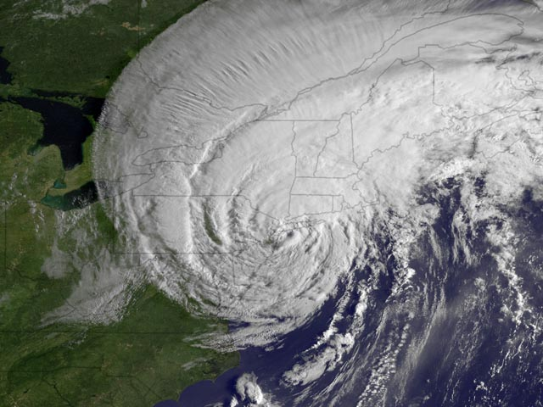
The Hudson River and Estuary Physical Response to Irene and Lee
Cohoes Falls, Mohawk River
Tropical Storm Irene
Credit: John Speer, hriyc.org
Philip Orton
Postdoctoral Research Associate, Stevens Institute of Technology
with Nickitas Georgas, Alan Blumberg and Julie Pullen, all at Stevens
Funding from the NOAA-RISA Program (Rosenzweig et al.) project
“Consortium for Climate Risk in the Urban Northeast (http://ccrun.org)”
Notes:
regional integrated sciences and assessments

Slide 2
Outline
Irene and Lee’s floods, in time-series
Irene: “Hudson’s eye” and “Birds-eye” view animations
Quantifying the merge … rainfall and surge
What might the future hold for Hudson floods?

Slide 3
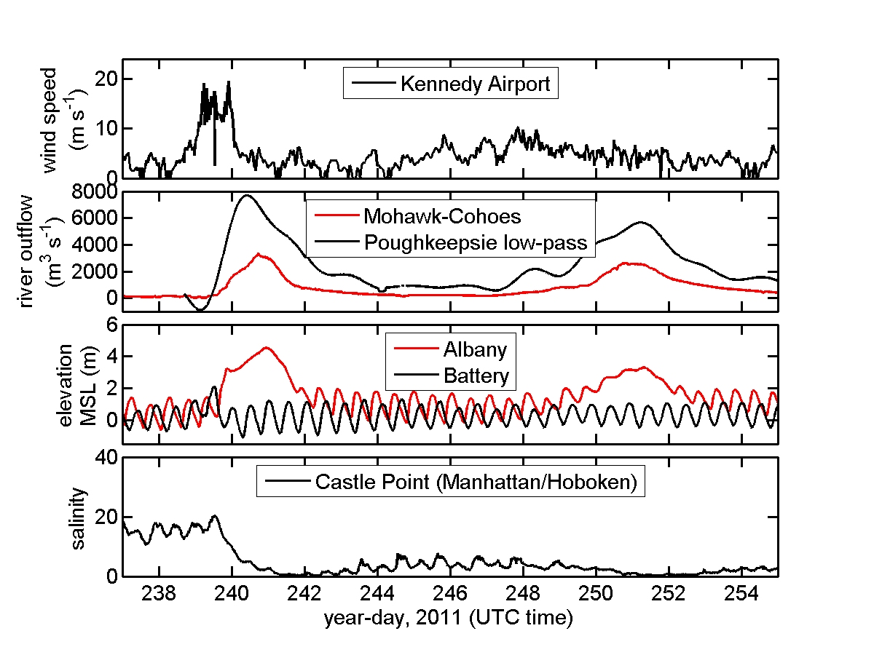
Irene and Lee Observations
Irene’s flows:
Mohawk-Cohoes:
“30-year flow”
Hudson-Troy:
“70-year flow”
(Suro, USGS, 2011)
Battery elevation was fourth highest since 1930, a ~20 year event
, NYC
Aug26
Sep13
data credits: HR-ECOS, NOAA-NDBC, USGS

Slide 4
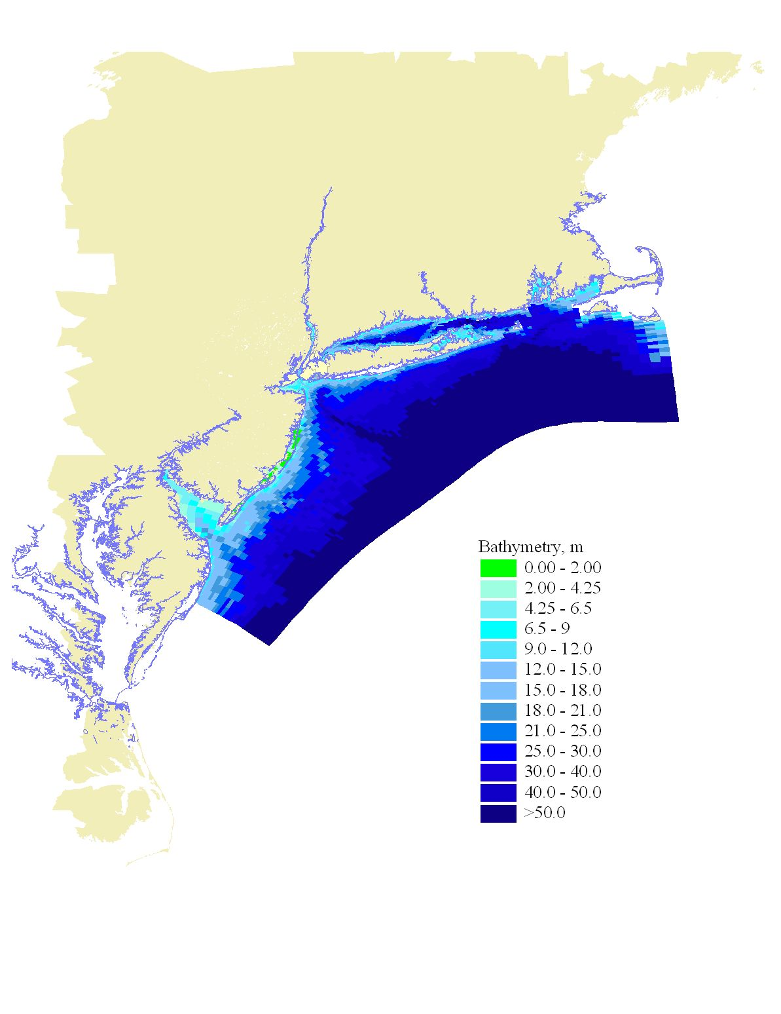
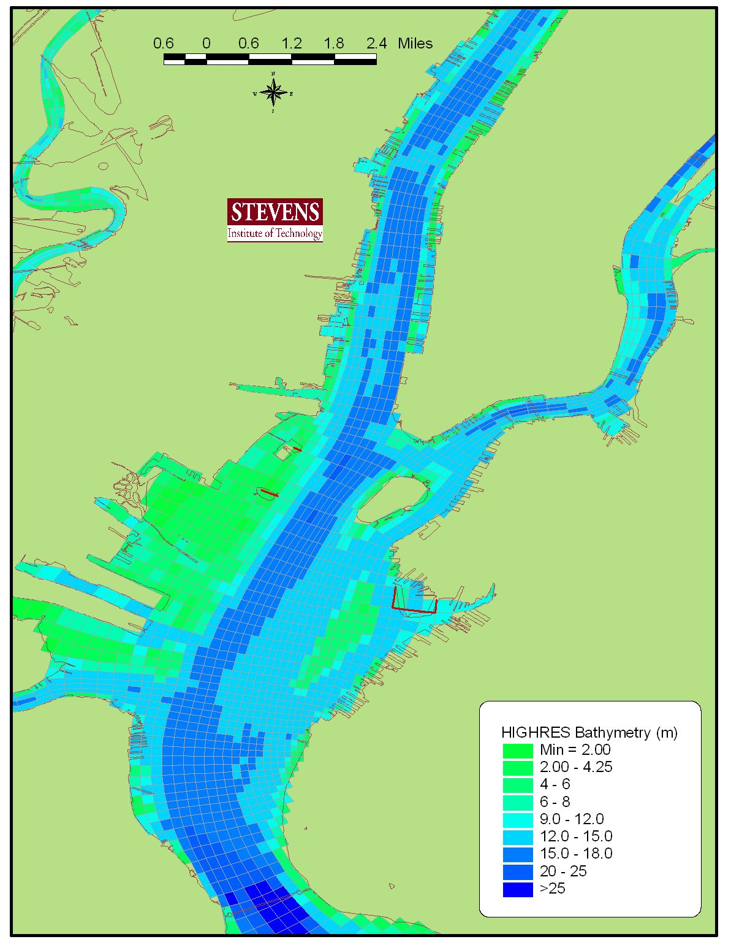
Hydrodynamic MODEL: Stevens ECOM (sECOM)
The GRID/DOMAIN: NYHOPS
Albany
Battery
Battery
NY Harbor Observing and Prediction System
Daily forecasts at http://stevens.edu/NYHOPS
High-resolution model grid (147x452 x10 vertical). 150,680 water cells
Freshwater: Gaged major tribs (93), estimated minor tribs (146), WWTP (241), rain-on-water
Indian Point
Battery
Notes:
All along the Hudson you have about 10 cells across the channel, as well as 10 cells in the vertical to resolve vertical variations

Slide 5
Albany
Hudson River
Manhattan
West Point
Piermont
Battery

Slide 6
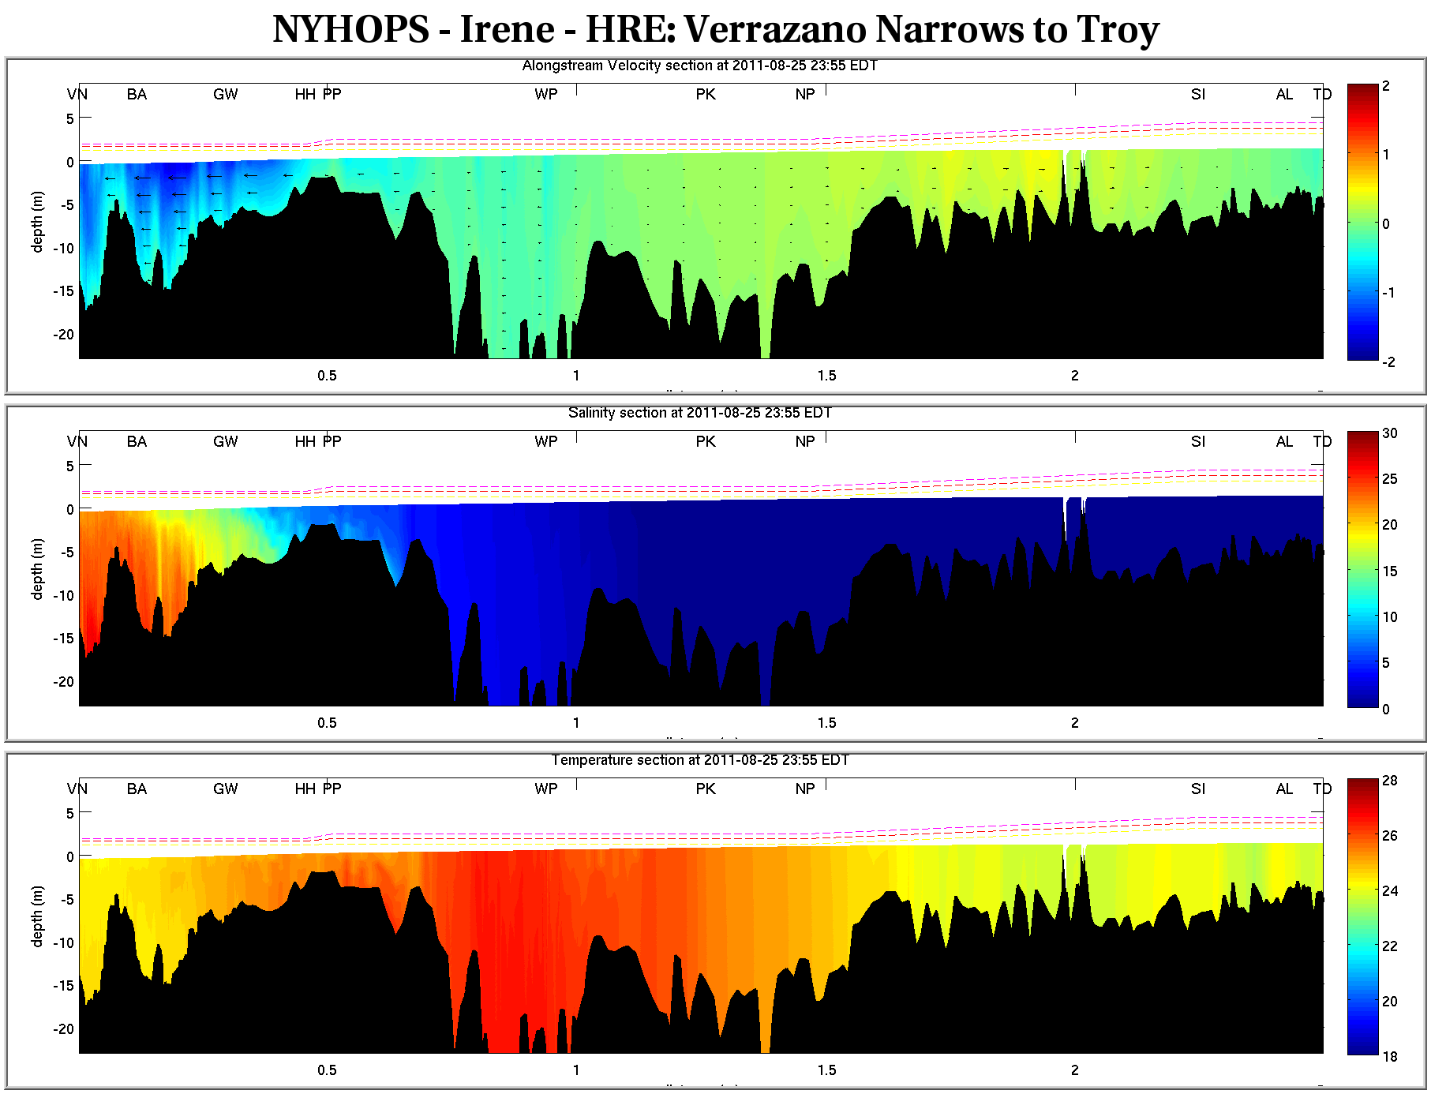
velocity (m/s)
salinity (ppt)

Slide 7
velocity (m/s)
salinity (ppt)

Slide 8
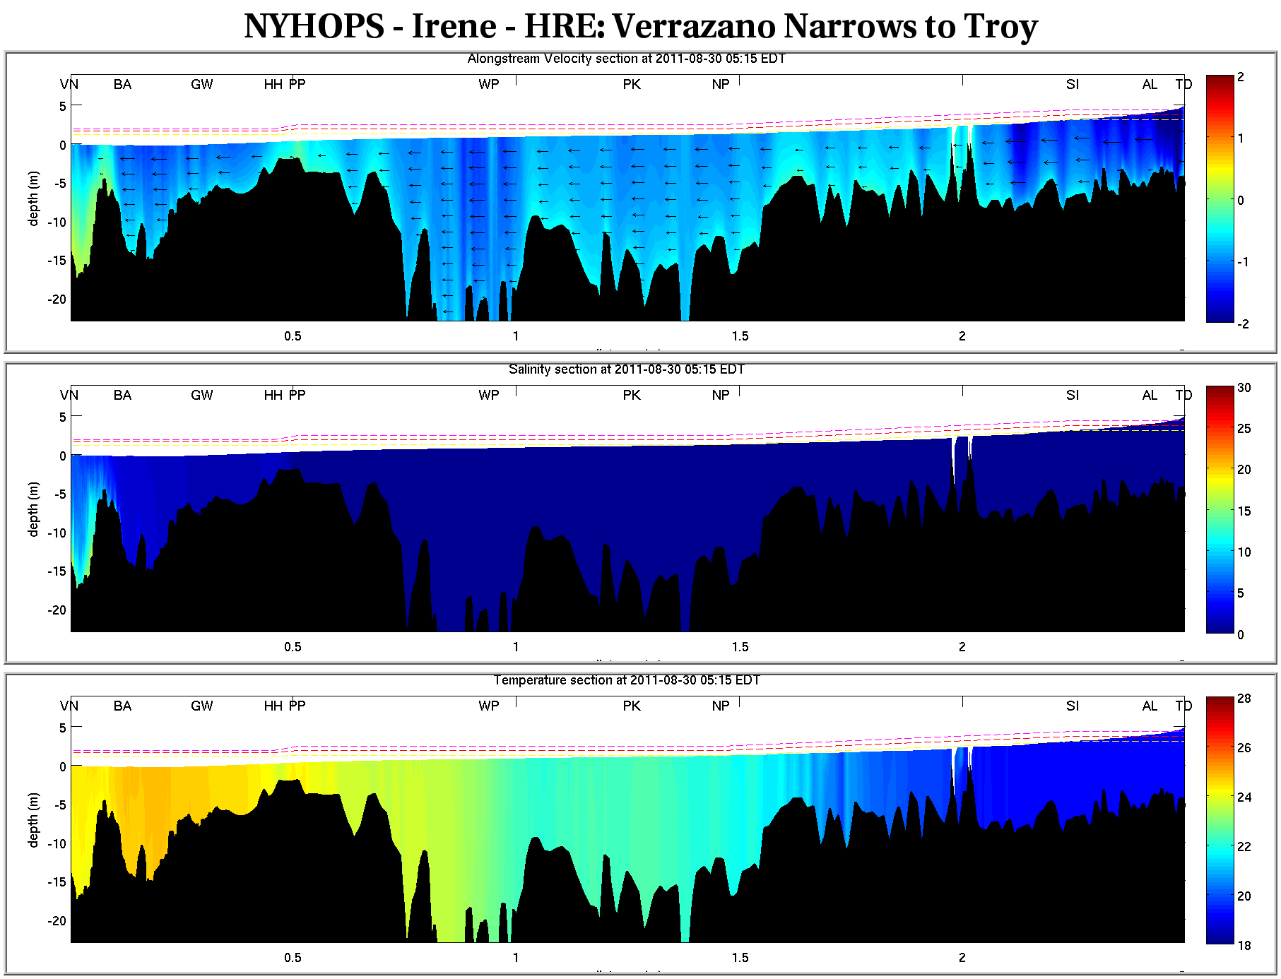
velocity (m/s)
salinity (ppt)

Slide 9
control run
neglecting freshwater
Orton, P., N. Georgas, A. Blumberg, and J. Pullen, 2012. Detailed Modeling of Recent Severe Storm Tides in Estuaries of the New York City Region,
Journal of Geophysical Research
Looking closer at Irene’s flood elevations …
peak surge at Battery
(HR-ECOS)
(HR-ECOS)
Thanks to Gary Wall for help with estimates of Troy freshwater flows

Slide 10
Freshwater Input Influence on Peak Elevation
Aug 2011 Irene Results
March 2010
Nor’easter Results
Similar in spite of major storm differences – coincided with spring freshet
FEMA flood maps and most storm surge models neglect freshwater, so likely underestimate middle-Hudson flood zones.

Slide 11
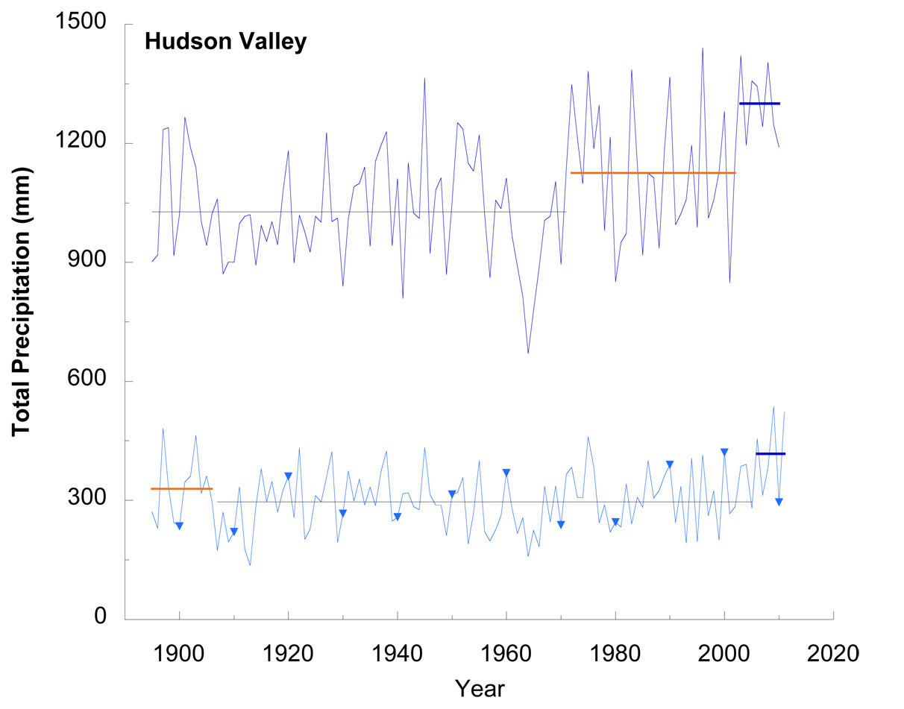
Hudson River Floods: What Does The Future Hold?
Climate models show high uncertainty, but past century and a new 500-year tree-ring based record suggest a wet future
(Pederson et al., 2012, Journal of Climate)
With sea level rise and potential further increases in rainfall, the Hudson is slowly getting doused from both ends
We have a new NYSERDA-funded project to create an online tool for users to map Hudson Valley flood zones (e.g. 100-year) for today and future decades
Notes:
The question for surge modeling should move forward form whether or not these should be considered at all, to what complexity to use in incorporating them.

Slide 12
Conclusions: Hudson River Flooding, Irene/Lee
Irene washed nearly all salt from the Hudson River estuary southward of Manhattan, and there was only a brief return to brackish conditions before Lee nearly did it again
Irene’s tributary flows were 30-year (Mohawk) and 70-year (Troy) floods, while NYC had a ~20-year flood elevation event
To model Hudson River water elevations, one needs to include both storm surge and rainfall effects
With sea level rise and potential further increases in rainfall, the Hudson is slowly getting doused from both ends – are defenses keeping up?
Notes:
The question for surge modeling should move forward form whether or not these should be considered at all, to what complexity to use in incorporating them.

Slide 13
The Hudson River and Estuary Physical Response to Irene and Lee
Cohoes Falls, Mohawk River
Tropical Storm Irene
Credit: John Speer, hriyc.org
Philip Orton
Postdoctoral Research Associate, Stevens Institute of Technology
with Nickitas Georgas, Alan Blumberg and Julie Pullen, all at Stevens
Funding from the NOAA-RISA Program (Rosenzweig et al.) project
“Consortium for Climate Risk in the Urban Northeast (http://ccrun.org)”
Notes:
regional integrated sciences and assessments

