Slide 1

Assessing the effects of Hurricane Irene on benthic macroinvertebrate communities in the Upper Esopus Creek
Alexander J. Smith, Barry P. Baldigo, Mike R. McHale
New York State Department of Environmental Conservation

Slide 2
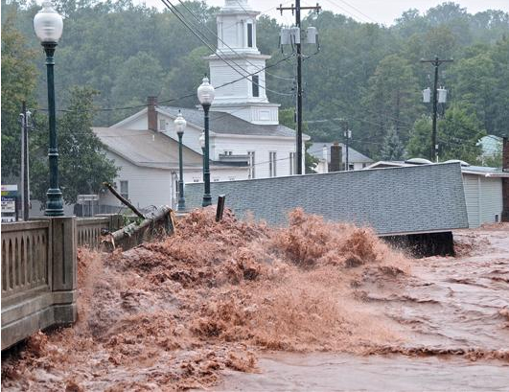
Outline
Project Background
  “Quantitative Assessment of Water Quality in the Upper Esopus Creek: fish, macroinvertebrates, periphyton, turbidity and nutrients”
Response to Hurricane Irene
Current Results
Next steps
New York State Department of Environmental Conservation

Slide 3
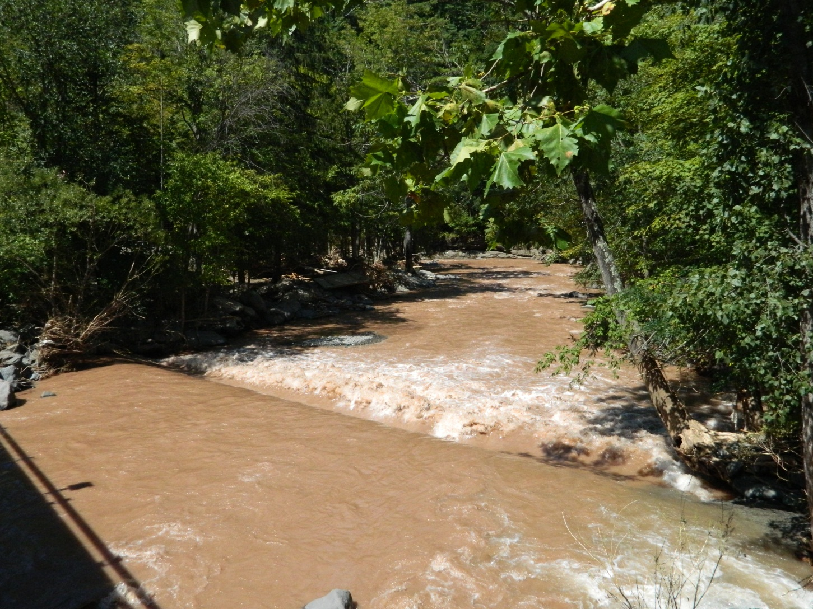
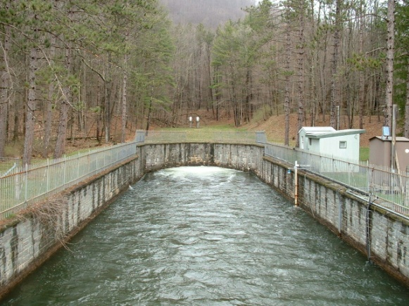
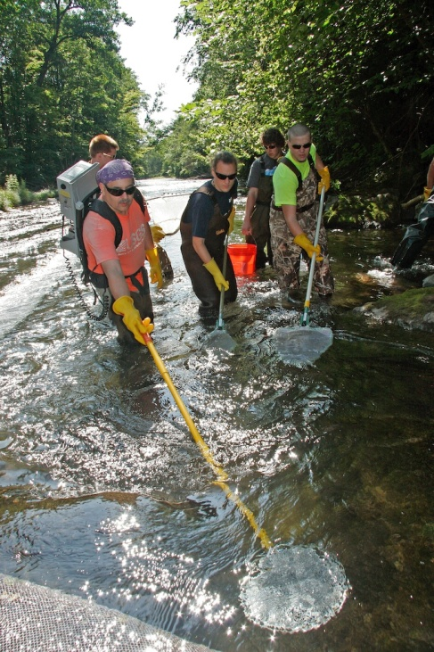
Upper Esopus Creek Project
Objectives
  Assess water quality and identify sources of:
    Turbidity
    Nutrients
  Quantify the impacts of:
    Shandaken Portal
    Village of Phoenicia (septic systems)
    Turbidity and Nutrients
  Methods
    20 sites in August 2009, 2010, and 2011
    Biological communities
    Water chemistries and discharge
New York State Department of Environmental Conservation

Slide 4
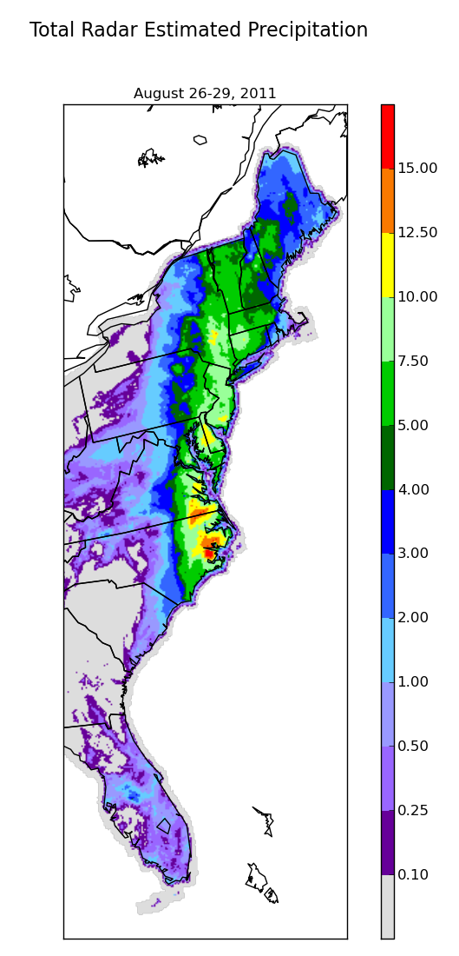
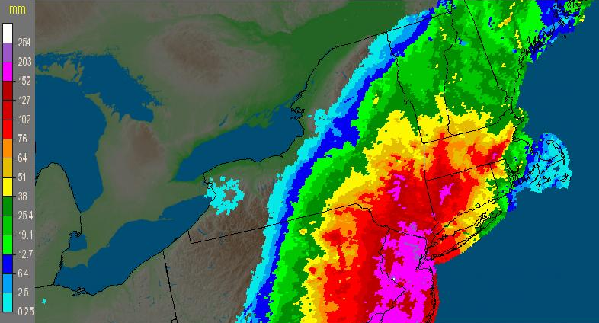
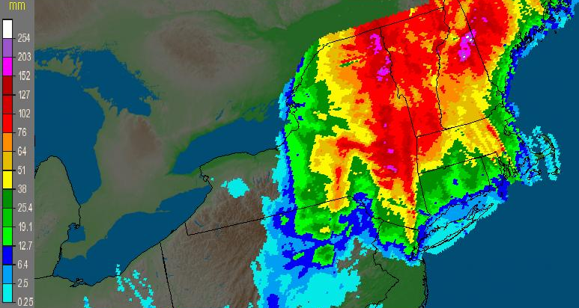

Precipitation
August 28
August 29
New York State Department of Environmental Conservation

Slide 5
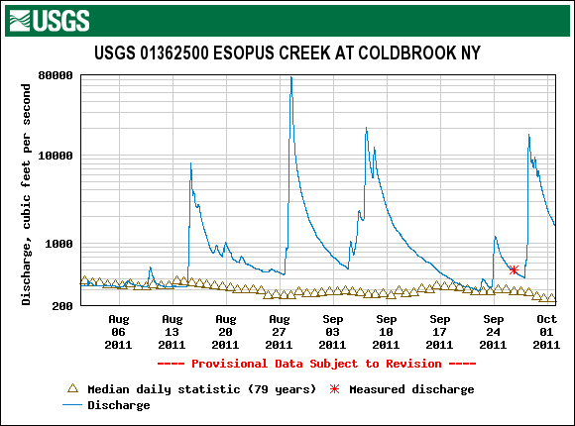
Hurricane Irene Flooding
Flood recurrence interval was 100-500 years
Irene ~ 80,000 cfs
Ave. ~ 300 cfs
One of the worst in recorded history for the Esopus Creek drainage
Irene
Lee

Slide 6
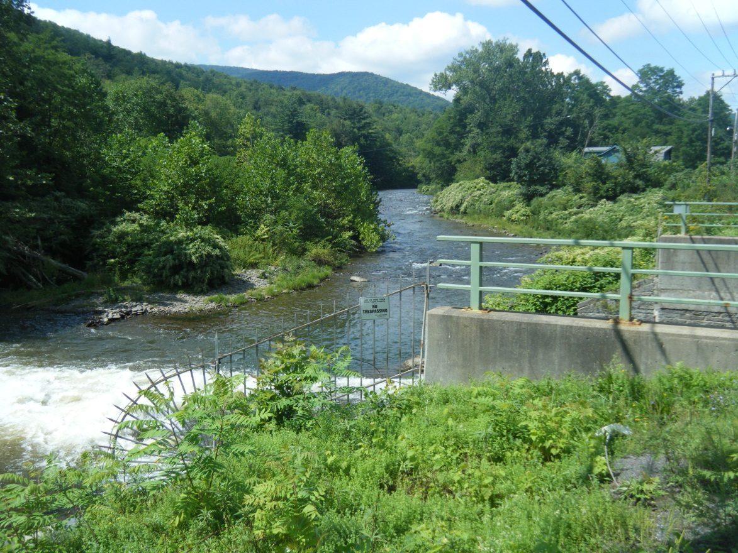
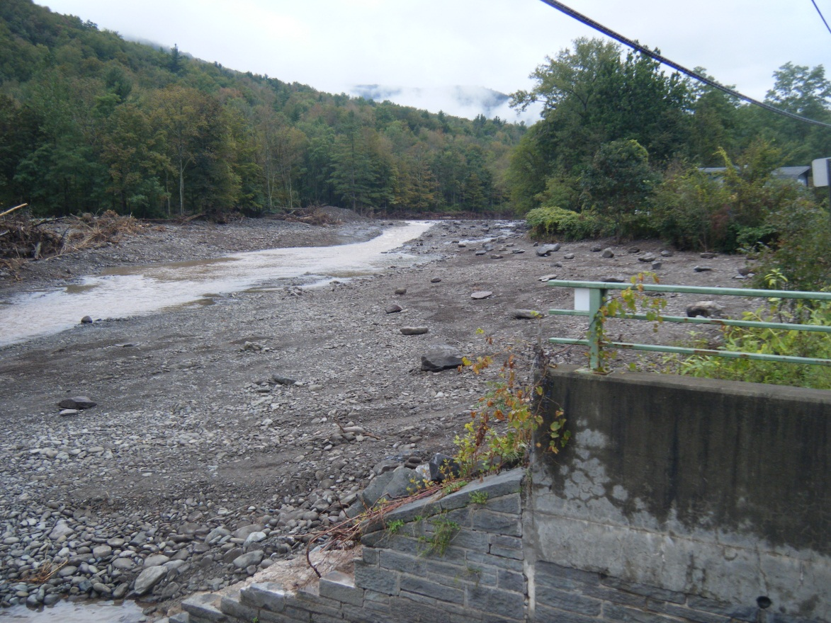
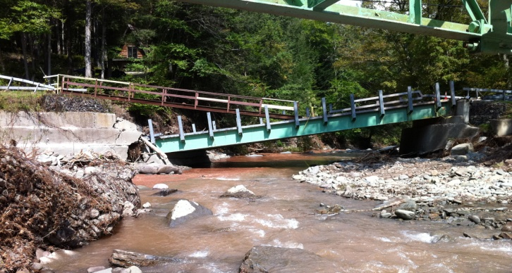
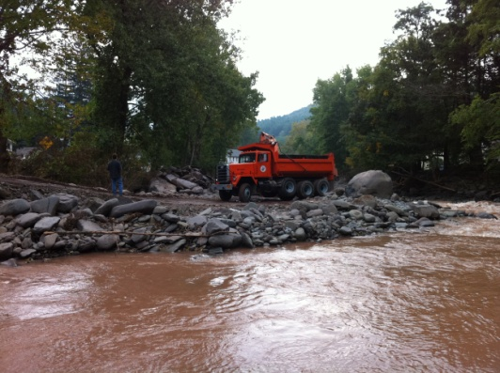
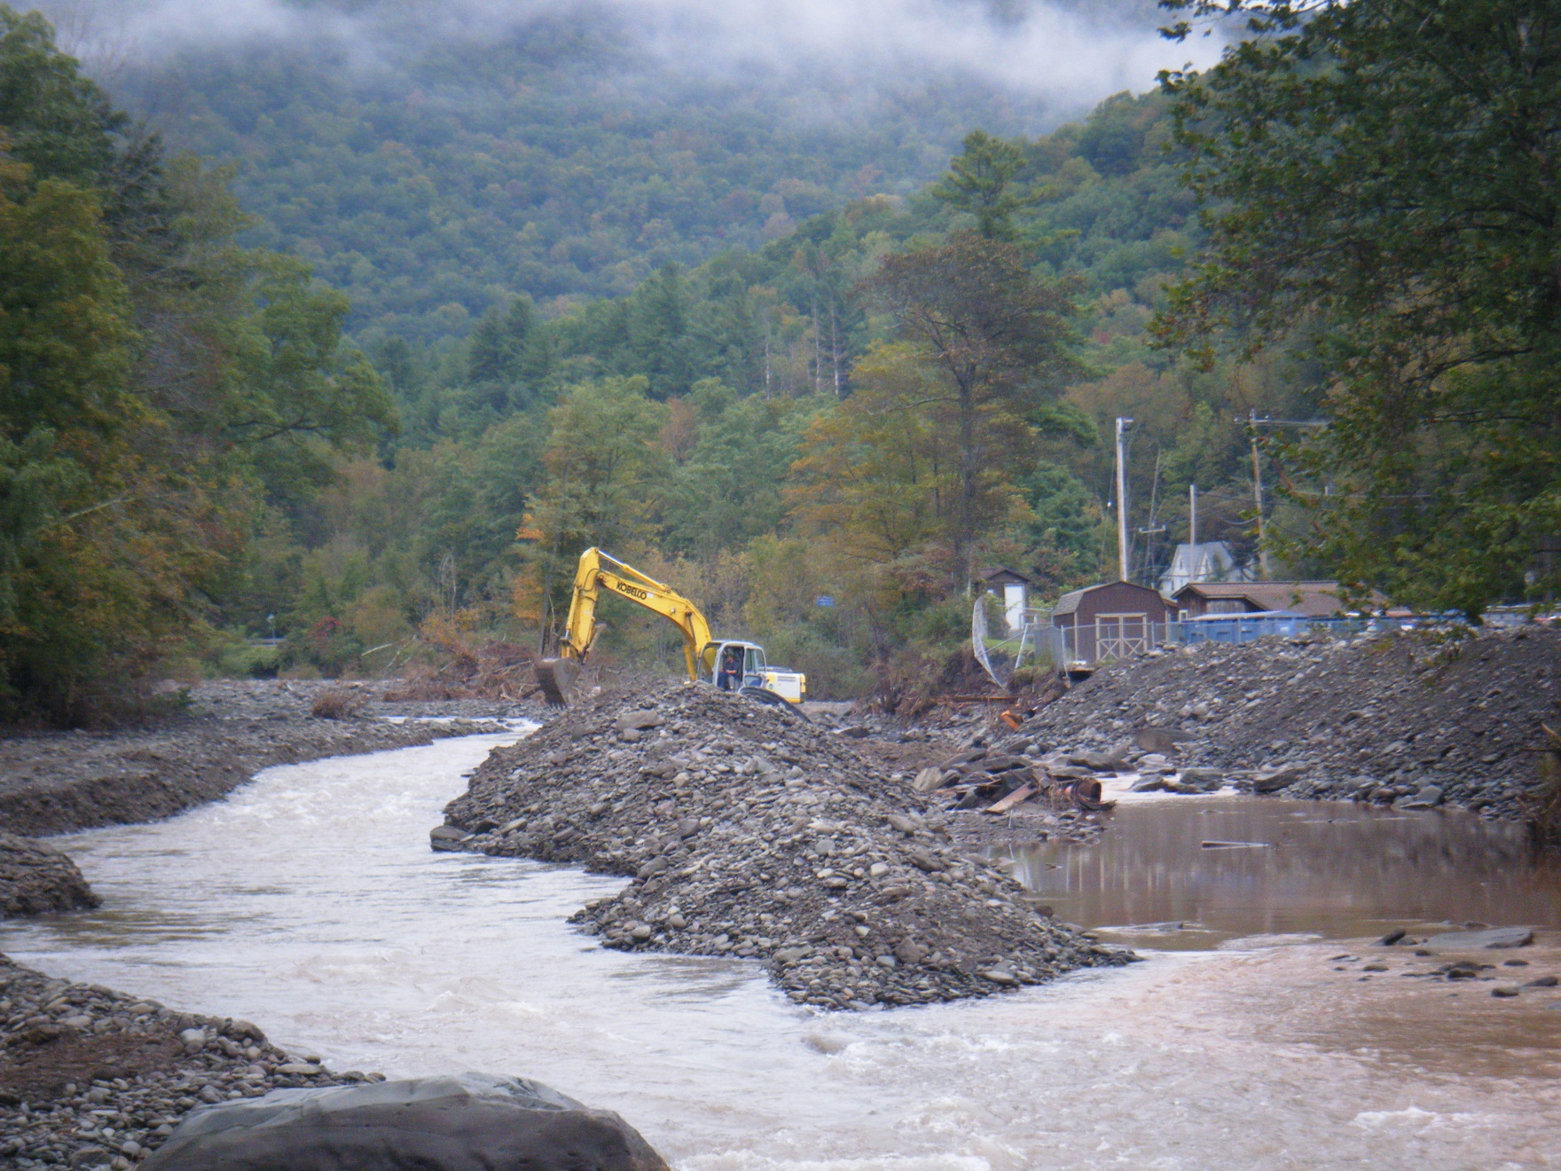
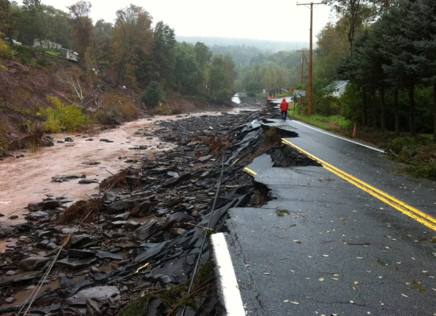
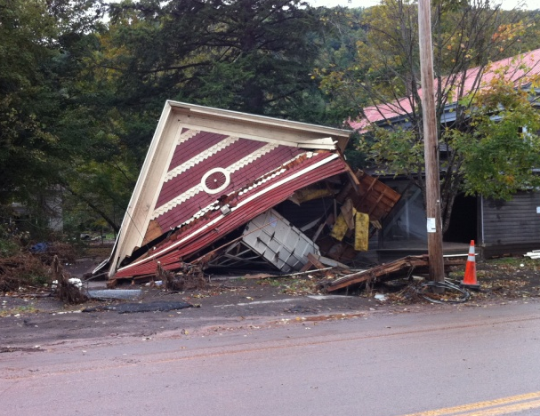
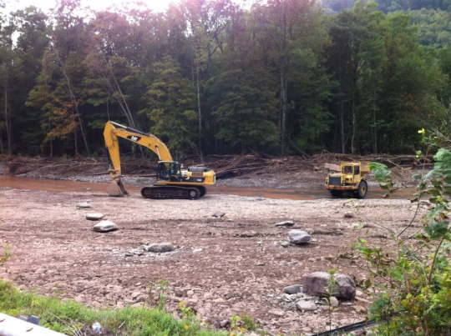
Pre-Irene
Post-Irene

Slide 7
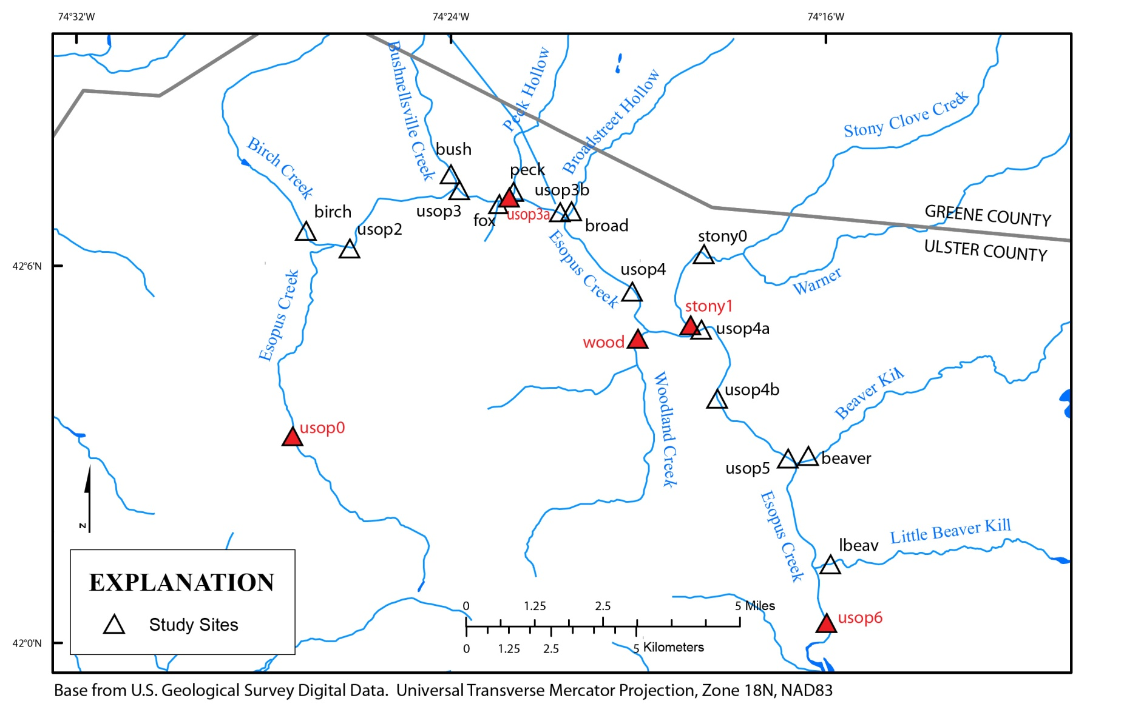
New York State Department of Environmental Conservation

Slide 8
Condition Assessment - BAP
Multimetric
  Spp. Richness
  EPT Richness
  Biotic Index
  Model Affinity

Slide 10
Sample Processing Effort

Slide 11
Community Structure

Slide 13
Conclusions
Although significant impacts to diversity, the Upper Esopus is a resilient system
Water quality assessment not necessarily the best indicator of recovery
  Multivariate ordination of community data shows a more complete picture
Monitoring is complete, full analysis and work up by spring/summer 2013

