Slide 1
Status of Hudson River Fishes: Local and Regional Perspectives
Karin E. Limburg, SUNY-ESF
Kathryn A. Hattala, Amanda L. Higgs, Andrew W. Kahnle, Hudson River Fisheries Unit, NYSDEC
Robert E. Schmidt, Simon’s Rock of Bard
John R. Waldman, CUNY Queens College

Slide 2
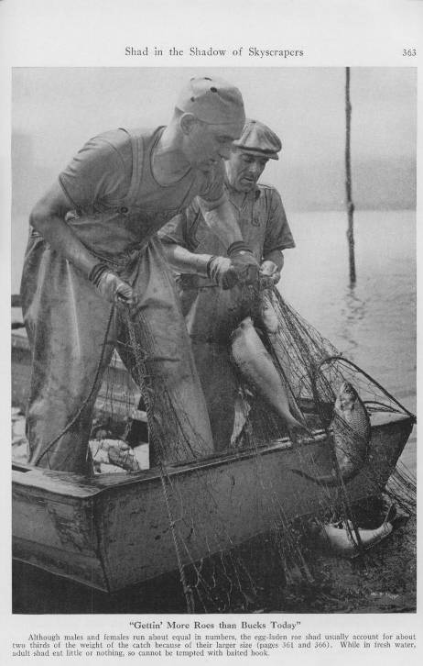
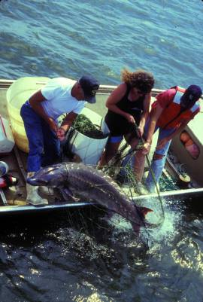
Notes:
Historically, the Hudson supported vast fisheries, which were strong right up to the 1880s…
Stocks were over-fished: sturgeon = clear-cut, then a small fishery started on remaining stock in the 1980s
Shad - repeatedly over-fished – 1880s then after WWII = the ‘blip in the 1980s was hopeful until the stock was hit again (double whammy of ocean and river fishing) , which drove it to collapse

Slide 3
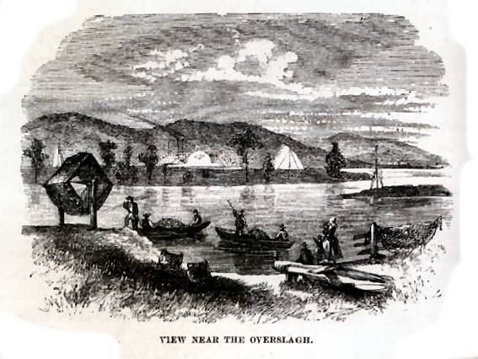
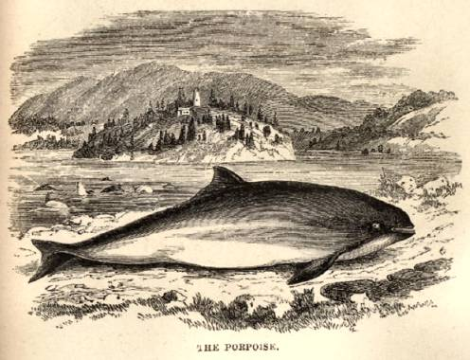
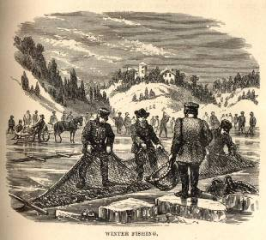
From Benson Lossing’s The Hudson From the Wilderness to the Sea (1866)
Notes:
Fishing was a year-round activity in the past…channeled islands upriver supported tremendous nursery grounds

Slide 4
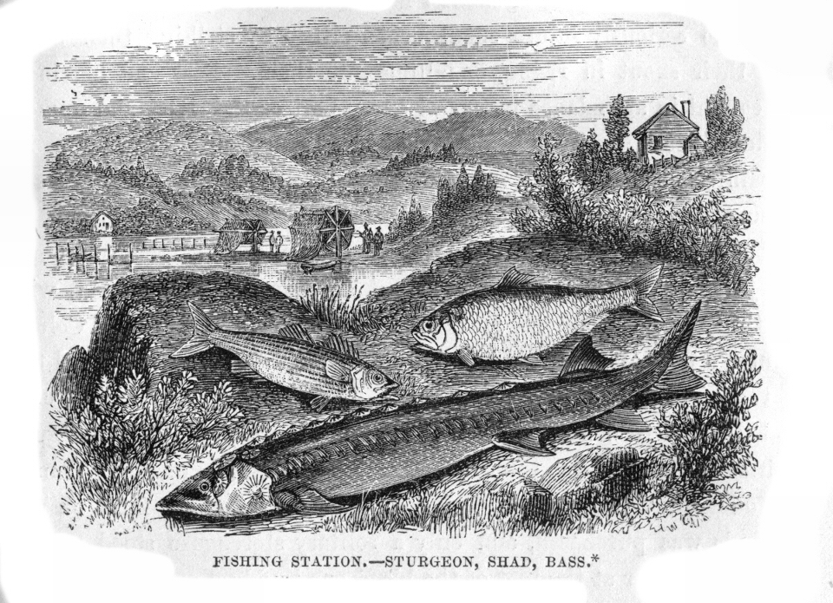
“The Big Three”

Slide 5
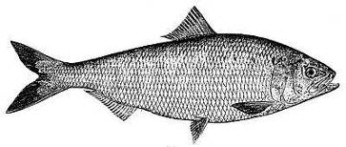
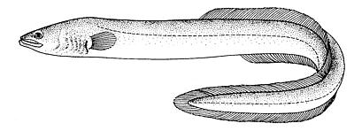
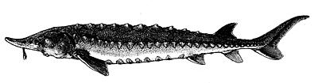
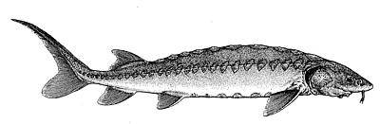
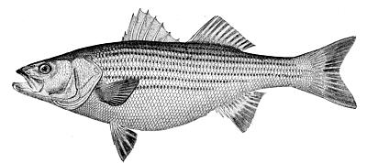
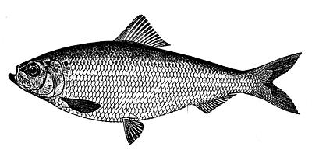
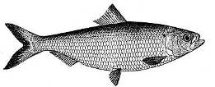
“The Big 7”
Notes:
Today’s focus will be on “The Big 7” with some definite favoritism shown to Alosa spp.

Slide 6
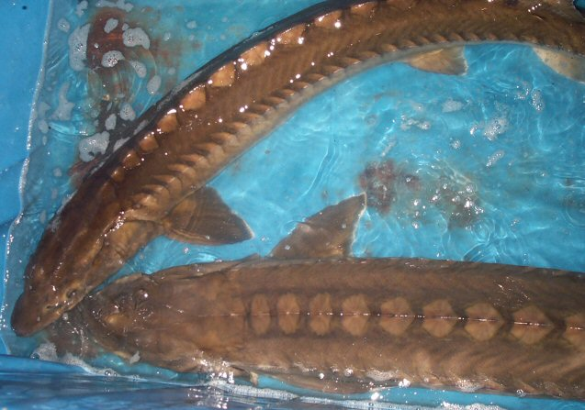
Sturgeons

Slide 7
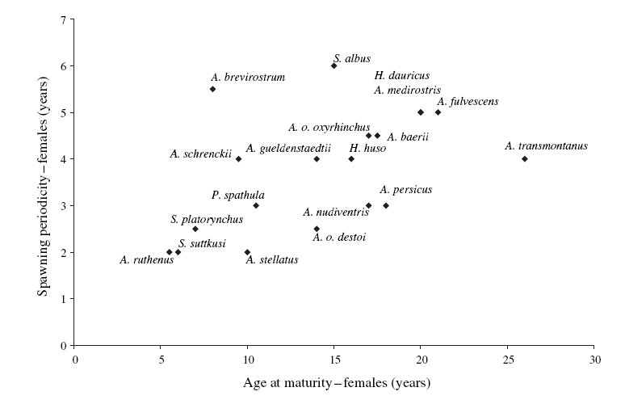
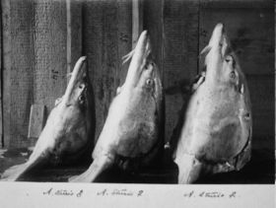
Sturgeons are long-lived, irregular spawners
Makes them extremely sensitive to overfishing
(Kahnle et al 1998, Pikitch et al. 2005)
Notes:
Kahnle et al was ASMFC assessment in 1998 where we identified over-fishing and sensitivity to it

Slide 8
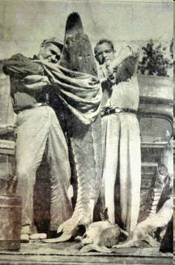
Atlantic sturgeon (Acipenser oxyrinchus)
1996 – NYSDEC closed state fisheries
1998 – ASMFC closed all other state fisheries
2012 NMFS lists as Endangered
Monday – new report out!
Reported landings in NYS (NYSDEC)

Slide 9
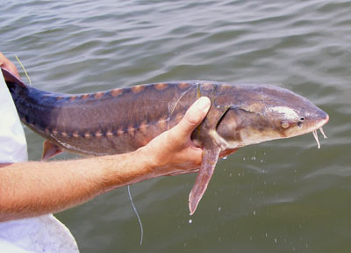
Shortnose sturgeon –
Federally protected by ESA since 1971
Maryland DNR
Notes:
Main points: cessation of fishing on these species has allowed them to rebuild slowly – (note here the HRG data is not realistic to show a trend for SN – the pop estimates indicate a lot of fish – but we have no data for trends – DEC currently sonic tracking fish as we find the enitre river is being used (Troy to NY harbor); “typical” behavior ( ie Kingston to Troy in spring is NOT true as we had a couple of tagged fish move SOUTH from Kinston overwintering area

Slide 10
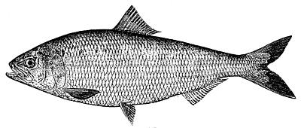
The American shad (Alosa sapidissima)
Once America’s 2nd most important commercial fishery – where are they now?
Overfished repeatedly from 1880s to the 1990s
All NY fisheries remain closed since 2010.

Slide 11
Notes:
What is the red box for?

Slide 12
Empirical Spawning Stock Biomass
1985-2011
Based on HRG Monitoring Program Egg Index (K. Hattala, NYSDEC)

Slide 13
DEC’s Hudson River Fisheries Unit has been monitoring shad with in-river tagging studies for past few years. Have seen which habitats they are found on in spawning grounds….

Slide 14
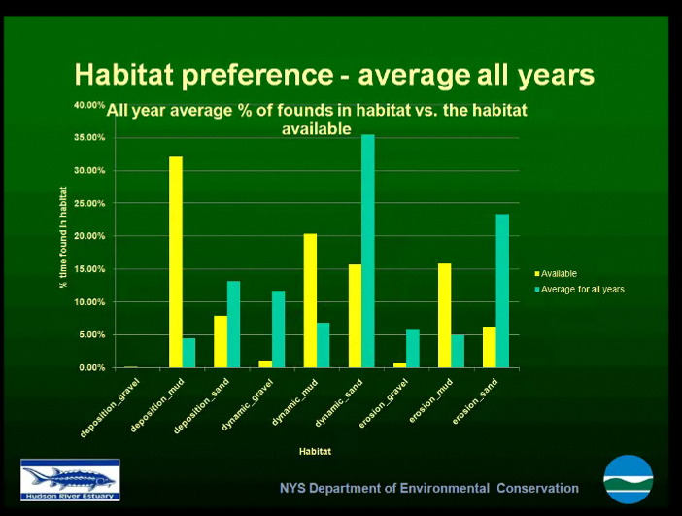
← sand
mud
gravel
(A. Higgs, NYSDEC)
Notes:
From Amanda’s HRF presentation

Slide 15
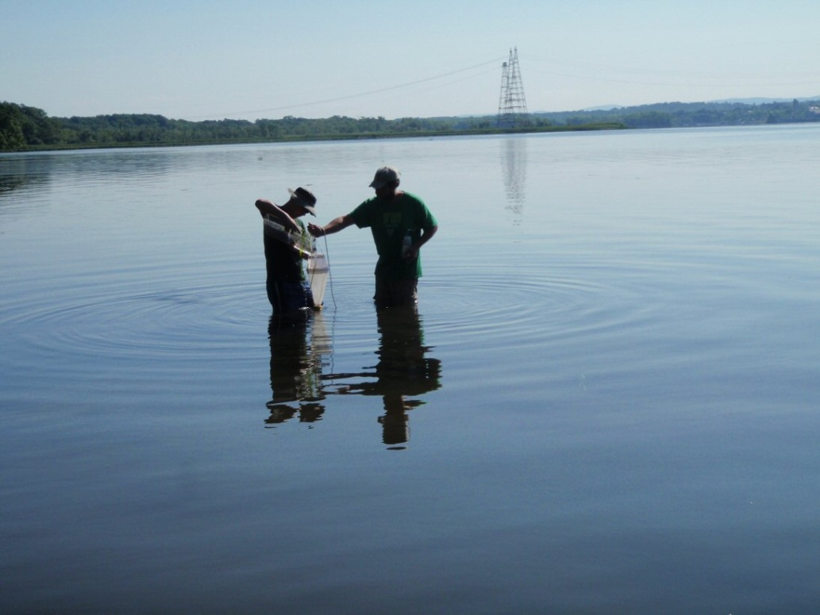
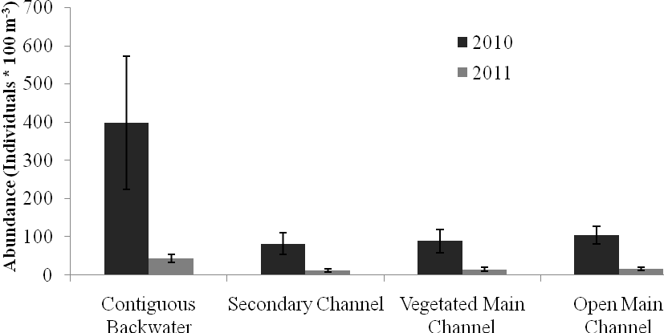
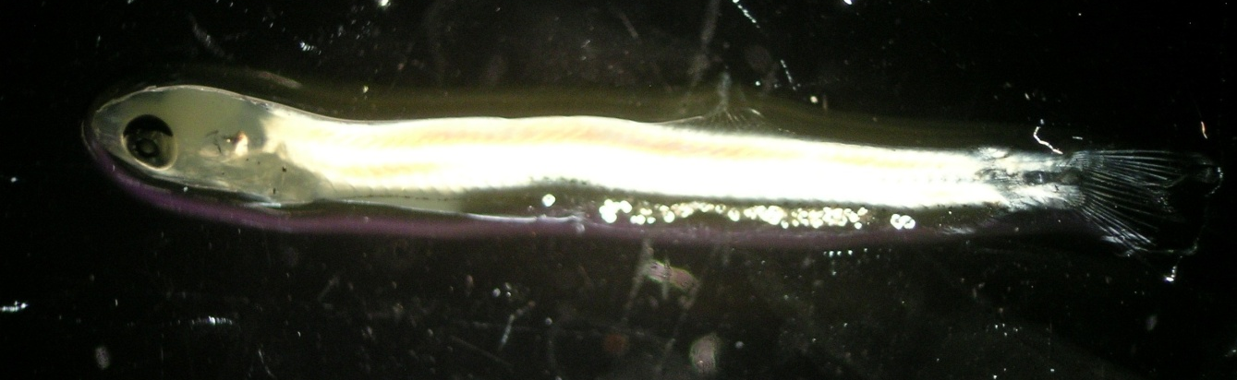
Habitat studies of larval American shad by C. Nack
Will follow up on hurricane impacts
Revenge of the shad!

Slide 16
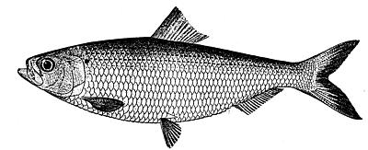
River Herring
alewife
blueback herring

Slide 17
Fishing up
Fishing down…
!
State and US fishery statistics

Slide 18
Compare U.S. shad and river herring catches – note difference in scales – factor of 10-20X higher R.H.
4500
4000
3500
Shad
3000
2500
2000
1500
1000
Metric tons per year
500
River herring

Slide 19
Just like American shad, the river herring catches in the 1880s were greatly reduced from earlier times…but how much reduced?
Records from a single river (Potomac) – upwards of 20 million shad/year caught

Slide 20
Data assembled by NYSDEC

Slide 21
Mohawk River blueback
Notes:
Slope of best-fit line for BBH = -1.08, and for Ale = -1.317 – red dot is Mohawk River bbk –( in line with Hudson) rest of data includes the Mohawk

Slide 22
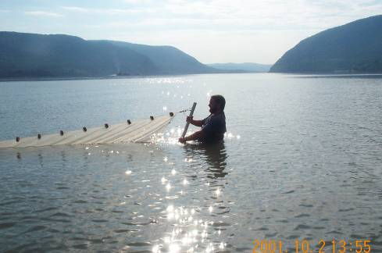
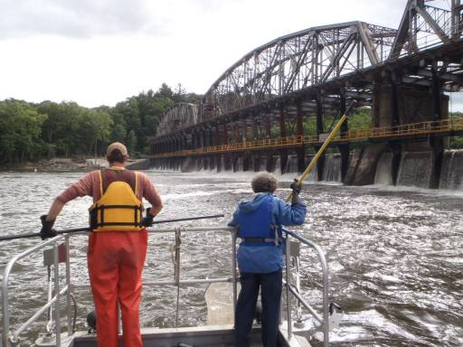
← Collecting blueback herring in Hudson & Mohawk, 1999-2001
Collecting blueback herring in Mohawk, 2012
Photo: Scott Wells

Slide 23
Sex ratios have skewed too
N = 73
N = 81
1999-2000
N = 159
N = 70
2012
Males
Females

Slide 24
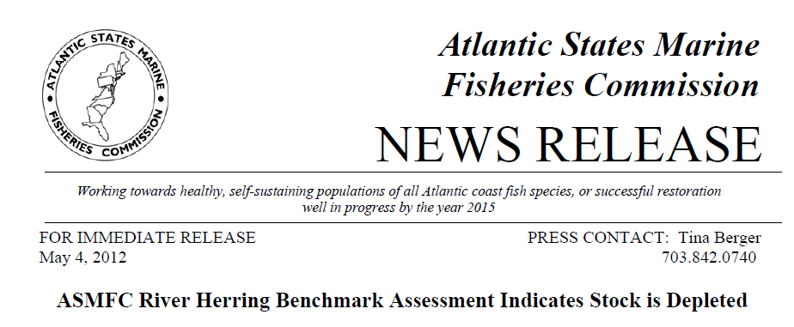
Current consensus – 1st coast-wide stock assessment completed for ASMFC (2012)

Slide 25
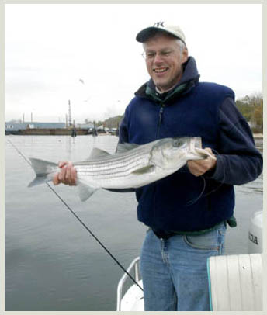
The Striped Bass
Notes:
A good news story, for a change

Slide 26
Maine to N. Carolina
Source: ASMFC

Slide 27
A good news story, for a change!
ASMFC coast-wide management restrictions put in place
Source: NYSDEC
Notes:
Chesapeake collapsed in early 1980s, ASMFC restrictions put in place to aid recovery; Hudson had a small spawning stock & was given same coastal protection , stock grew quickly

Slide 28
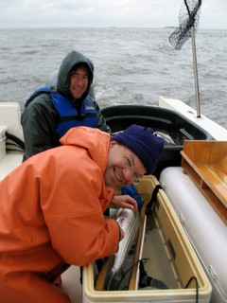
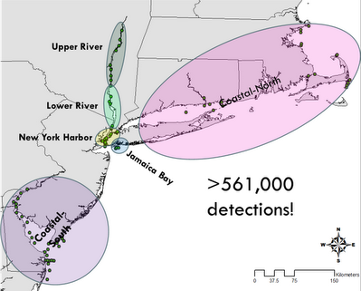
Recent studies by Dave Secor et al. tracking where HR stripers come and go…
Notes:
From Secor’s website: In ongoing research, we released acoustically-tagged contingents of striped bass (total=70) captured from (1) the Hudson River spawning ground in the Hudson River in spring; (2) the NY Harbor in fall; and (3) the upper Hudson River in fall. Remote receivers tracked their movements throughout the Hudson River, the NY Harbor and other estuaries along the Atlantic coast (see figure above). Results indicate that like Manhattan, the surrounding NY Harbor invites immigrants from distant locales. A good number of Harbor striped bass likely began life elsewhere, but still home to the Harbor year after year during fall and winter months. Striped bass also showed expected “contingent” behaviors – an increased tendency for residency by striped bass tagged in the upper Hudson River in the fall and a tendency for oceanic migrations by striped bass tagged on the spawning ground in spring.

Slide 29
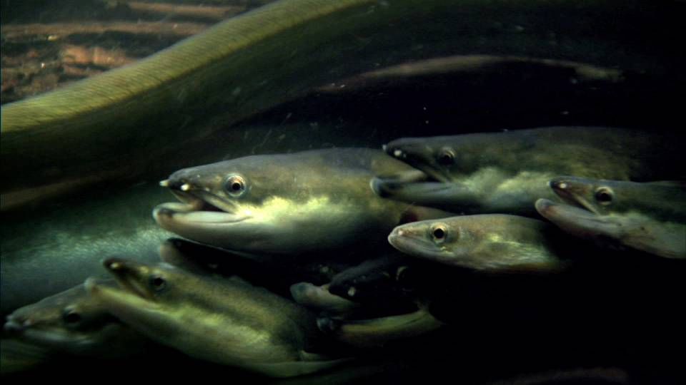
The American Eel
www.pbs.org

Slide 30
Regional Indices: Hudson River
Notes:
Only one YOY index was available for Hudson River region—the HRU Long River Index. The yellow eel index was developed by combining the HRU Long River, NYDEC Alosine Beach Seine, and NYDEC Striped Bass Beach Seine yellow-stage standardized indices. Note that both indices only go through 2009 because the source indices were only available through 2009.
30

Slide 31
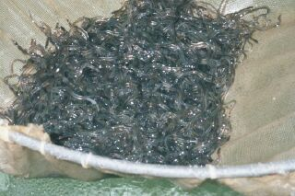
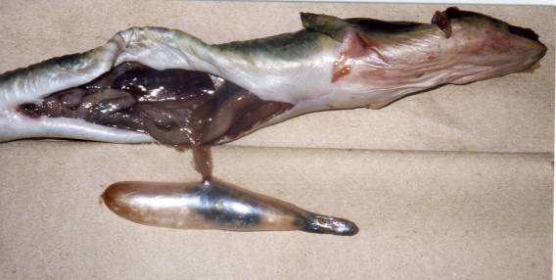
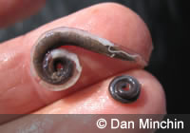
Region wide, some causes of eel decline:
Glass eel “product”
“…4800-5300 pieces (glass eels) per kg, depending on time of season ordered”
Lucrative!! $2600/lb (2012)
Nematode infection rate
(Anguillicola crassus)
Photo and data: Wendy Morrison

Slide 32
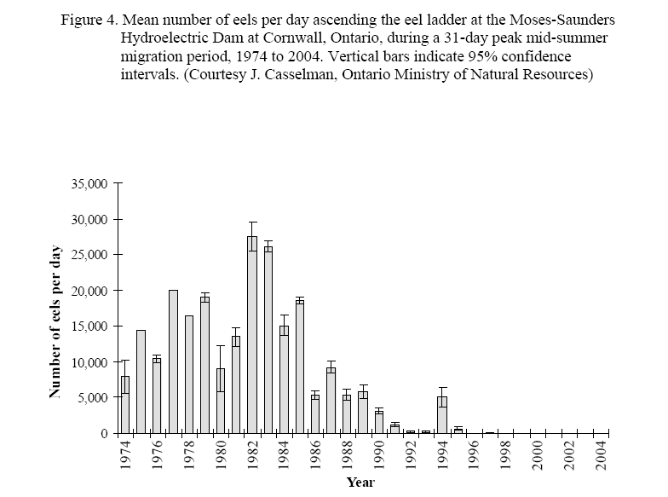
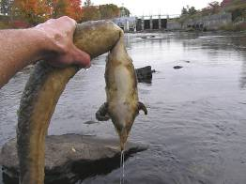
Glooskapandthefrog.org
Hydropower impacts?
ASMFC eel technical review board, 2006

Slide 33
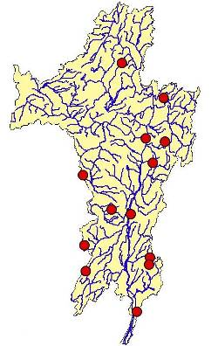
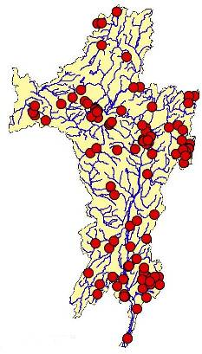
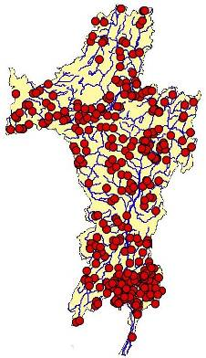
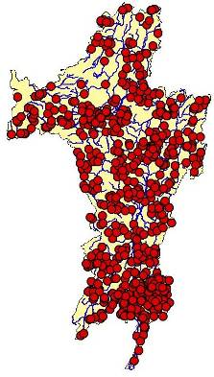
Dams Over Time*
1850
1900
1950
2000
*not including dams missing dates
Source: Swaney et al. (2006), in Hudson River Fishes and Their Environment

Slide 34
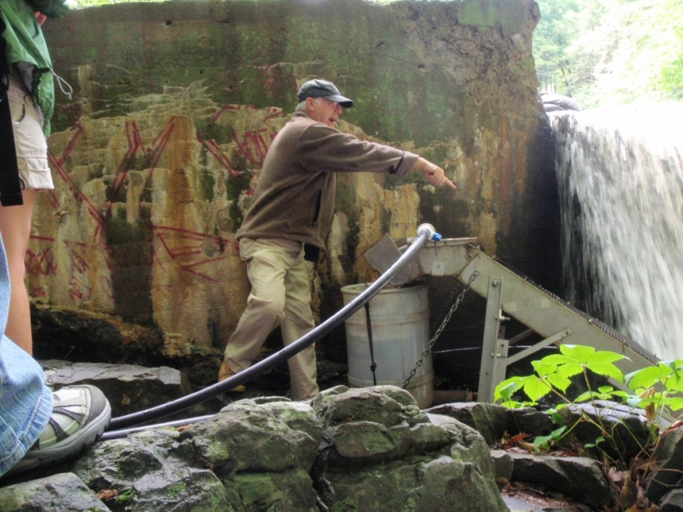
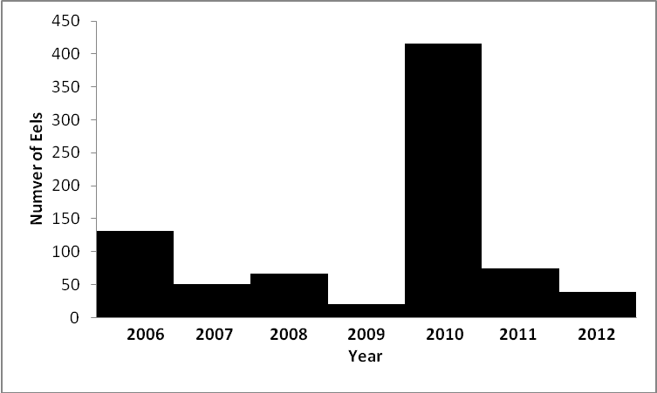
Sizes of eels caught in ladder trap
Total Length, cm
Experimental eel ladder – operated by Bob Schmidt & colleagues on Saw Kill since 2006
Number of eels caught in ladder trap

Slide 35
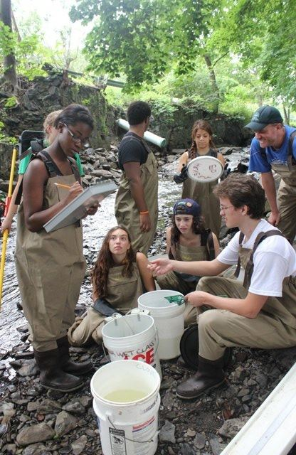
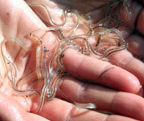
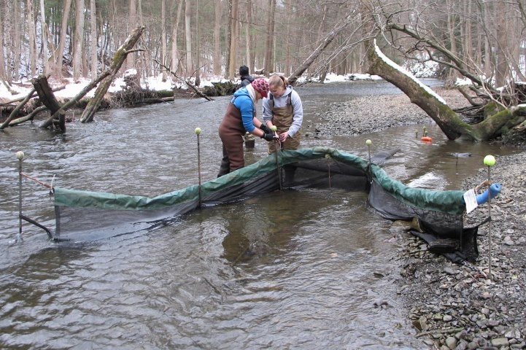

Citizen Science:
The Art of Engaging Folks in GLASS EEEEELS!
(monitoring, that is)
Photos: NYSDEC; and two facebook sites

Slide 36
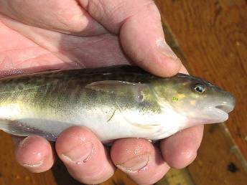
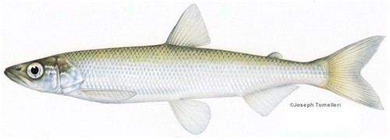
What about the other 205 species logged in for the Hudson River estuary?
news.nationalgeographic.com
Notes:
Tomcod – long and storied history w/PCBs and PAHs; rainbow smelt: 1st victim of global warming, last one seen in HR in 1998 (or ’95?)

Slide 37
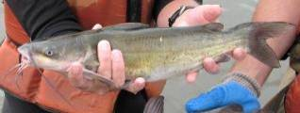
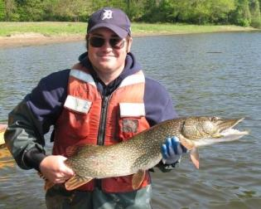
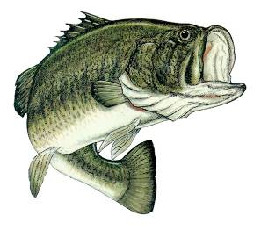


…and the new-ish, “Gang of 20” – the non-native predators…with little to no information about their status!

Slide 38



