Slide 1
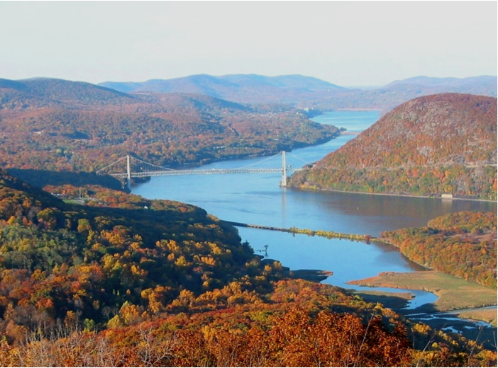
Ecological Effects of Hudson River PCBs
Isaac Wirgin
Department of Environmental Medicine
New York University School of Medicine
SUNY New Paltz
April 24, 2013

Slide 2
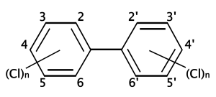
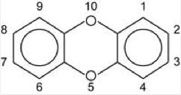
Characteristics of legacy contaminants
Highly lipophilic
Environmentally persistent
Resistant to metabolism in receptor organisms
Bioconcentrate
Biomagnify in food chains
PCBs
PCDDs (dioxins)

Slide 3
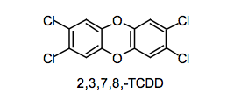
PCBs and Dioxin (PCDD) Facts
Different PCB and PCDD homologues have different numbers of chlorine (Cl) substitutions
  Up to 10 different PCB homologues
Different congeners have different numbers and positions of Cl substitutions
  209 different PCB congeners
Toxicities of different PCB congeners differ dramatically
  Congeners without ortho substitutions are usually most toxic
  TCDD may be the most toxic chemical known
  TEF=Toxic Equivalency Factor- toxicity of PCB or PCDD congeners compared to TCDD

Slide 4
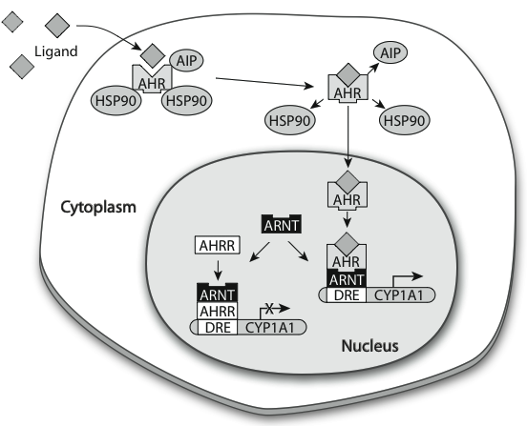
Aryl Hydrocarbon Receptor (AHR) Pathway
Cytoplasmic transcription factor that mediates most toxicities of coplanar PCBs and PCDD/Fs
  AHR knockouts are insensitive to many toxicities induced by TCDD, PCBs, and PAHs
Activates transcription of a battery of xenobiotic metabolizing genes in the AHR battery
  Cytochrome P4501A (CYP1A)
One AHR in mammals, two AHRs (AHR1 and AHR2) in fishes and birds
  AHR2 is more functional in fishes

Slide 5
PCB and TCDD Toxicities in Animals
Reproductive Impairment
Mortality in early life
Teratogenic
Endocrine Disruption
Carcinogenic
Induce Gene Expression

Slide 6
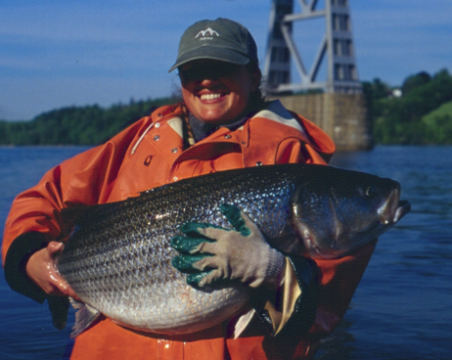
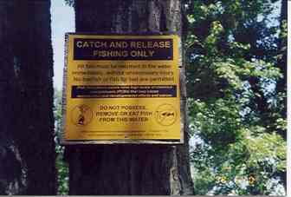
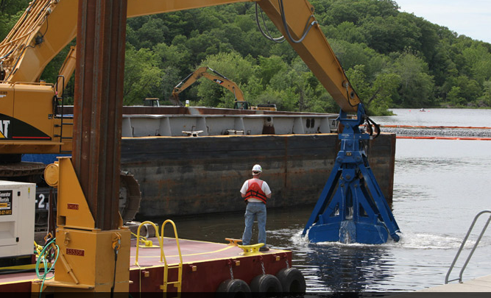
Hudson River PCB Facts
Up to 1.3 million pounds released from 1947-1977 from two GE facilities at RM 197 and 195
Commercial striped bass fishery closed in 1976 and health advisories issued against consumption of HR fishes
Declared a federal Superfund site in 1984
EPA record of decision to remediate in 2002
Phase I of remediation in 2009
Phase II of remediation to last for 6 years began in 2111

Slide 7
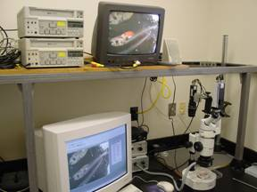
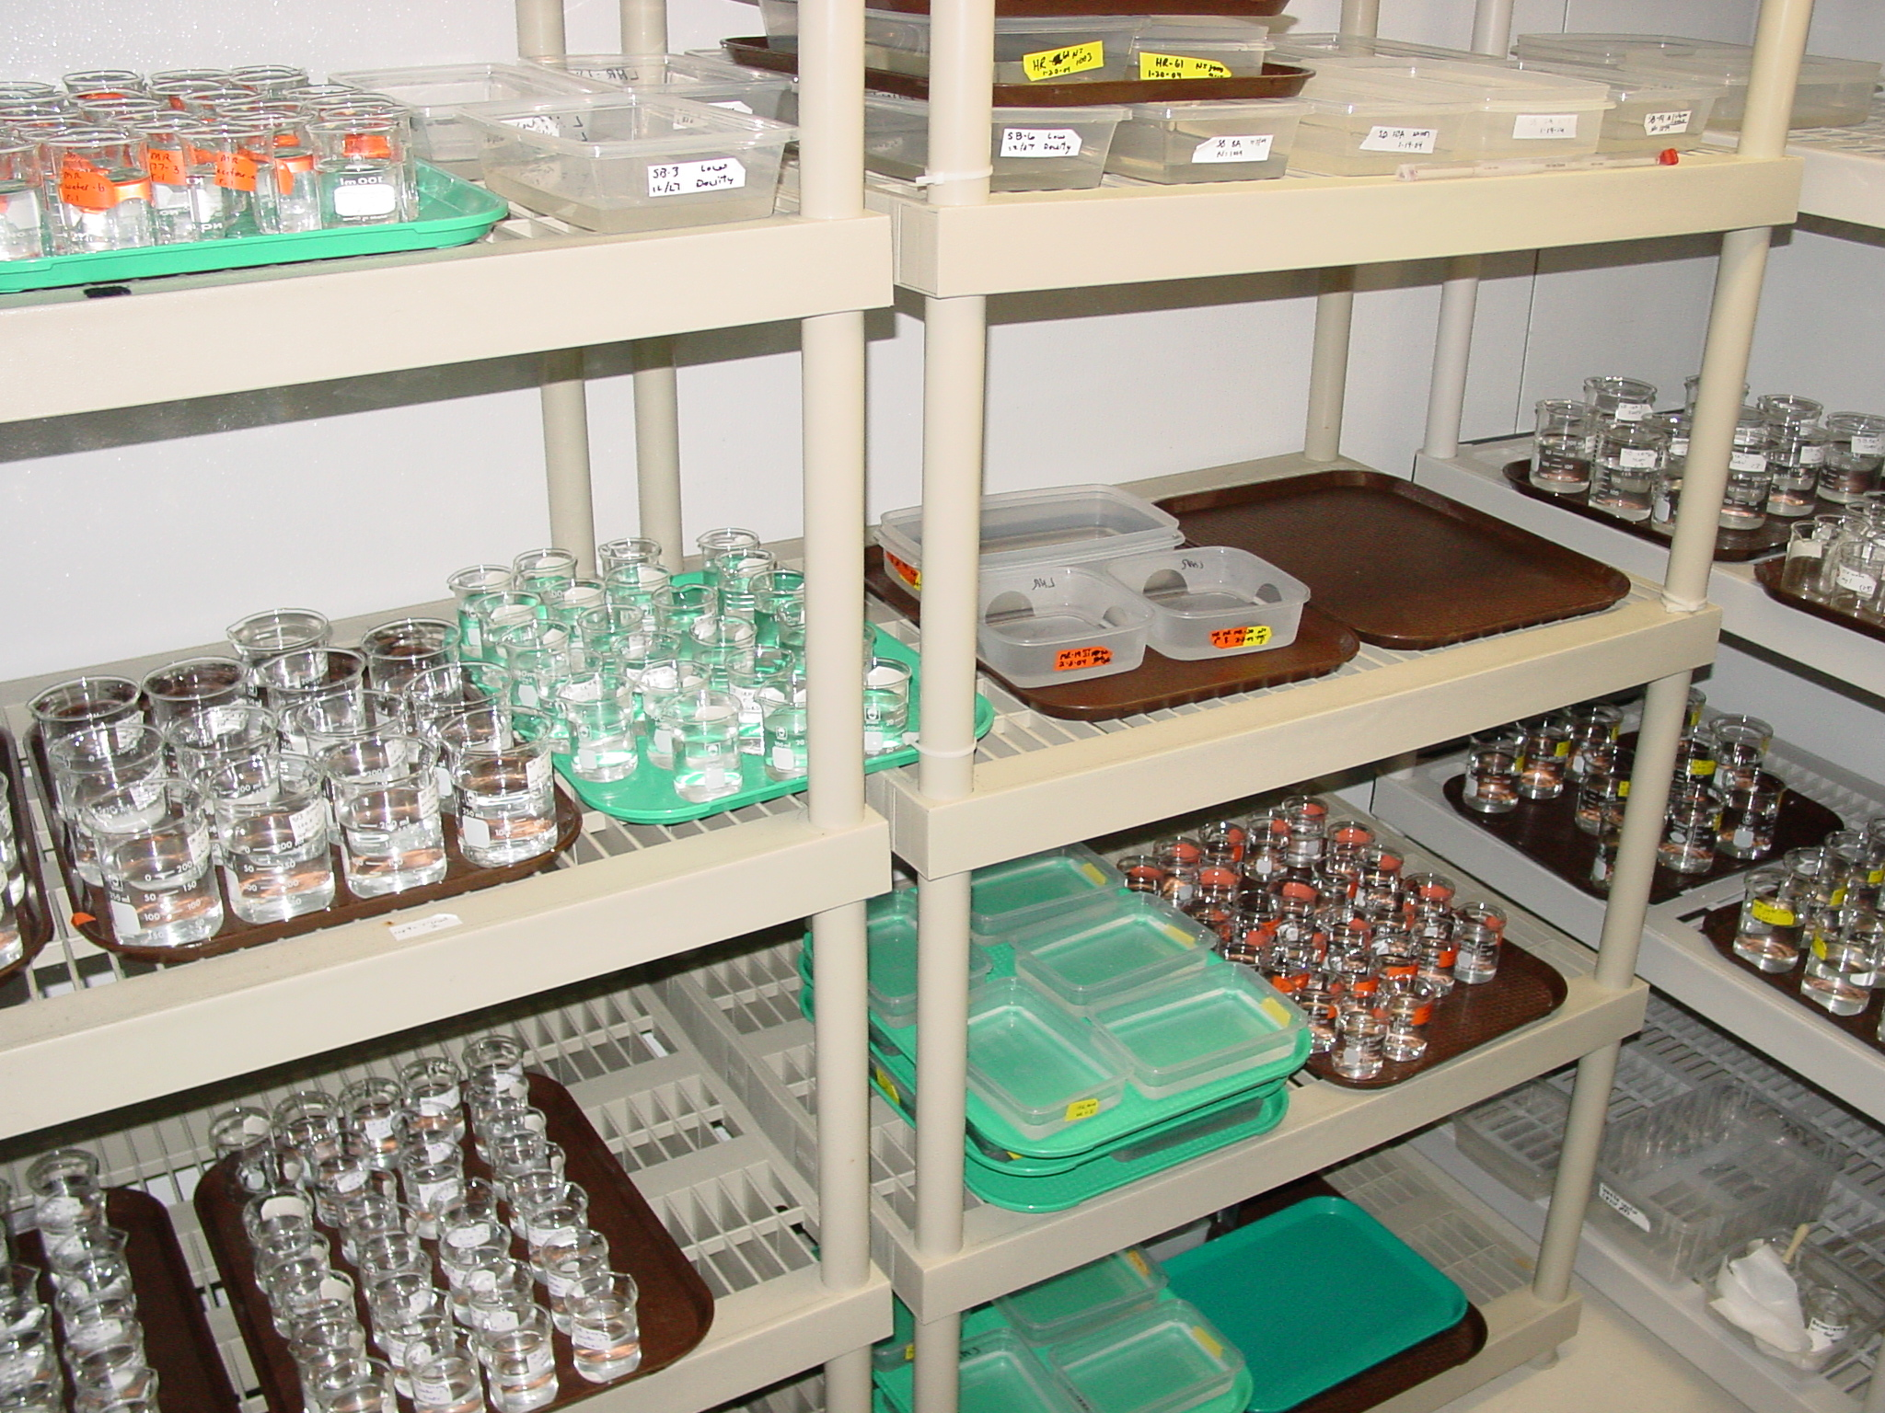
Ecological Risk Assessment
Identify potential ecological problem
Determine effective doses that elicit toxic responses under controlled laboratory conditions
Determine burdens of toxicants in environmentally exposed organisms
Compare effective toxic doses in the lab to those in environmentally exposed organisms
Characterize ecological risk

Slide 8
Problems with this approach
Interspecific, inter-population, and inter-individual variation in susceptibility to toxicity
Differences among life stages in sensitivities
Multiple stressors in the environment
  Mixtures of contaminants
  Climate change
  Nutritional status

Slide 9
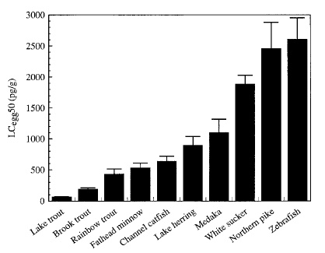
Interspecific Variation among Freshwater Fishes in LC_{50s} to TCDD
Elonen et al. 1998

Slide 10
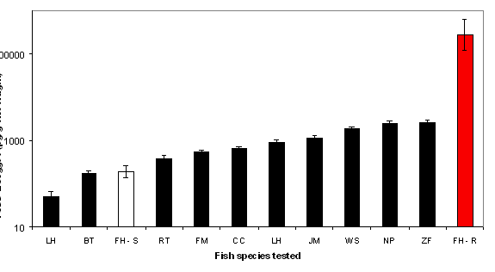
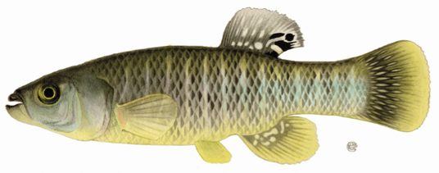
Inter-population Variation in Sensitivities of Fundulus heteroclitus to TCDD Induced LC_{50s}
S=Sensitive Population
R=Resistant Population
Population data from Diane Nacci- USEPA

Slide 11
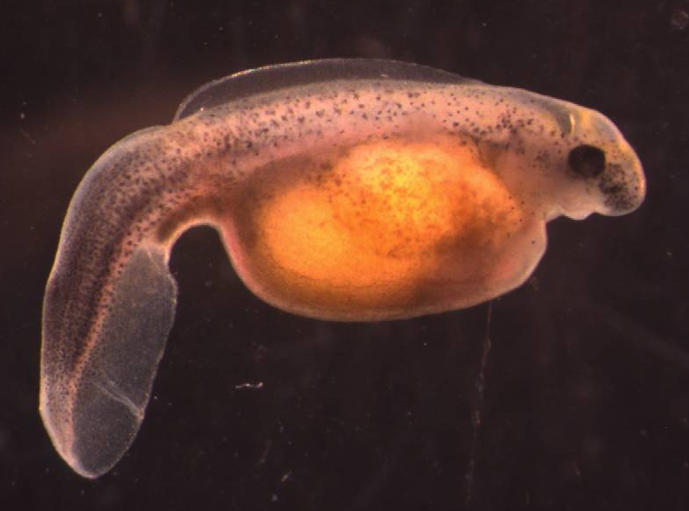
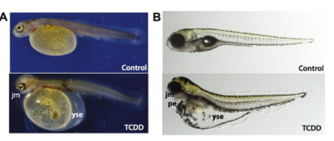
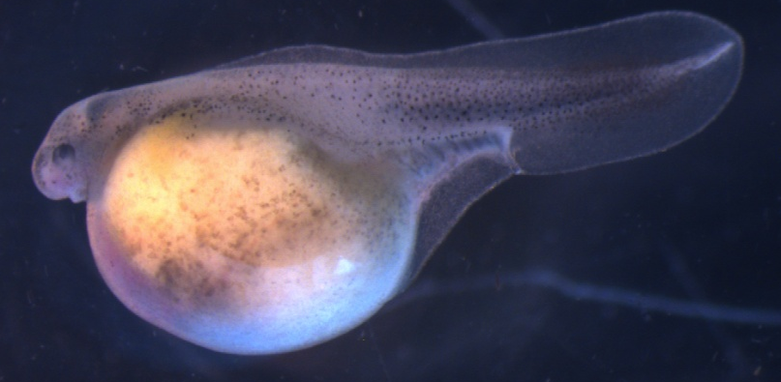
Early life-stage toxicities in fishes
Sensitive response to PCDD/Fs, coplanar PCBs, and some PAHs
Mediated by activation of the AHR pathway
Relevant at the population level
Usually due to structural and functional impairment of the heart
Manifestations include pericardial and yolk sac edema, craniofacial malformations, aberrant spinal curvature, and reduced survivorship

Slide 12
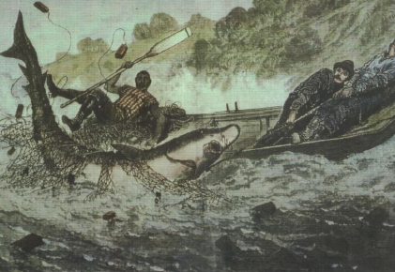
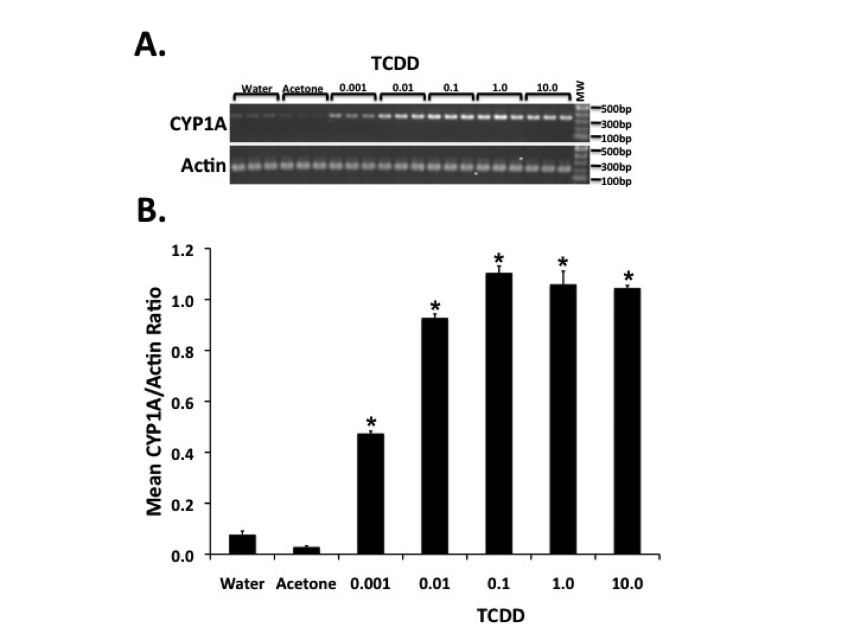
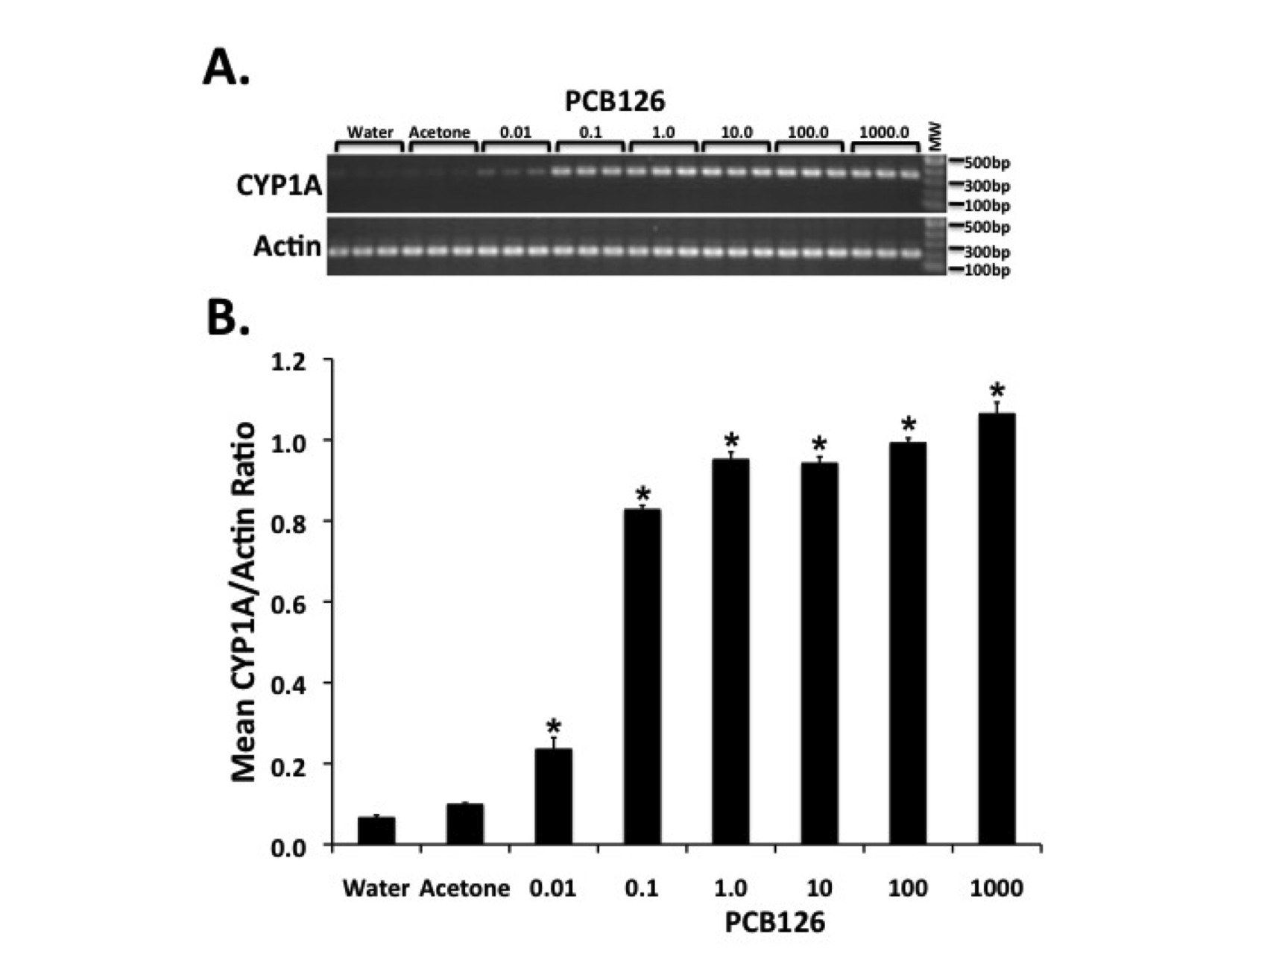
Analysis of AHR2 Mediated CYP1A Expression in PCB126 and TCDD treated Atlantic sturgeon larva (ppb)

Slide 13
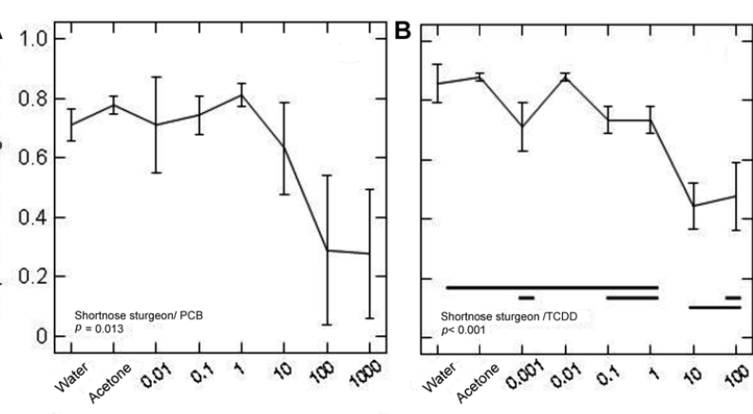
Survivorship to hatch of shortnose sturgeon embryos treated with PCB126 or TCDD

Slide 14
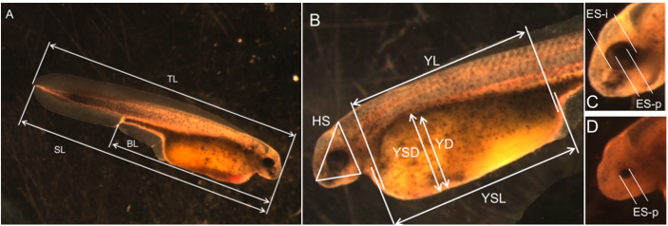
Eleven morphometric characters screened in PCB126 and TCDD treated Atlantic and shortnose sturgeon embryos

Slide 15
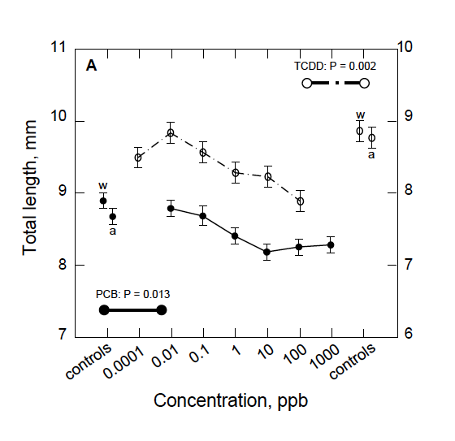
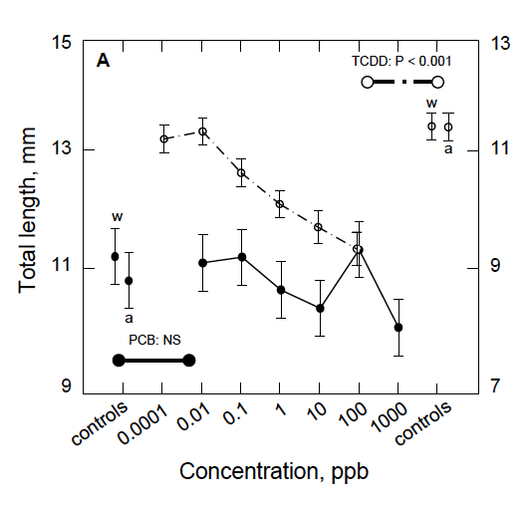
Total length in TCDD and PCB126 treated Atlantic sturgeon and shortnose sturgeon
Atlantic Sturgeon
Shortnose Sturgeon

Slide 16
Eye Development Index
(5=normal, 1=highly abnormal)

Slide 17
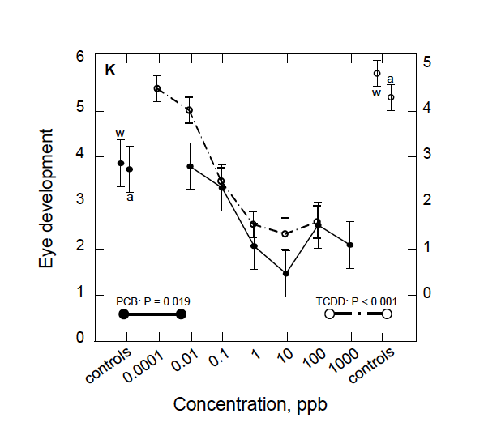
Eye Development Index in
PCB126 and TCDD Treated Atlantic Sturgeon Larvae

Slide 18
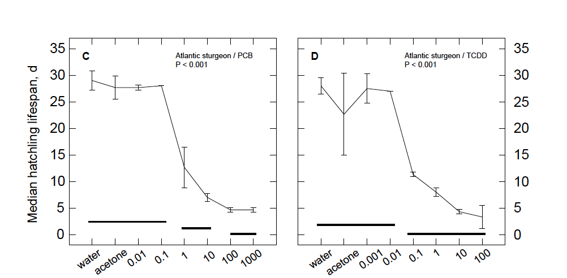
Mean Lifespan of Atlantic Sturgeon Larvae Treated as Embryos with PCB126 or TCDD (ppb)

Slide 19

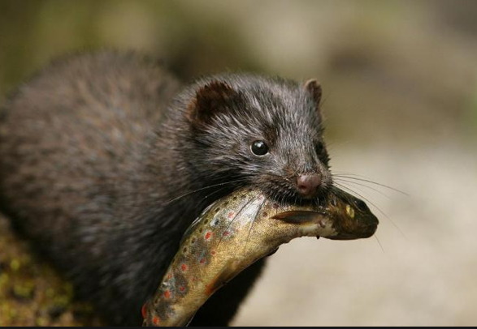
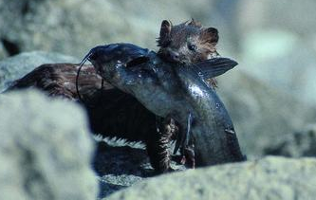
Why study American mink?
Ranched mink highly sensitive
  to reproductive and early life toxicities from TCDD and PCBs
  histological deformities of the jaw
Depend on HR floodplain for habitat, food, and breeding sites
Aquatic ecosystem based diet-20% piscivorous
Small isolated demes-sensitive to population genetics effects

Slide 20
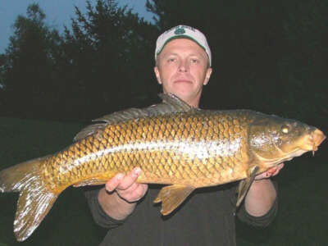
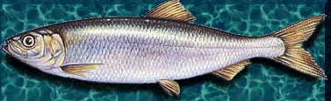
Hudson River Fish Diet Study
Ranched mink fed diet of carp from three upper Hudson sites diluted with sea herring
97% of TEQs in experimental diet from PCBs-mostly from PCB126 (74%)
Five doses of Hudson carp containing μg total PCBs/g feed (TCDD TEQs) of
  0.0074 (0.41) (only herring)
  0.7 (4.8)
  1.5 (10)
  2.8 (18)
  4.5 (28)
  6.1 (38)
Bursian et al. 2013ab

Slide 21

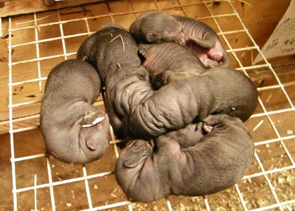
Some of the Endpoints Scored
Total PCBs and total TEQs in adults, kits, juveniles
Number females whelping
Number kits whelped/female
Number kits whelped alive/female
Stillbirth and kit mortality at 3 and 6 weeks
Histopathology of adults, kits and juveniles

Slide 22
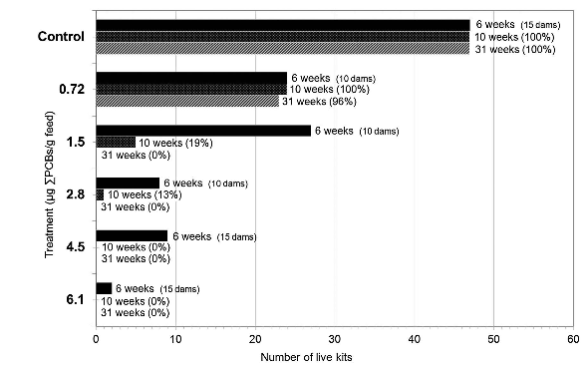
Survivorship of Kit Offspring of Mothers Fed Diets with 5 Doses of HR Fish at 6, 10, and 31 Weeks of Age
(Bursian et al. 2013a)

Slide 23
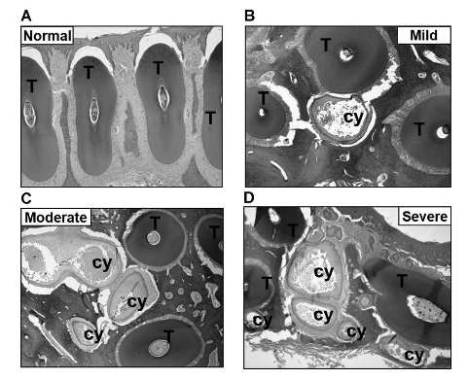
Severity of jaw lesions in kit offspring of female mink fed diets with varying doses of PCBs
(Bursian et al. 2012)

Slide 24
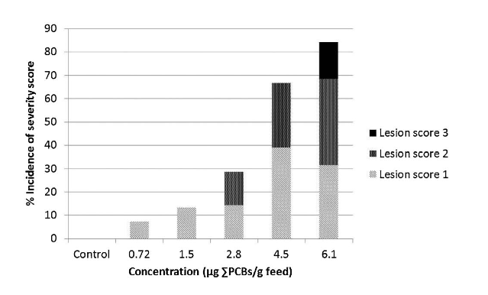
Percent Incidence of Severity Scores of Jaw Lesions in Mink Kit Offspring of Mothers Fed Diet of Graded Doses of Hudson Fish
Bursian et al. 2013b

Slide 25
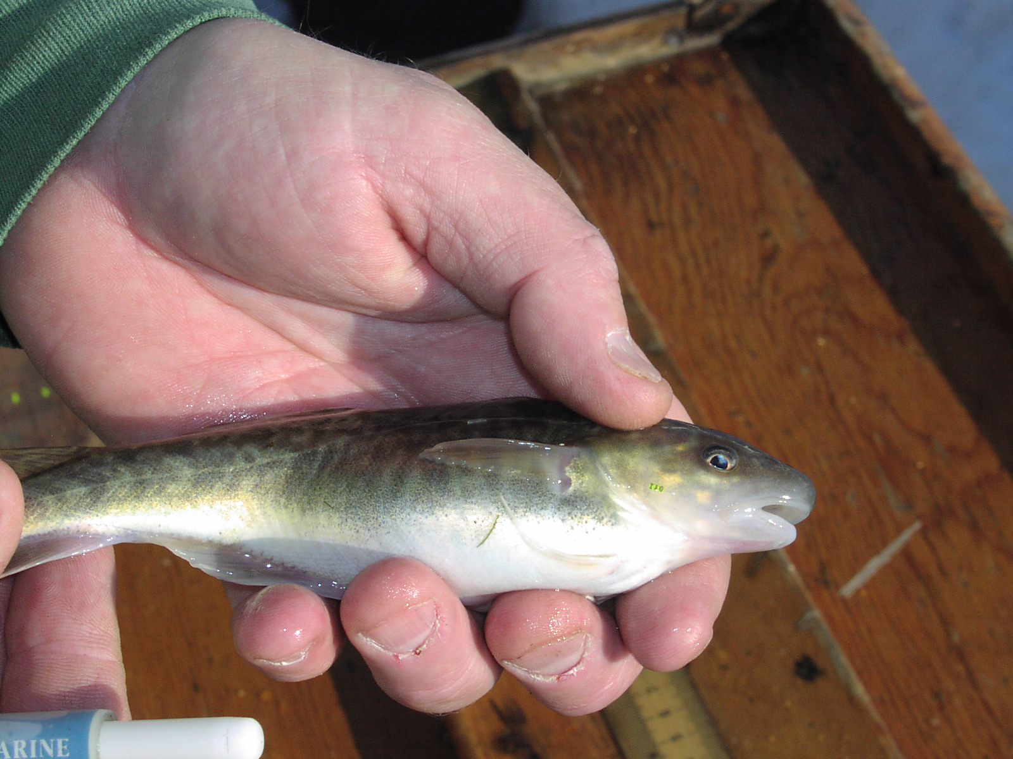
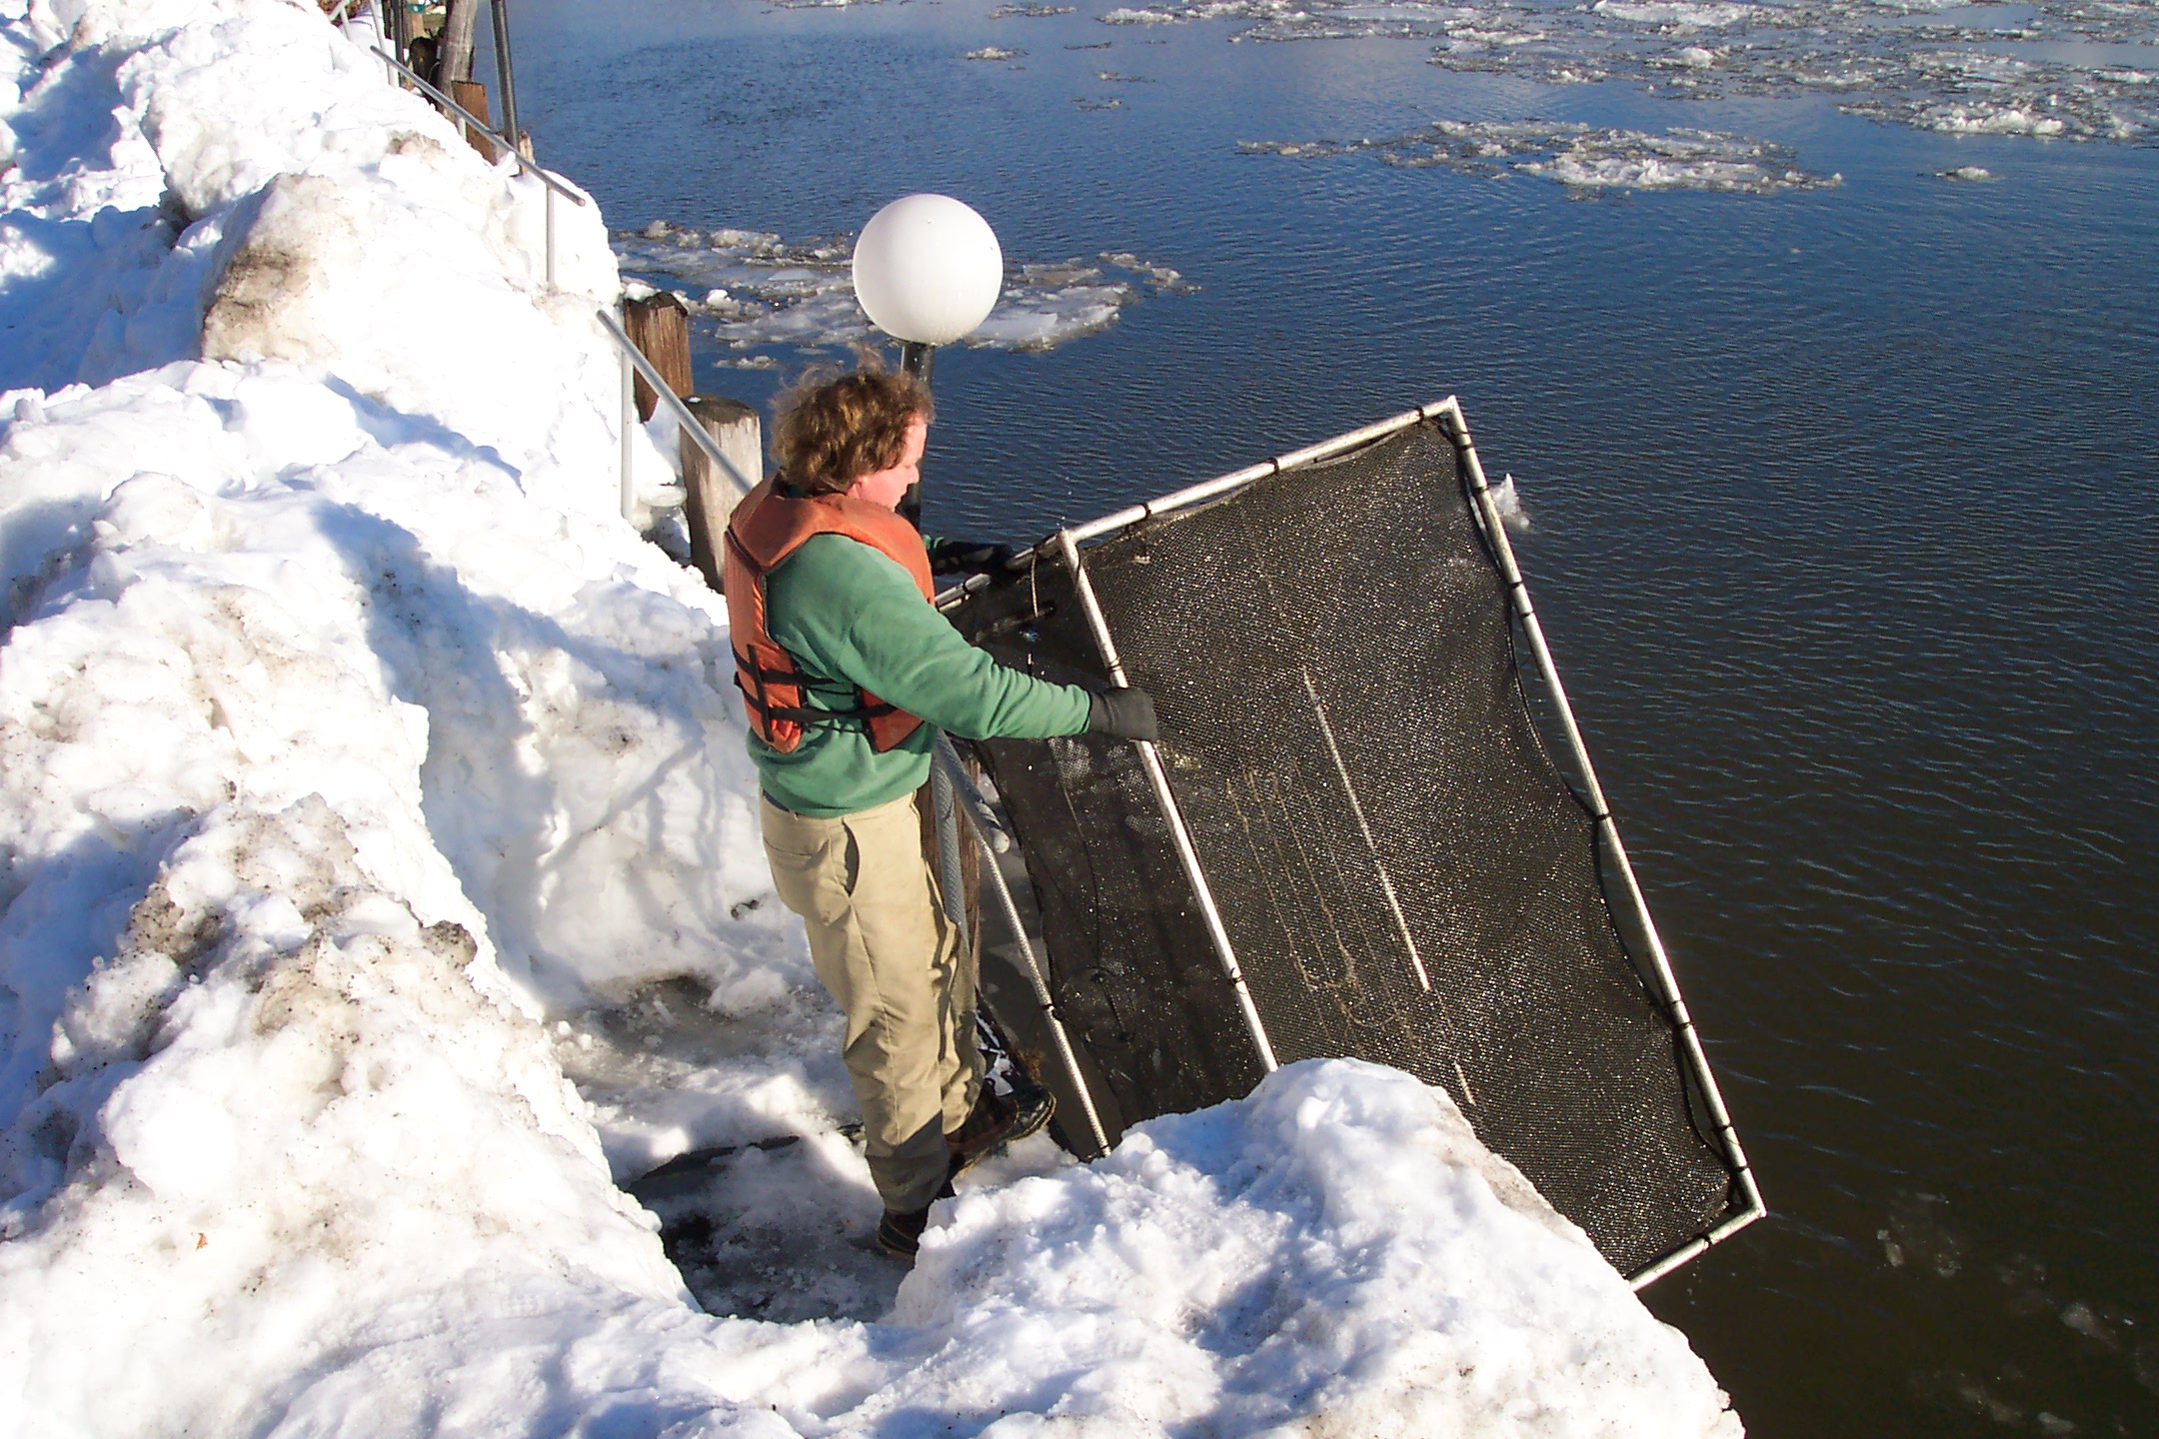
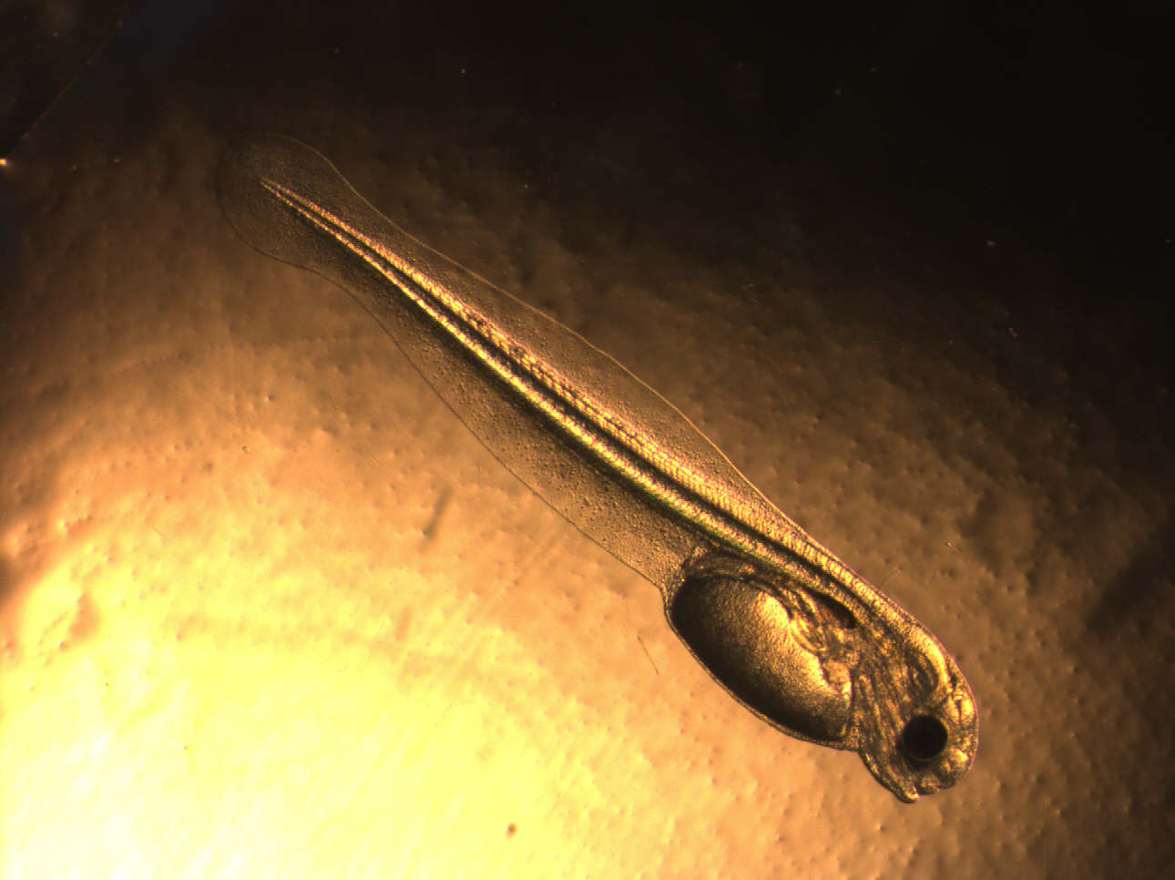
Why use Atlantic tomcod as an environmental sentinel?
Lipid-rich livers
Bottom-dwelling
Complete life histories within estuaries
  Reproductively isolated from other populations
Distributed to Albany as a single panmictic population
Only winter-time spawners in the Estuary
Extraordinarily high prevalence of liver tumors during the 1980s in the HR- 95% in two–year olds
Truncated age structure- 97% one-year olds

Slide 26
From M. Mattson, Normandeau Associates

Slide 27
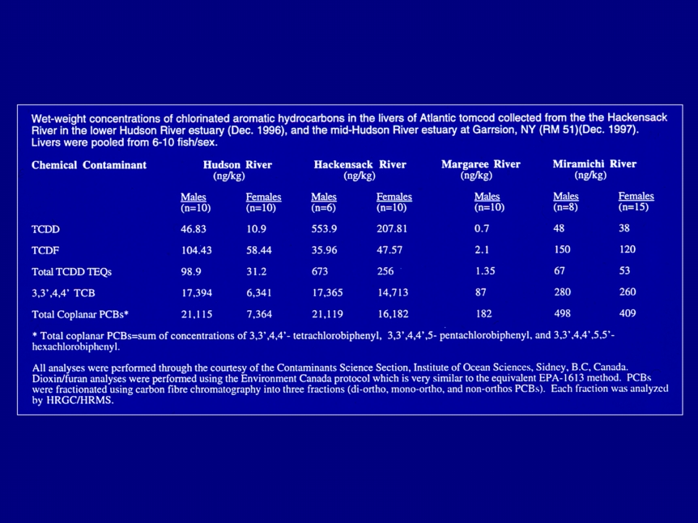
Hepatic Burdens of PCBs and PCDD/Fs in Adult
Tomcod from the HR Estuary and Elsewhere

Slide 28
Survivorship of Tomcod Embryos from the Hudson River or Shinnecock
Bay Treated with Graded Doses of Four PCB congeners or TCDD
Dioxin concentration (ppb)
Dioxin concentration (ppb)
0.001
0.01
0.1
1.0
0.001
0.01
0.1
1.0
Shinnecock Bay
Hudson
River
1.0
1.0
control
0.8
control
0.8
0.6
0.6
Survival
50th-ile
Survival
50th-ile
0.4
0.4
0.2
0.2
0
dioxin
0
126
81
77
169
0.001
0.01
0.1
1.0
0.001
0.01
0.1
1.0
PCB concentration (ppm)
PCB concentration (ppm)
PCB congener TEF Potency relative to PCB 126
126 0.0056 1.0
81 0.0010 0.2
77 0.00014 0.02
169 0.00007 0.01

Slide 29
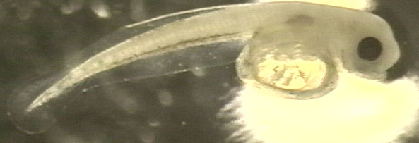
Response variables assayed in early life-stages of tomcod
Rates
Morphometrics
Mortality in embryonic period
Developmental rate to hatching
Late embryo heart-beat frequency
Yolk-sac larvae survival
Yolk-sac larvae activity
Growth & condition of larvae & juveniles
Total length & curvature of larvae
Yolk quantity
Yolk-sac size
Body length & depth
Jaw length
Eye diameter
6
5
10
9
12
7
4
8
2
11
3
1

Slide 30
Principle component analysis (PCA) of population and dose effects of PCB mixtures on morphology
Population
5
Hudson
Miramichi
3
Dose (ppm)
1
0.01
Larger - length, depth, yolk major axis
0.1
Smaller - yolk minor axis, yolk sac minor axis
Principal axis 2
-1
1.0
-3
-5
-5
-3
-1
1
3
5
Larger - eyes, length, head, jaw
Smaller - yolk, yolk sac
Principal axis 1

Slide 31
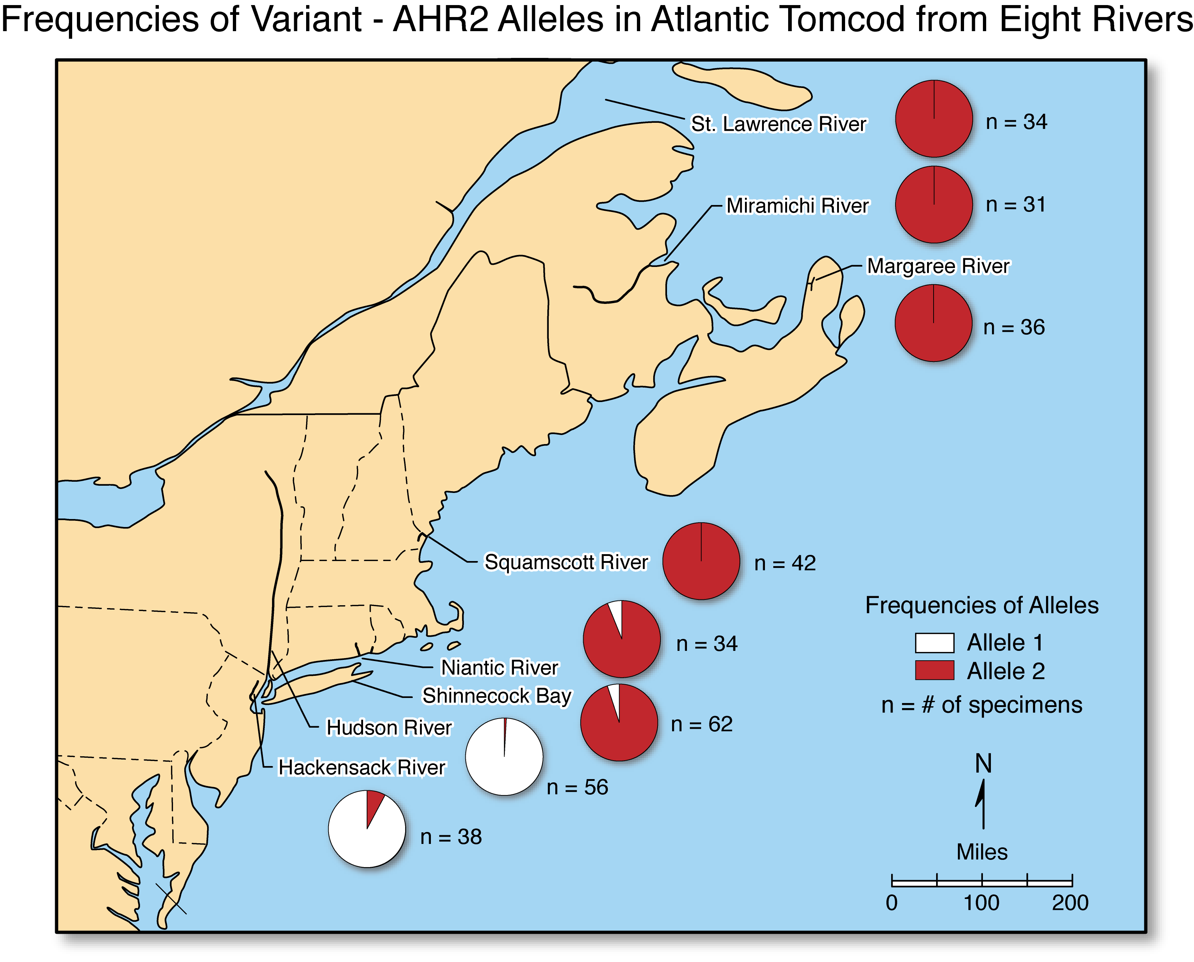

Slide 32
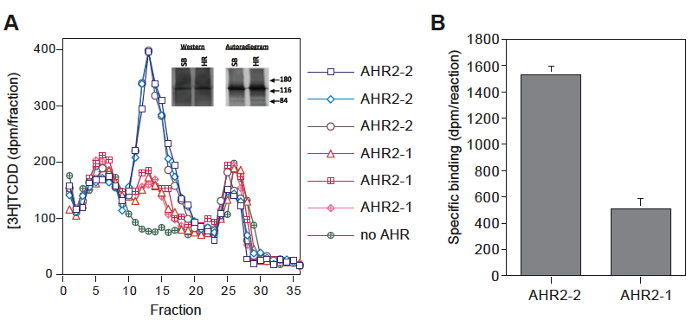
Comparison of in vitro expressed variant AHR2 proteins in binding of TCDD (2 μM)
AHR2-1 Hudson protein, AHR2-2 Shinnecock protein

Slide 33
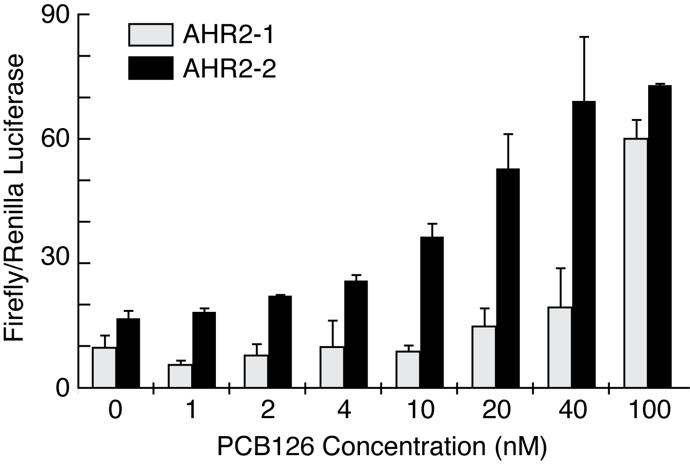
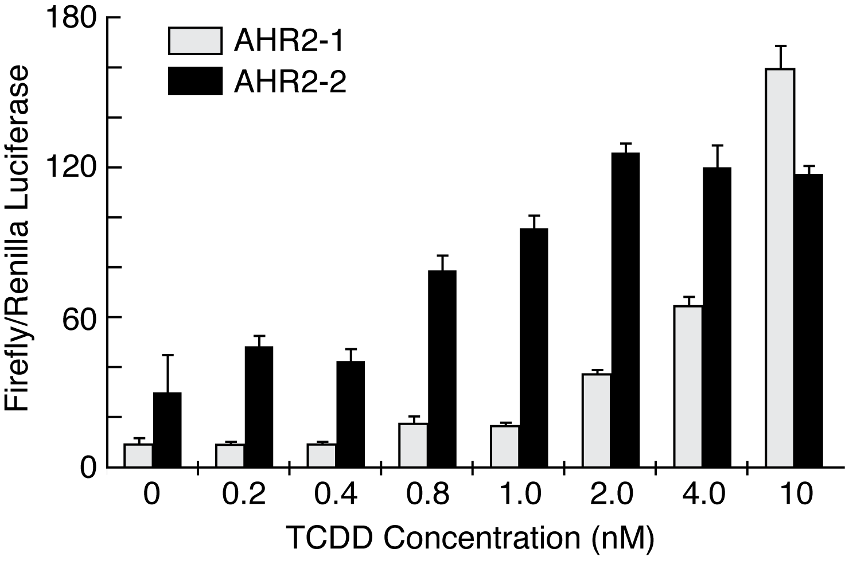
Comparison of Reporter Gene Expression of Variant AHR2
Proteins in PCB126 and TCDD Treated AHR Deficient
Cells
Hudson
Hudson
Shinnecock
Shinnecock

Slide 34
What do we know?
Some vertebrate species in the HR are highly vulnerable to PCB and TCDD induced early life toxicities under controlled laboratory conditions
Probably variation among species in vulnerabilities based upon their differing life history characteristics
Burdens of PCBs in HR populations often exceed those that induce toxicities under controlled conditions
It is likely that short term acute toxicities of early life stages occurred historically in the Hudson
Exposure to PCBs probably served as an agent for strong natural selection in Hudson populations

Slide 35
What we don’t know and probably should know
Tissue burdens of PCBs on a congener-specific basis in ecological receptors of interest
Is resistance a common phenomenon in highly exposed populations in the Hudson and elsewhere
Will remediation of upriver hotspots have a rapid benefit to bioaccumulation and tissue burdens of PCBs in downriver ecological receptors
Effects of exposure to multiple PCBs and other stressors (endogenous and exogenous)
  Metals
  Thermal stress

