Slide 1
Historical Ecology of the Hudson Valley:
How Environmental Decisions of the Past Affect those of the Future
April M. Beisaw
Assistant Professor of Anthropology
Vassar College

Slide 2
Environmental Histories
Chronological story - how humans changed environment
  Start with pristine
  Describe general impacts
    Often inferred from actions
  Mostly qualitative
Humans do what they want - environment changes

Slide 3
Environmental History of Catskills
Making Mountains by David Stradling
  Agricultural impacts
  Tanning industry impacts
  Tourism industry impacts
  Watershed development impacts

Slide 4
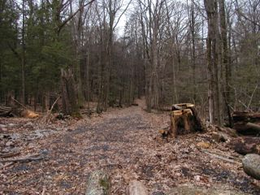
Regional Environmental Histories
PROs
  Details impacts from certain activities or events
  Help us envision natural and cultural changes
CONs
  Isolated stories
  Relatively short time spans

Slide 5
Historical Ecology
Anthropological paradigm
  “historical ecology traces the ongoing dialectical relations between human acts and acts of nature, made manifest in the landscape. Practices are maintained or modified, decisions are made, and ideas are given shape; a landscape retains the physical evidence of these mental activities” (Crumley 1994:9)

Slide 6
Historical Ecologies
Story how humans modified environment and were modified by it
  No pristine starting point
  Not necessarily chronological – interwoven stories
  Describes differential impacts
    Includes unexpected impacts discerned from data
  Mixture of qualitative and quantitative analyses
Human decisions are partially in response to local environmental changes

Slide 7
Shifting from EH to HE
Environmental History
Historical Ecology
Isolated elements
  i.e. Forest composition
Major activities
  i.e. Agriculture
Recent past
  i.e. Colonization
Inter-relations
  i.e. Alterations to animal habitat intentionally caused by agriculturalists for hunting
Minor activities
  i.e. Removal of leaf litter
All of human history
  i.e. Additive impacts

Slide 8
Shifting from Ecosystems to Landscapes
Ecosystems
Landscapes
Maintain equilibrium until altered
Can be restored to original or returned to equilibrium
Sustainability = maintain the ecosystem
React to humans
Constantly changing
Forever altered
Sustainability = maintain way of life
Humans and environment react to each other

Slide 9
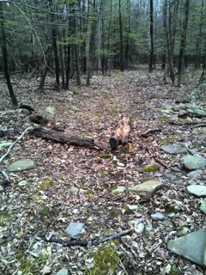
Minor Activities – Major Impacts
Collection of leaf litter resulted in depletion of soil nutrients that changes the forest composition
Encouraged mixed oak-pine woodland
Cessation of cultural practice changed forest composition again

Slide 10
Lasting Impacts
Post-agriculture forests are not returning to pristine state
Scarcity of seed trees
Fewer animals for seed dispersal
Similar environments can have very different land-use histories
Take advantage of variation in plant communities
Leave behind different plant communities

Slide 11
Environment is Always Changing
6000 years ago = Moist, Oak/Hemlock, Increase small mammals
4000 years ago = Declining hemlock
3500 years ago = Oak/Hickory
2000 years ago = Oak/Chestnut/Hemlock
500 years ago = Increasing Spruce/Pine

Slide 12
Native Americans Actively Changed Environments
3,000 years ago - Use of fire to clear agricultural land
Encouraged oak/chestnut/hickory/walnut
10,000 years ago – Nut harvesting
Encouraged same tree species
Not accidental

Slide 13
Change is Fast – Even in Rural Areas
By 1800 – Stream and lake habitat down 50%
By 1850 – 95% loss of river herring habitat from mill dams alone
Already 1500+ commercial sites using water power just in the state of Maine

Slide 14
What Historical Ecology is NOT

Slide 15
What Historical Ecology is NOT
Critique of the past
  No good vs. bad decisions

Slide 16
What Historical Ecology is NOT
Critique of the past
  No good vs. bad decisions
Distinct field of research
  Perspective that brings together interdisciplinary data while focusing on a materialist approach

Slide 17
What Historical Ecology is NOT
Landscape ecology
  All landscapes are human-influenced
Cultural ecology/behavioral ecology
  Humans aren’t just adapting
Conservation biology
  Human activity isn’t “destructive”
Ecology of past environments
  No ecosystems

Slide 18
What Historical Ecology Is
History of resource management
  Landscapes are created through human agency
About contemporary issues
  Focus on understanding change
  Make better decisions for the future

Slide 19
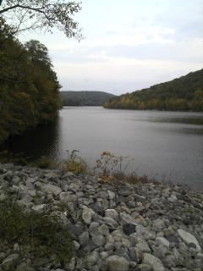
One Decision Has Multiple and Unexpected Impacts
Migration of the river channel and groundwater extraction removed marshy wetlands
Can’t be recreated without return of water
Restoration attempts = installing lake wetlands
Water retention systems and parks already exceed “original” lacustrine wetlands

Slide 20
Implementing Historical Ecology
Inter/Multi/Trans-disciplinary team formation
  Unified by clear research design
Independent lines of inquiry contribute qualitative and quantitative data
  Contradictory evidence seen as new avenue of research
Seek site specific evidence for human decisions
  Culture-environment relationship as dialogue not dichotomy
  Decisions can vary between sites and change through time
    Not all European agriculturalists tend their fields the same

Slide 21

Lessons from Vikings
  Sustainable?
    Waterfowl successfully managed but fish and soil were not
    Trade networks increased when local resources decreased
  Uniformity?
    Some farms still in use, others reduced to subarctic desert long ago
      Poorer farmsteads used less sustainable practices

Slide 22
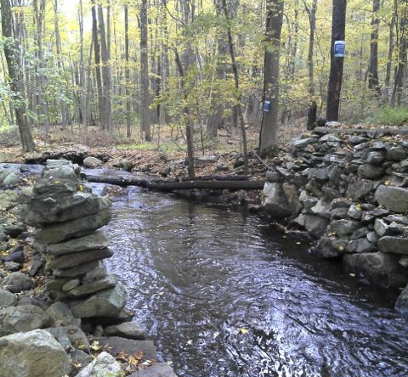
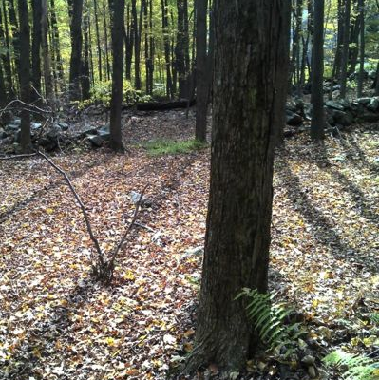
How do environmental decisions of the past affect those of the future?
Inheriting a changed landscape - so focus should be on what we want to encourage for the future instead of picking an arbitrary past to try to return to

