Slide 1
Science Underpinning Restoration
Are we ready?
!
Today’s snippets are my opinion, examples – not answers

Slide 2
We better be!
New and re-invigorated Restoration efforts
  HREP Restoration Plan (Dan Miller)
  TNC Re-start of Army Corps process (Andy Peck)
New potential funding streams
Hudson is a well-studied ecosystem

Slide 3
Why Restore?
Hudson has been damaged in the past
  Physically (dredge and fill, hardening)
  Chemically (contaminants, nutrients, wastewater)
  Biologically (stock declines, invasives)
Hudson has demonstrated resilience yet still has room to improve
Public is re-embracing their River

Slide 4
What needs to happen?
Support (Gov’t, public and $$$)
Partner collaboration/coordination
Science foundation : what to do, where and why
Each of these is hard work! All are necessary.

Slide 5

What to do? Where? Why?
Setting Targets is Hardest Part
Historical?
Opportunistic?
Strategic?

Slide 6
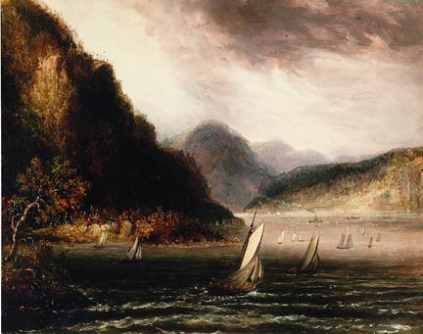
Historic Targets
Pro:
  Documented previous condition
  Familiarity
Con:
  Rules have changed

Slide 7
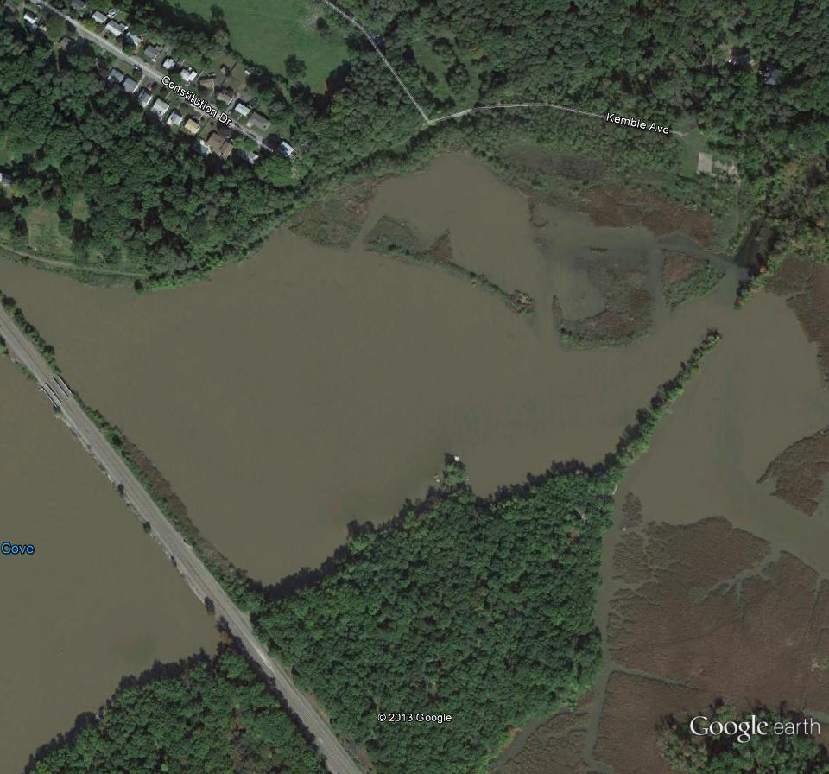
Opportunistic
Site or funding “dictates” action
  Perhaps most common (mitigation)

Slide 8
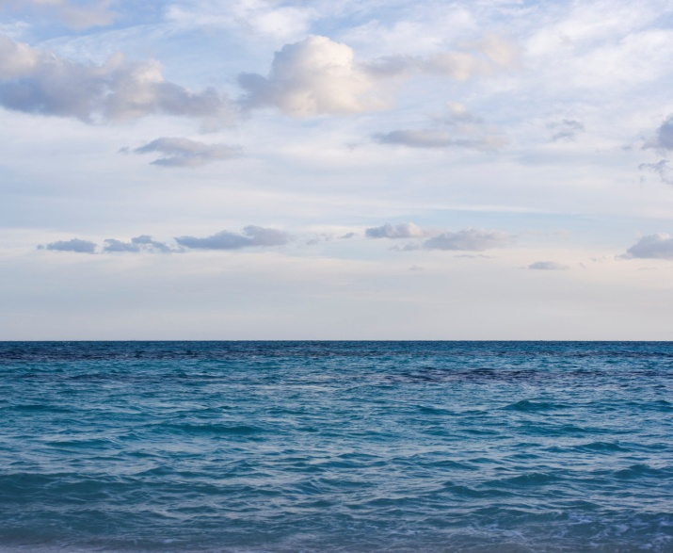
Strategic
Watershed or Ecosystem Scale Goals
Requires Lots More Information
  Unconstrained by location, history
  How much of what, where and why
Recognizes trade-offs

Slide 9
Some (arbitrary) examples
 | Marsh Water Quality | Diadromous Fish Habitat | Side Channel | Submerged Aquatic Vegetation | Tributary Barriers | Invasive Management
ACTION
BENEFIT
UNKNOWNS

Slide 10
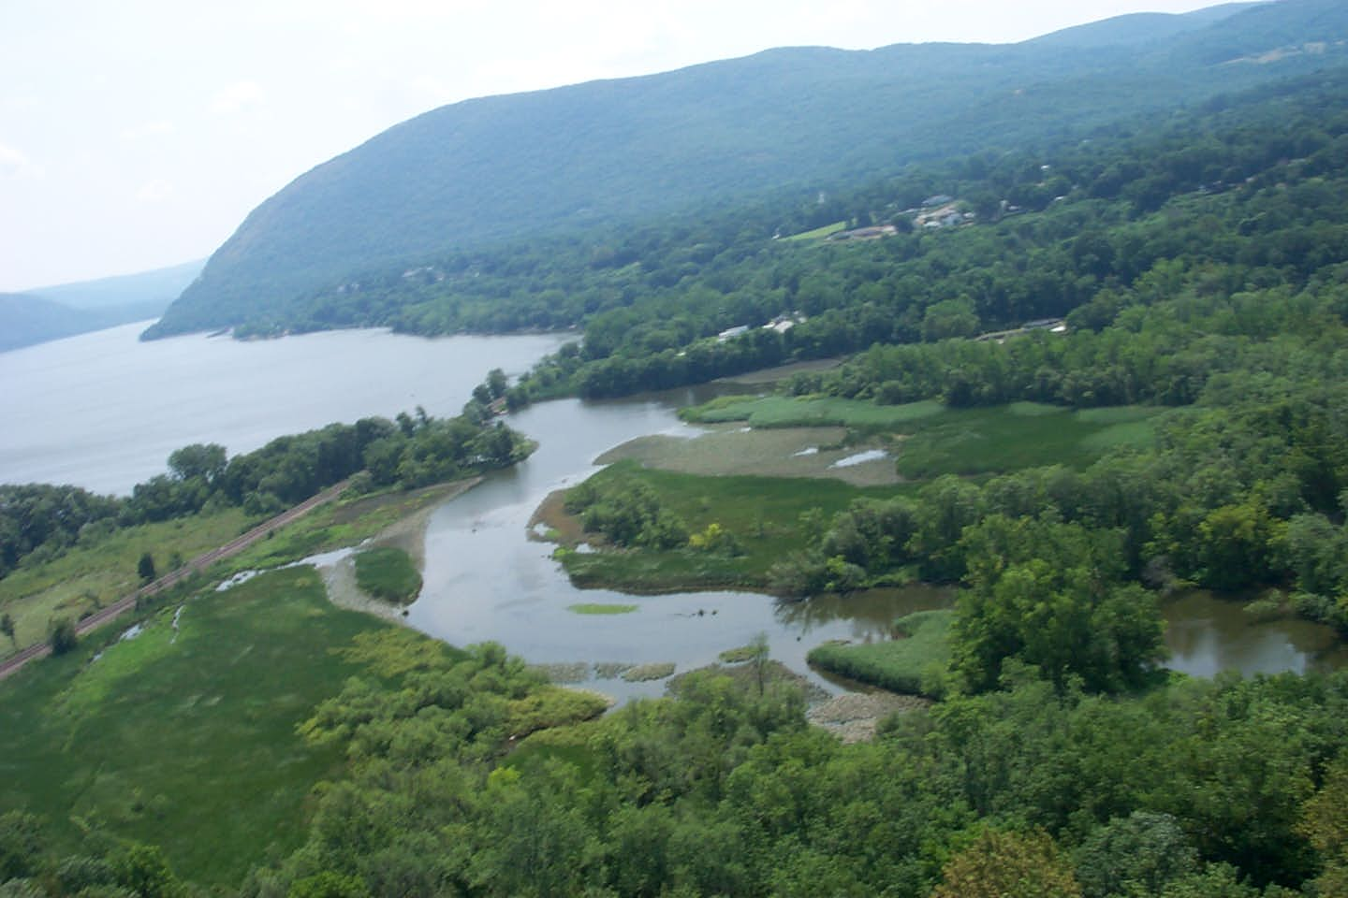
Tidal FW Marshes (WQ Benefit)

Slide 11
TIVOLI NORTH BAY
NO3
Stage
Marshes are sinks for NO3
Rate of decline as tide ebbs-compare across sites
TIME (h)

Slide 12
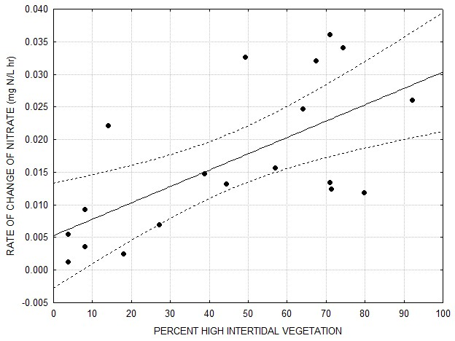
NITRATE REMOVAL ACROSS SITES
P = 0.01
r² = 42%
Fast decline
Slow decline

Slide 13
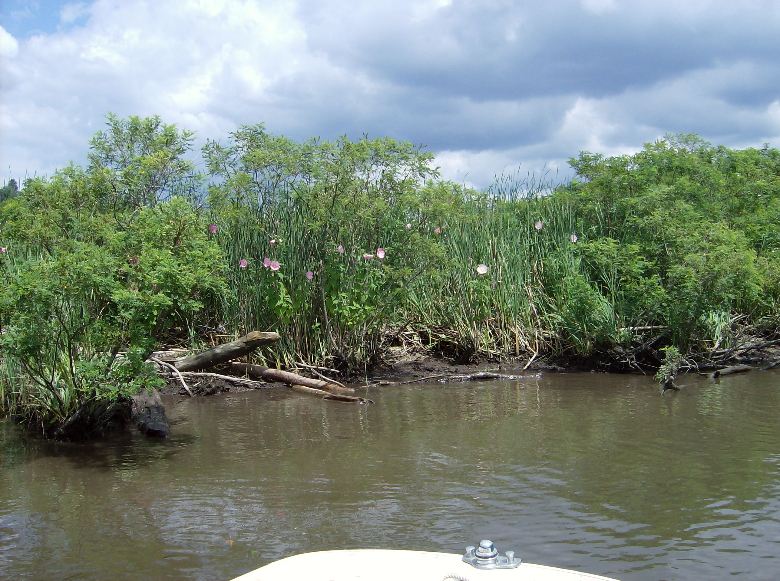
Typha-dominated high marsh plane affects
capacity for nitrate removal

Slide 14
Some (arbitrary) examples
 | Marsh Water Quality | Diadromous Fish Habitat | Side Channel | Submerged Aquatic Vegetation | Tributary Barriers | Invasive Management
ACTION | Re-connect Room to move
BENEFIT | WQ Habitat
UNKNOWNS | Sedimentation Salinity

Slide 15
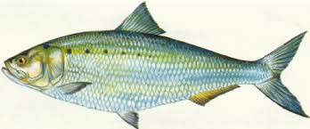
FISH MAIN CHANNEL HABITAT
DEC Tracking – Shad and Sturgeon
  (Thanks to Amanda Higgs and Andy Kahnle)
  Similar question – Benthic Invertebrates - Strayer et al 2006 FW Biology

Slide 16
Some (arbitrary) examples
 | Marsh Water Quality | Diadromous Fish Habitat | Side Channel | Submerged Aquatic Vegetation | Tributary Barriers | Invasive Management
ACTION |  | Preservation Creation Access?
BENEFIT |  | Replenish Stocks
UNKNOWNS |  | River Habitat Limiting? True at higher pop. density?

Slide 17
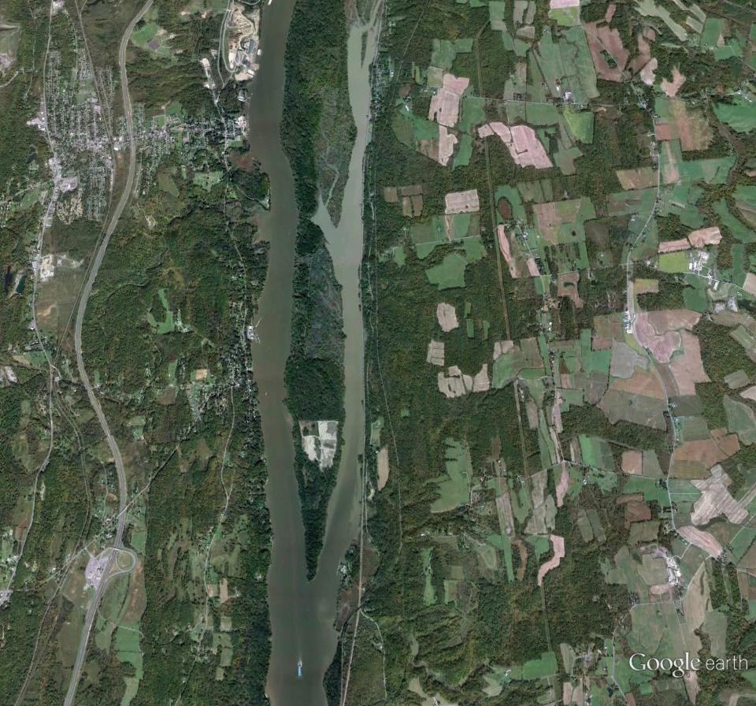
Side Channel Re-connection
Slow water, vegetated, adjacent wetlands
Historical modification

Slide 18
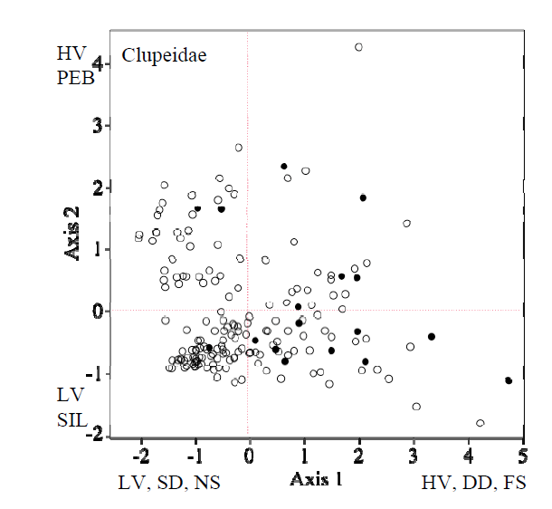
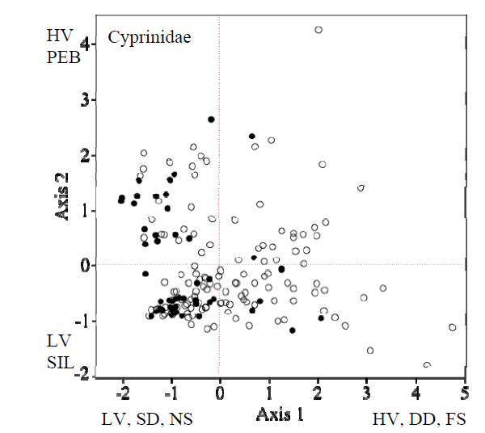
Low vel, shallow, near shore
High vel, deep, far shore
HABITAT PREFERENCE – Post Yolk Sac Minnows and Herrings
Stouthamer, C. E. and M. B. Bain. 2012. Quantifying Larval Fish Habitat in Shoreline and Shallow Waters of the Tidal Hudson River. Section VII: 1-25 pp. In S.H. Fernald, D.J. Yozzo and H. Andreyko (eds.), Final Reports of the Tibor T. Polgar Fellowship Program, 2010. Hudson River Foundation.

Slide 19
Some (arbitrary) examples
 | Marsh Water Quality | Diadromous Fish Habitat | Side Channel | Submerged Aquatic Vegetation | Tributary Barriers | Invasive Management
ACTION |  |  | Re-connect
BENEFIT |  |  | Young fishes More “edge” Adjacent wetlands Better flushing
UNKNOWNS |  |  | Invasives Sediment quality

Slide 20
Some (arbitrary) examples
 | Marsh Water Quality | Diadromous Fish Habitat | Side Channel | Submerged Aquatic Vegetation | Tributary Barriers | Invasive Management
ACTION
BENEFIT
UNKNOWNS
Are we ready?
Argue for preservation/prevention
Quantified benefits
Informed debate on relative merits
Anticipate trade-offs

