Slide 1
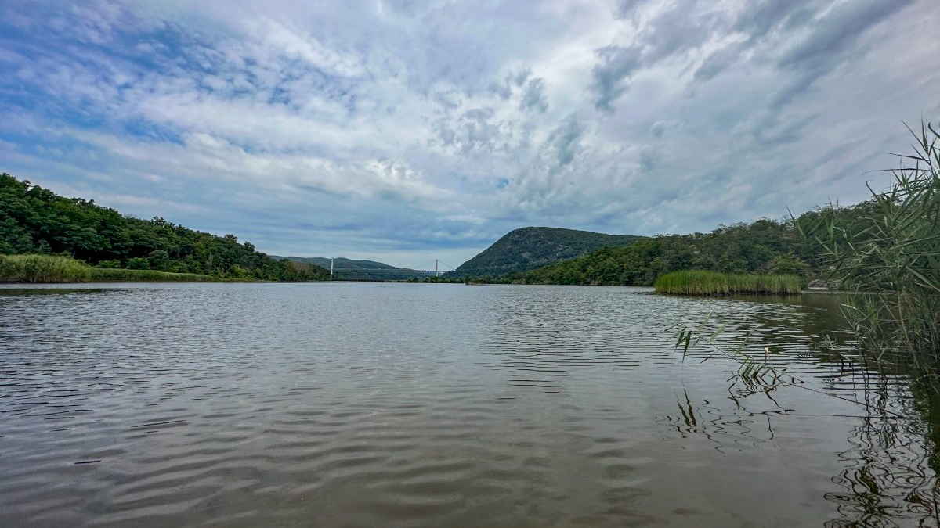
Real-Time Abiotic Monitoring in the Hudson
Brittney Flaten
NEIWPCC & NYSDEC
October 8, 2024

Slide 2
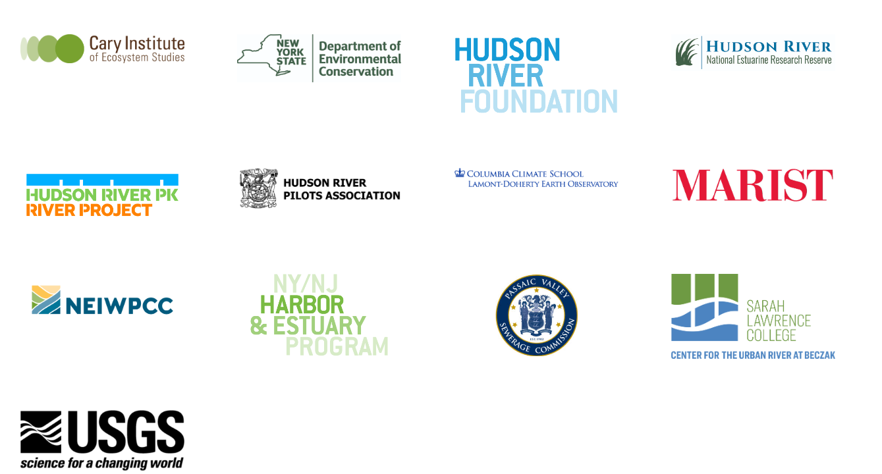
Acknowledgements

Slide 3
What do we mean when we say “abiotic”?
Non-living components of the ecosystem
In the River:
Temperature
Salinity
Turbidity
Substrate composition
Water velocity

Slide 4
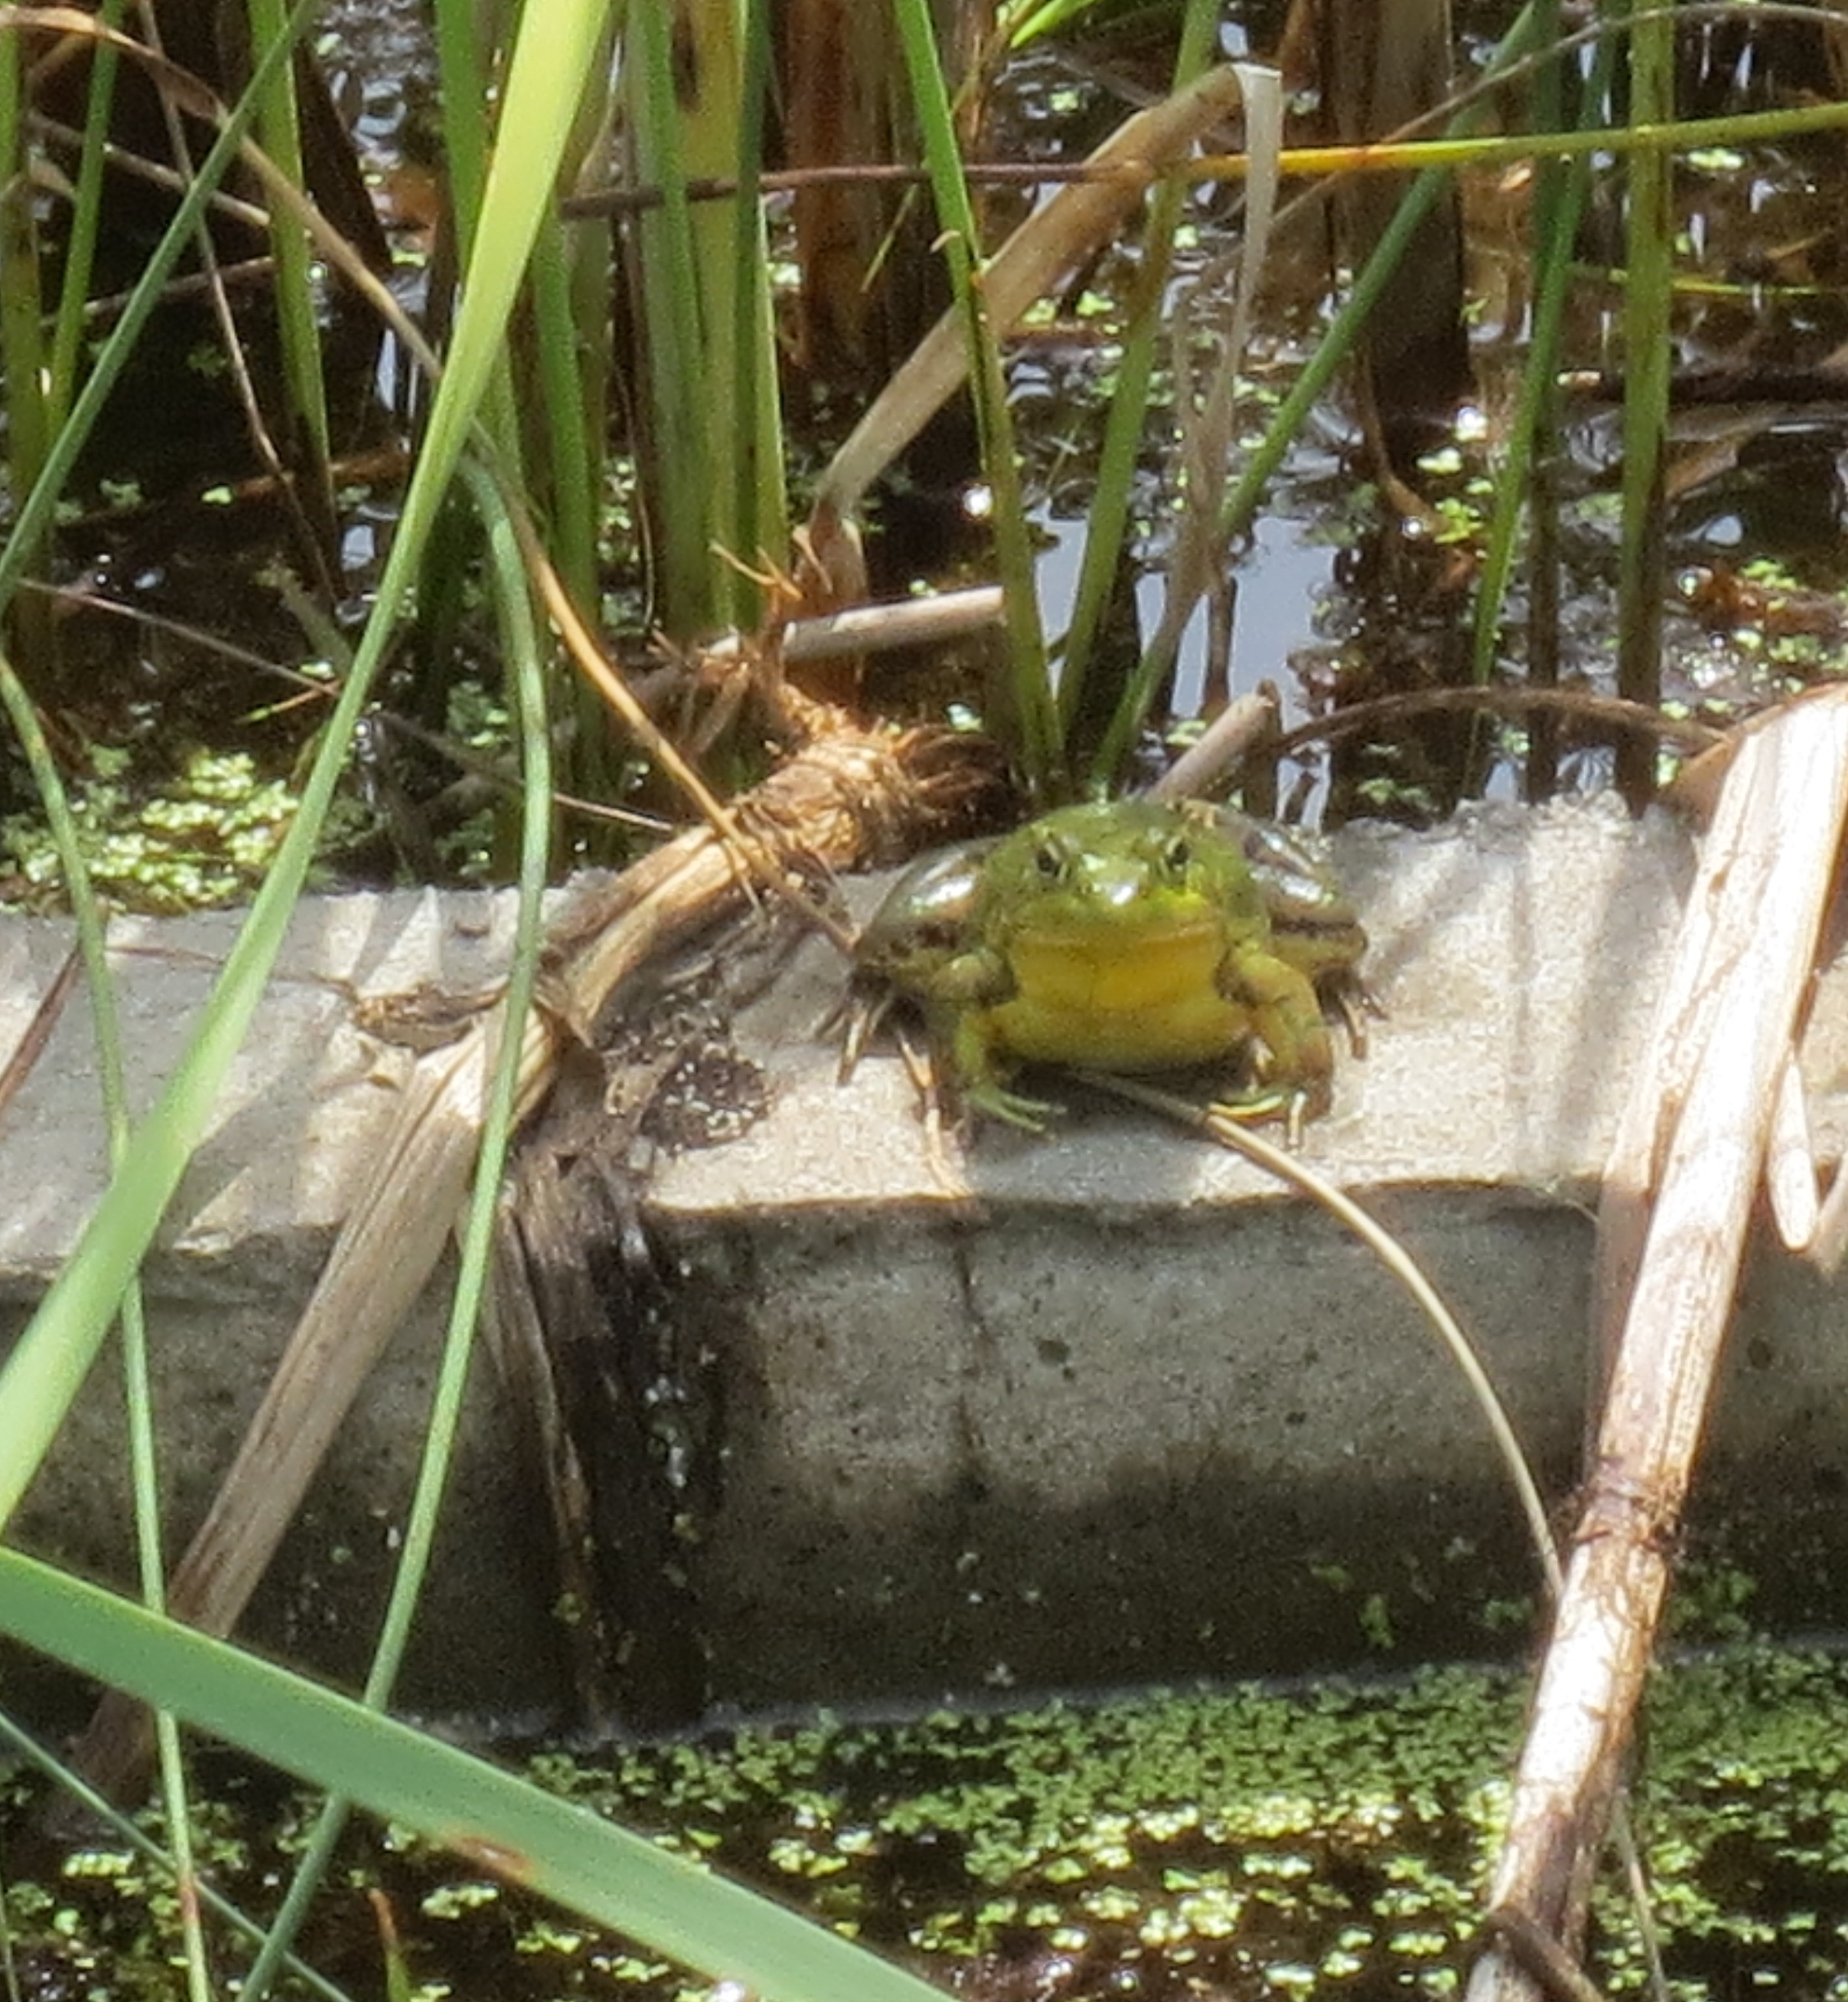
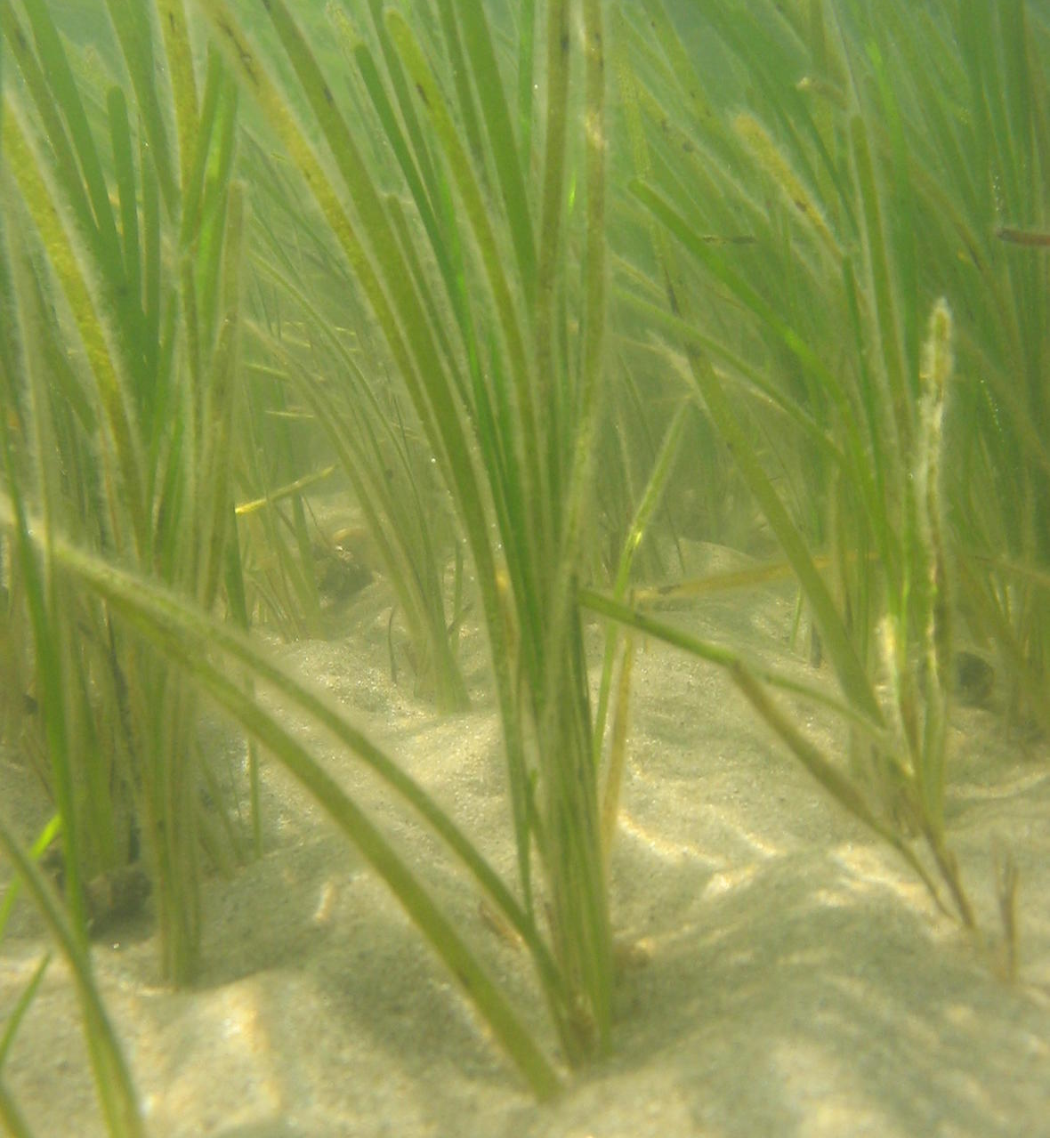
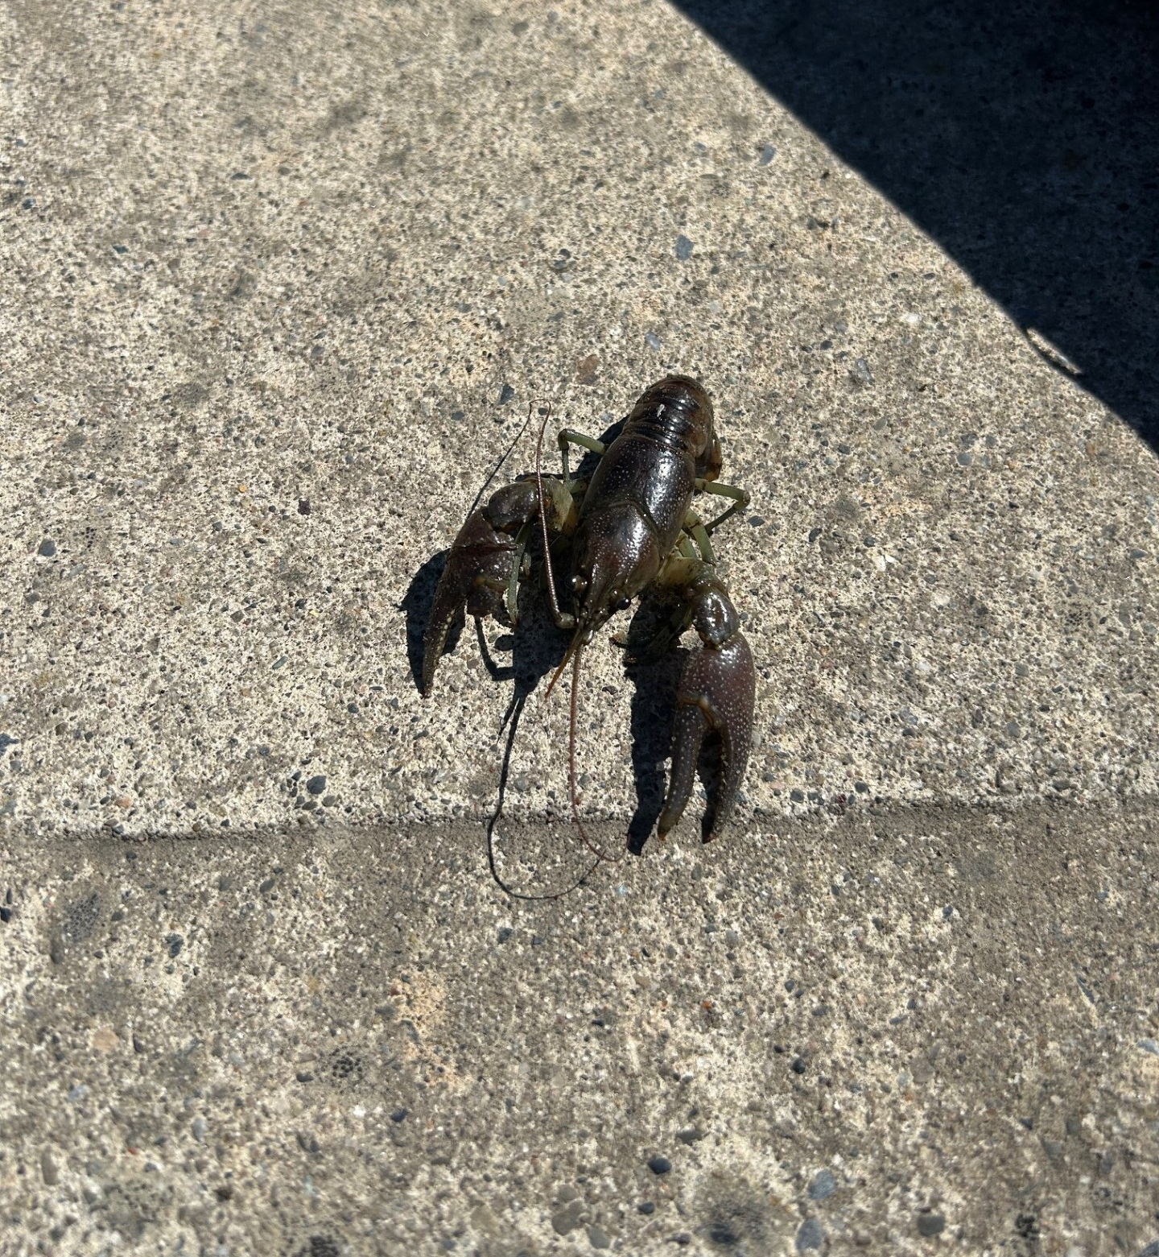
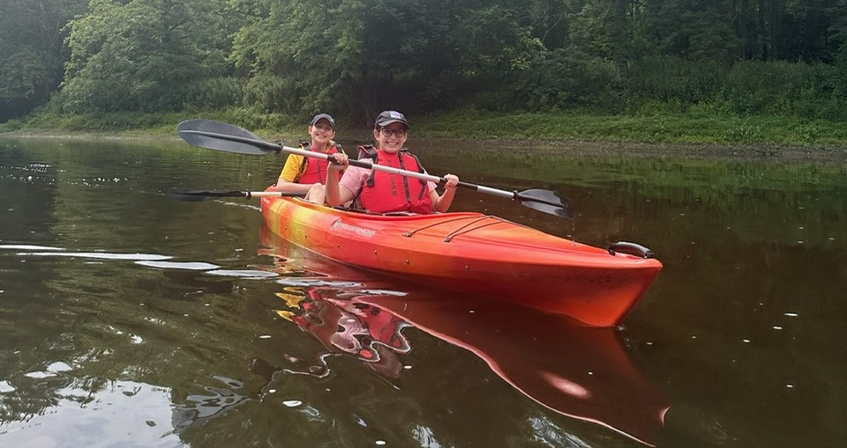
Who cares?

Slide 5
A Brief and Incomplete History of Abiotic Monitoring
Mid-90s: Monitoring at HRNERR
System-wide Monitoring Program
2008: Established network of sites from Schodack to Castle Point
Hudson River Environmental Conditions Observing System
Goal: Provide widespread, high frequency data
Notes:
Sawkill, Stony Creek, Tivoli Bays
Emphasize importance of high frequency data

Slide 6
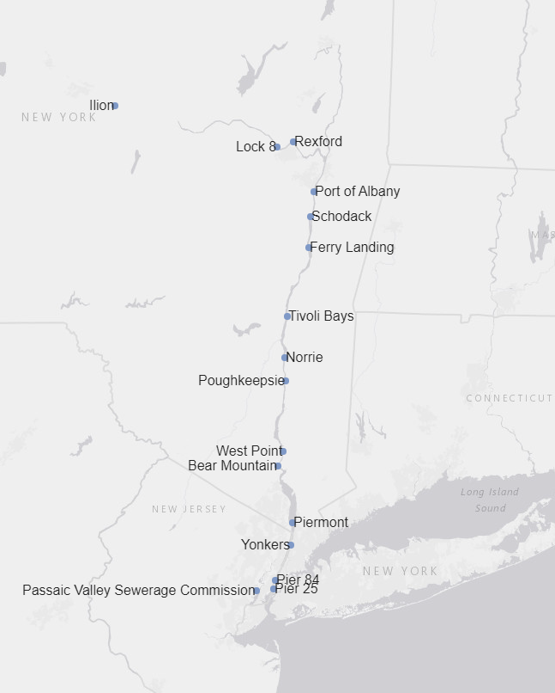
Hudson River Environmental Conditions Observing System (HRECOS)
Network of water quality monitoring stations
Plus weather stations
Data recorded every 15 minutes
Transmitted online every hour
“Near real-time”
Parameters include:
Water temperature
Dissolved oxygen
Conductivity
Turbidity
pH
Chlorophyll & phycocyanin at select sites
Anyone can access it!

Slide 7
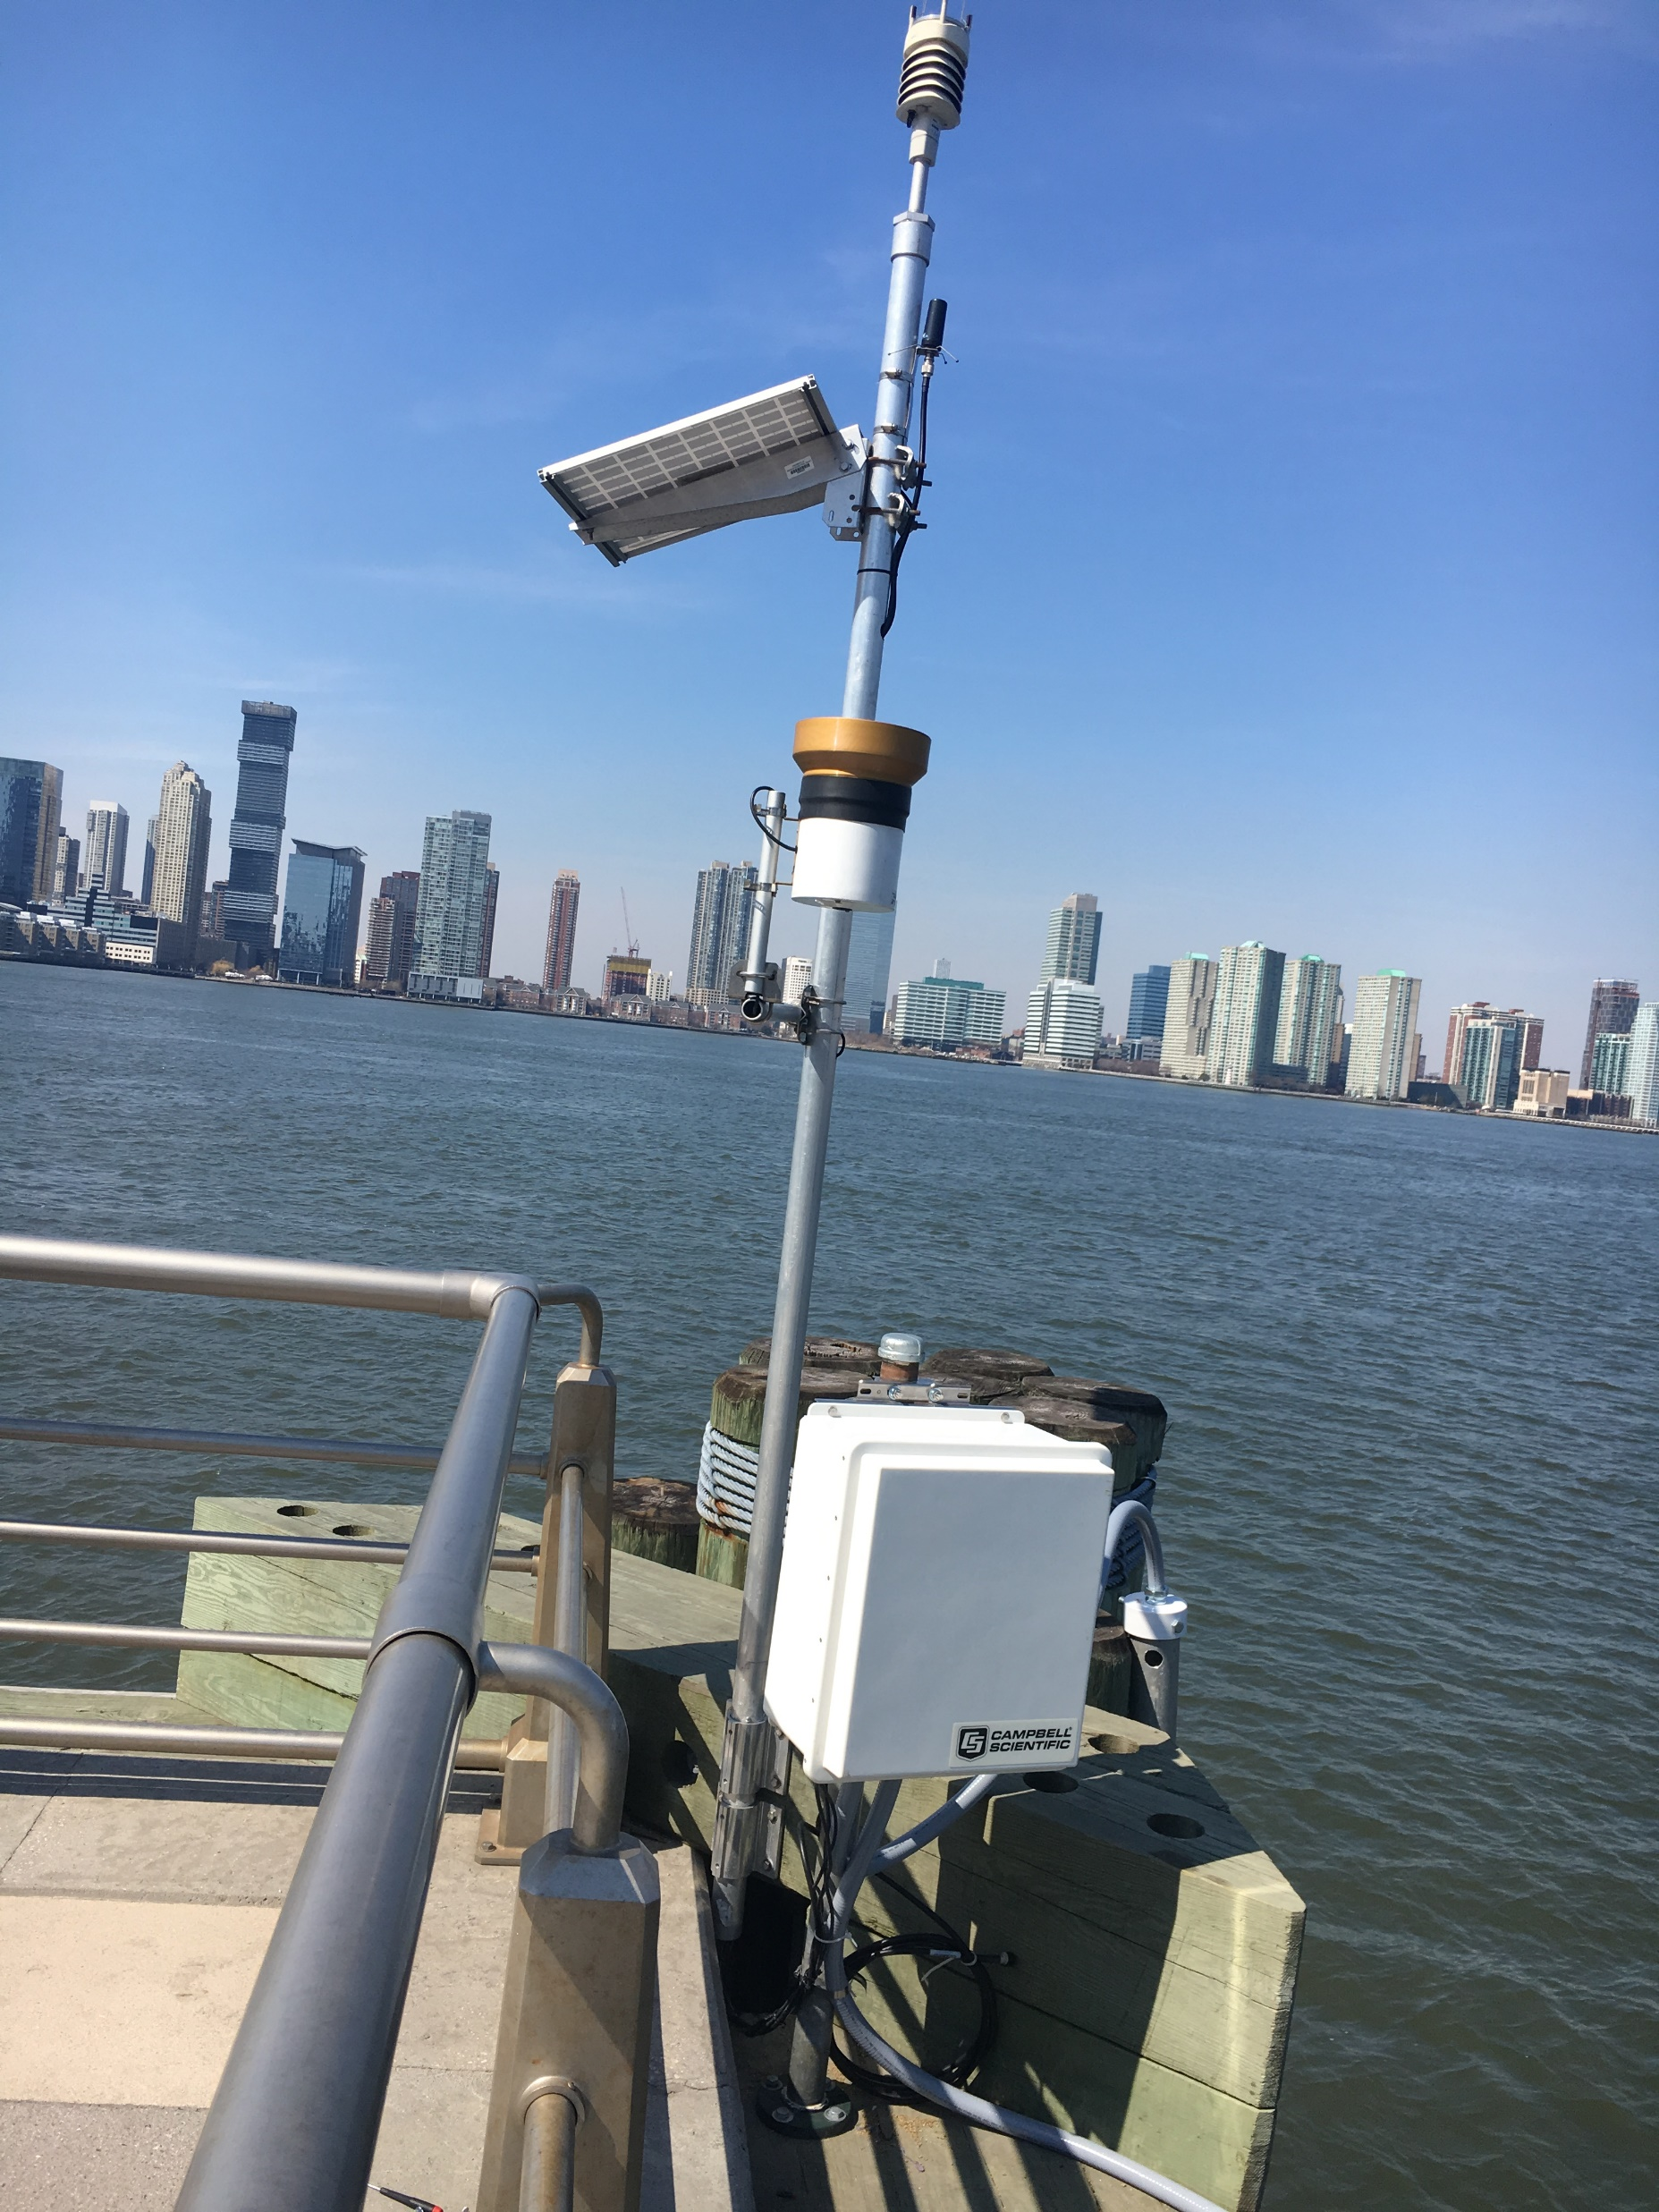
What goes into real-time monitoring?

Slide 8
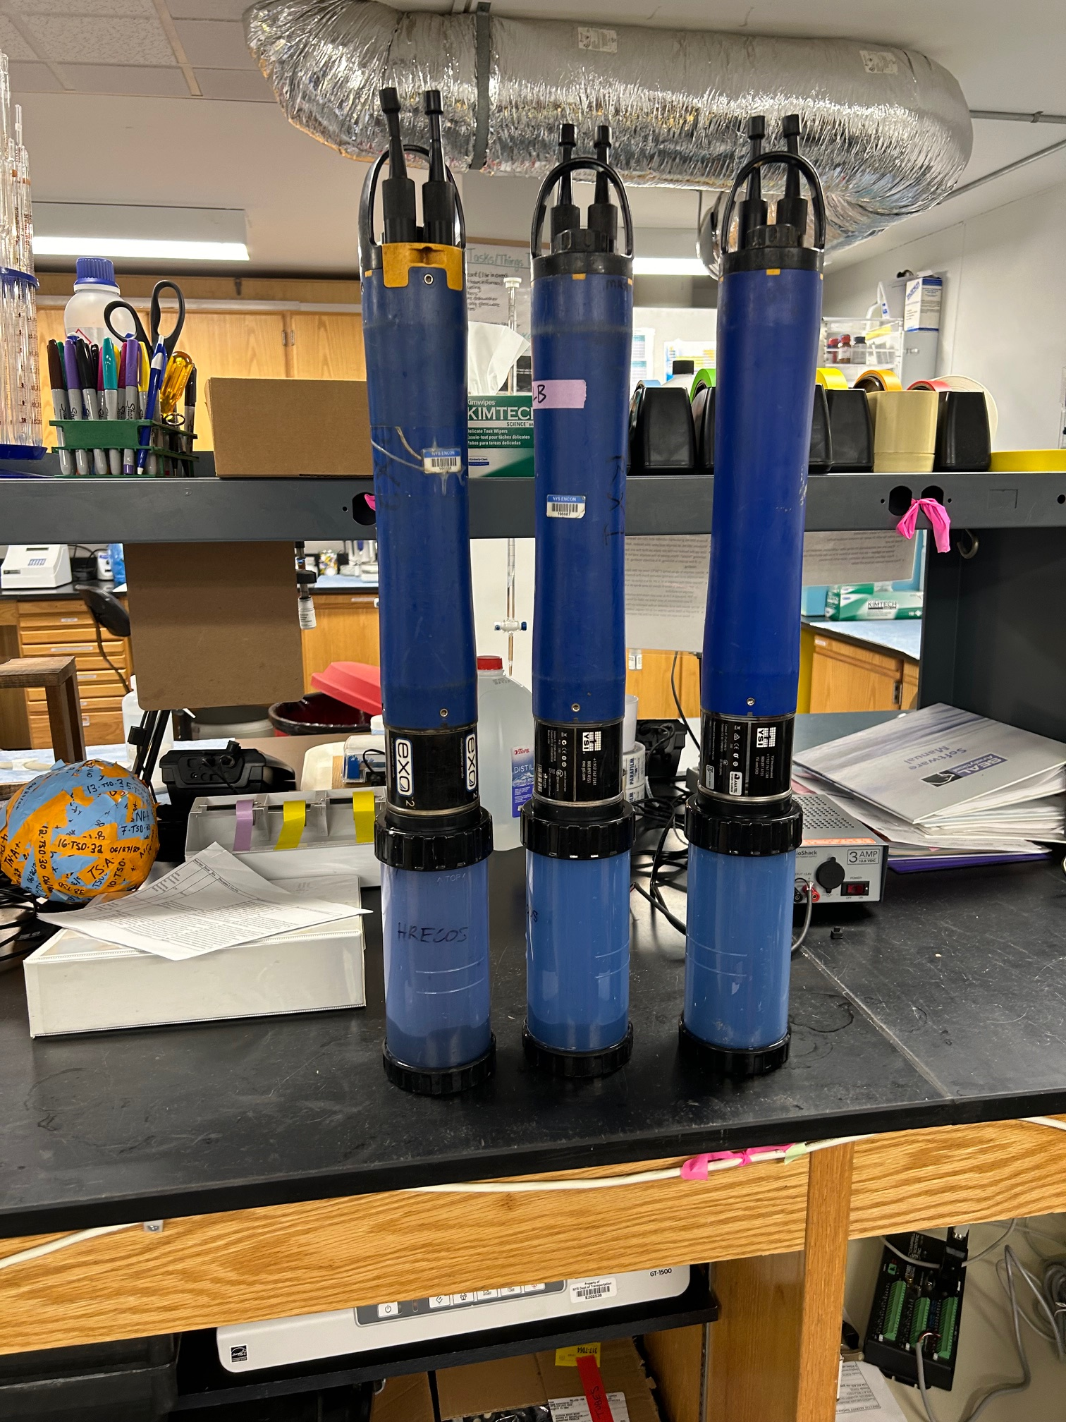
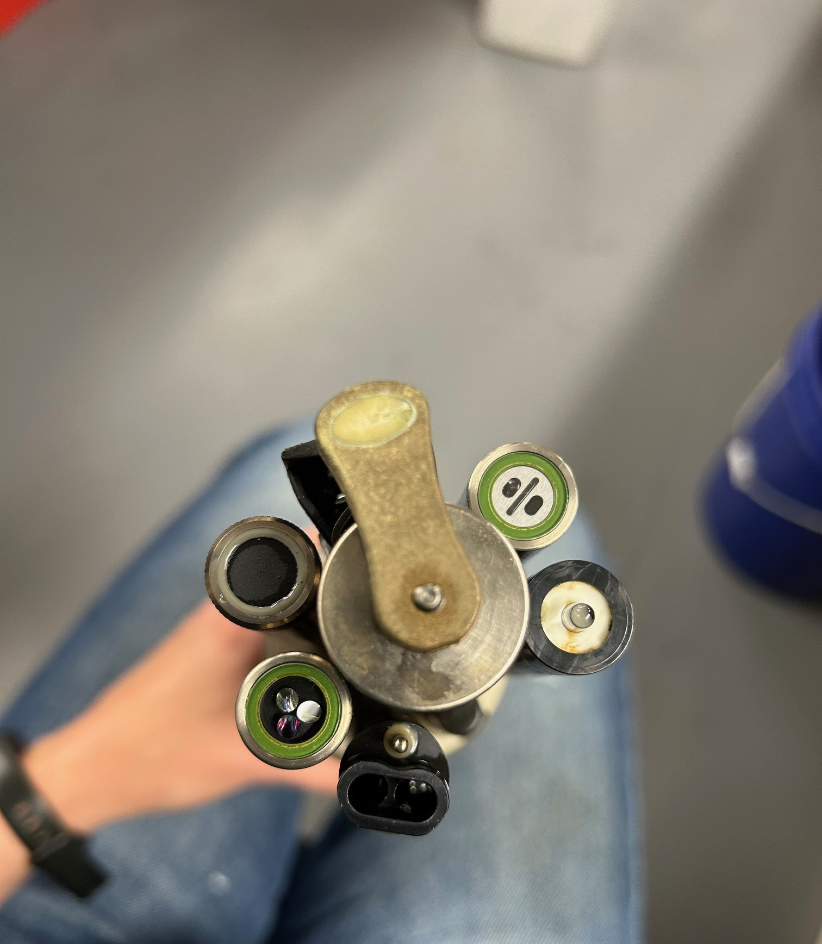
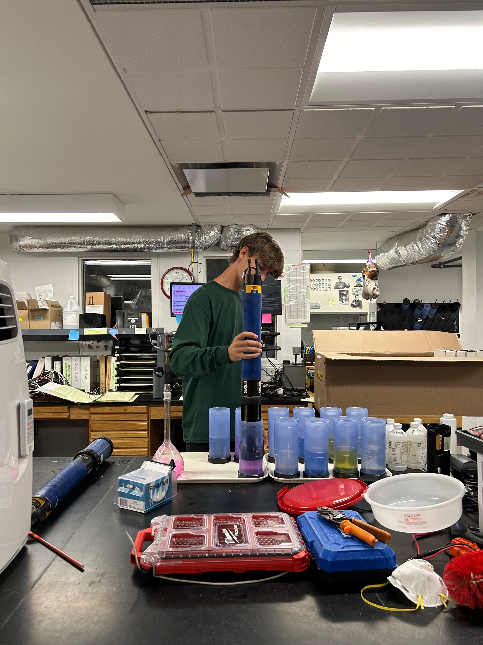
Multiparameter sondes
Calibration
Sensors

Slide 9
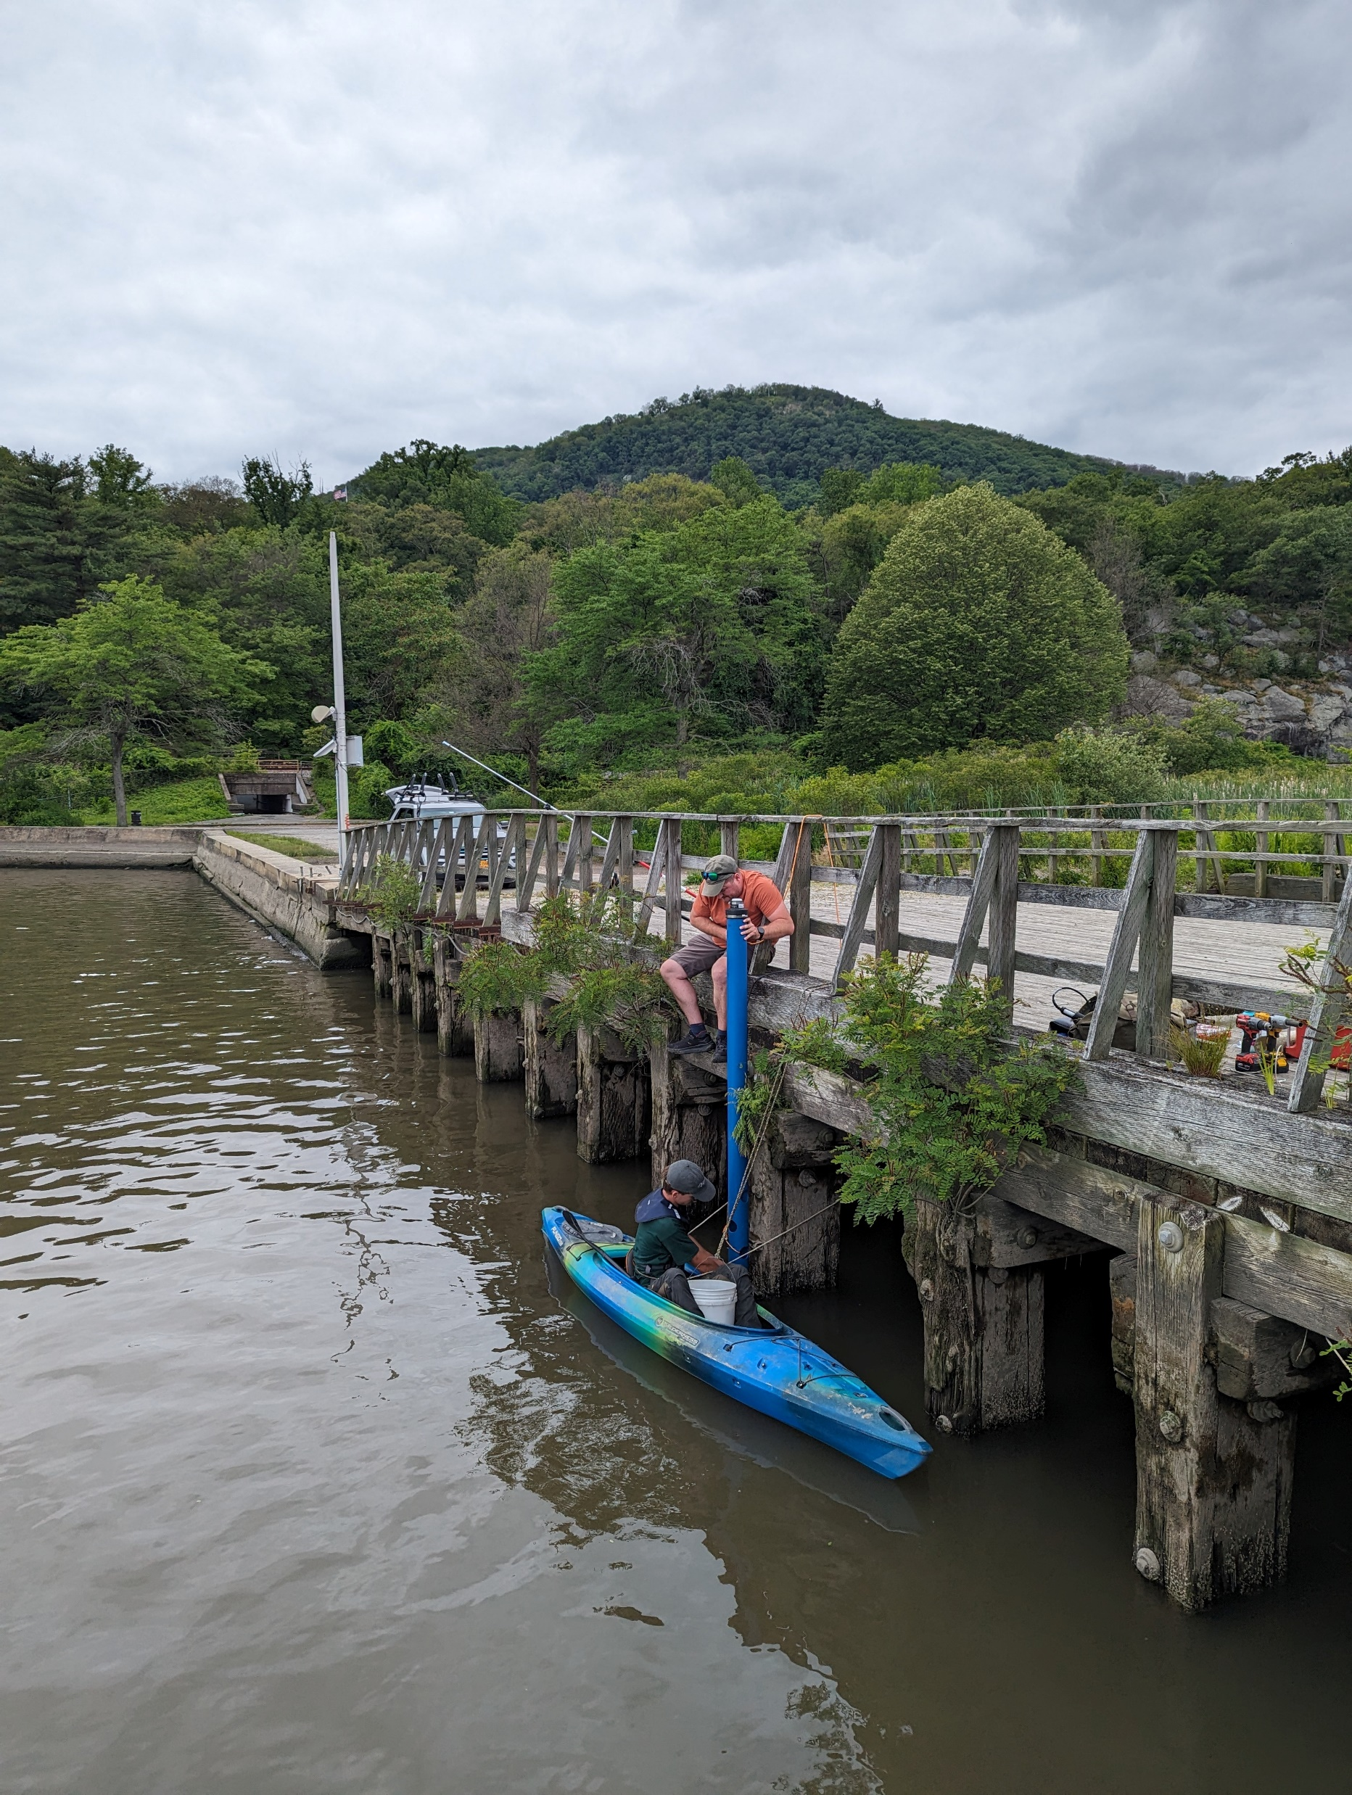
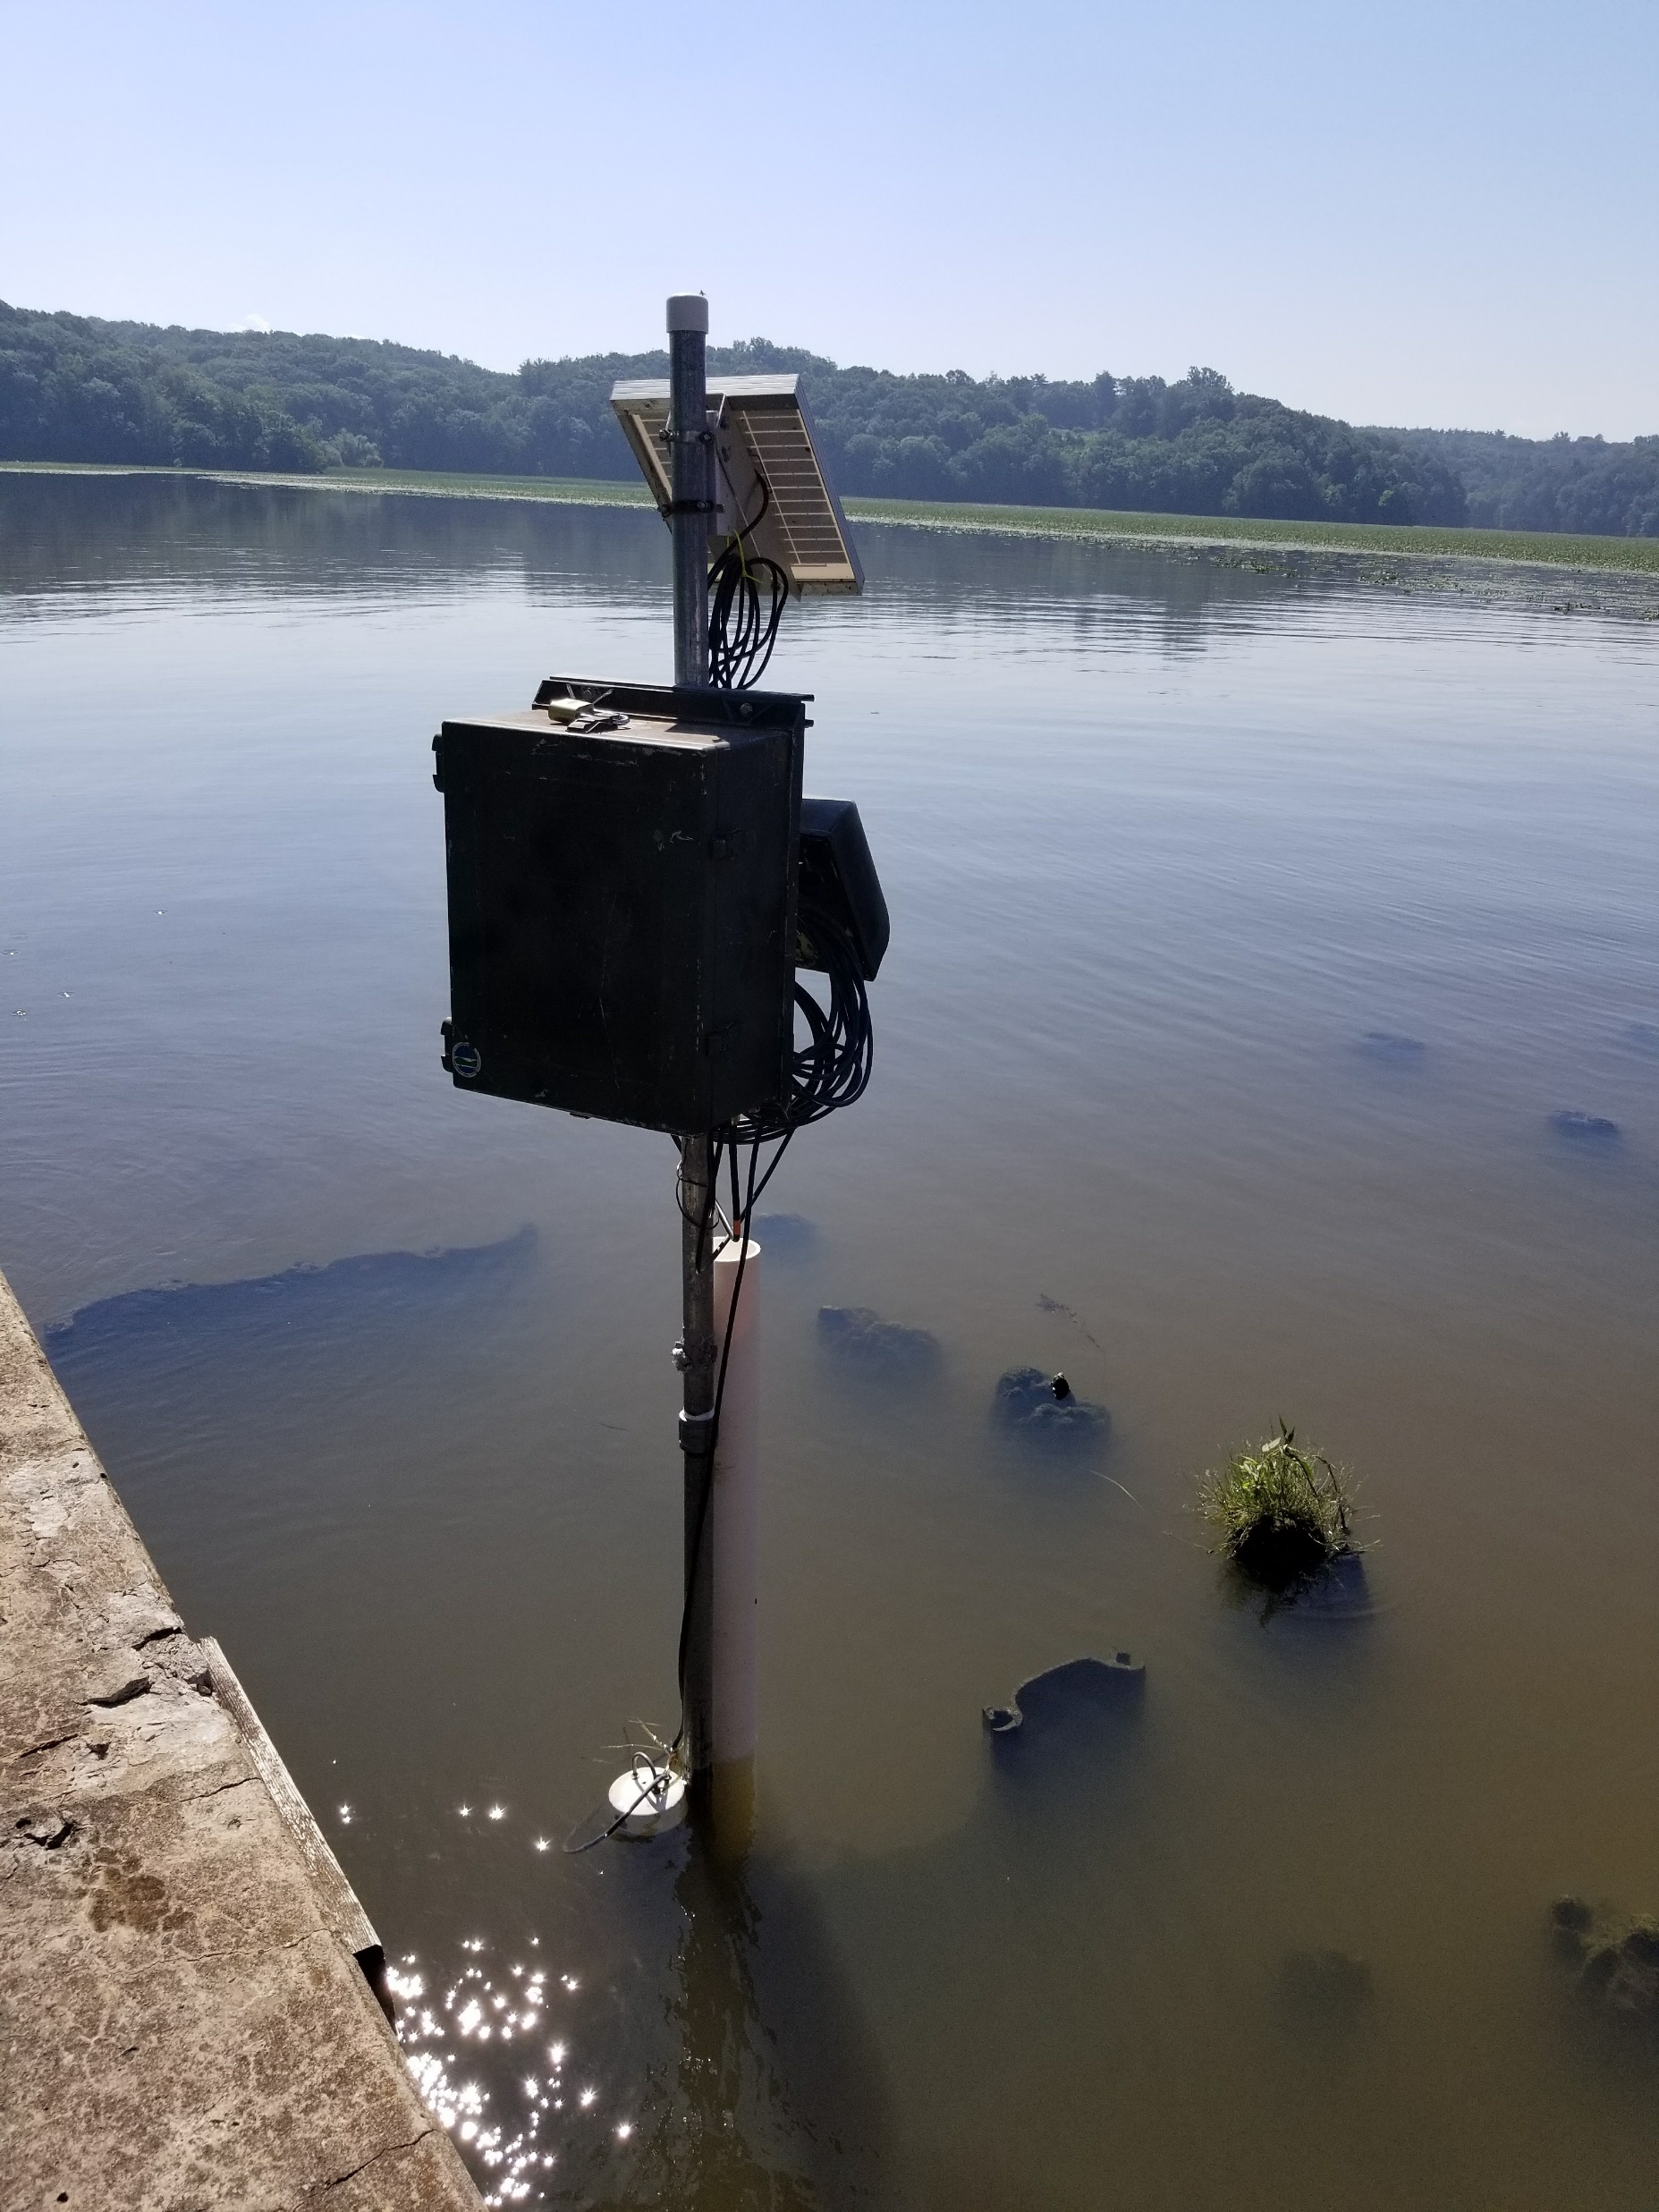
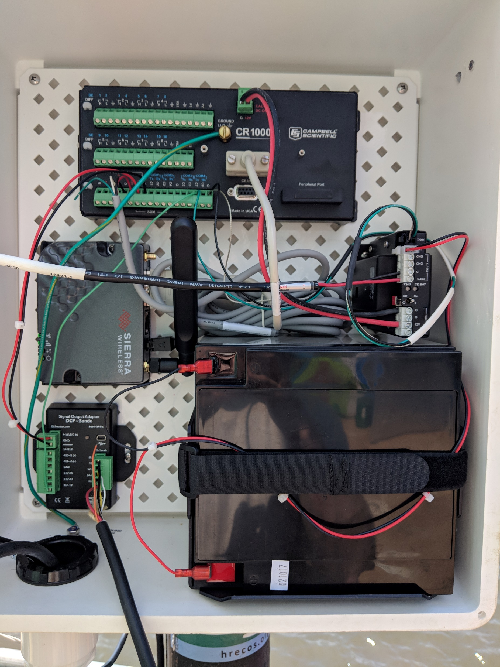
Deployment tube
Enclosure
A look inside…

Slide 10
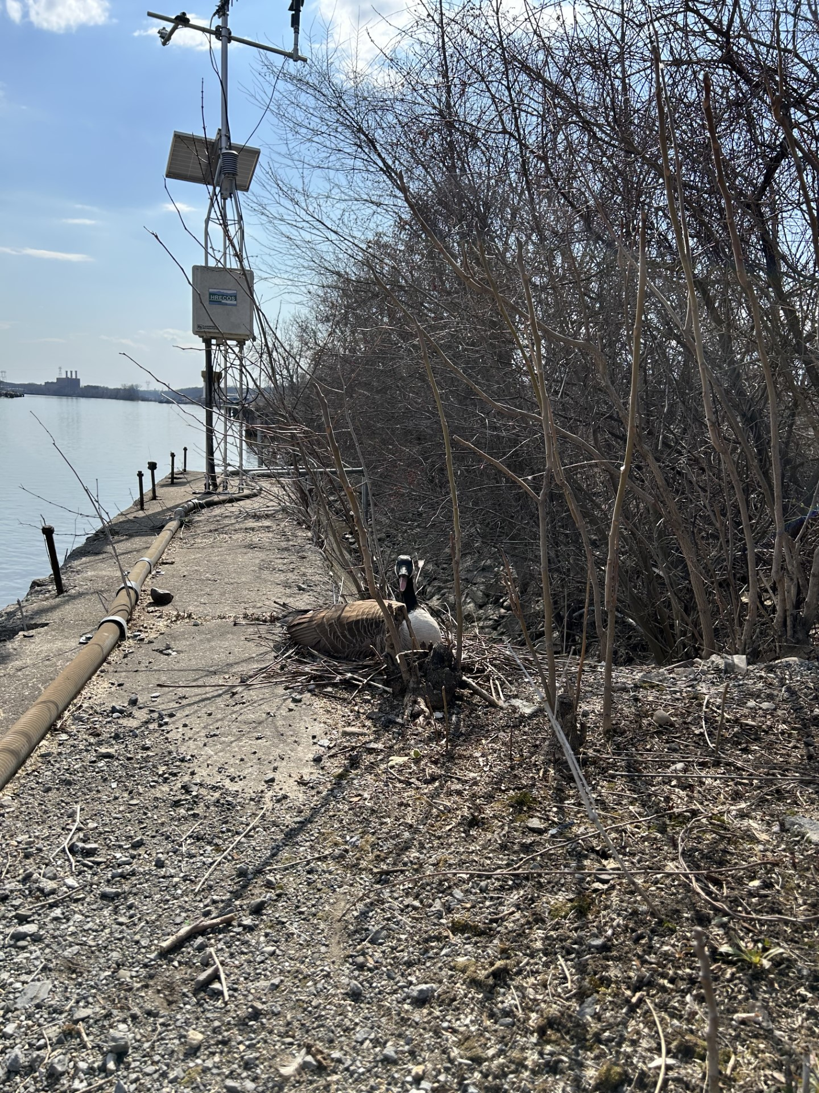
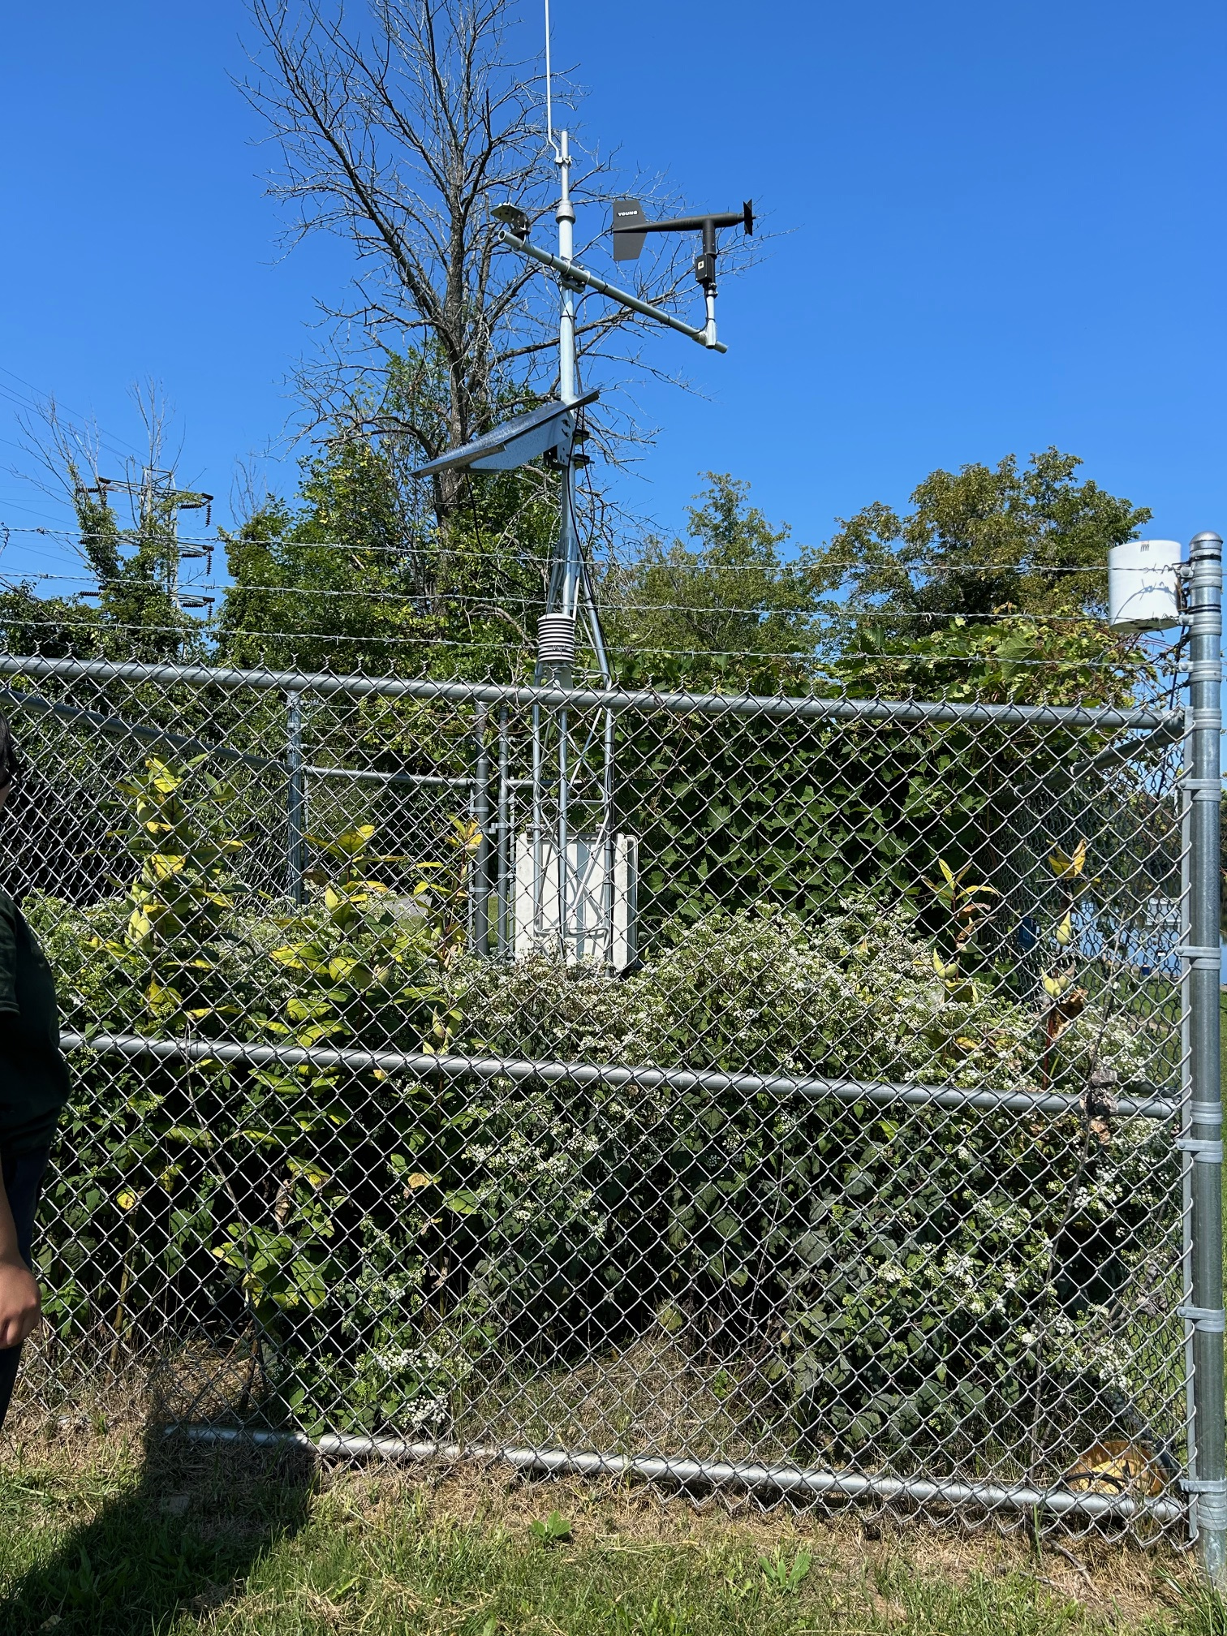
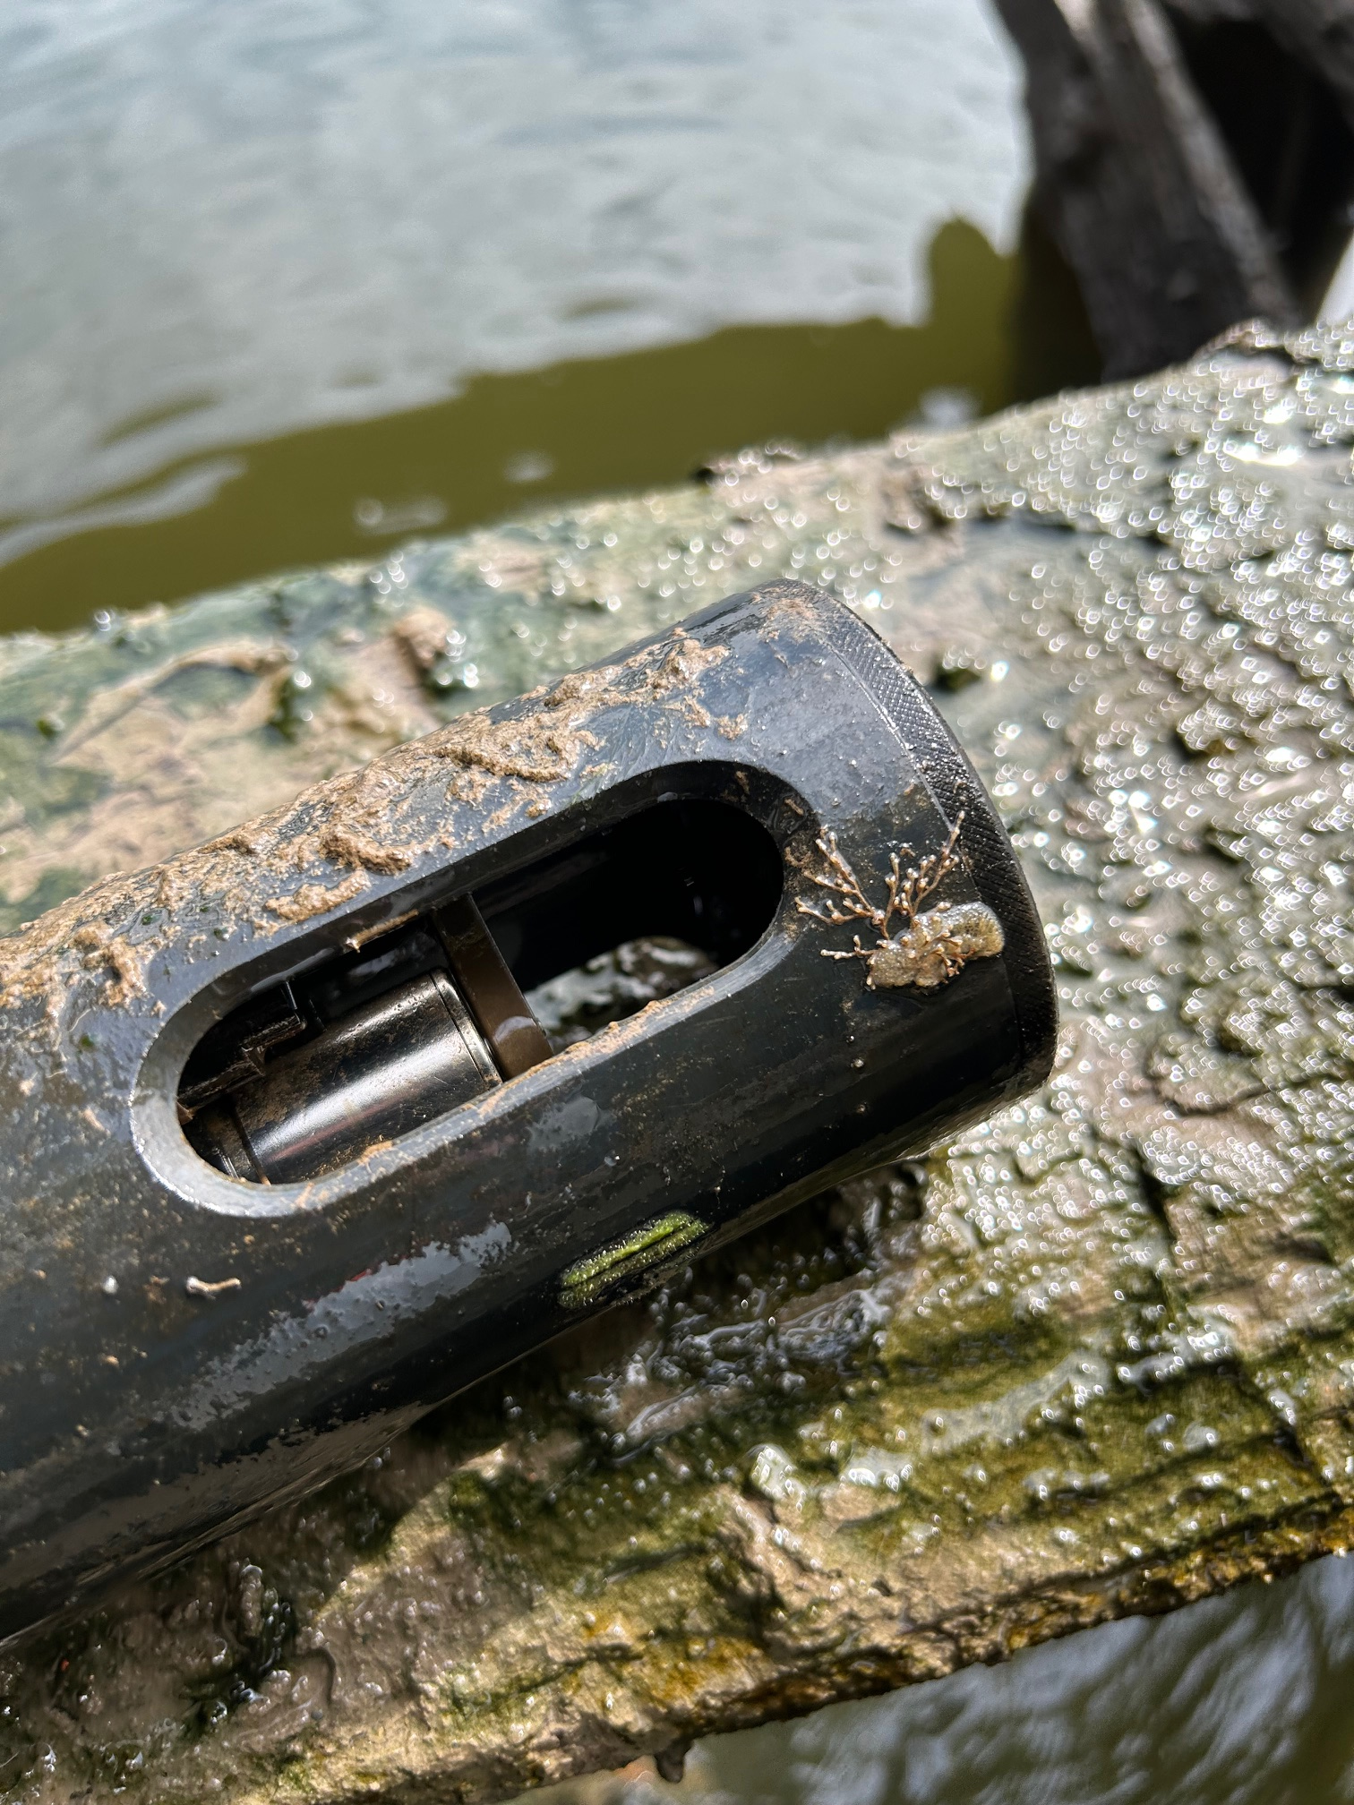
Wildlife conflicts
Plant interference
Aquatic life

Slide 11
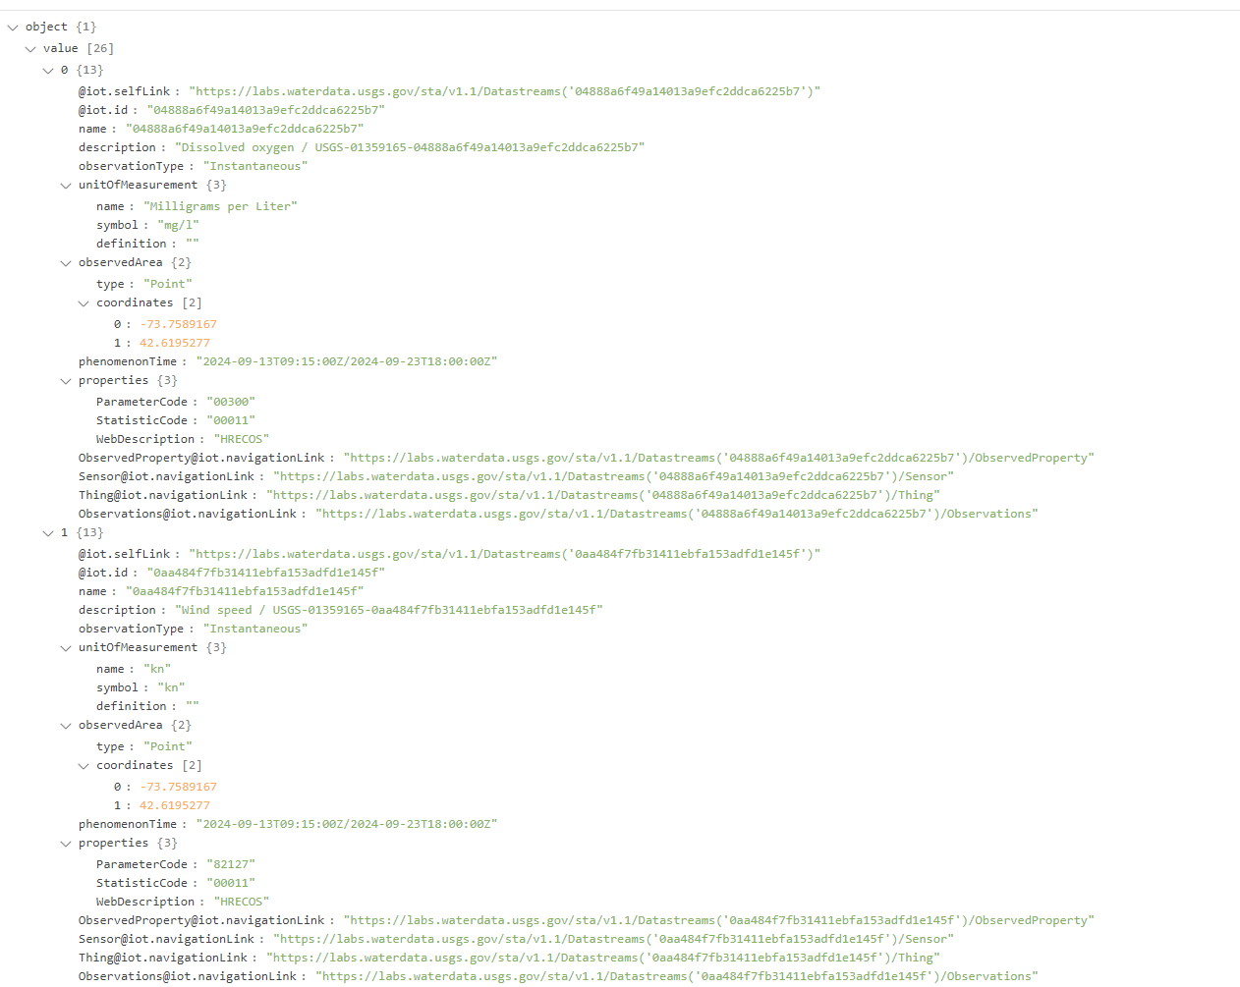
Data ultimately end up on web service or an API
????

Slide 12
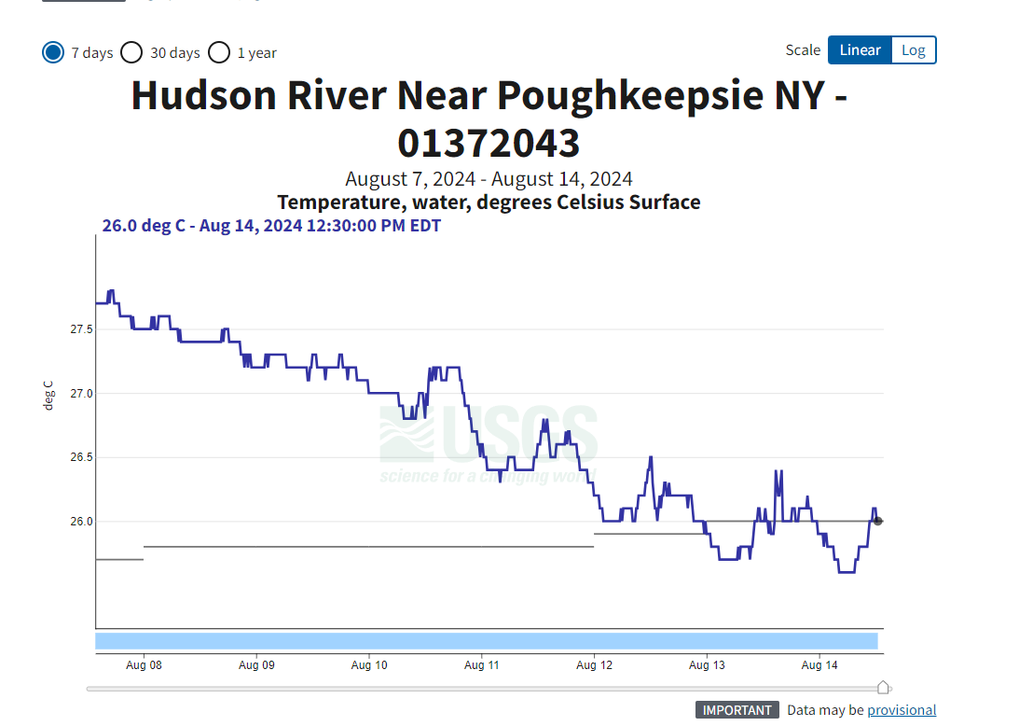
Source: USGS Water Data

Slide 13
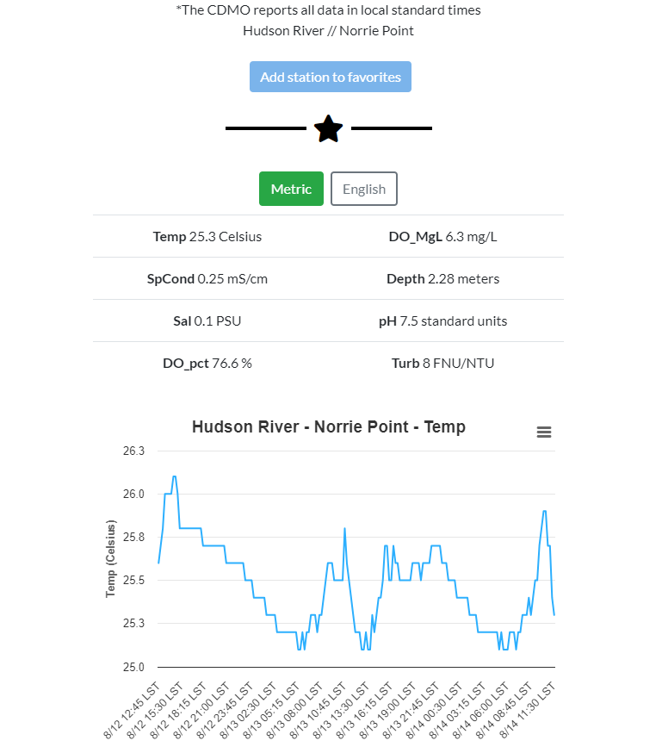
Source: CDMO Real-Time Application

Slide 14
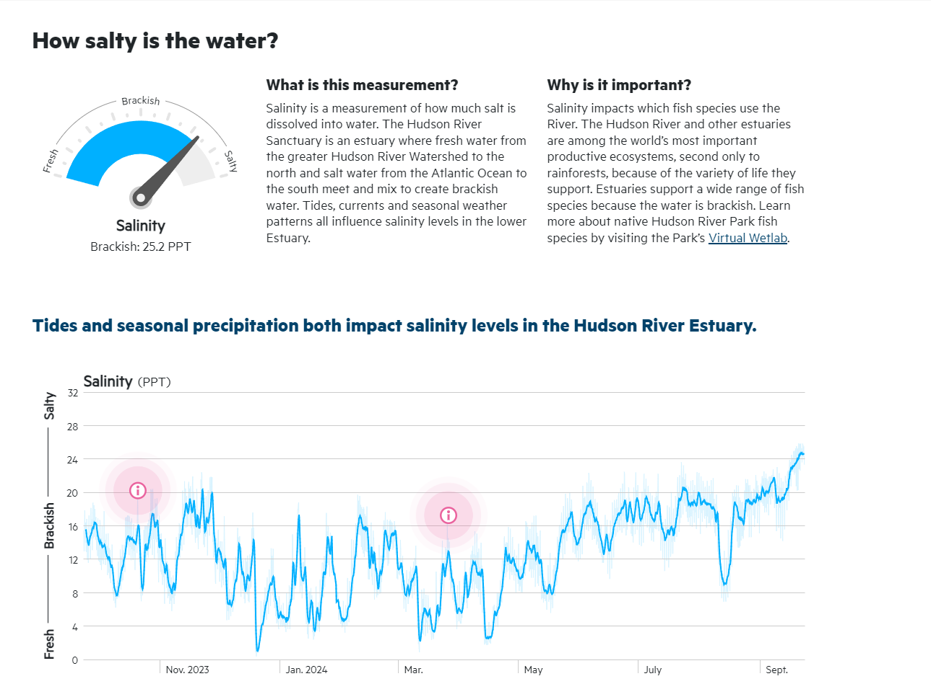
Source: Hudson River Park

Slide 15
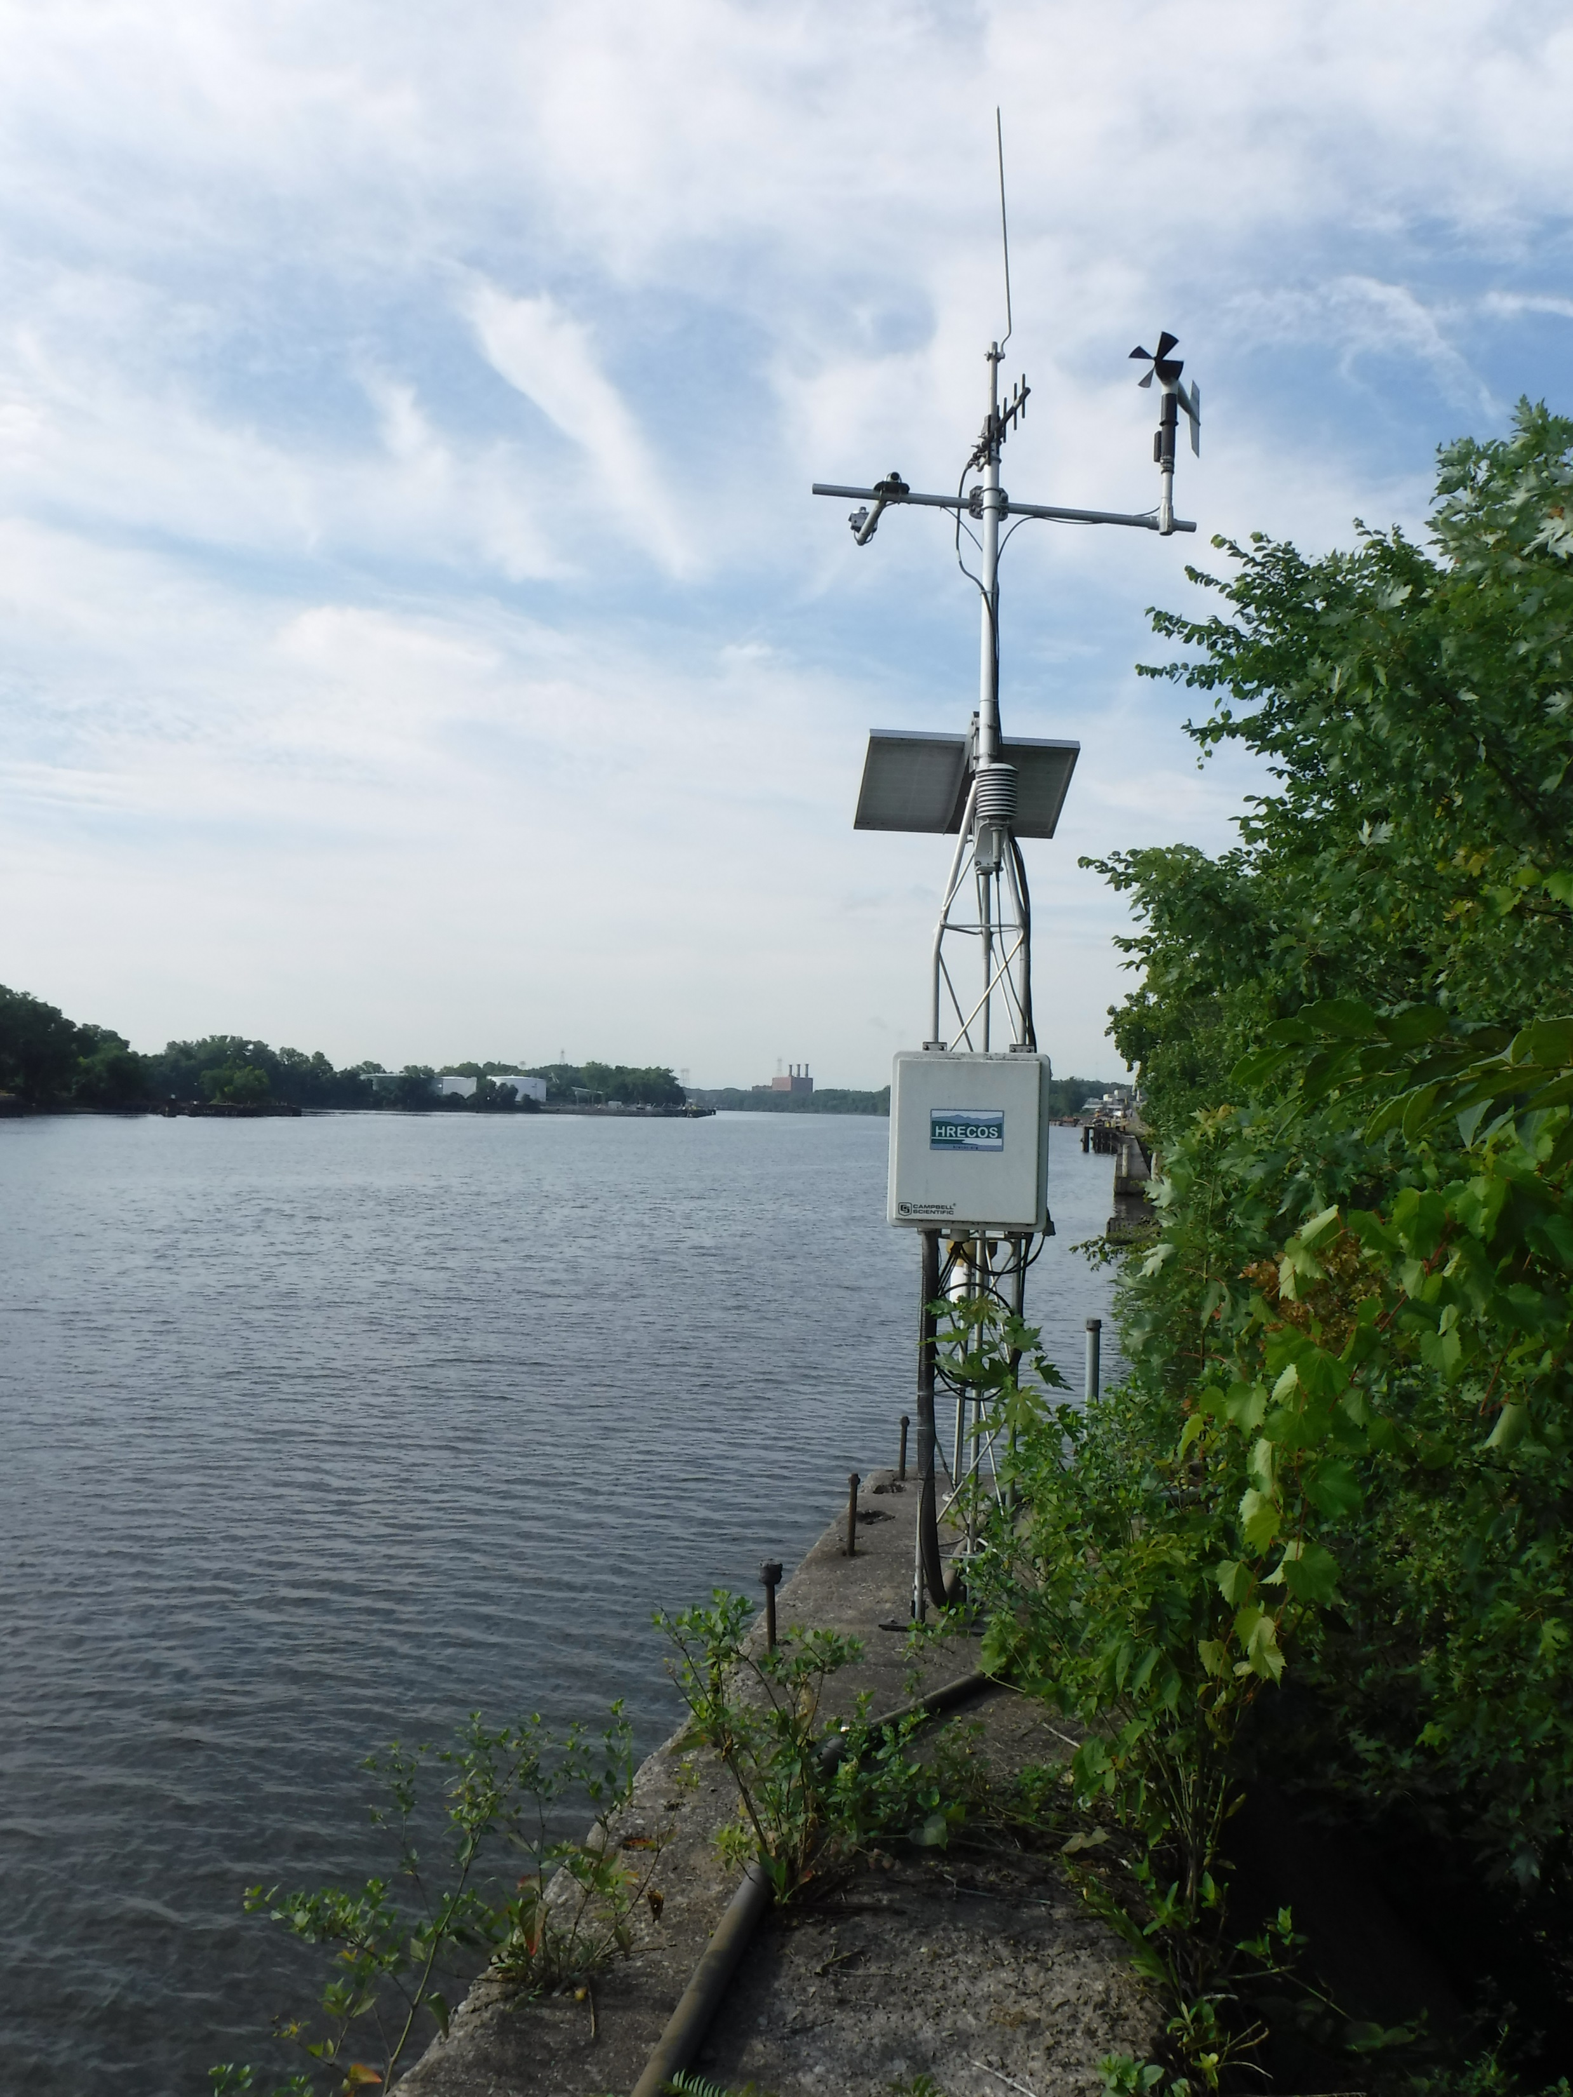
What if I want to download the data?

Slide 16
So Many Choices!
USGS Water Data
USGS Mapping Application
NERRS Centralized Data Management Office
dataRetrieval in R

Slide 18
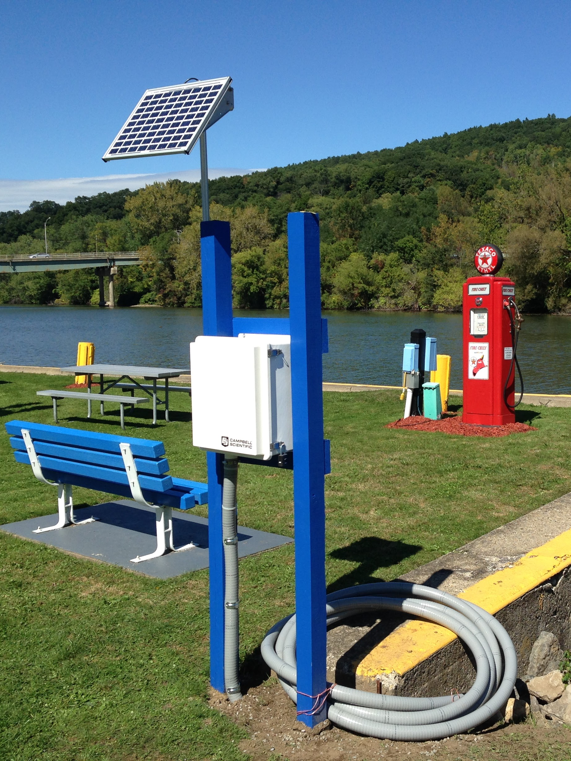
What can we learn?

Slide 19
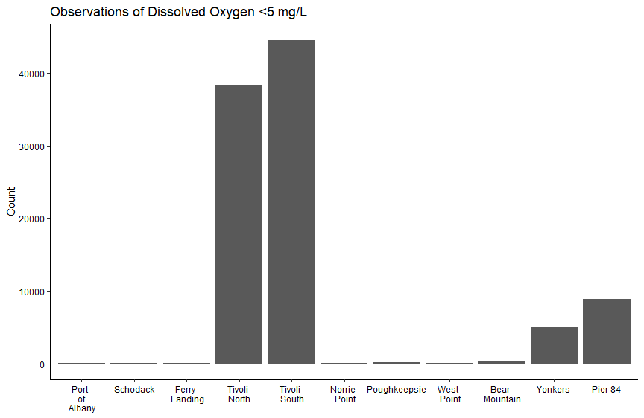

Slide 20
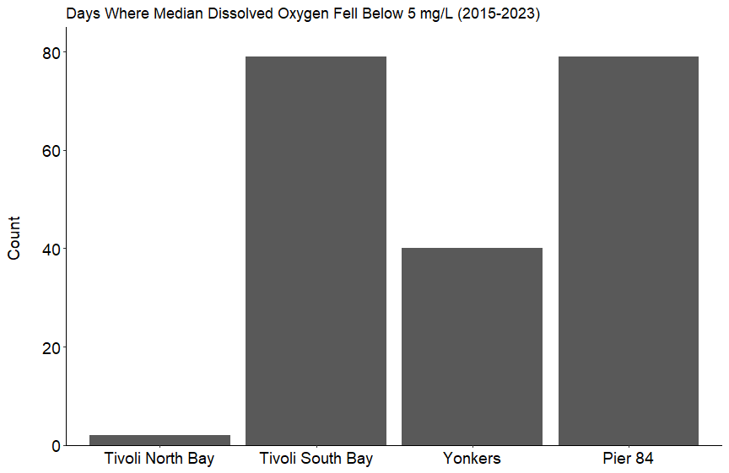
Notes:
11 stations

Slide 21
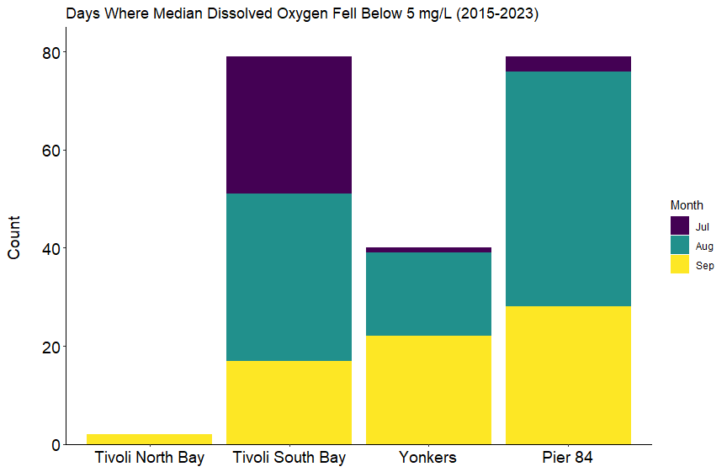

Slide 22
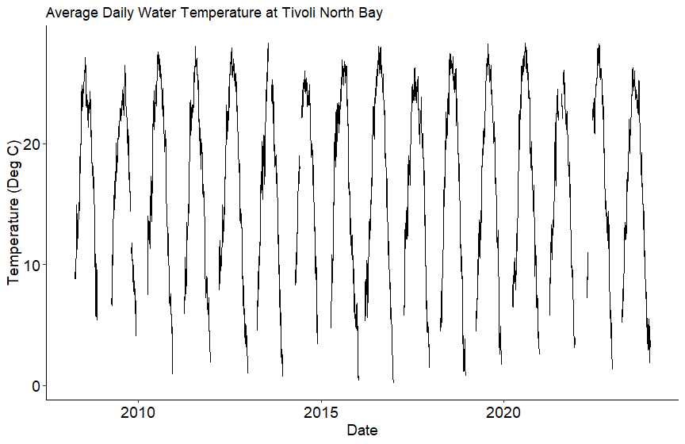

Slide 23
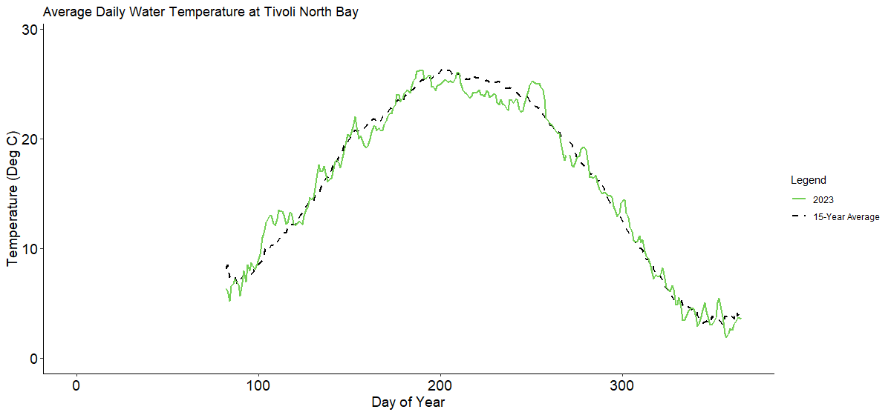

Slide 24
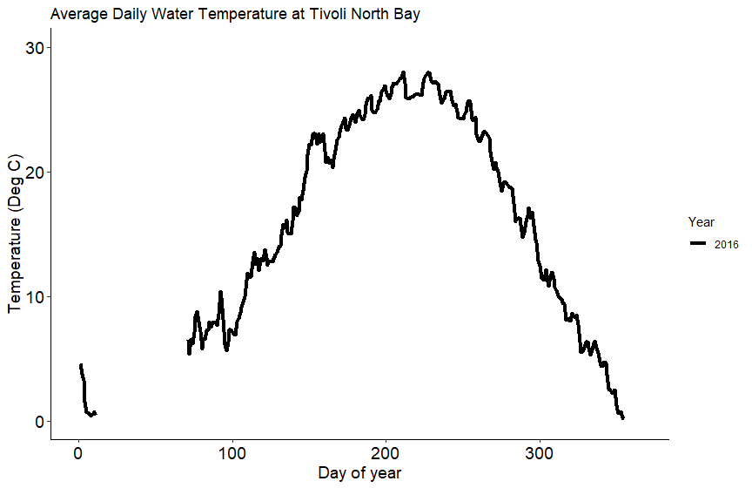

Slide 25
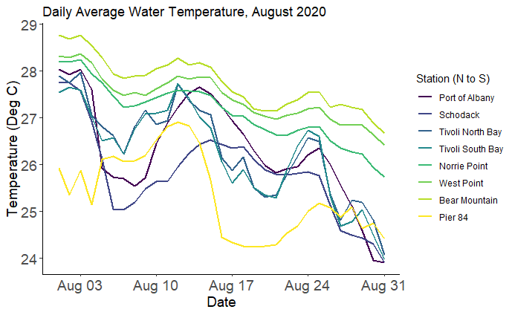

Slide 26
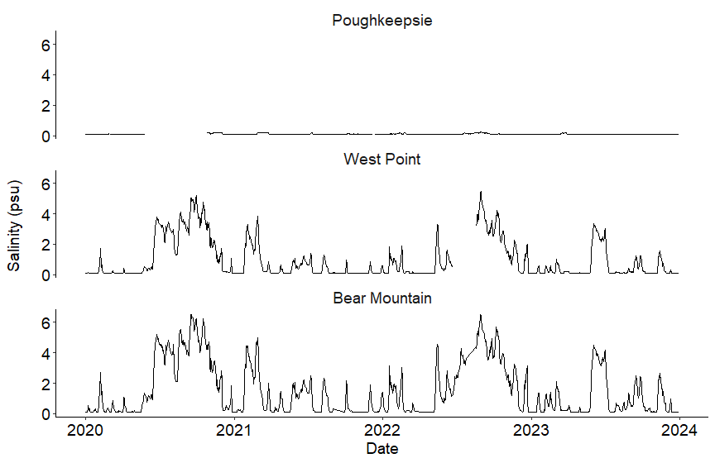

Slide 27
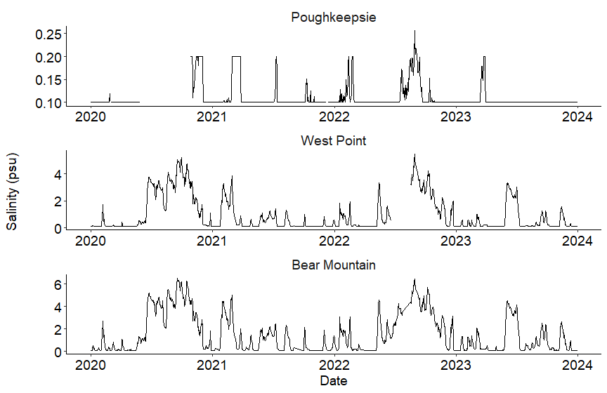

Slide 28
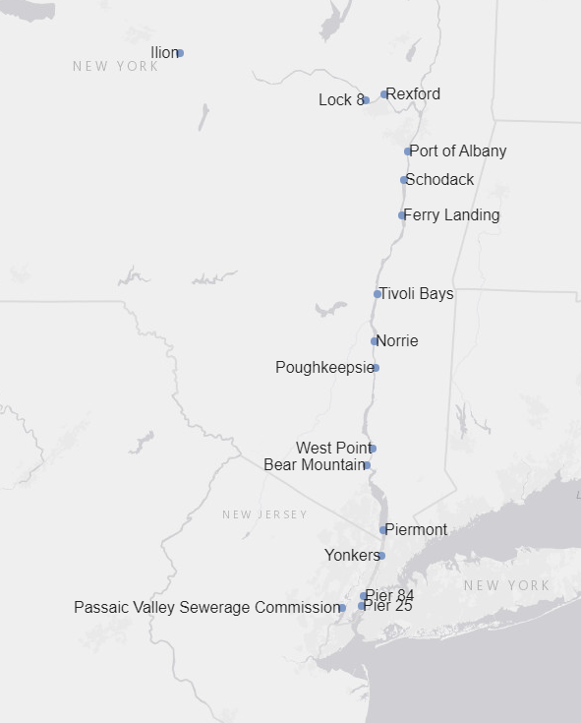
Questions?
Brittney.Flaten@dec.ny.gov
hrecos@dec.ny.gov
hrecos.org

