Slide 1
The Archived Samples and Data
Challenge and Opportunity
Stony Brook HRBMP (Chen Lab): https://you.stonybrook.edu/hrbmp/

Slide 2
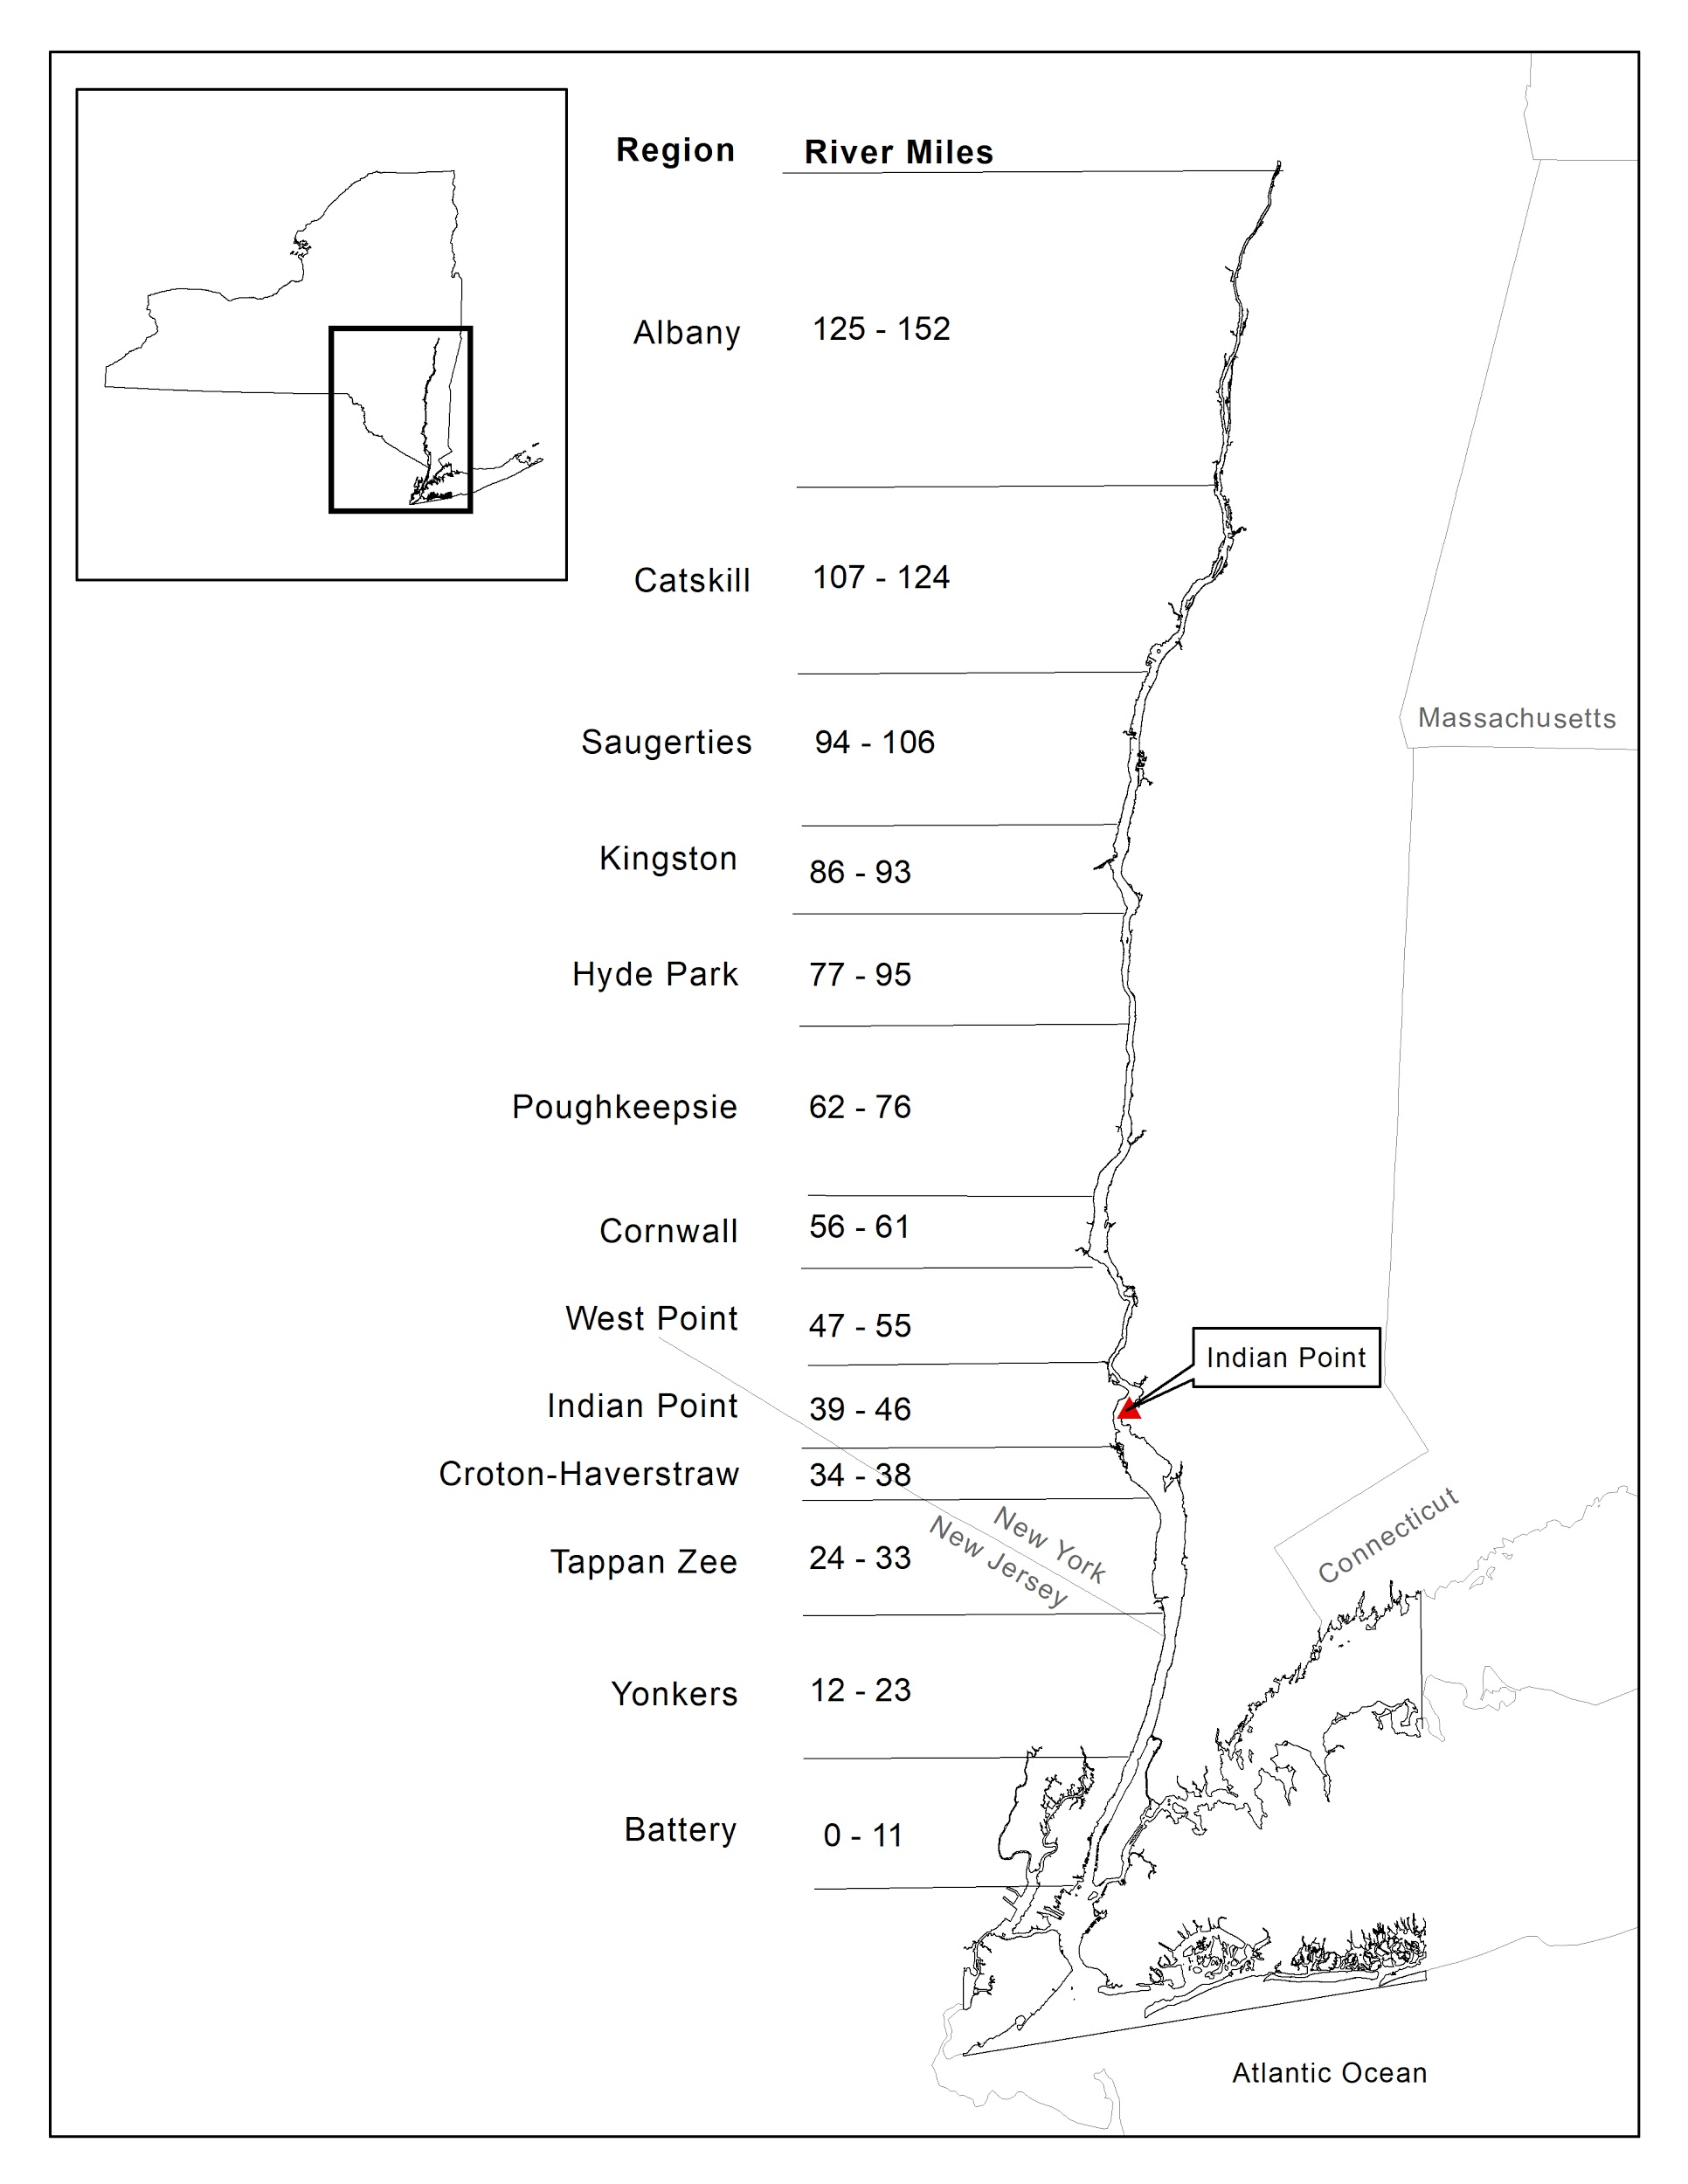
Historical Hudson River Biological
Monitoring Program
Created to address concerns over the potential impacts of river water drawn in by power plants for their cooling systems on fish populations. One of the major plants of concern was Indian Point.
First river wide survey in 1974, and continued the full program until 2017 with the decommissioning announcement of Indian Point Power Plant.

Slide 3
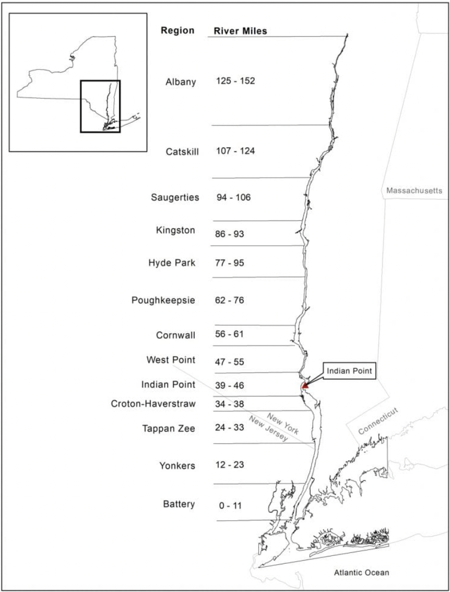
Historic Hudson River Biological Monitoring Program
Long River Survey (LRS) (1974-2017)
Fall Juvenile Survey (FJS) (1974-2020)
Beach Seine Survey (BSS) (1974-2017)
Water Quality Survey (WQS) (1974-2018)
Sturgeon tagging program (1989-2018)
Stock assessment programs
Striped bass (1984-2017)
Atlantic tomcod (1981-2017)
White perch (1971-1988)
Impingement and entrainment programs
These surveys provide data on the abundance, stage structure, and spatiotemporal distributions of finfish species

Slide 4
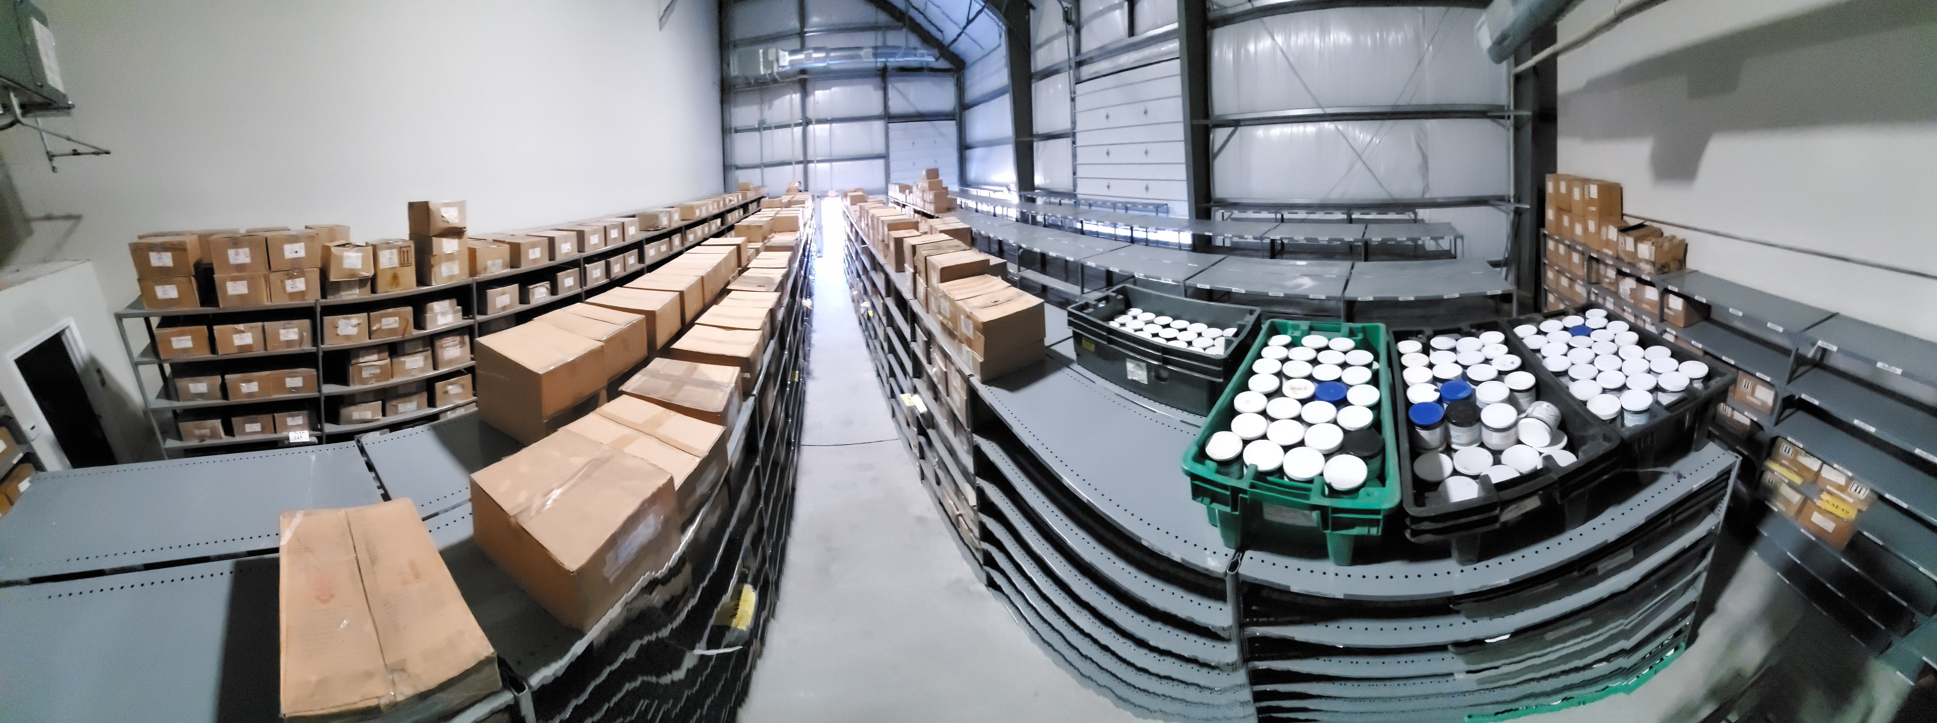
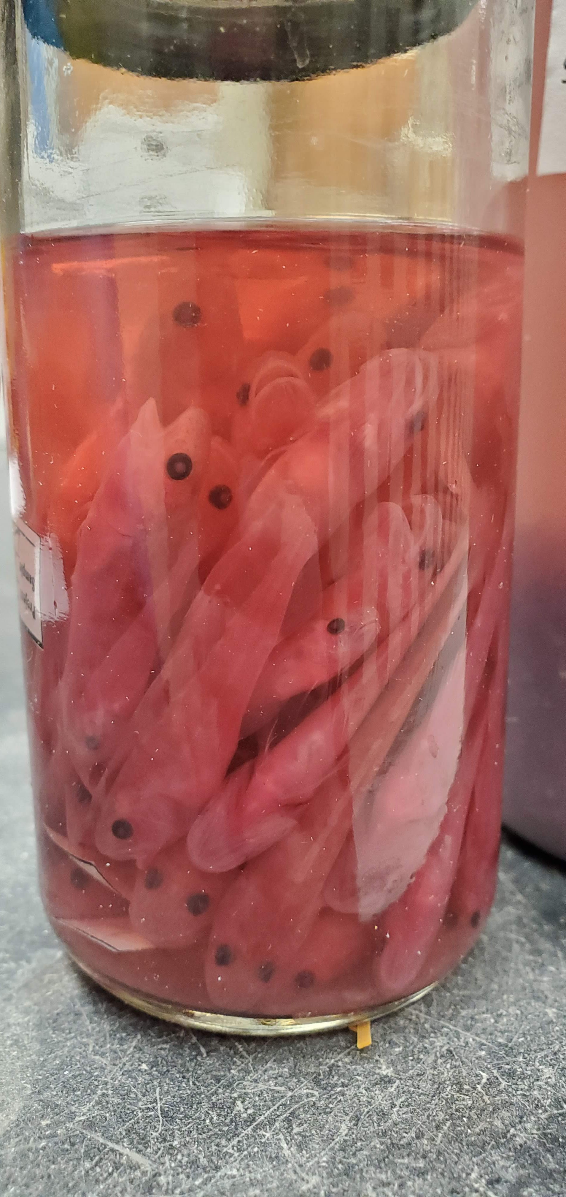
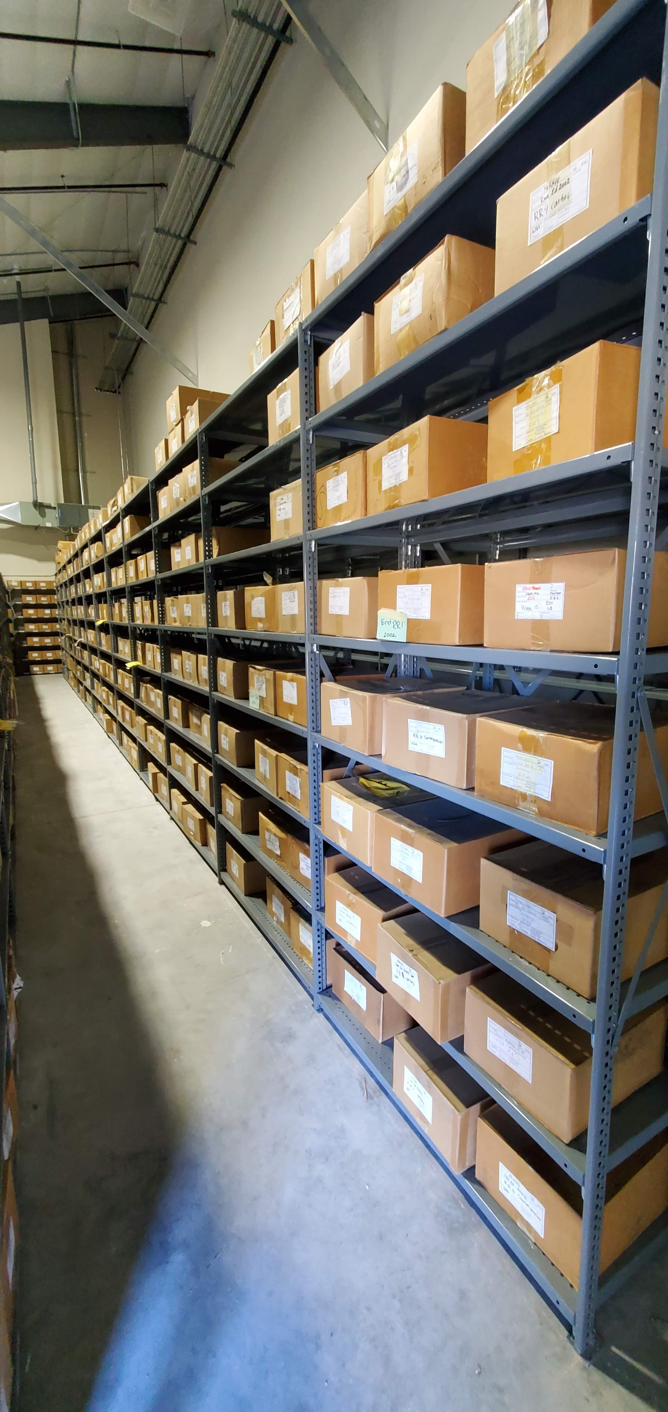
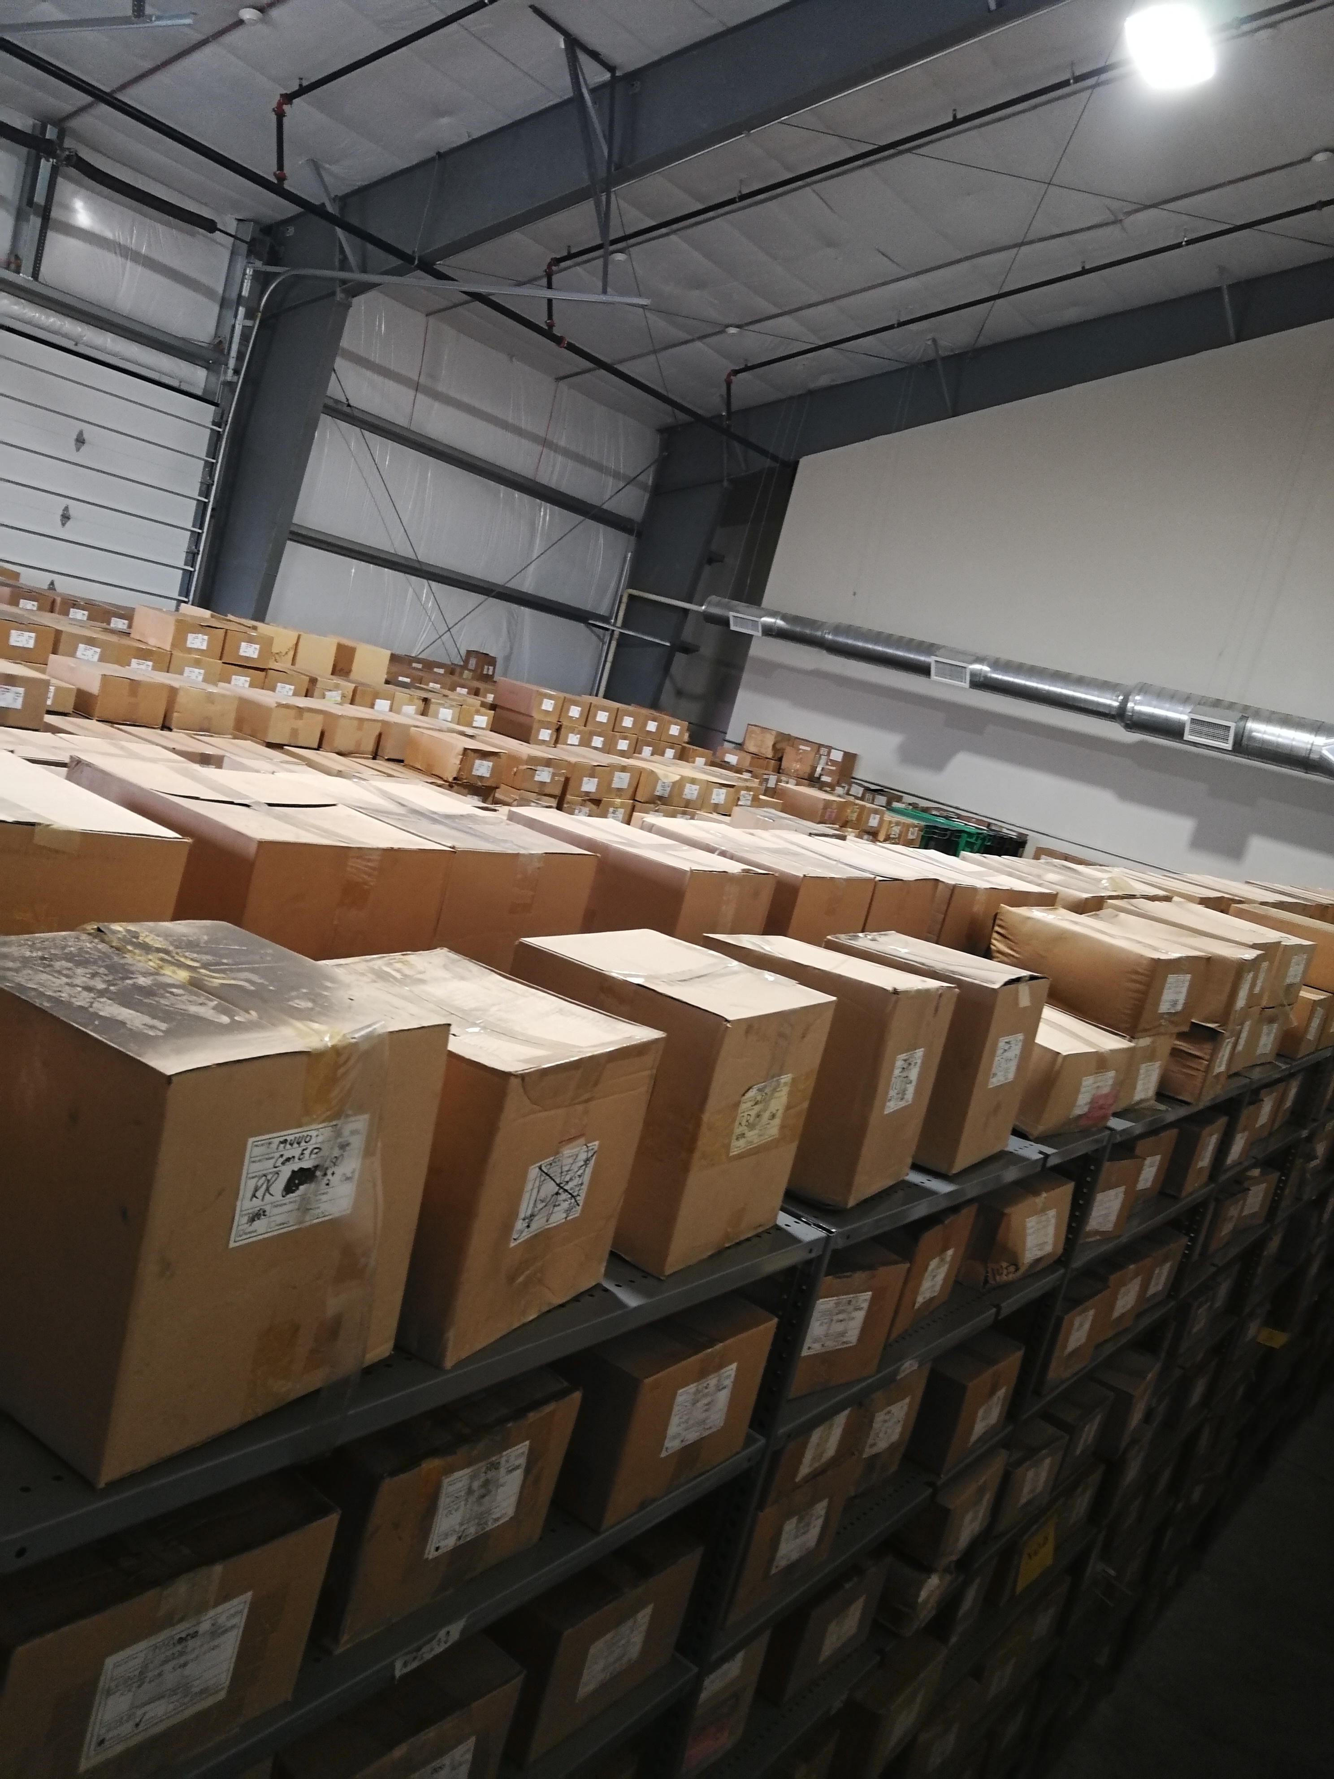
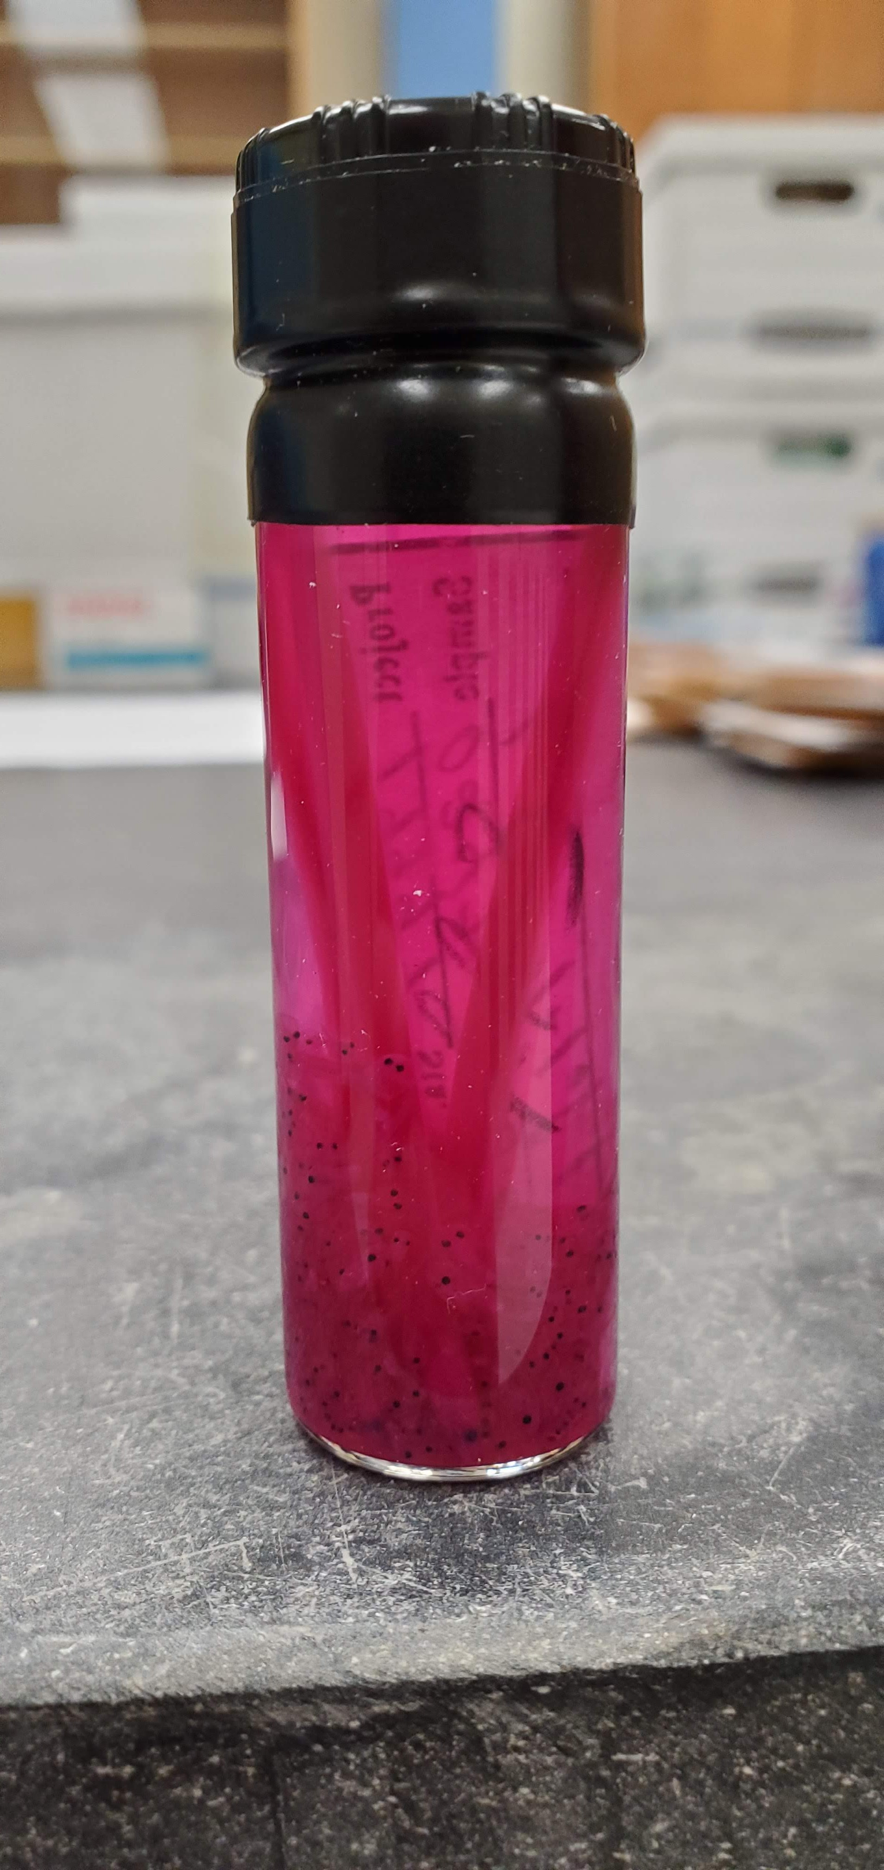
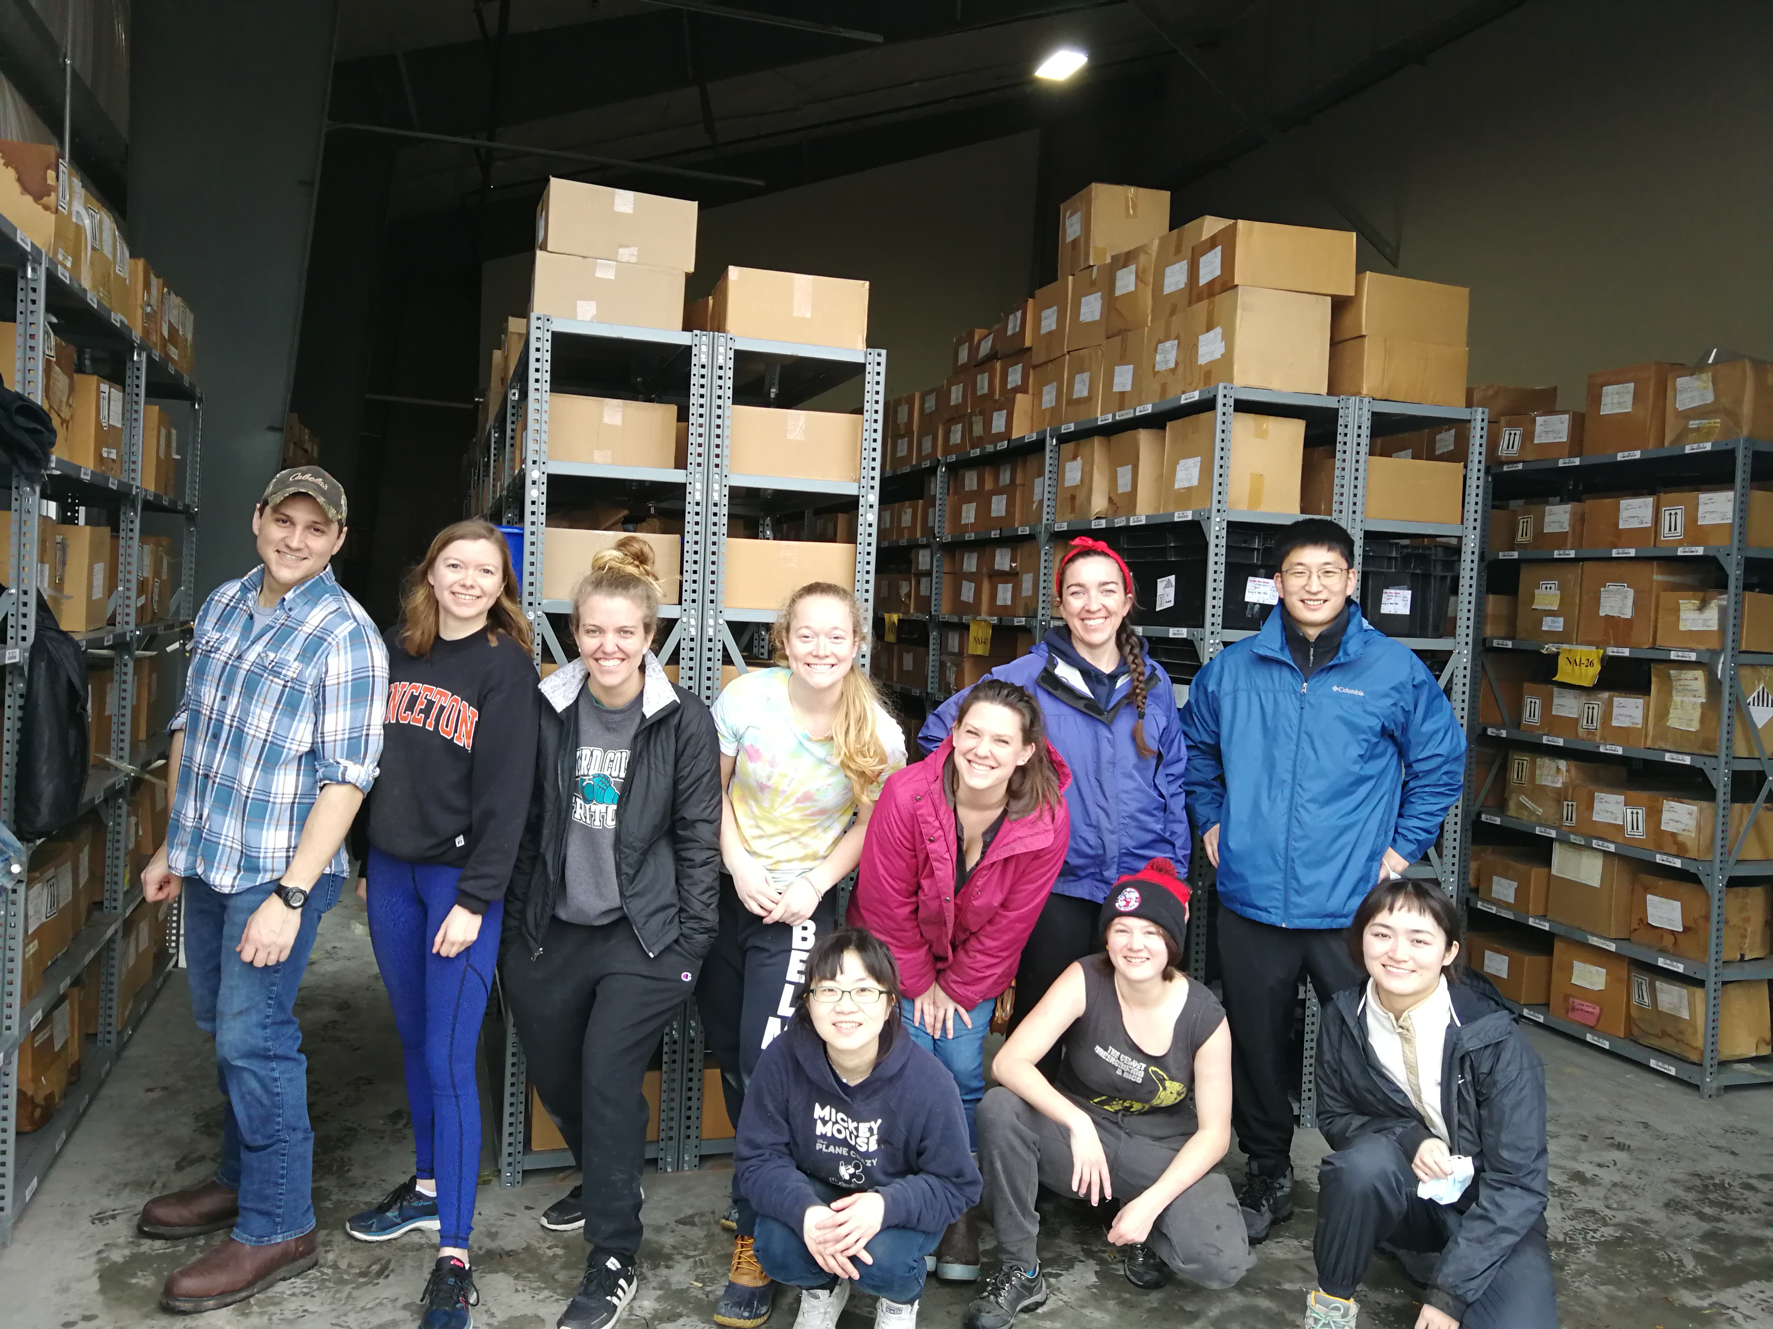
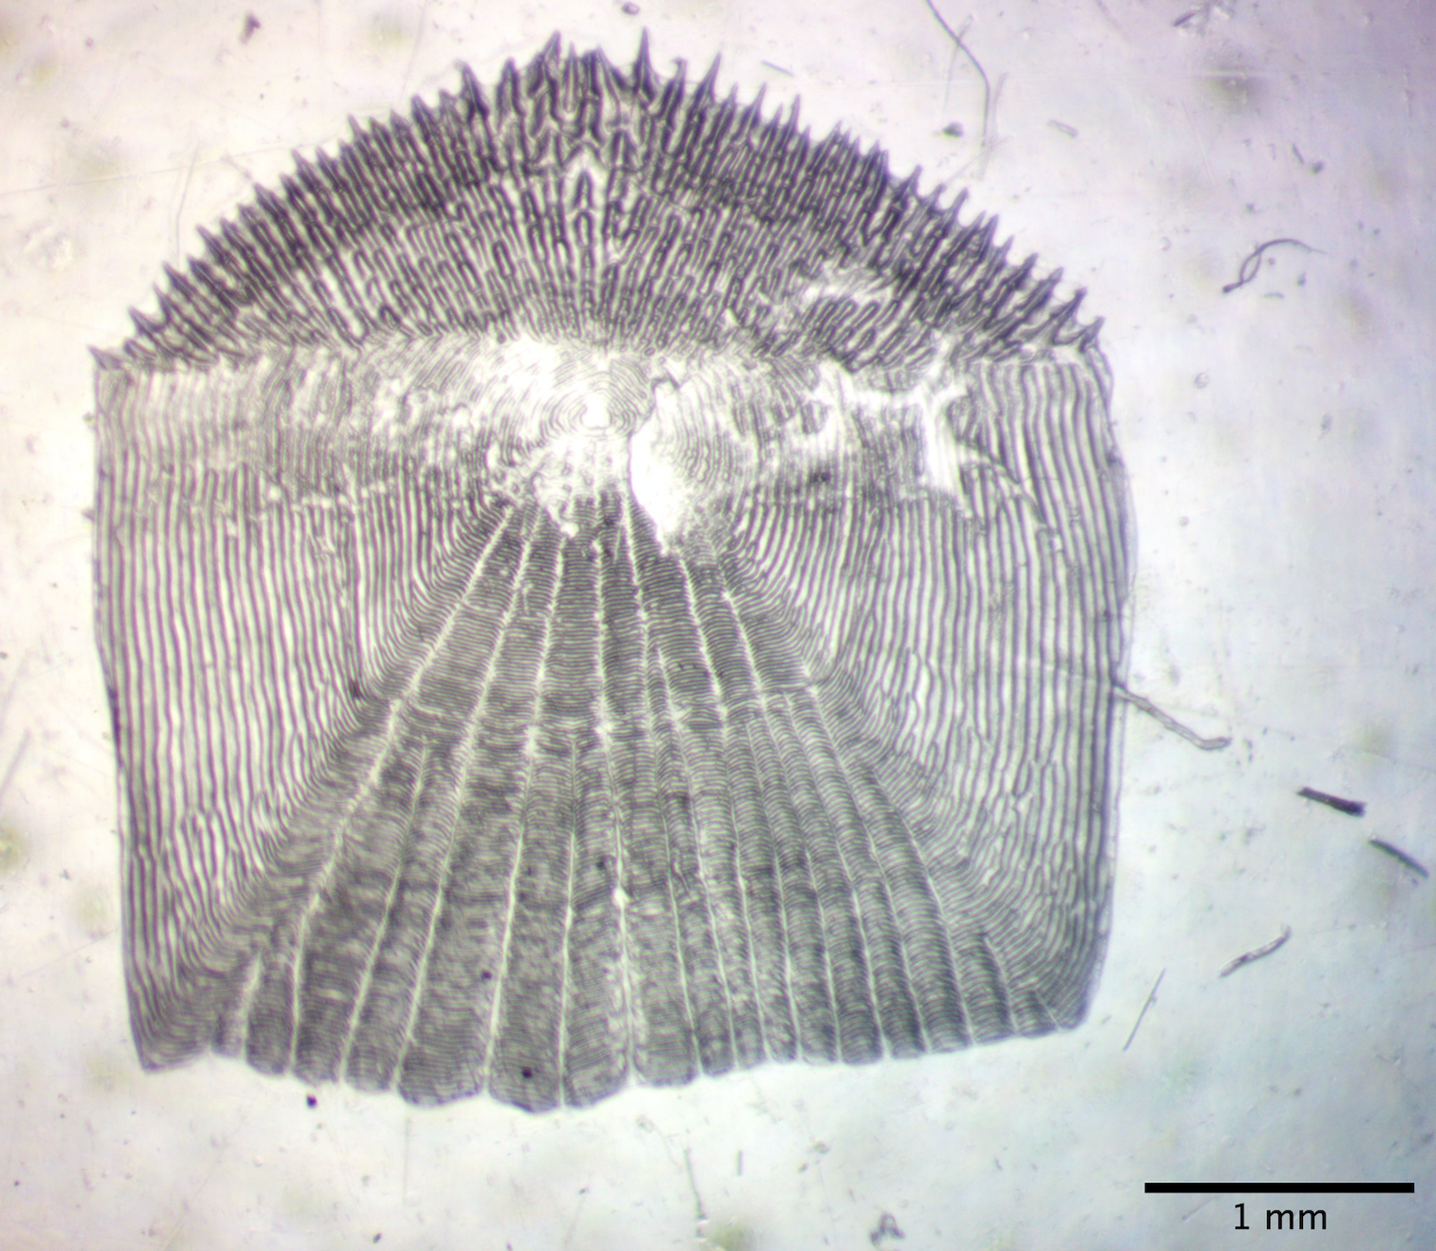
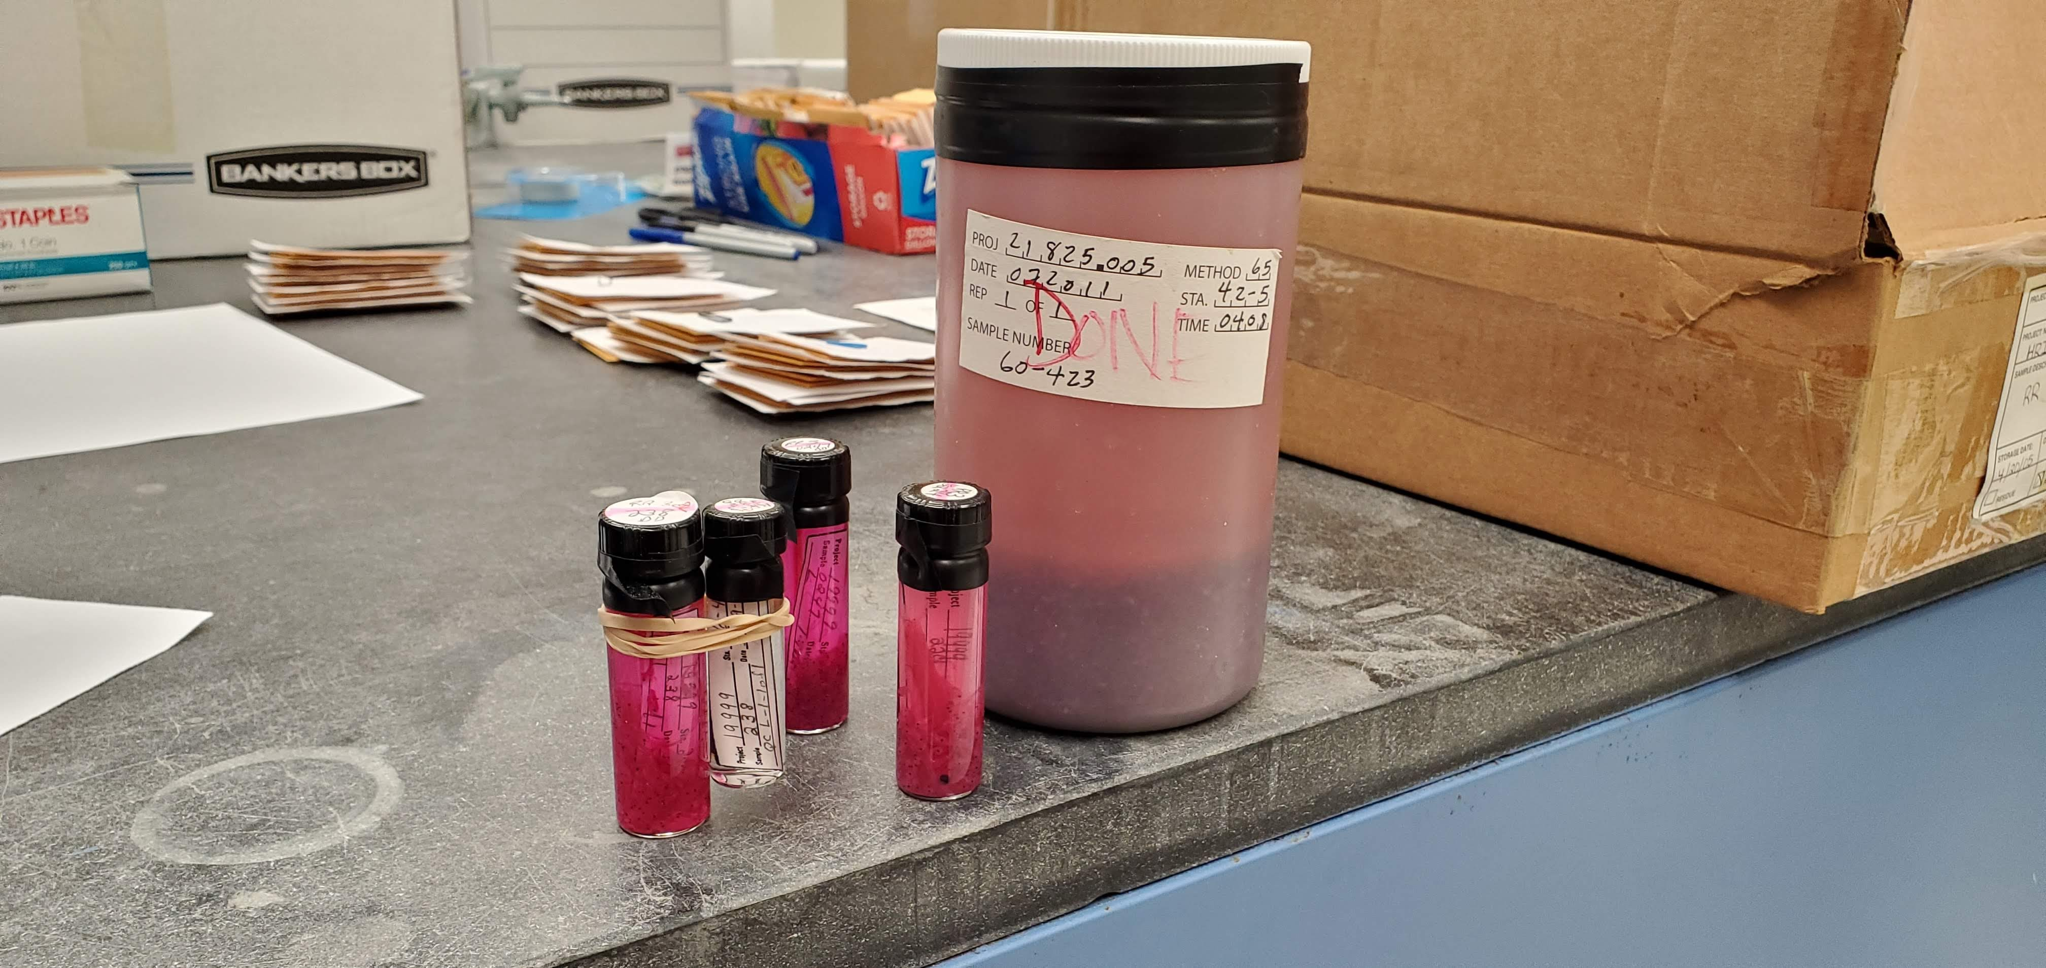
Historical HRBMP
A Gift from Entergy to Stony Brook University
Database:
Data from various monitoring programs
Background info
Reports and docs
Biological samples:
Striped bass scales in SoMAS
Fish samples in warehouse

Slide 5
Historical Biological Samples
Collection Name | Description of Contents | Preservatives
Long River Ichthyoplankton | Contingency samples (unsorted sample material) | 6% Formaldehyde
Long River Ichthyoplankton | Vials: identified specimens (larvae, Morone, eggs, non-split larvae), Vials: Pterygiophore Study (Striped Bass & White Perch separation) | 6% Formaldehyde
Beach Seine | Young of year fish | 6% Formaldehyde
Fall Shoals | Young of year fish | 6% Formaldehyde
Otoliths | Contingency samples (unsorted sample material) | 70% Ethanol
Tomcod Fecundity | Fish gonads & eggs | 6% Formaldehyde
Alden Labs | Ichthyoplankton larvae used in the Flume Study | 6% Formaldehyde
IPEC Barge & Trawl | Sample residue (sorted sample material) | 6% Formaldehyde

Slide 6
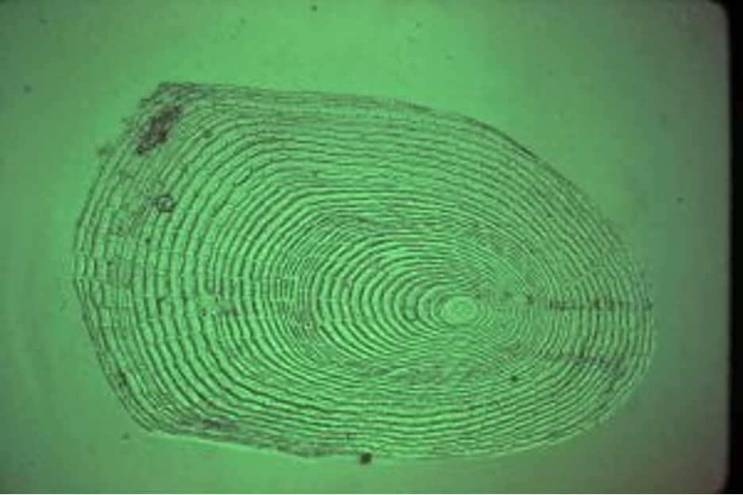
Fish Scales
Scales taken mostly from age-1 and age-2 striped bass as a part of an overwintering study. All scales taken from a 10-mile region along Manhattan.
Years: 1989- 2017
We have scales from about 500,000 sampled fish.

Slide 7
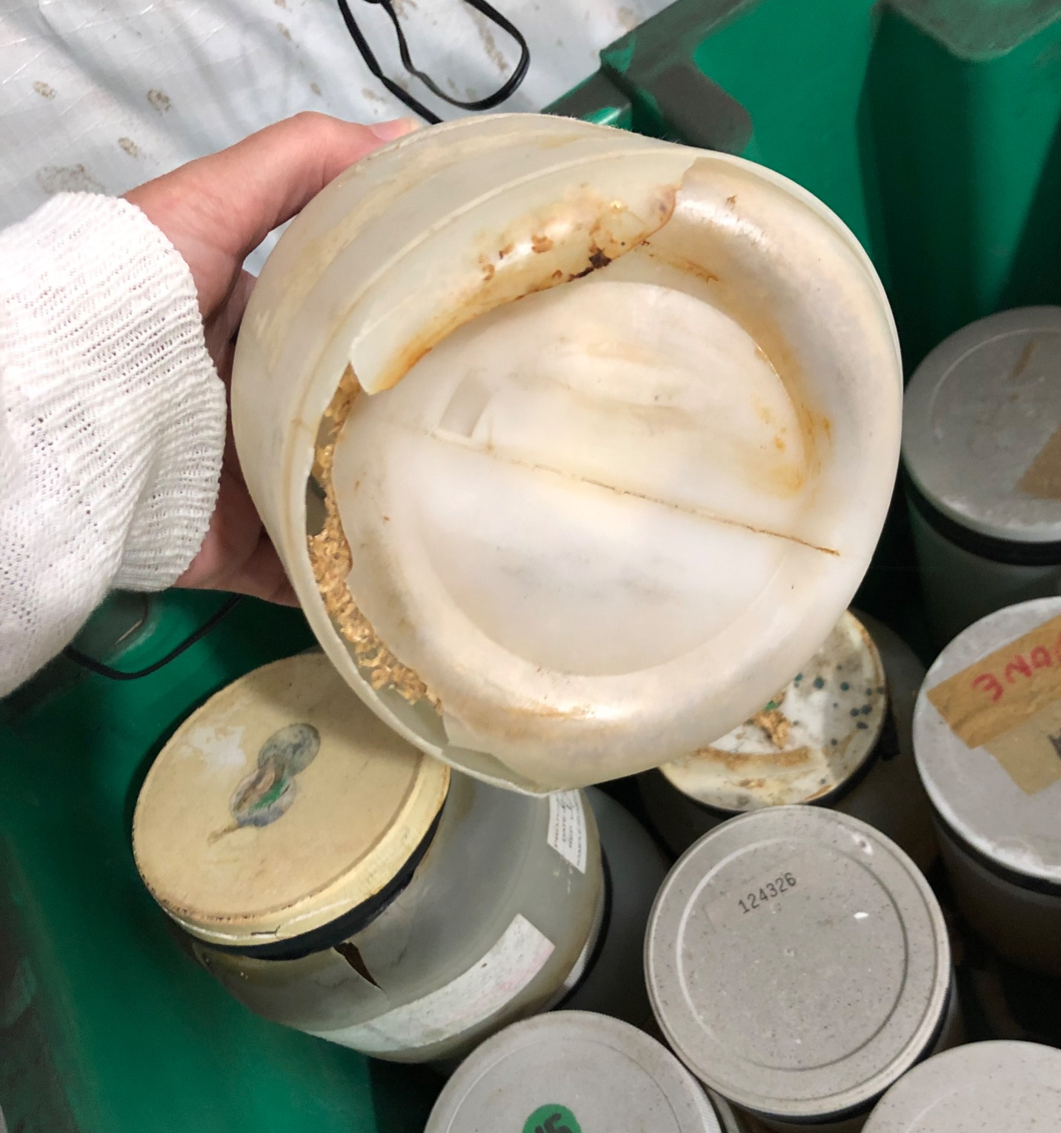
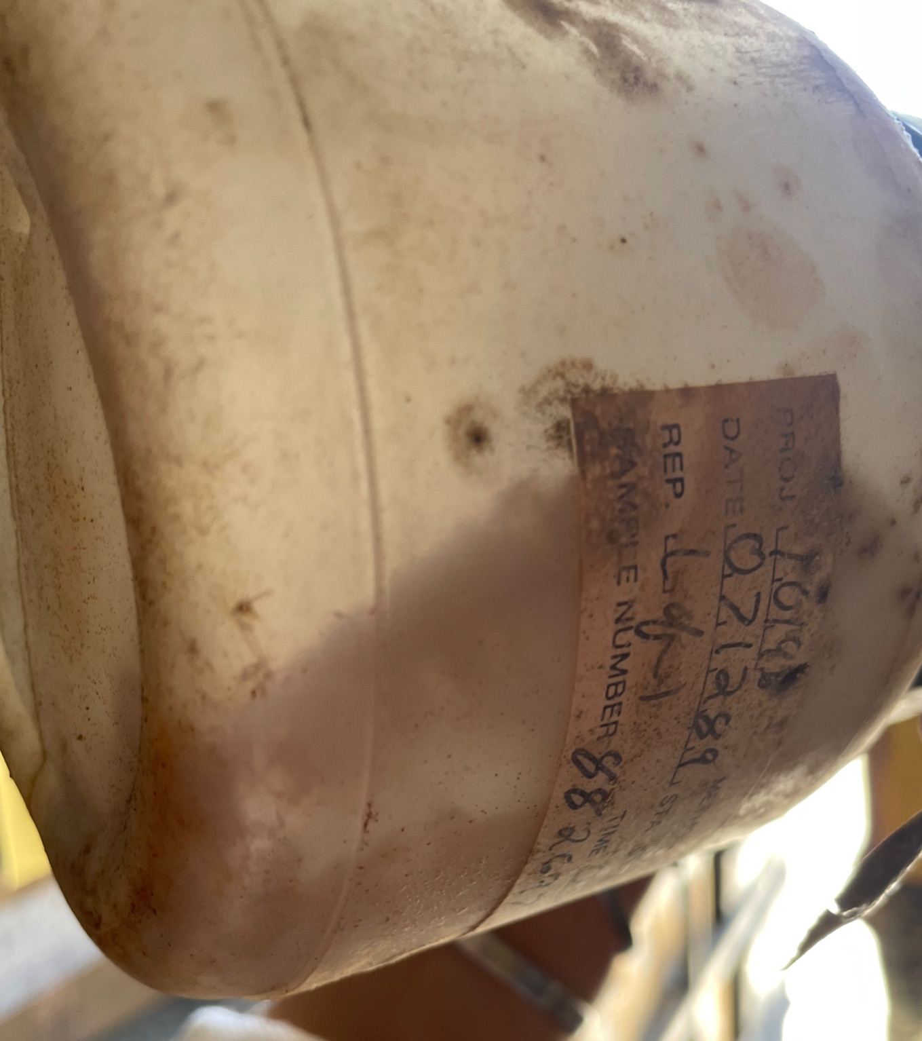
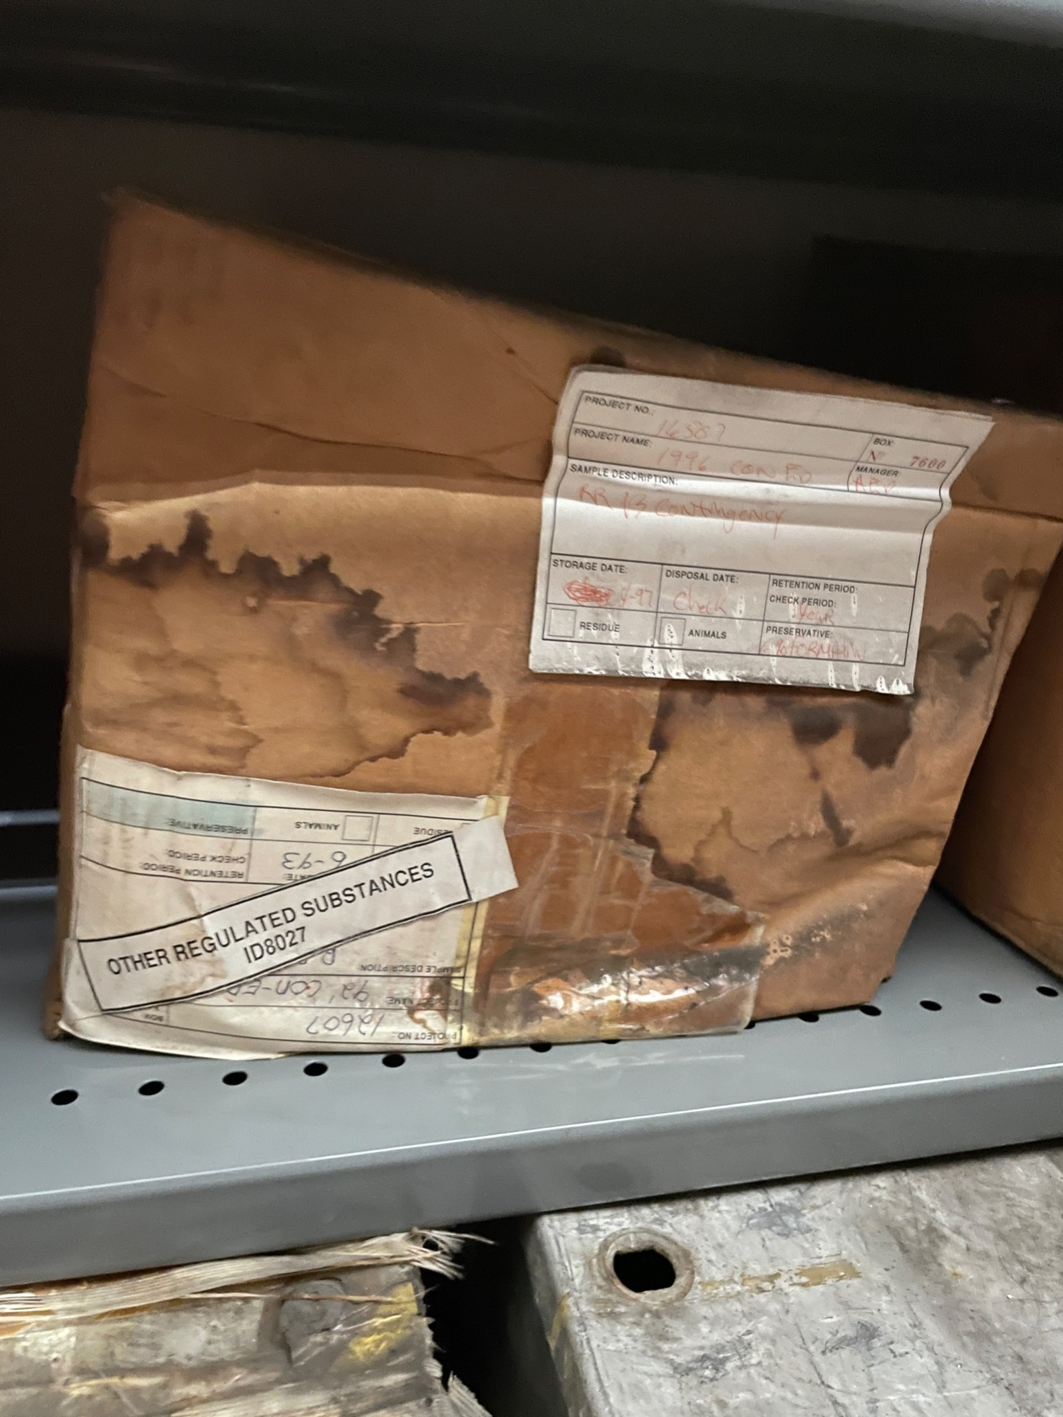
The Good
The Bad
The Ugly

Slide 8
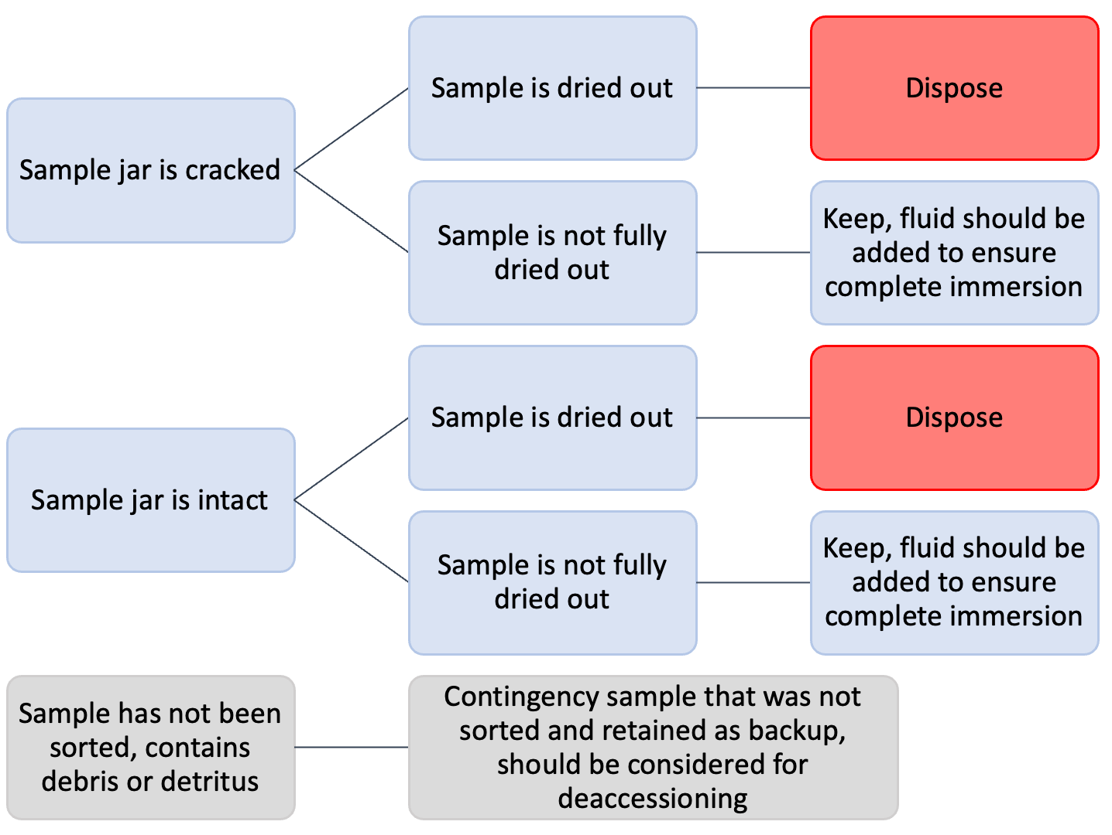
Biological Samples
Developed protocol for handling samples with SBU Health and Safety
Working on data entry of storage sheets for sample boxes
Developed proptocol to keep/discard based on condition
Notes:
Storge sheets have never been digitized, and with out that we do not know what id fish are in which boxes.
Curtains sample advice was based solely on condition,
Curating Samples For HRBMP - This is for designating samples based on quality of the sample to be saved in the collection or disposed of. Any samples that are in poor condition and set aside for disposal need to be documented fully as removed from the collection and why.

Slide 9
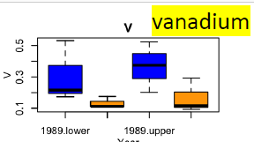
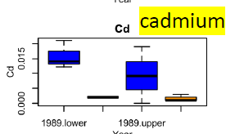
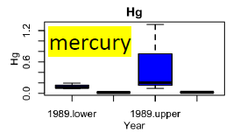
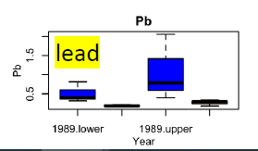
Research Projects Using the Collection
Heavy metal analysis project (Dr. Brian Jackson, Dartmouth Toxic Metals)
Analyze fish scales for heavy metals
Temporal change in growth for striped bass (Poster by Sarah Praisner)
Microchemical analysis of striped bass scales to understand changes in habitats (in collabration with UNM)
Exploring/Improving methods studying microplastic contamination in the Hudson River using a historical biological collection (Dr. Shipley)
2017
2017
2017
2017
2017
2017
2017
2017

Slide 10
Challenges
Large quantity with different qualities - high storage costs, huge workload to screen, and difficult to decide the sample fates
Sample organization and digitalization – Time consuming to organize the samples, lack of funding
Formalin- affecting utility of the samples
Storage safety
Opportunity for 2nd chance, new research ideas/programs, new education program and collaborations

Slide 11
HRBMP Database
40+ years
Million lines of data
Many fish species
Stage specific
Biological data
Complex structure
Changes in sampling protocols
No overall metadata

Slide 12
Needs
Know the data better- Metadata
Make the data temporally and spatially comparable – Calibrate and standardize data to remove inconsistencies
Develop data sharing policy – Minimize misuse of the data and promote collaborative research efforts
Identify scientific and management questions – increase impacts and contribute to science-based HR management
Opportunity: new research ideas/programs, new education program and collaborations

Slide 13
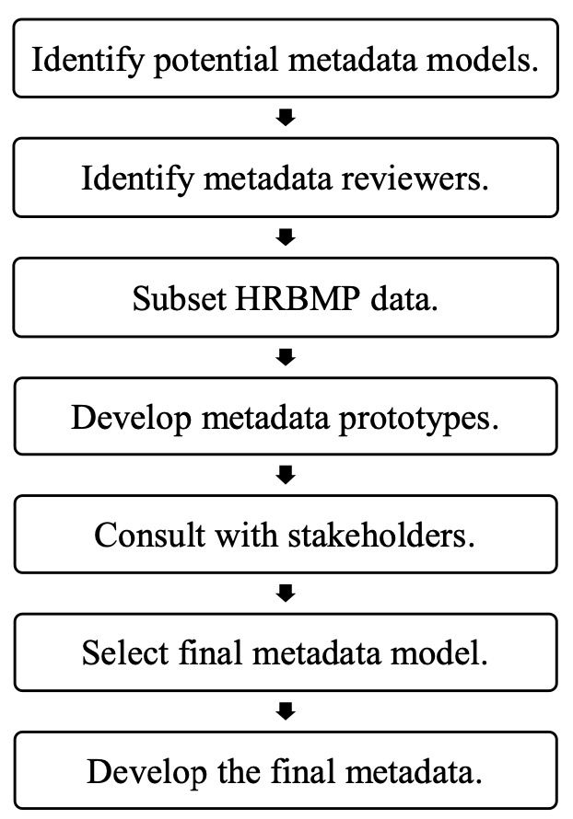
Long River Survey Metadata Development
Identified and reached out to 18 reviewers, got feedback from 10
Academia, state/fed agencies, industry, and nonprofits
Reviewers were provided with:
Metadata model descriptions
Description of the LRS
LRS timeline
Bay anchovy data used to generate metadata prototypes
Five metadata models- FGDC, ISO, NEAMAP, FGDC+NEAMAP, and ISO+NEAMAP

Slide 14
Metadata Development
Selected the metadata model to use moving forward- FGDC+NEAMAP
Incorporated suggestions from reviewers regarding the LRS summary and timeline documents
Developed metadata for the entire LRS dataset
Expanded metadata development to the other surveys
Water Quality Survey (WQS)
Fall Juvenile Survey (FJS)
Beach Seine Survey (BSS)
Finalized the data sharing policy

Slide 15
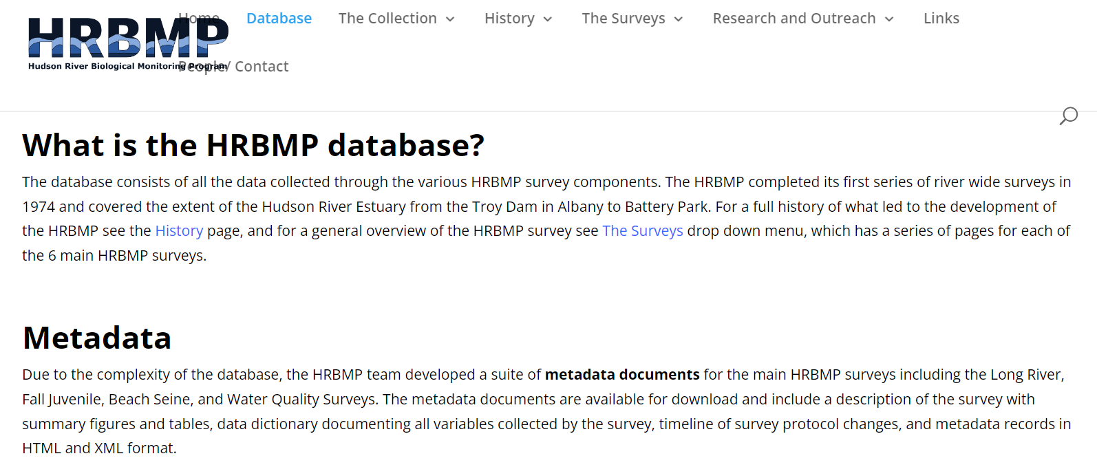
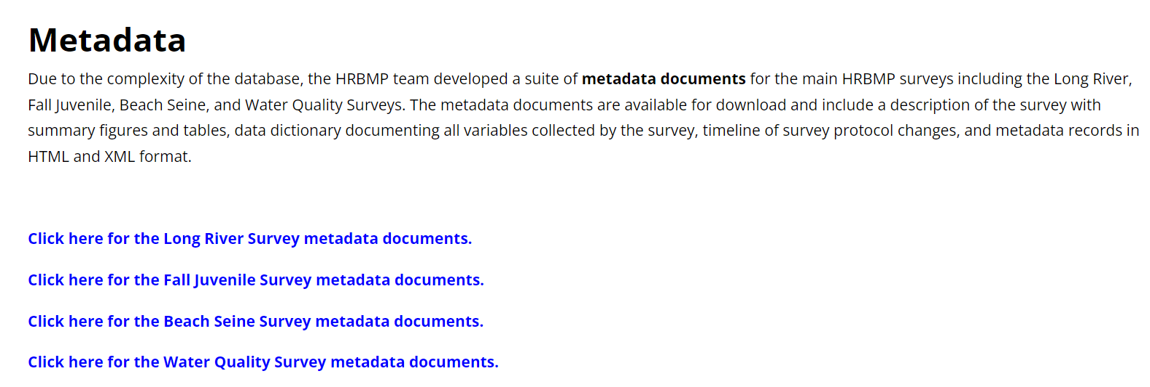
Stony Brook Hudson River Biological Monitoring Program: https://you.stonybrook.edu/hrbmp/
Notes:
Based on data sharing policy of NEAMAP and NOAA
The data sharing policy gives an overview of the survey
Names of SBU staff to be co-authors will be included with the document for how data are used

Slide 16
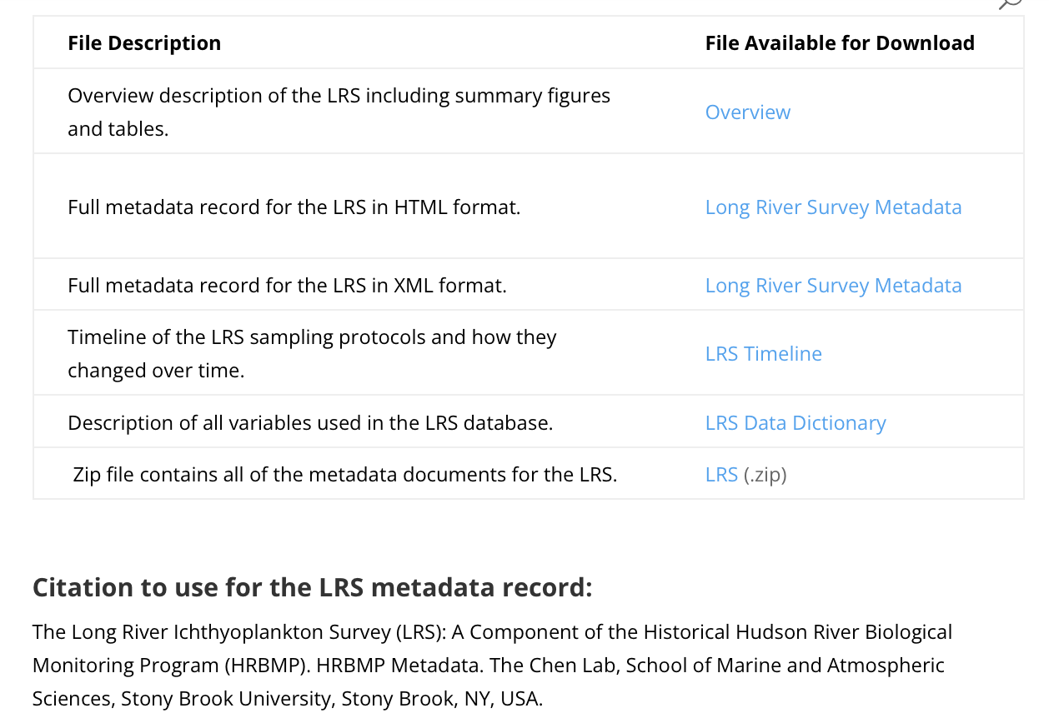

Slide 17
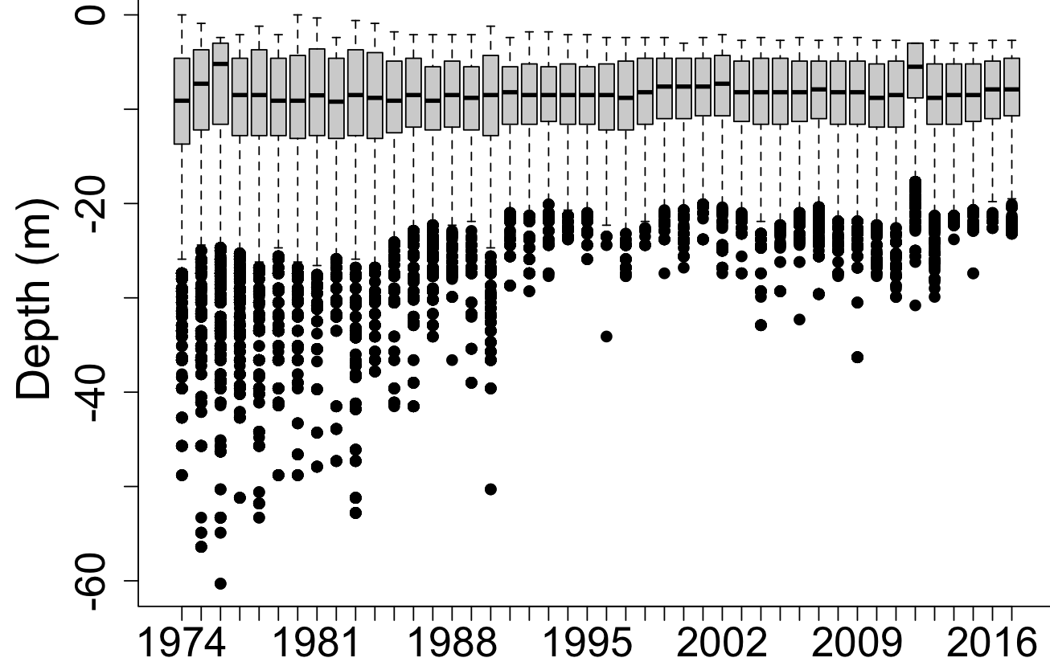
Long River Survey Data Calibration
Background: LRS protocol has been changing over time
Target species, sampling depth, sampling time, day of year, river KM, gear
Risks: gaps and biases in catch (fish abundance estimate) over space and time
Objectives:
Understand the effects of survey changes to data quality (bias)
Calibrate the available LRS data to reflect the sampling effects
Hindcasting the missing data
Figures credit to H. Chang

Slide 18
1. Target Species
1974 | striped bass
1975-1981 | striped bass | white perch | Atlantic tomcod
1982-1989 | striped bass | white perch | Atlantic tomcod | American shad | bay anchovy | weakfish | white catfish | spottail shiner | Atlantic sturgeon | shortnose sturgeon | alewife | blueback herring
1990-1991 | striped bass | white perch | Atlantic tomcod | American shad | bay anchovy | weakfish | white catfish | spottail shiner | Atlantic sturgeon | shortnose sturgeon | alewife | blueback herring | rainbow smelt
1992-1996 | striped bass | white perch | Atlantic tomcod | American shad | bay anchovy | weakfish | white catfish | spottail shiner | Atlantic sturgeon | shortnose sturgeon | alewife | blueback herring | rainbow smelt | gizzard shad | hogchoker
1997-2017 | striped bass | white perch | Atlantic tomcod | American shad | bay anchovy | weakfish | white catfish | spottail shiner | Atlantic sturgeon | shortnose sturgeon | alewife | blueback herring | rainbow smelt | gizzard shad | hogchoker | bluefish

Slide 19
2. Temporal Coverage
Variation in annual start and end dates
Variation in length of sampling season

Slide 20
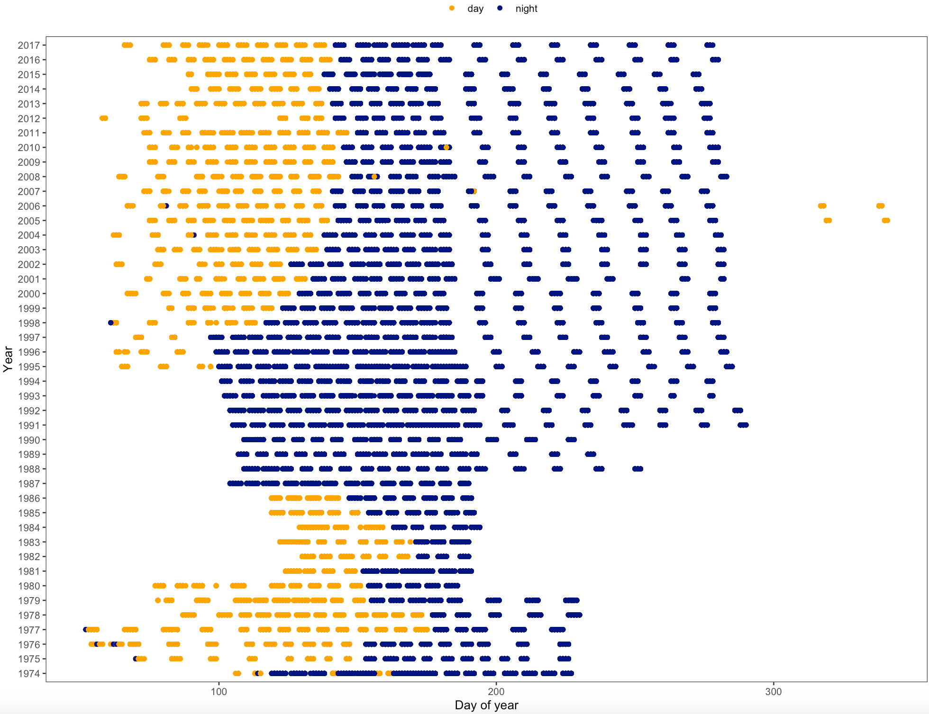
Diel Differences
Day
Night
No daytime sampling
Notes:
The LRS changed from daytime sampling to nighttime sampling 3 weeks after the occurrence of striped bass eggs to reduce gear avoidance by post-yolk-sac-larva (PYSL)

Slide 21
3. Sampling Spatial Coverage
Inconsistent sampling effort of river regions
Notes:
Add figure showing changes in sampling depth
Inconsistent sampling effort of river regions
Decreased in sampling depth and inconsistent sampling depth effort

Slide 22
3. Sampling Spatial Coverage
Inconsistent sampling effort of river regions
Inconsistent sampling effort of sampling depth
Decreasing trend in sampling depth annually
Notes:
Add figure showing changes in sampling depth
Inconsistent sampling effort of river regions
Decreased in sampling depth and inconsistent sampling depth effort

Slide 23
Rationale
Remove variability not directly attributable to fish abundance
Abundance can be associated with many factors
Data need to be calibrated so that estimates are comparable over time and space
Changes in sampling protocols
The sampling effects should be carefully examined
Evaluate data quality and identify impacts on the interpretation of LRS data

Slide 24
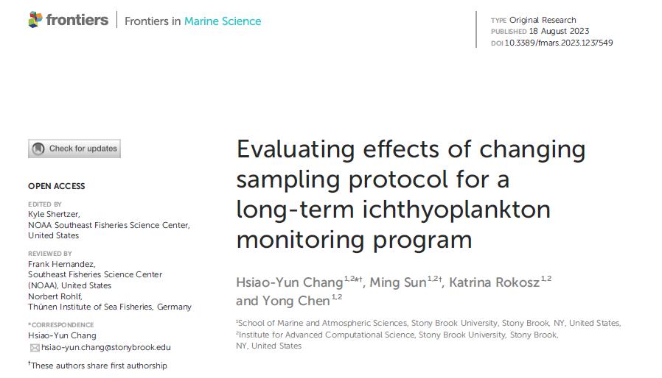
Long River Survey Data Calibration
Developed statistical models for representative species and life stages to build a duplicable workflow for calibration
Products:
Calibrated datasets for representative species and life stages
A duplicable workflow to calibrate all species/life-stages in the LRS dataset
An evaluation of effects of sampling changes to data quality by comparing “calibrated” and “original” datasets, for future survey design reference
Development of unbiased “model-based” abundance indices for representative species

Slide 25
THE CHALLENGE 3: LACK OF INTEGRATED PRODUCTS AND SERVICES
Address Challenges in Monitoring and Managing a Changing Hudson River Ecosystem
Why did it change?
RESEARCH
What has changed?
OBSERVATIONS
How will it change?
PROJECTIONS
Climate and human
Climate and human
Hudson River ecosystem
Climate and human
Hudson River ecosystem
Biological resources
Hudson River ecosystem
Biological resources
Social & economic
Biological resources
Social & economic
Social & economic
Why change?
What changed?
Decision Makers
Future change?
SPATIAL SCALES: River to regional
What action to take?
Time scales: Seasonal, annual to decadal
Fisheries & environmental monitoring & management
Protected species & area management
Outreach, stakeholder engagement and education

Slide 26
Peer reviewed publications
*Chang, H., K. McKown, and Y. Chen. 2023. A long-term ichthyoplankton monitoring program suggests climate-induced environmental variabilities changed fish communities in the Hudson River estuary. Frontier in Marine Sciences Volume 9 - 2022 | https://doi.org/10.3389/fmars.2022.1077997
*Pan, X., S. *Arsenault, K. *Rokosz, and Y. Chen. 2023. Spatial variability in the responses of striped bass spawning phenology to climate-induced environmental change. Global Ecology and Conservation https://doi.org/10.1016/j.gecco.2023.e02405
*Chang, H., M. Sun, K. Rokosz, Y. Chen. 2023. Evaluating effects of changing sampling protocol for a long-term Ichthyoplankton monitoring program. Frontiers in Marine Science https://DOI:10.3389/fmars.2023.1237549
*Chang, H.-Y., Pendleton, R., Kenney, G., McKown, K., Eakin, W., Maniscalco, J., and Chen, Y. 2024. Spatiotemporal dynamics of spawning habitat distribution of American shad (Alosa sapidissima) in the Hudson River Estuary under multi stressors. Canadian Journal of Fisheries and Aquatic Sciences https://doi.org/10.1139/cjfas-2023-024
*Hunt, N., *K. Rokosz, and Y. Chen. 2024. Understanding the dynamics of fish spawning habitat in a changing ecosystem using a long-term ichthyoplankton monitoring dataset. Canadian Journal of Fisheries and Aquatic Sciences. https://doi.org/10.1139/cjfas-2023-0361
*Chang, H. and Y. Chen. 2024. Shifting spawning phenology in the Hudson River American shad (Alosa sapidissima). Marine and Coastal Fisheries

Slide 27
Manuscripts under review/revision
*Pan, X., W. Zhang, A. Nguyen, J. Best, R. Pendleton., Y. Chen. 2024. Decadal-scale changes in fish spawning strategies: a case study of striped bass in the Hudson River. CJFAS
*Lowe, E., *K. Rokosz, *C. Hodgdon, *H. Chang, and Y. Chen. 2024. Spatiotemporal Shifts in Anguilla rostrata Population in a Changing Hudson River Estuary. Trans. Am. Fish. Soc.
*Nguyen, A., *S. Arsenault, *S. Praisner, N. Fisher, B. Jackson, Y. Chen. 2024. Conservations have improved heavy metal contaminations in Hudson River Striped Bass.
*Yang., X., *J. Wo, T. Keilin, Y. Chen. 2024. Understanding effects of multiple drivers on species richness of a coastal marine ecosystem from the perspective of ecosystem connectivity. Ecological Indicators
*Rokosz, K., C. Hodgdon, Y. Chen. 2024. Assessment of the impacts of changing survey diel protocols in estimating fish abundance indices.
*Arsenault, S., *R. Linner, Y. Chen. 2024. Evaluating effects of data quality and variable weighting on habitat suitability modeling. Ecological Modeling

Slide 28
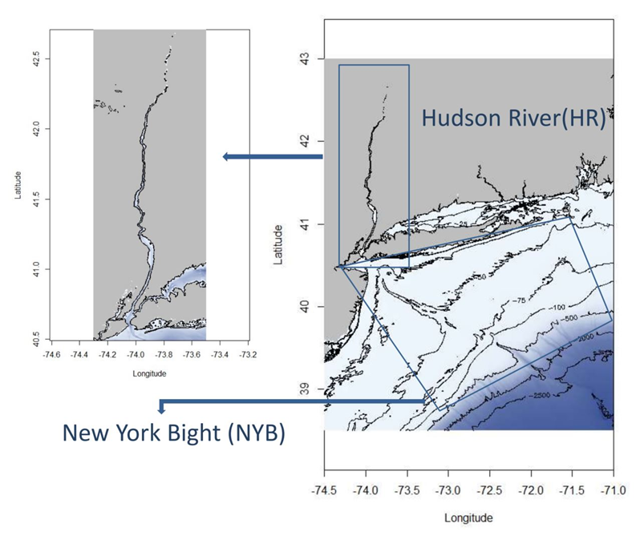
Hudson River-NY Bight Ecosystem Modeling
Develop an end-to-end model for the HR-NYB ecosystem;
Tune the model to simulate the observed HR-NYB ecosystem dynamics;
Use the tuned model to evaluate the impacts of key environmental and anthropogenic drivers on the HR-NYB ecosystem dynamics;
Develop an outreach program to showcase the utility of the developed end-to-end model
Fig. Proposed spatial domain for the developing EEM

Slide 29
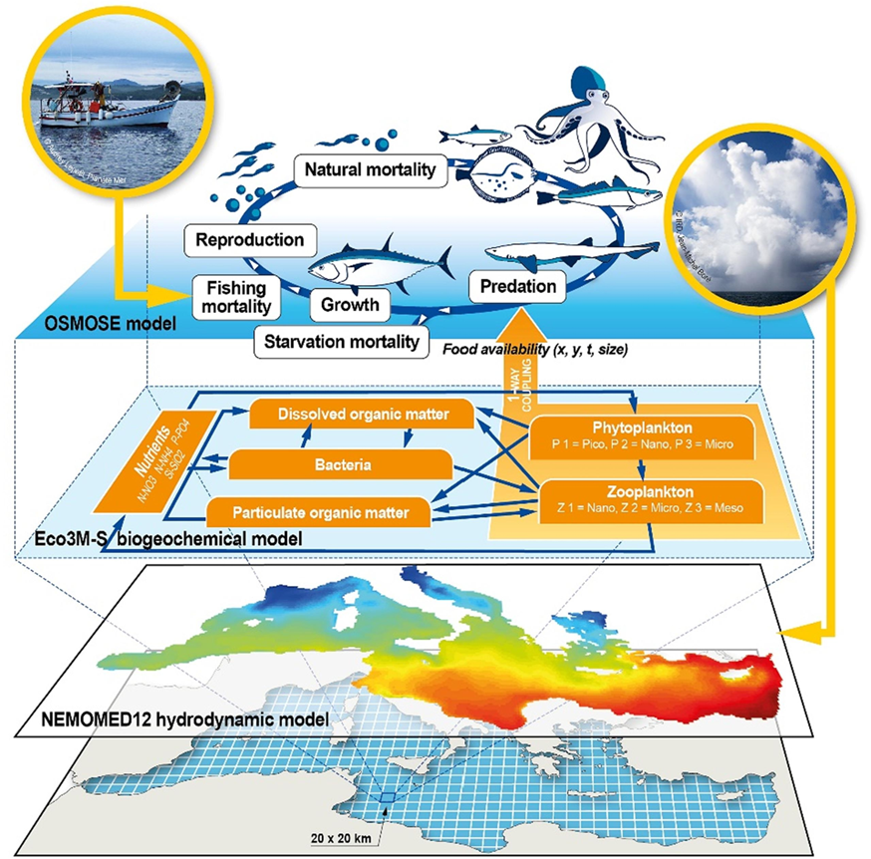
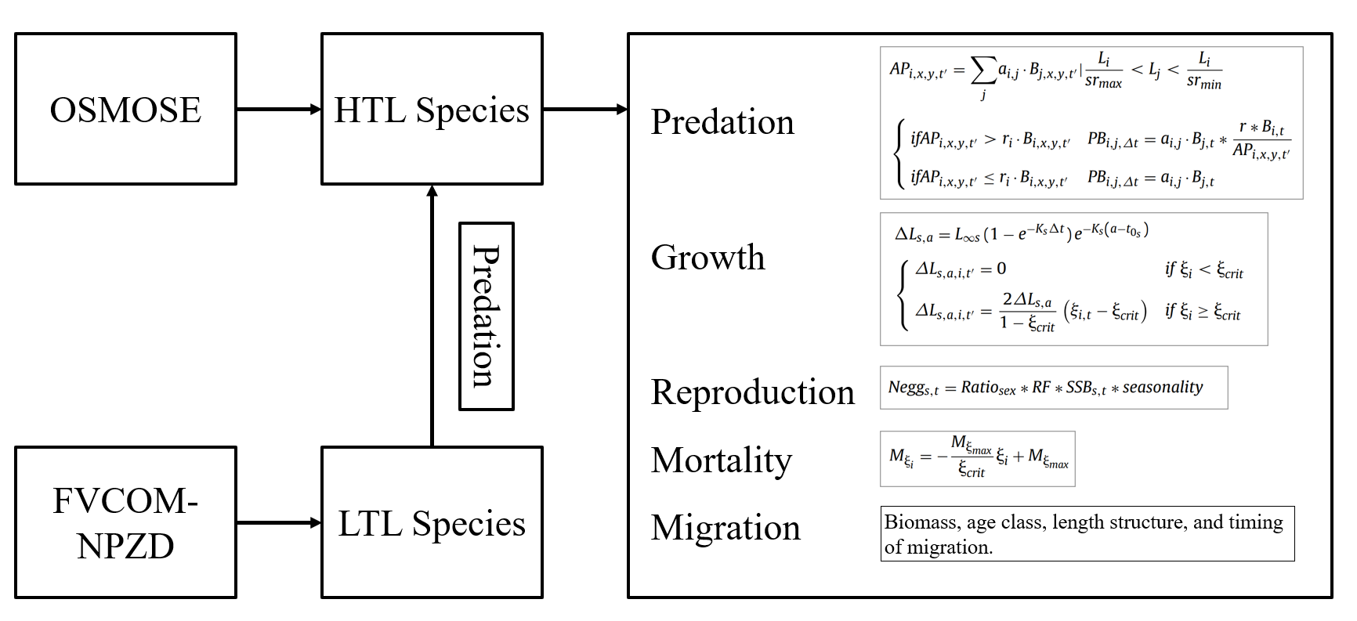
Hudson River-NY Bight Ecosystem Modeling
Fig. Proposed model structure for EEM of the HR-NYB ecosystem
Fig. EEM for the Mediterranean Sea, From Moullec et al., (2019)
Notes:
Add diagram (with really nice levels from other paper) and modeling

Slide 30
Thoughts on HRBMP
A monitoring program should have clearly defined objectives with funding and concrete plan to achieve the goals;
Metadata are needed to better inform potential users of the data availability;
Any changes in sampling protocol and survey design should be carefully evaluated;
Comparability with historic HRBMP needs to be considered to ensure high quality data of long time series;
Operating budget needed for promoting data sharing and wider use
Historic fish samples represent a unique opportunity to re-examine fish and environments in the past using new technologies that were not available in the past;
Sample preservation method needs to be carefully evaluated to ensure the utility of the samples;
Possible shrinkage of preserved fishes should be evaluated (Poster);
Sample sharing and collaborations are needed to fully use valuable samples.

Slide 31
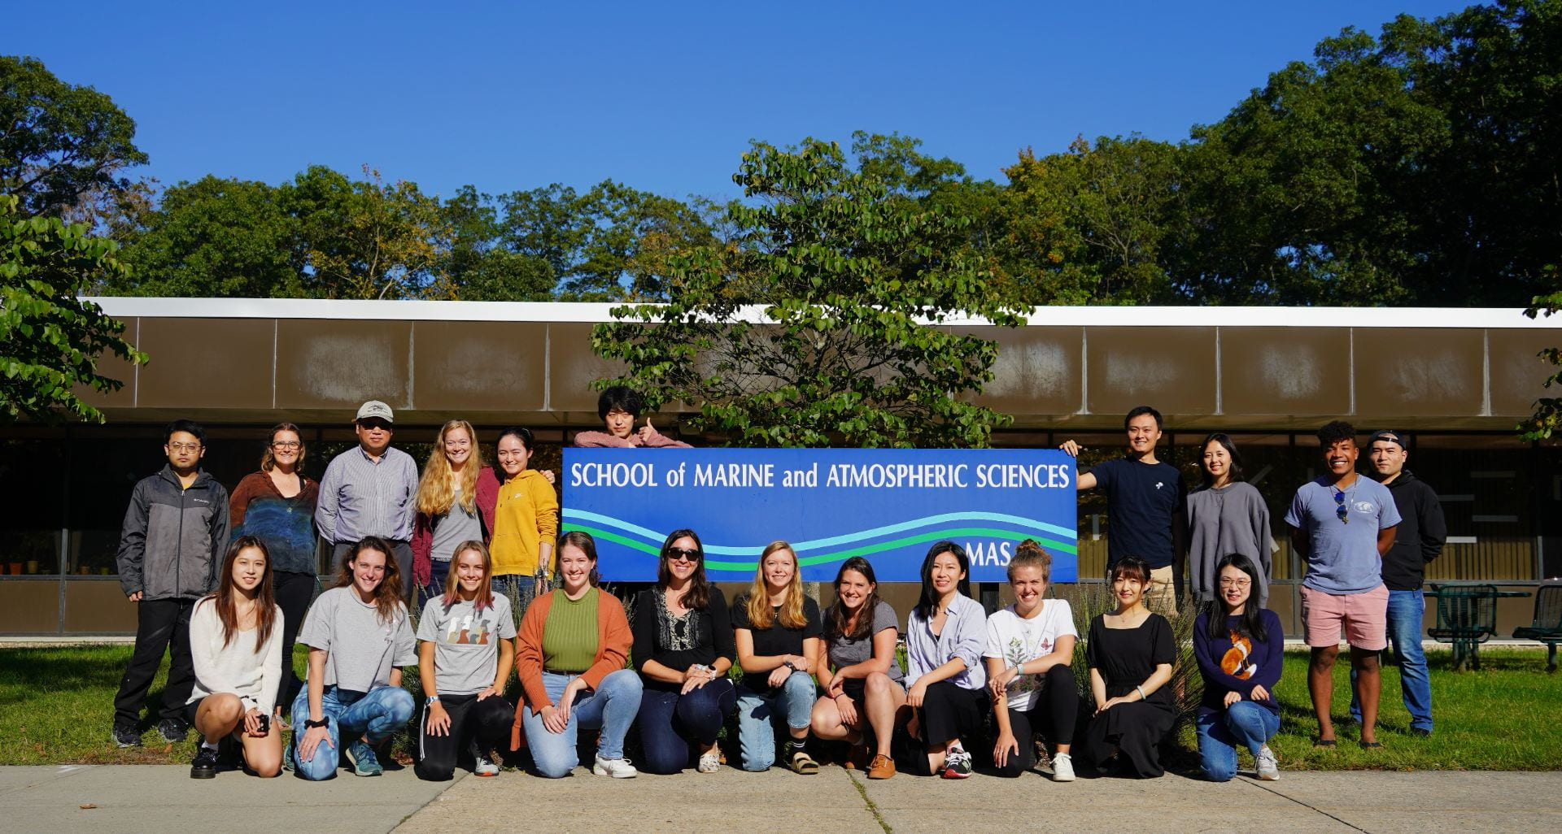
Acknowledgements
Notes:
SoMAS, HRF, HRP, Entergy, NY Sea Grant, IACS, NYSDEC, Normandeau, SBU

Slide 32
Thank you !
Questions?

Slide 33
Rationale
Remove variability not directly attributable to fish abundance
Abundance can be associated with many factors
Data need to be calibrated so that estimates are comparable over time and space
Changes in sampling protocols
The sampling effects should be carefully examined
Evaluate data quality and identify impacts on the interpretation of LRS data

Slide 34
LRS lv3, lv4, lv5 data were used
Variables were renamed to be consistent over years.
Compile spatial data of surveys (station data, river mile, site, etc)
1974-1981: directly linked
Link WQS to LRS
WQS: match lat/lon based on station (if available)
LRS: match lat/lon collected in 2002-2017 based on river mile and site
1982-2017:
Subset WQS data by river run and universal krige WQS data with depth
Yearly datasets were pooled, and species data can be extracted.
Kriged WQ data were then merged with LRS data based lat/lon, depth, and river mile

Slide 35
Challenges Needs
Complex structure
40+ years, million lines of data
Different survey programs
Many fish species
Stage specific
Biological data
Changes in sampling protocols
Inconsistent spatial and temporal coverages
Not carefully evaluated
Not calibrated or standardized
No overall metadata
No dedicated operating budget to improve the database and respond to data requests
Know the data better- Metadata
Make the data temporally and spatially comparable – Calibrate and standardize data to remove inconsistencies
Develop data sharing policy – Minimize misuse of the data and promote collaborative research efforts
Identify scientific and management questions – increase impacts and contribute to science-based HR management
Have a dedicate budget - maintain the database and respond quickly to future data requests

