Slide 1
Riverkeeper Water Quality Monitoring Collaborative and Data Portal
Shannon Roback, Ph.D.
Science Director
Riverkeeper

Slide 2
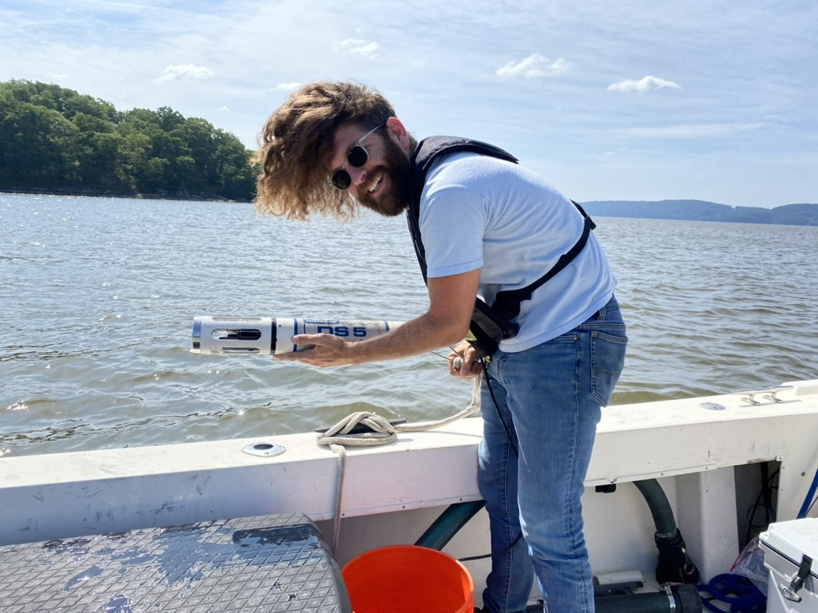
Riverkeeper Baseline Water Quality Monitoring Program
Collecting water quality data since 2008
Enterococcus
78 estuary locations
Over 100 tributary locations
Academics, community and watershed groups, and hundreds of volunteers
Estuary locations: pH, turbidity, conductivity, dissolved oxygen, temperature, chlorophyll

Slide 3
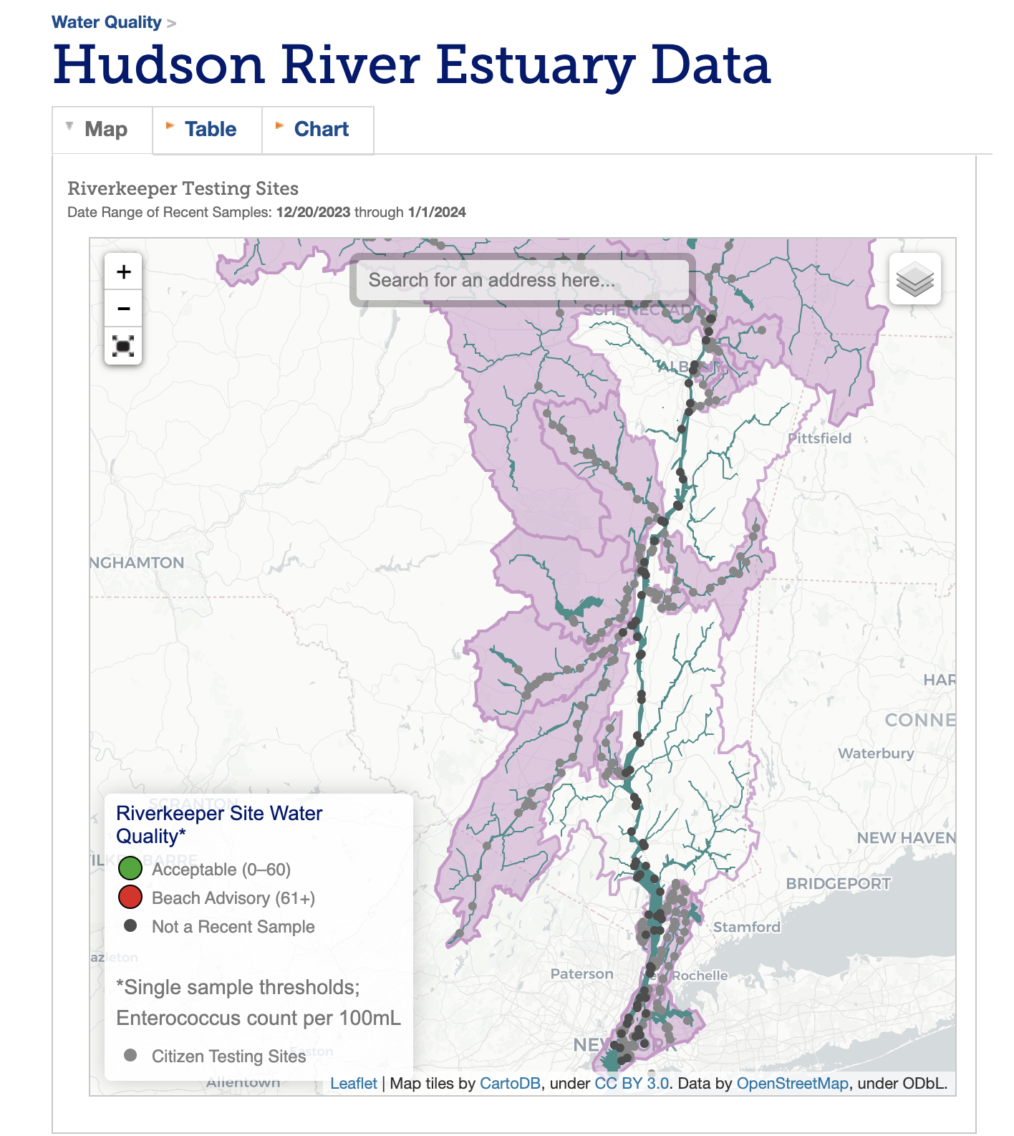
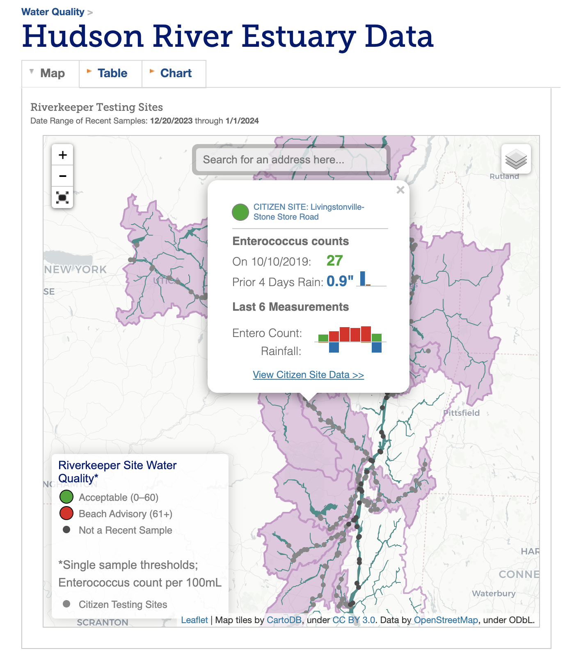
Current Data Access
https://www.riverkeeper.org/water-quality/hudson-river/

Slide 4
Where is it safe to swim/recreate?
How has water quality changed over time?
What areas pose the greatest risk to aquatic species?
How does precipitation impact water quality?

Slide 5
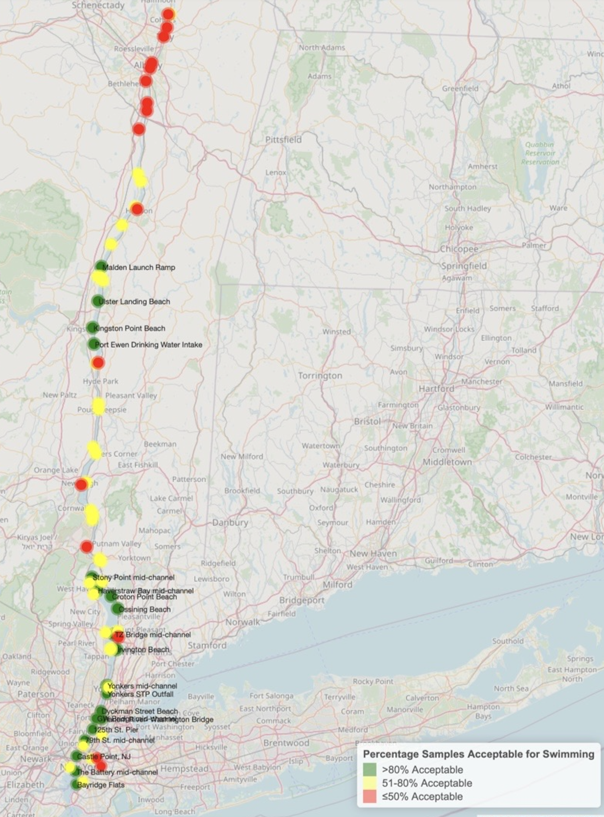
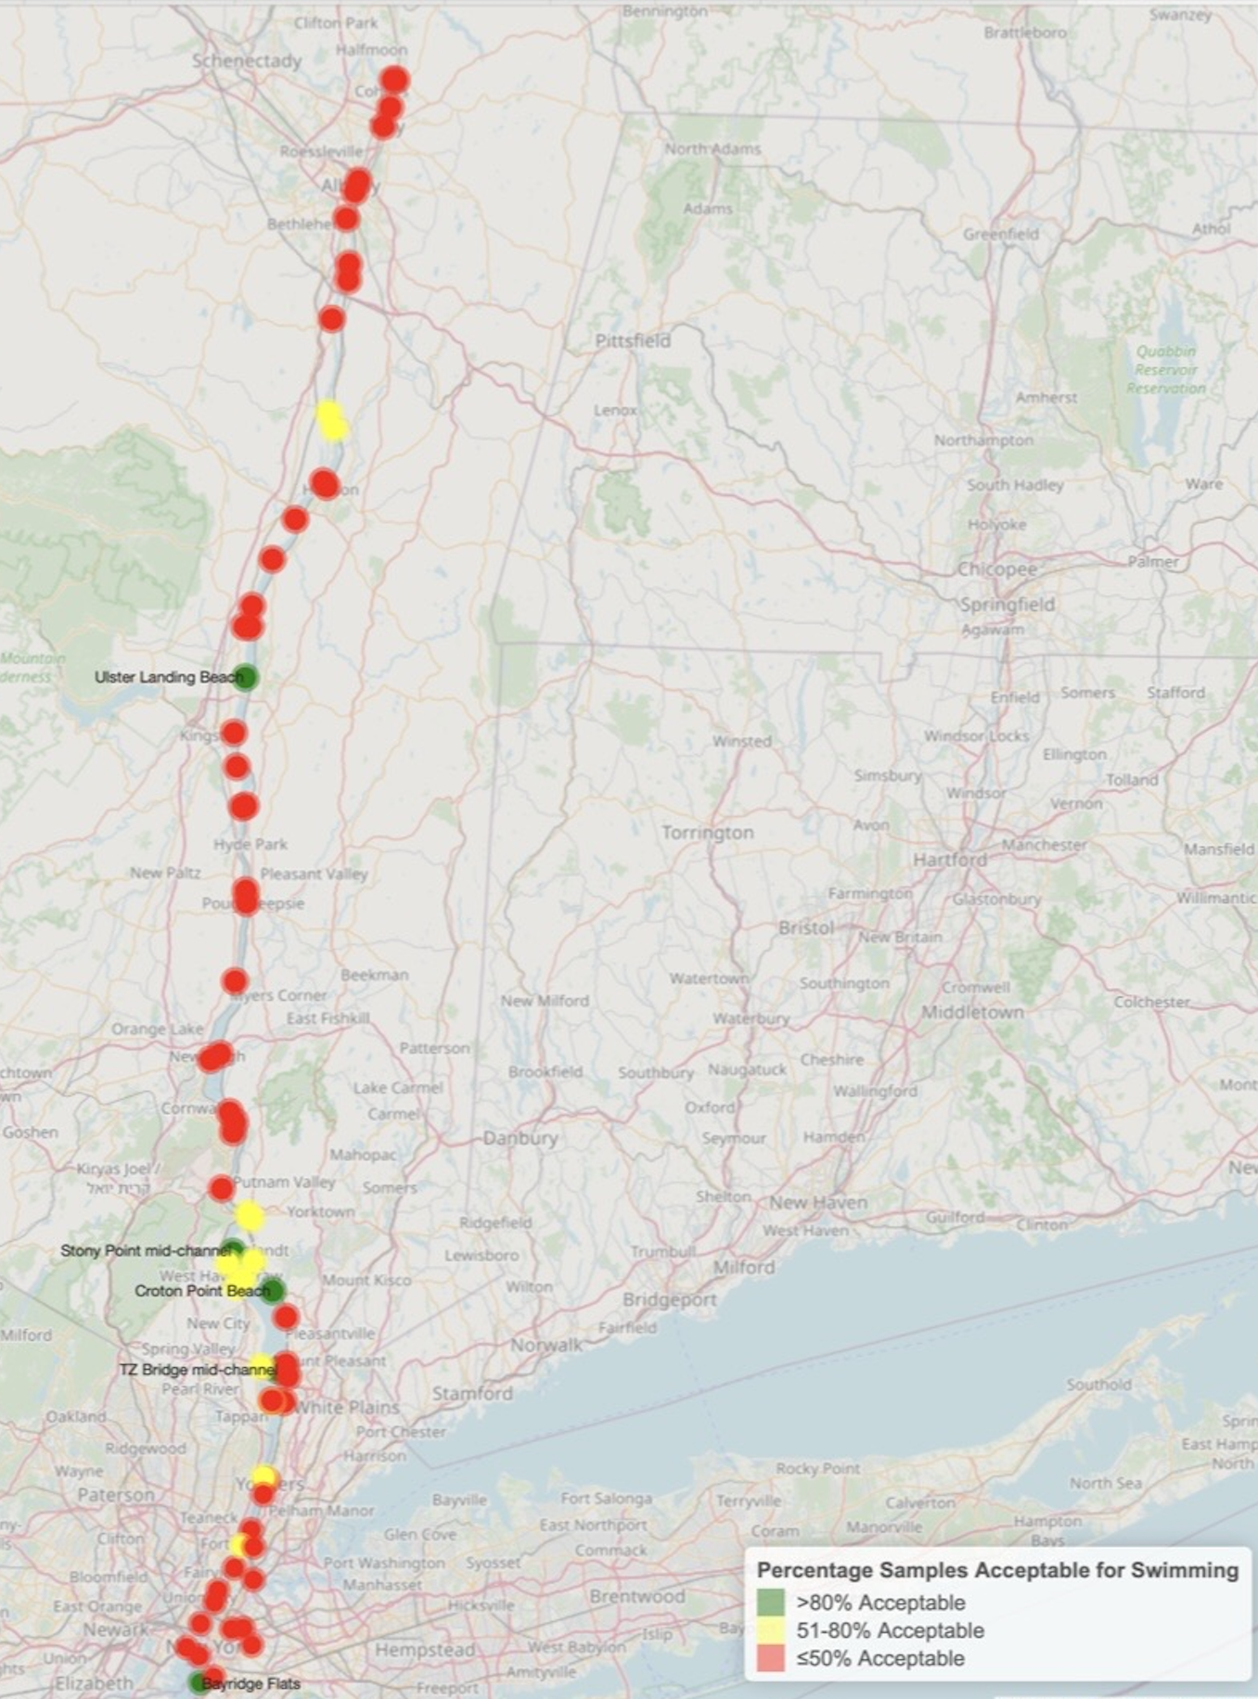
Dry Weather Wet Weather

Slide 6
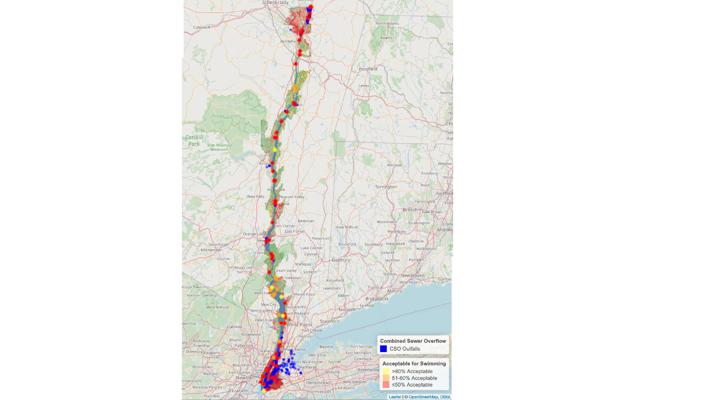
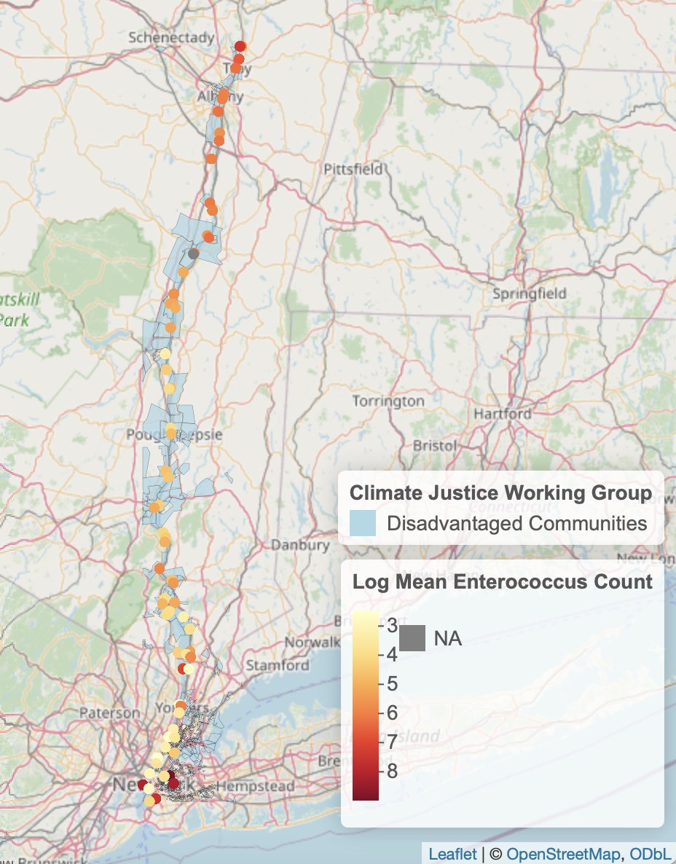

Slide 7
Climate Impacts Affecting Water Quality
Global air, land and water heating
Precipitation changes
Sea level rise
Infrastructure failures

Slide 8
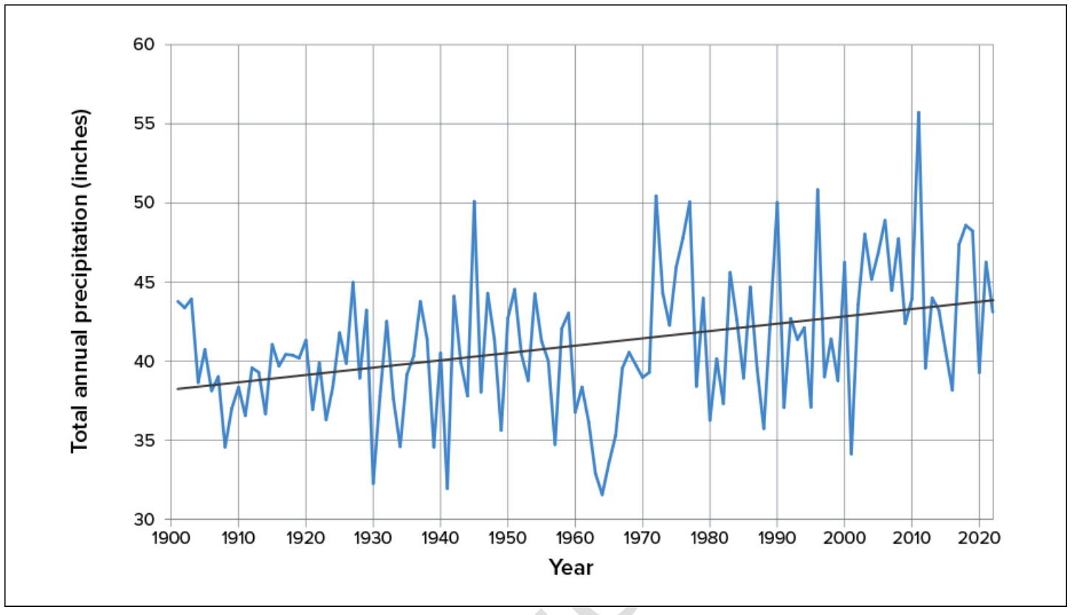
Precipitation Change
Largest percentage increases in annual precipitation are projected for the New York City, Catskills, and South Hudson
Increases in winter and spring
Projected annual precipitation in New York State during the 21st century, relative to 1981–2010
Annual total precipitation in New York State, 1901–2022
New York State Climate Impacts Assessment, 2024, New York State Energy Research and Development Authority, Albany, New York, USA

Slide 9
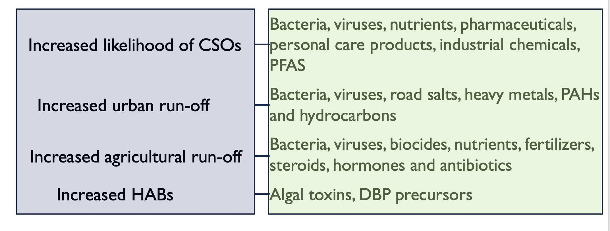
Deluge Impacts

Slide 10
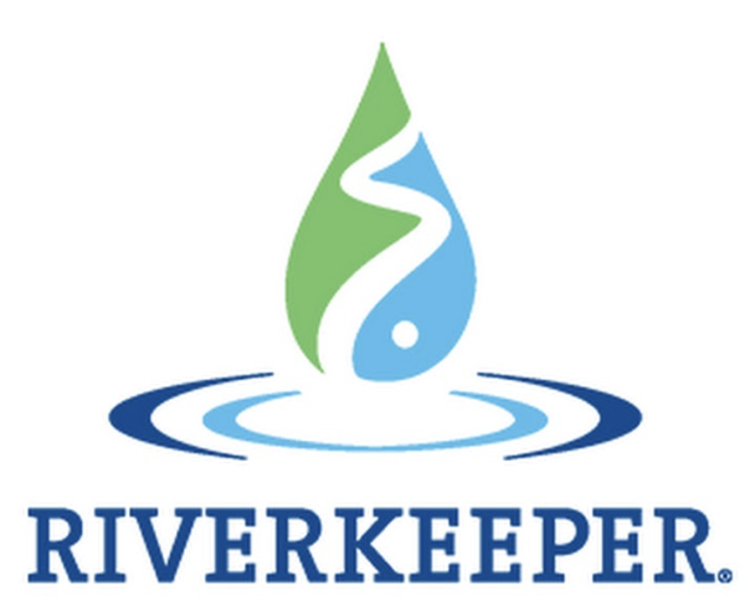
Warming Impacts
Increased nitrogen and phosphorus release from soils due to mineralization
Increased nutrient release from sediment due to increased DO in water column
Increased harmful algal growth due to higher water temperature
Increased incidence of harmful algal blooms (HABs)
HABs occurred in more lakes and reservoirs across New York in 2016–2019 compared with 2012–2014
USGS and New York State Department of Environmental Conservation. (2020). Harmful algal blooms by county 2012–2019

Slide 11
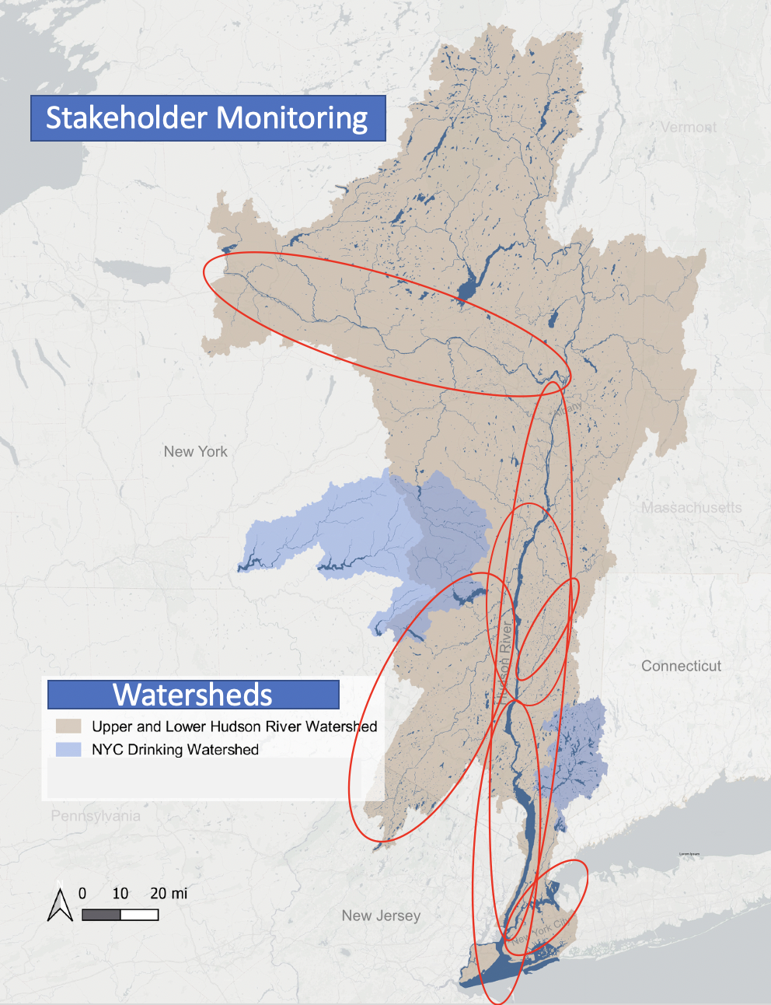
Current Monitoring
Riverkeeper
Academics
Regulators
Watershed groups
Local government
Hudson River
Tributaries

Slide 12
Collaborative Development
December 2023 Stakeholder meetings
Academics
Regulators
Watershed groups
Local government officials and staff
Environmental justice groups
Riverkeeper staff
April 2024 Symposium
Share success stories
Develop pilot monitoring plan for 2025
Create Affinity Groups
Develop QAPP
Pilot expanded monitoring program in summer 2025

Slide 13
Focus of Meetings
1. Current watershed monitoring
What questions are we trying to answer?
What will answering these questions accomplish/can this support advocacy?
2. What are the biggest water quality challenges/issues in the region?
3. How do we address these challenges?
What data do we need?
4. Who currently has capacity for monitoring and what are our shared monitoring capabilities?
5. Does a collaborative model make sense to help us with addressing our shared questions and goals?

Slide 14
Monitoring Challenges (Scientific)
Assessing impacts of climate change
Assessing legacy pollution
Assessing impacts to disadvantaged communities
Assessing stormwater pollution impacts
Occurrence of emerging contaminants
Invasive species impacts
Linking water quality to human and organism health
Identifying sources of non-point source pollution
Assessing impacts from agriculture

Slide 15
Monitoring Challenges (Organizational)
Lack of funding for short and long-term monitoring
Difficulty providing matching funding as required by some grantors
Reliance on temporary student labor
Requirements for data to be ELAP certified for certain uses
Loss of institutional knowledge as the result of a “graying” water workforce and retirements
Collaboration

Slide 16
Monitoring Challenges (Communication)
Data being collected are not being effectively utilized by decision makers
Data are not being effectively communicated to a variety of audiences including the public
Lack in ability to turn data into action

Slide 17
Water Quality Monitoring Collaborative
Goals
Understand monitoring needs
Identify emerging threats
Develop collaborative projects
Seek shared funding
Improve training of new scientists
Collect data that can be used for advocacy
Climate change
Equity
Advocacy/improvements
Pollution source identification
Research questions
Swimmable, fishable, drinkable

Slide 18
Riverkeeper’s Expanded Monitoring Program
Understand how climate change is impacting water quality
Collect additional data in environmental justice communities
Improve data access, communication and utilization

Slide 19
Riverkeeper’s Expanded Baseline Monitoring Program Parameters
Estuary: enterococcus, pH, turbidity, DO, conductivity, chlorophyll, temperature, nitrate, phosphorous, dissolved organic matter, total blue-green algae
Tributaries: enterococcus, pH, turbidity, DO, conductivity, chlorophyll, temperature, nitrate, phosphorous, total blue-green algae, chloride
Locations: environmental justice communities, swimming locations, areas impacted by flooding, areas impacted by HABs, CSO outfalls, drinking water sources, source water for communities in DWSP2 program, assess efficacy of interventions

Slide 20
Affinity Groups and Exploratory Monitoring
eDNA/biological monitoring
Real time monitoring/sensors
Nutrients/harmful algal blooms
Emerging contaminants
Science Communication
NYC
Mohawk

Slide 21
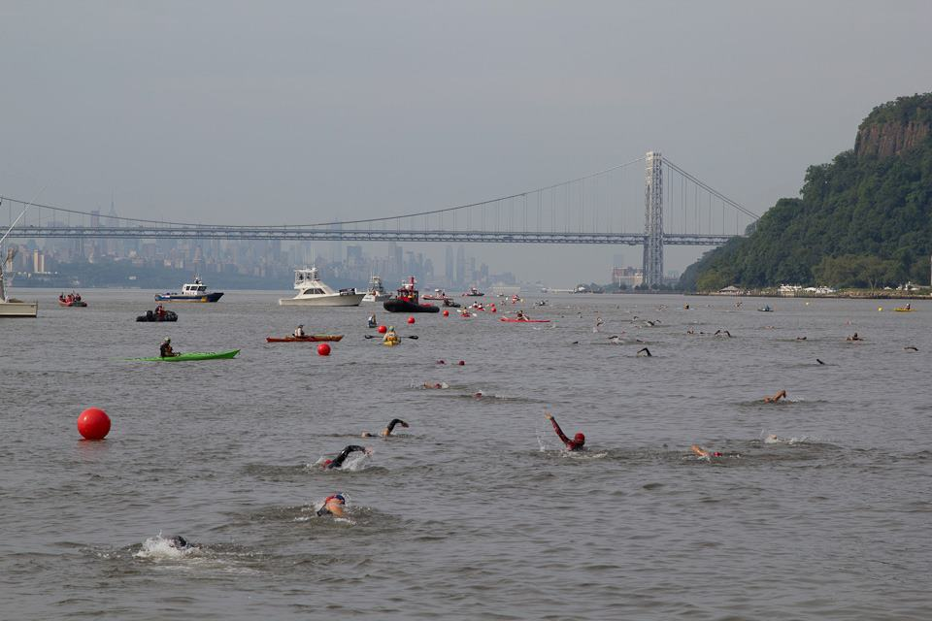
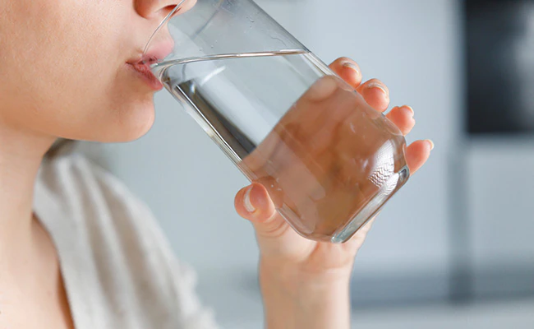
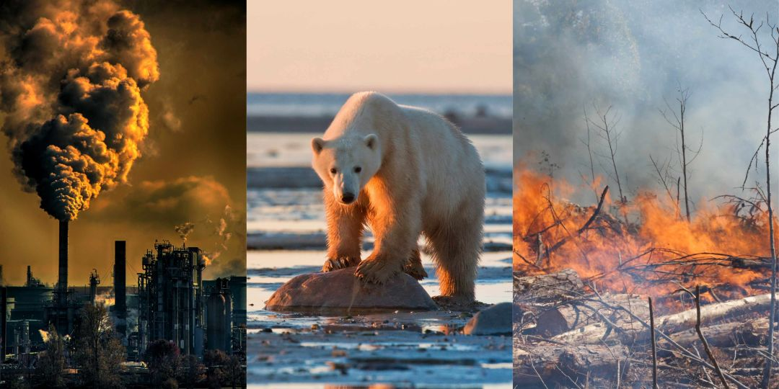
Riverkeeper Data Portal Redesign
Where is it safe to swim? How is my drinking water? How is climate change impacting water quality?

Slide 22
Where is it safe to swim?
Enterococcus and other Riverkeeper water quality data
Precipitation data
Grading system for sample locations
HABs occurrence
Access points

Slide 23
How is my drinking water?
Riverkeeper water quality data: turbidity, salinity, chlorophyll, fDOM, nitrate
Drinking water provider (population served, source, system information)
Violations of Safe Drinking Water Act
Annual Water Quality Report

Slide 24
How is climate change impacting water quality?
Riverkeeper water quality data: salinity, water temperature, chlorophyll, turbidity, fDOM
Sea level rise projections
Flooding projections
Wetlands

Slide 25
Other Data Portal Capabilities
Sources of pollution
Sub-watersheds
Data from third parties (HRECOS, academic studies)
Graphing and visualization
Data download capabilities
Connect users to action

Slide 26
Thank you
Questions?

