Slide 1
Monitoring the Resilience of Aquatic Habitats
Sarah H. Fernald
Manager, Hudson River National Estuarine Research Reserve
October 8, 2024
Notes:
I will be presenting some results from my work on monitoring the tidal wetlands in the Hudson River National Estuarine Research Reserve, including some analyses on the resilience of these habitats to projected climate change stressors.

Slide 2
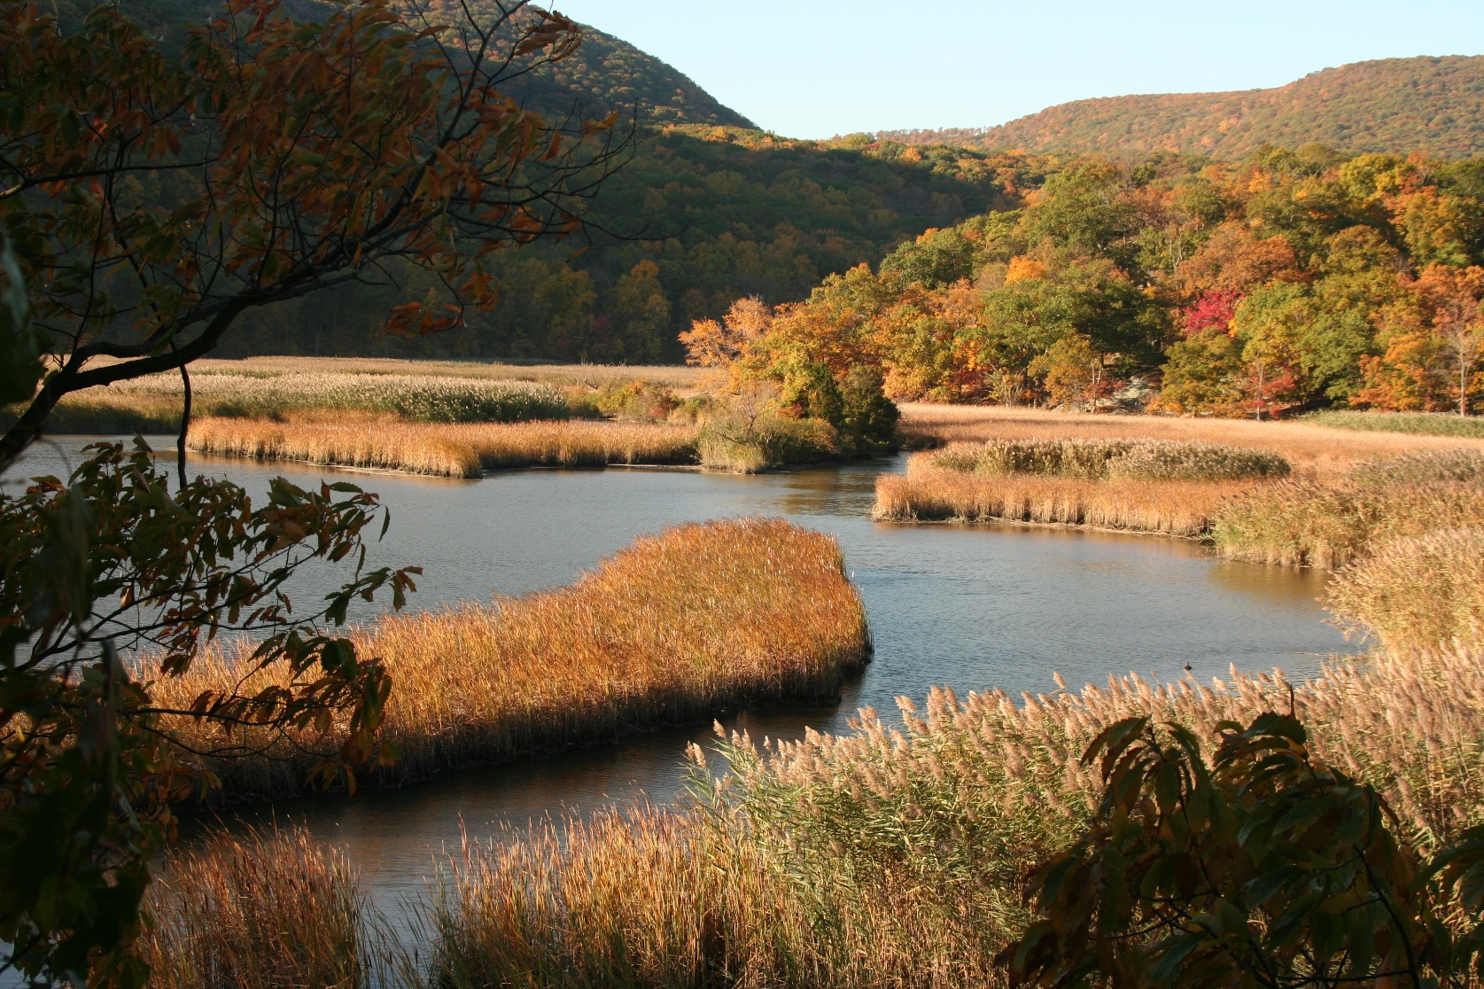
Notes:
Tidal marshes are a significant habitat for many ecologically important fish, birds and other organisms. They also have valuable functions such as filtering sediments and contaminants from water, controlling flooding, and processing nutrients.
The freshwater tidal marshes of the Hudson River Estuary are a globally rare habitat. The type of vegetation that grows here is dependent upon inundation and elevation. Submerged aquatic vegetation grows in the deepest areas. This transitions up to mud flats and broad-leafed vegetation like spatterdock, with native cattail or invasive Phragmites usually dominating the upper elevations of the marsh.

Slide 3
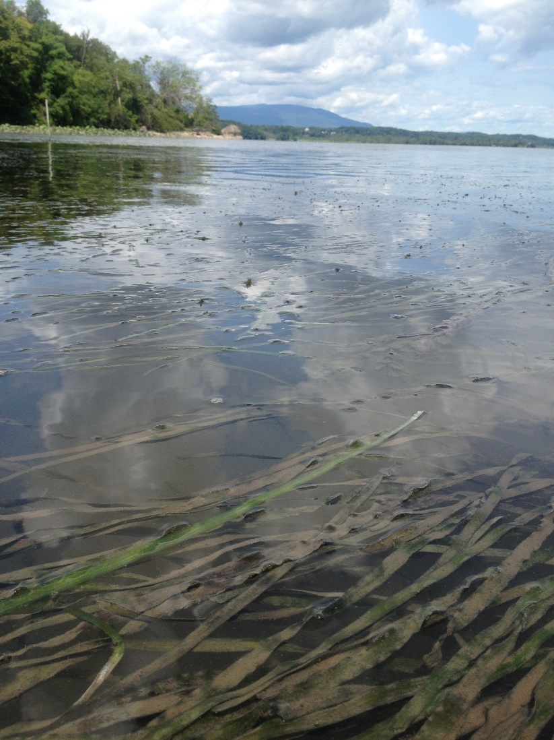

Slide 4
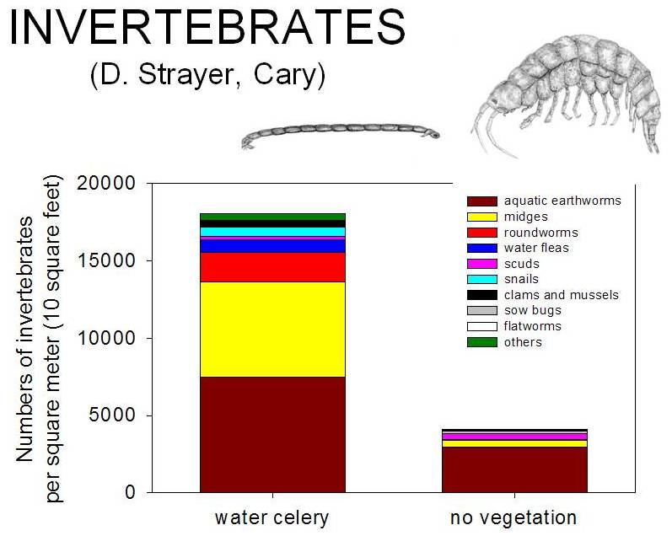
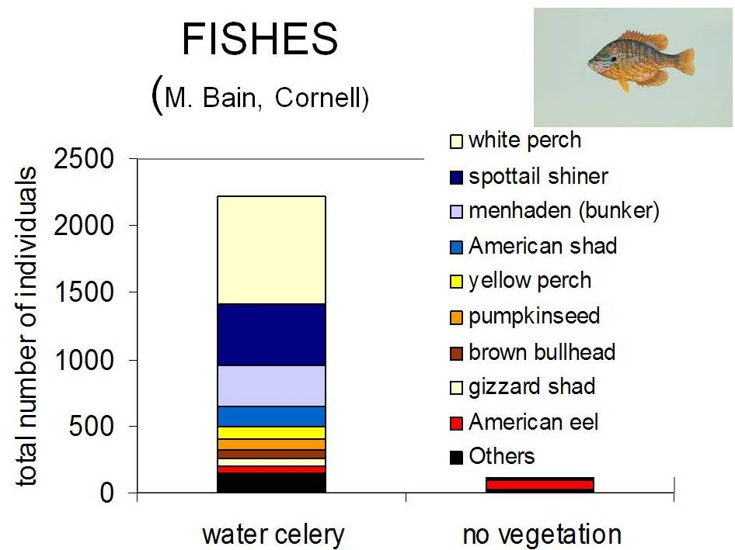
Ecological Functions of SAV More fish food = more fish

Slide 5
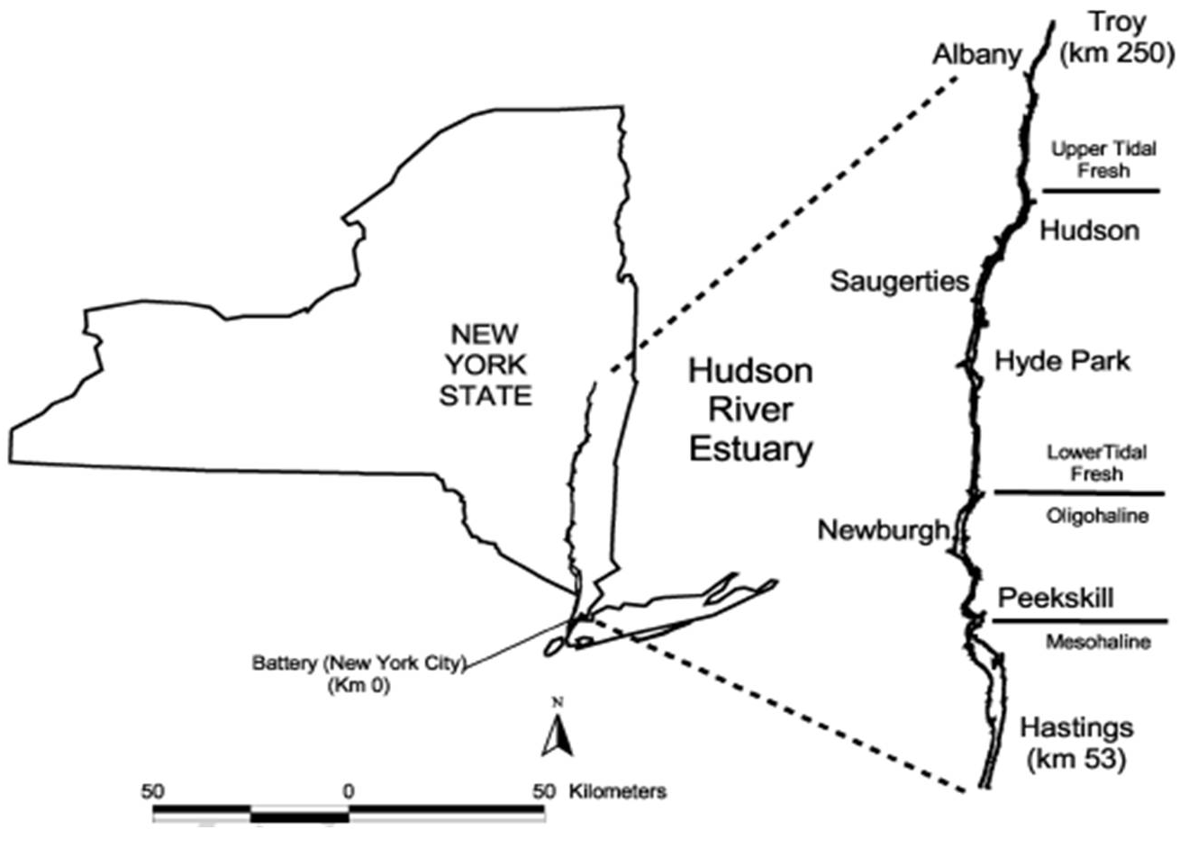
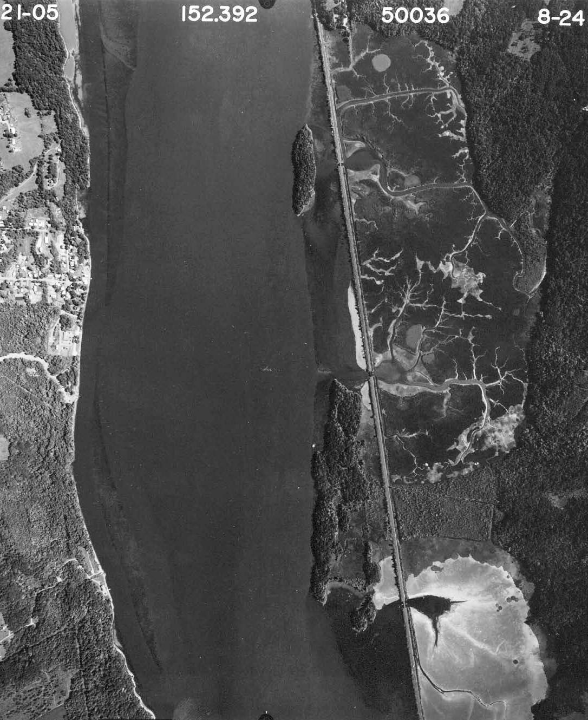
Hudson River Estuary Habitat Maps Hastings - Troy Aerial Photo Inventory
River Section at Tivoli Bays
Funded by:

Slide 6
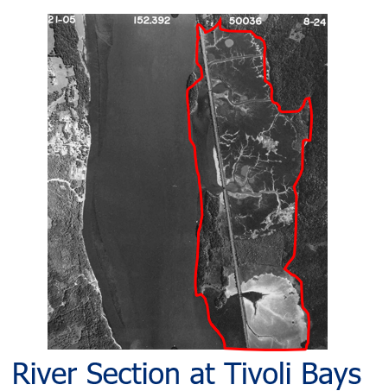
Submerged Aquatic Vegetation Mapping
Tivoli, NY
Adjacent to
Bard
College
Cruger
Island

Slide 7
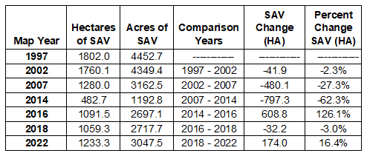

Slide 8
There are over 1,400 acres less SAV habitat today than 25 years ago

Slide 9
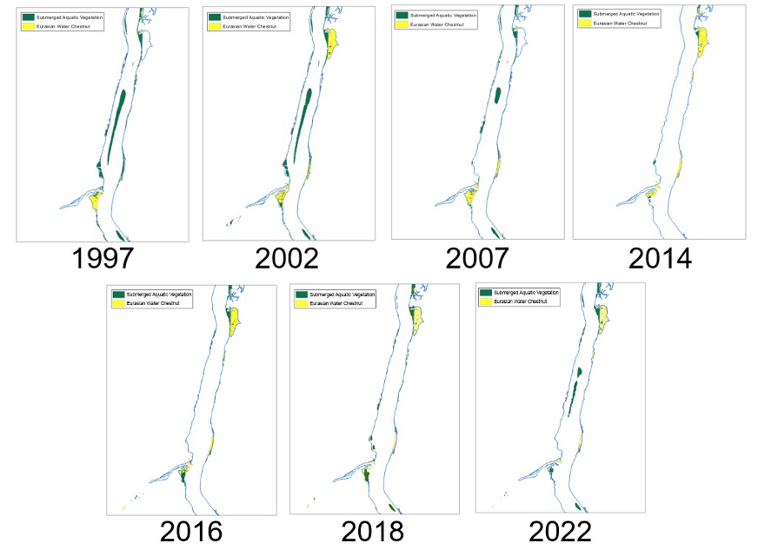
Submerged Aquatic Vegetation
Invasive Water Chestnut
Kingston-Rhinecliff Bridge SAV Bed Change Comparison 1997 - 2022

Slide 10
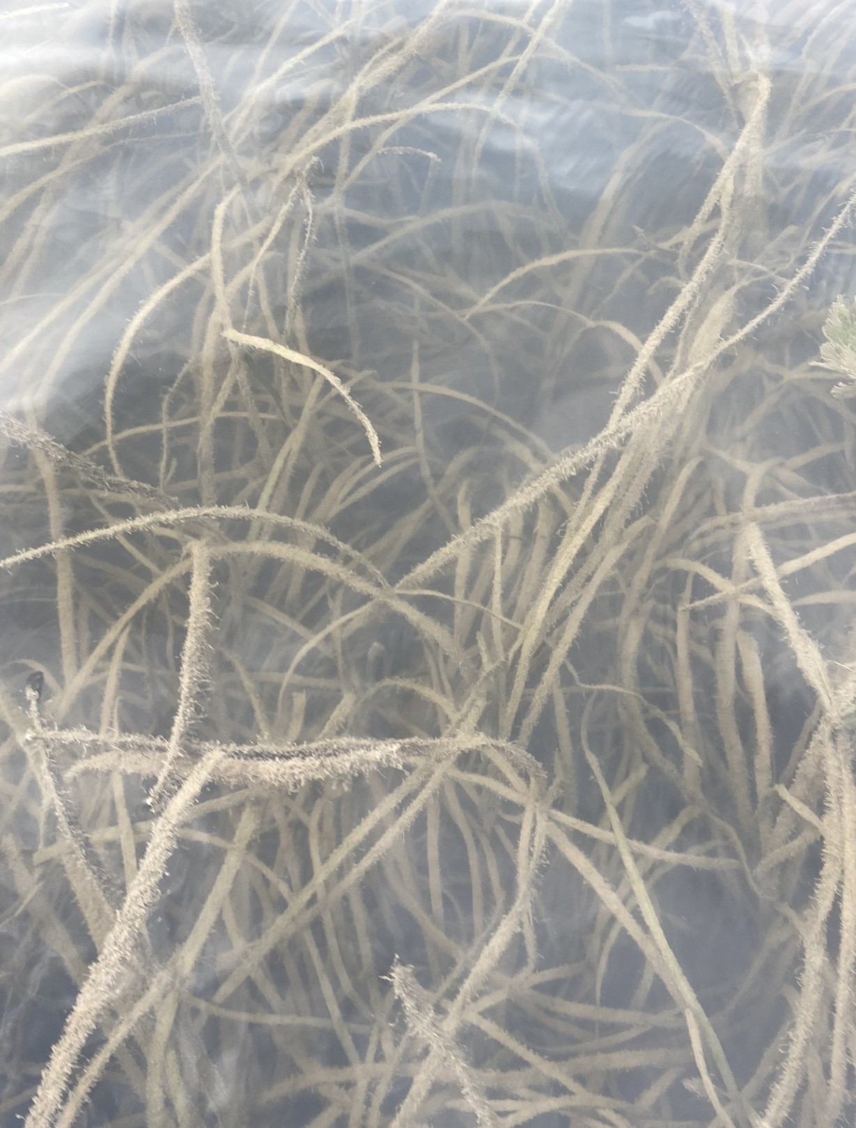
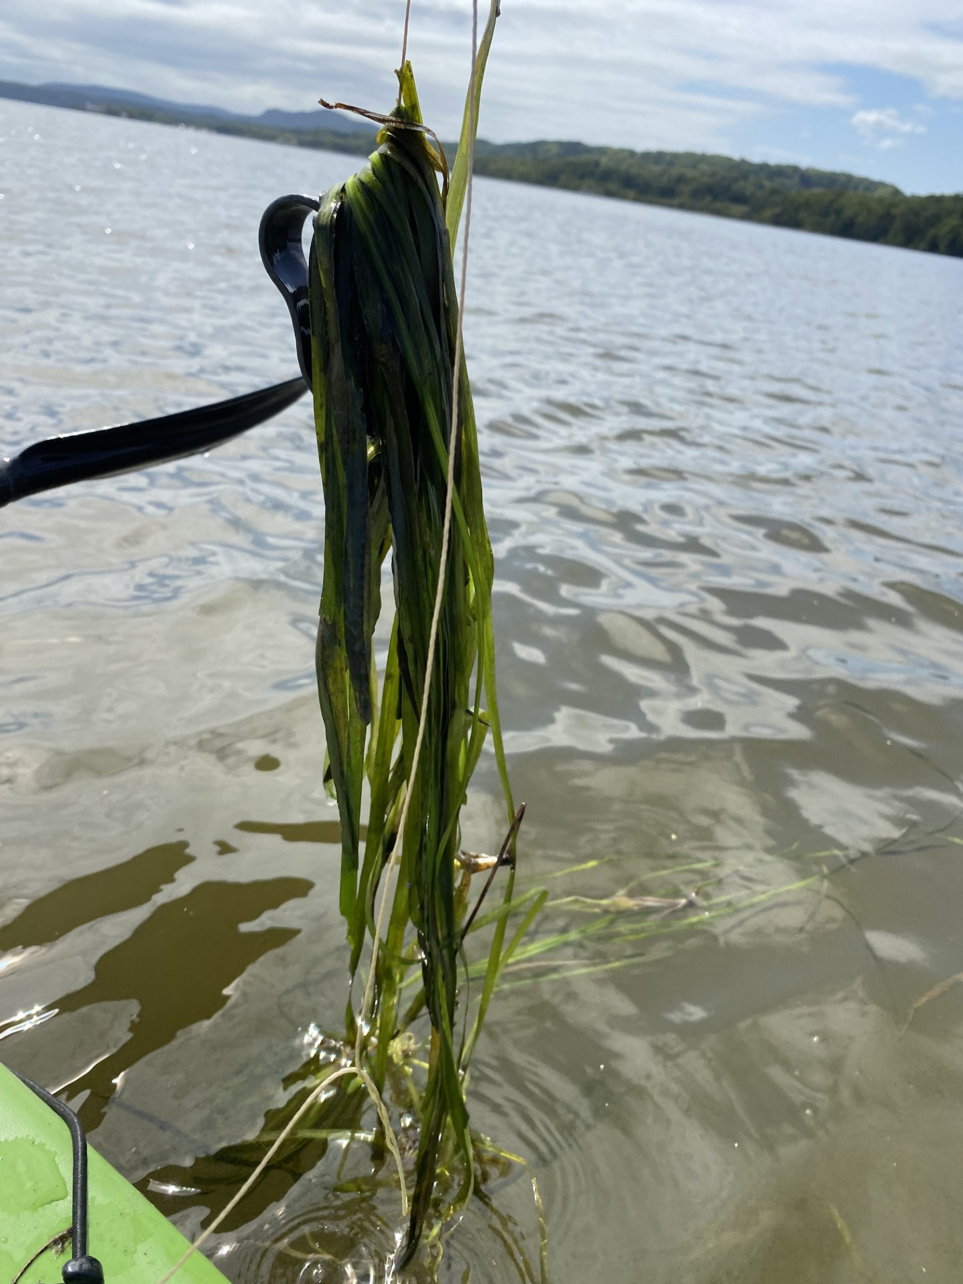
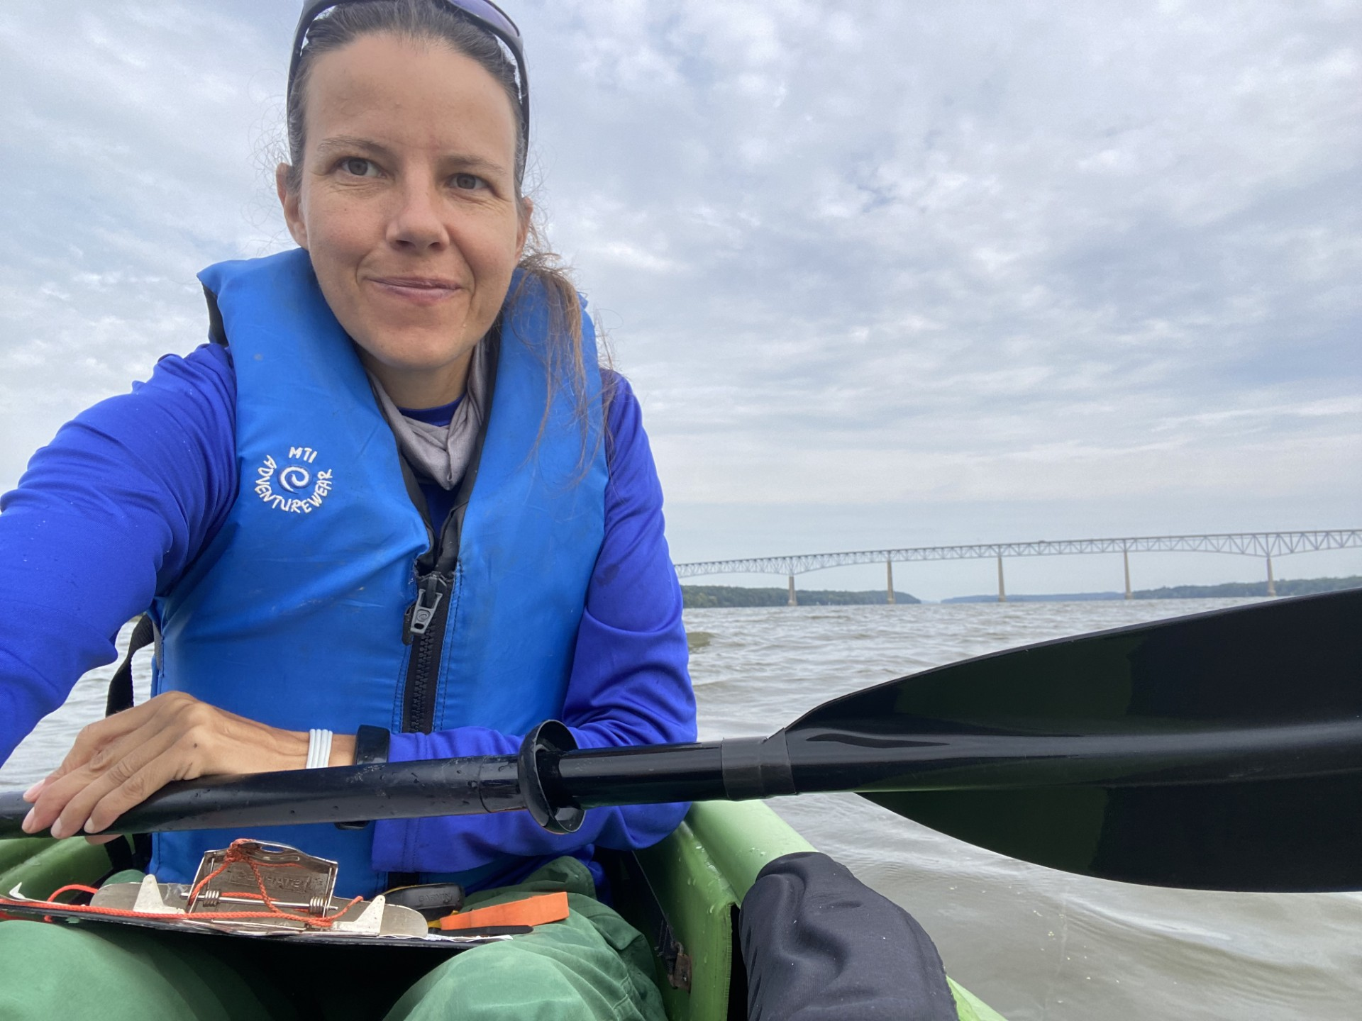
SAV Volunteer Monitoring Program
Confirmation of robust SAV growth under Kingston-Rhinecliff Bridge in 2024

Slide 11
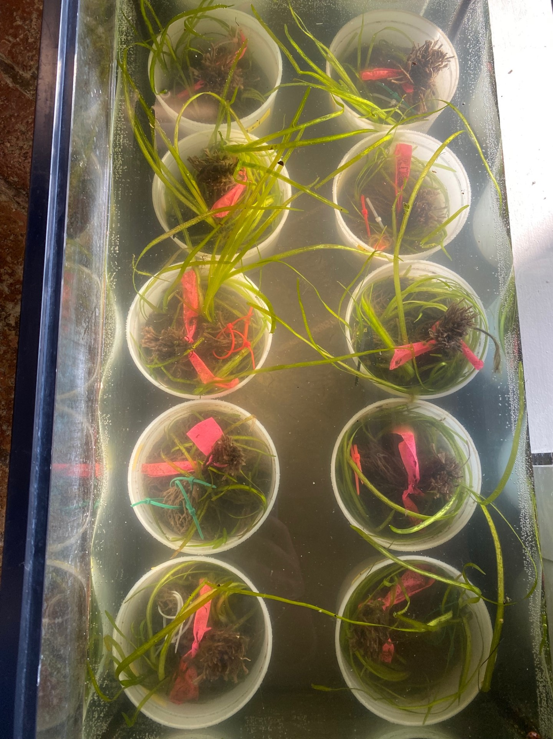
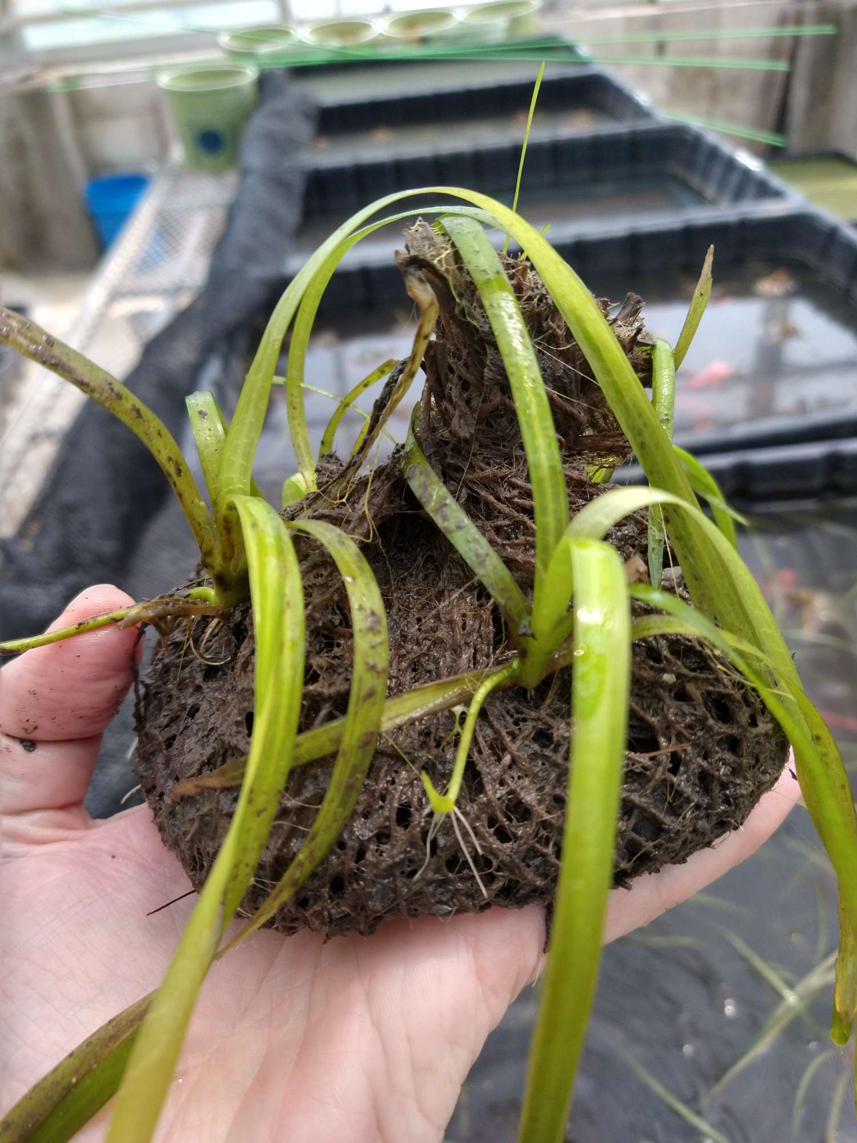
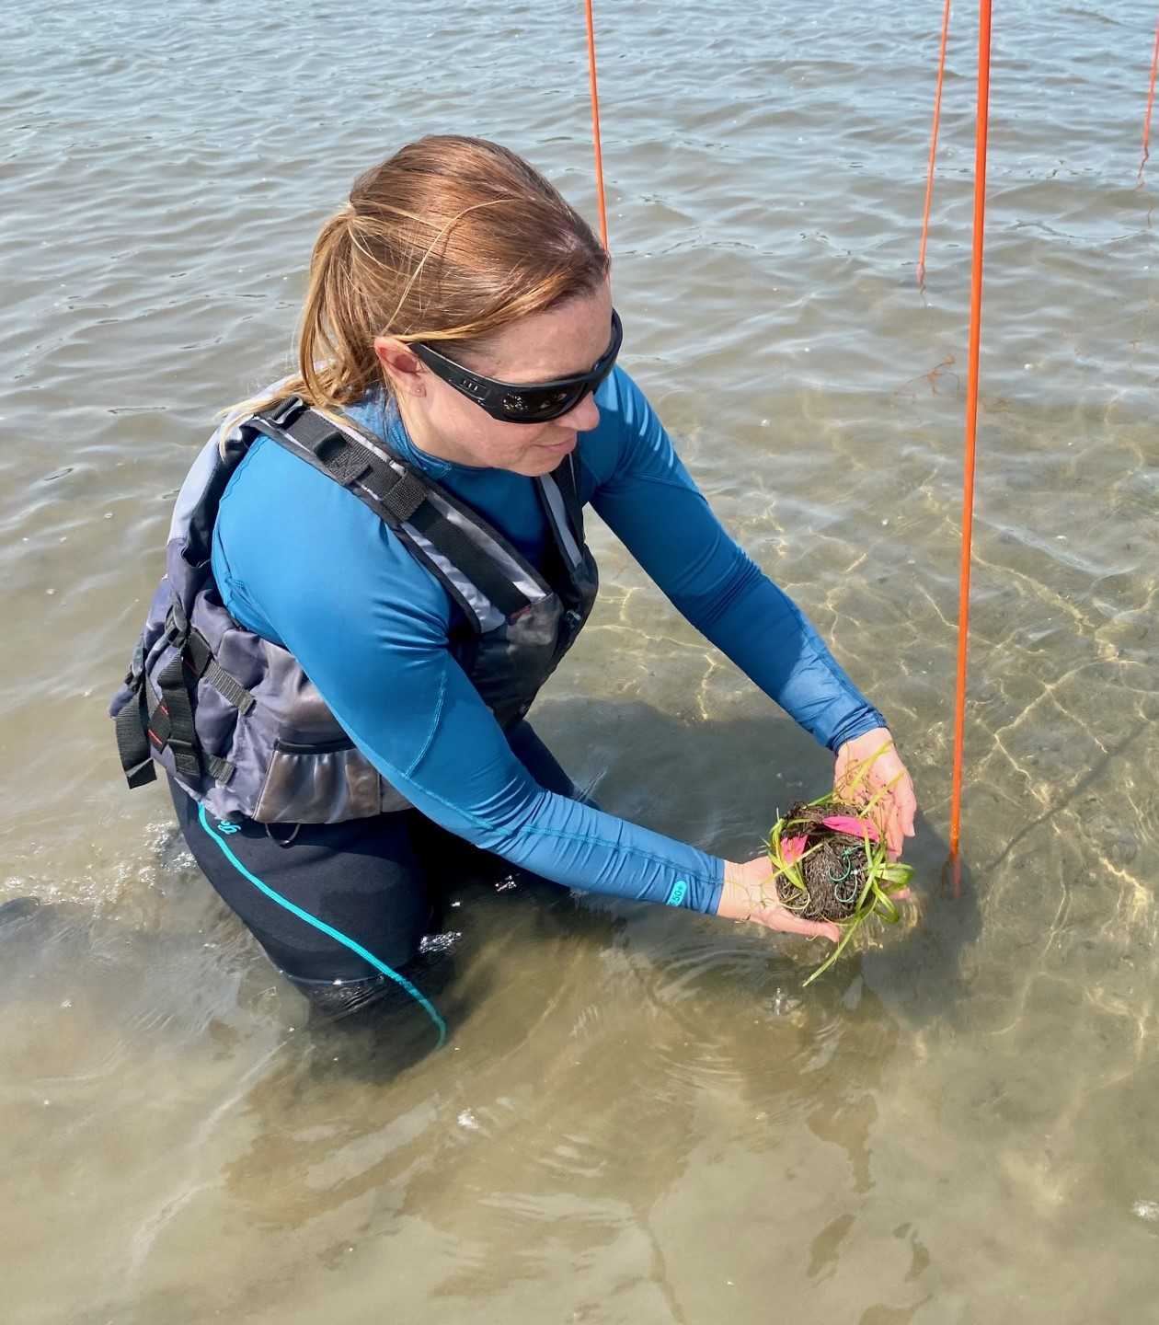
SAV Propagule Rearing
SAV Planting

Slide 12
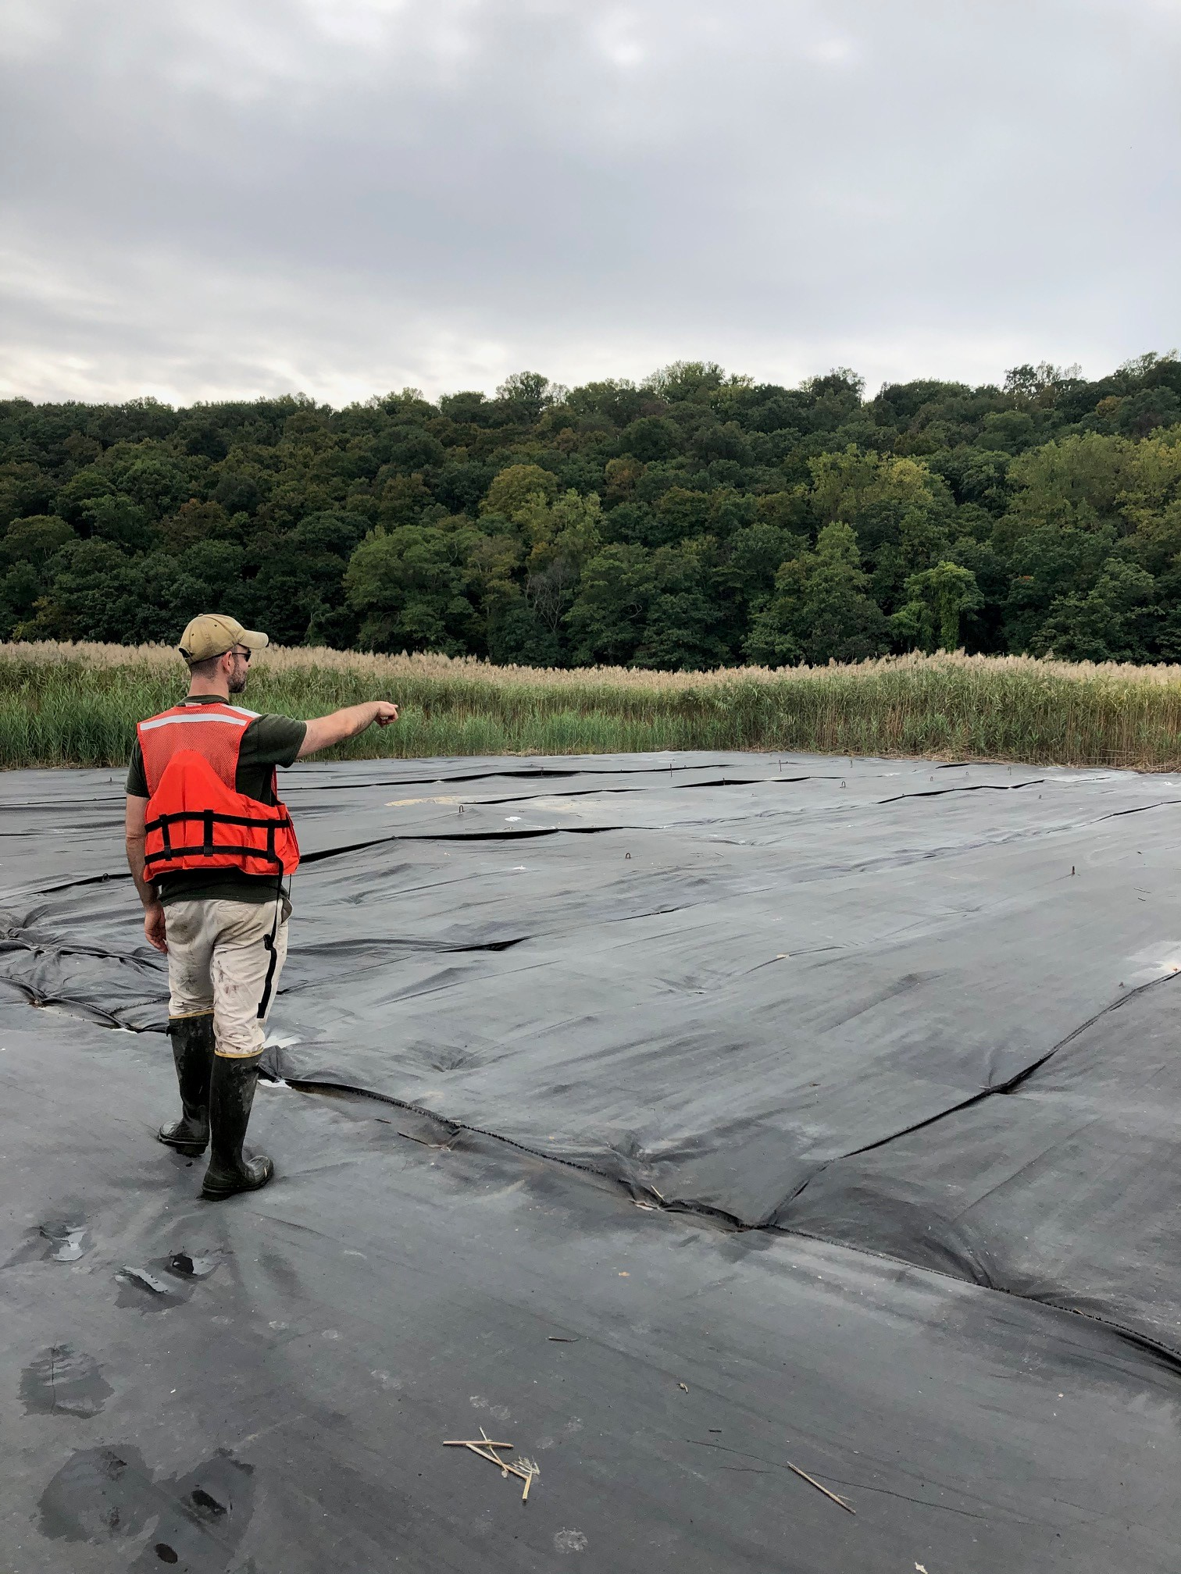
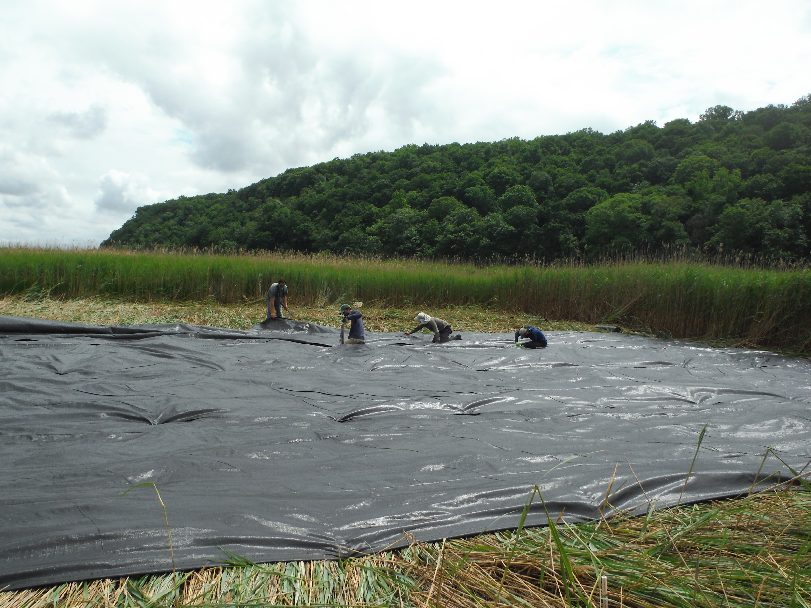
HRNERR Restoration Priorities:
Invasive Species Management

Slide 13
Hudson River Estuary Tidal Wetland Maps Two inventories: 2007 and 2018 Third inventory planned for 2026/2027
River Section at Tivoli Bays
Funded by:

Slide 14
Hudson River Estuary Tidal Wetland Maps Two inventories: 2007 and 2018 Third inventory planned for 2026/2027
Cruger
Island
Bard
College
River Section at Tivoli Bays
Funded by:

Slide 15
Scenic Hudson.org
Cruger
Island
Bard
College

Slide 16
Scenic Hudson.org
Cruger
Island
Bard
College

Slide 17
Scenic Hudson.org
Cruger
Island
Bard
College

Slide 18
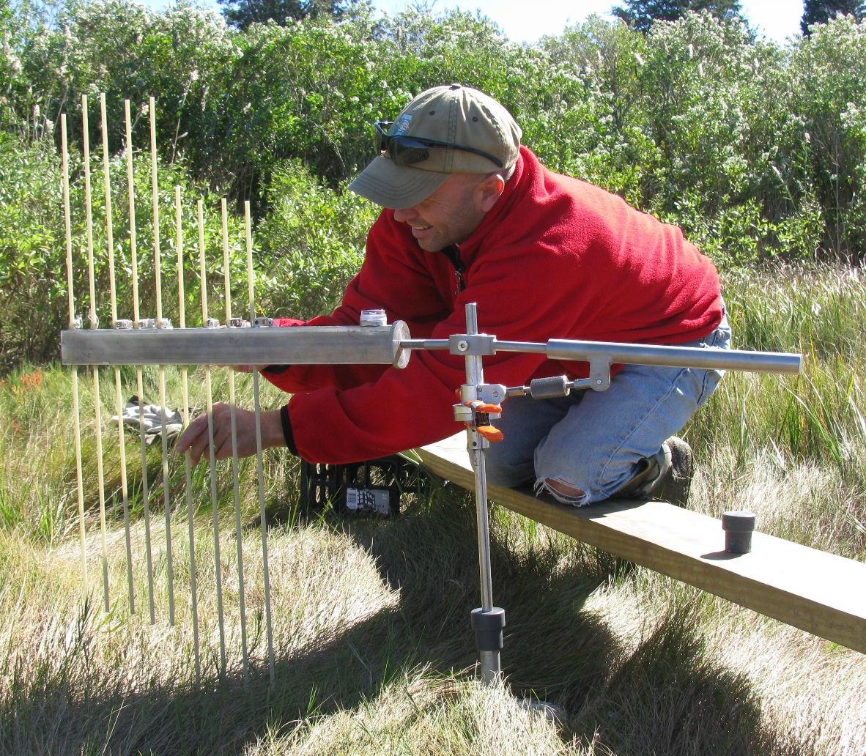
Surface Elevation Table (SET)
USGS Photo: Narragansett Bay National Estuarine Research Reserve
Notes:
SO how do changes in water level compare to changes in the elevation of tidal marshes? To assess this, Surface Elevation Tables (SETs) were installed in Tivoli Bay in 2012,. SET stations provide a nondestructive method for making highly accurate measurements of sediment elevation over long periods of time relative to a fixed elevation benchmark. This benchmark is established by driving rods into the marsh to refusal. To collect marsh elevation data, a temporary arm is installed on the benchmark and pins are lowered to the marsh. The height of the pins are recorded and corrected to elevation of the benchmark. This picture is not on the Hudson, but in the brackish marshes of Narragansett Bay where you can actually see what my colleague Kenny Raposa is doing. The reality of collecting SET data in freshwater tidal wetlands…

Slide 19
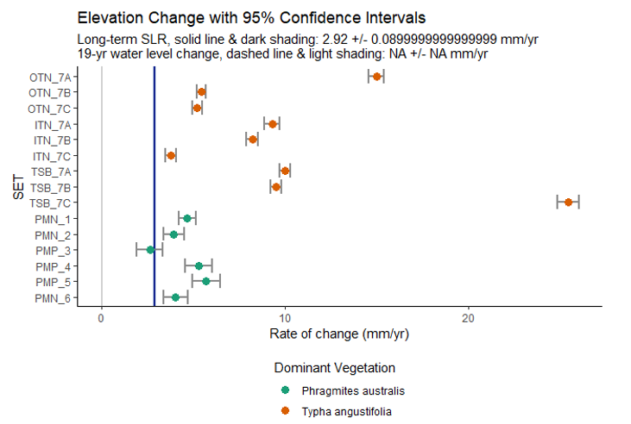
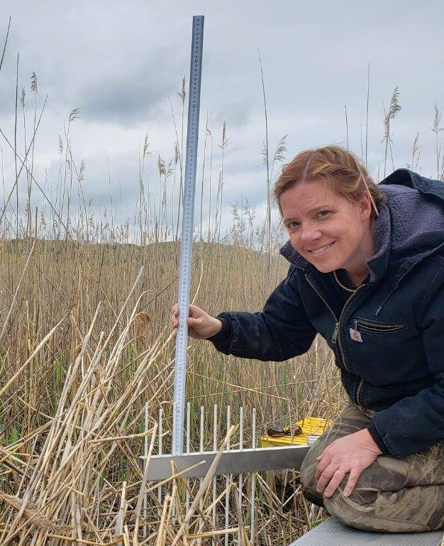

Slide 20
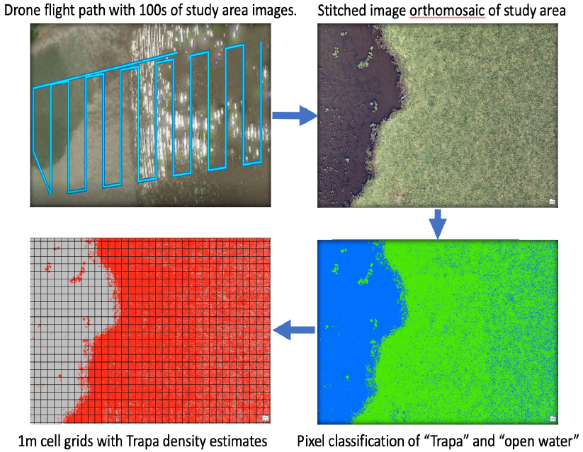
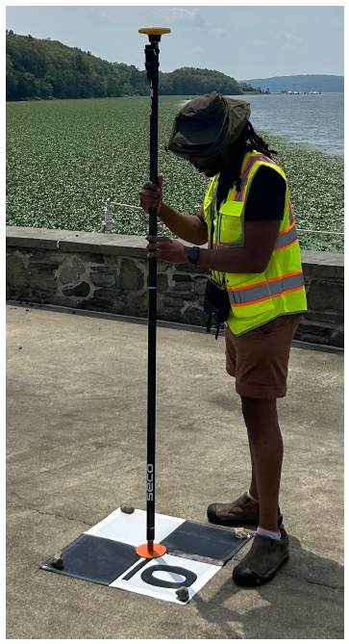
Monitoring Innovations: Aerial Drones for Environmental Assessment
Leslie Jarrett, School of Earth and Environmental Sciences, Queens College, CUNY

Slide 21
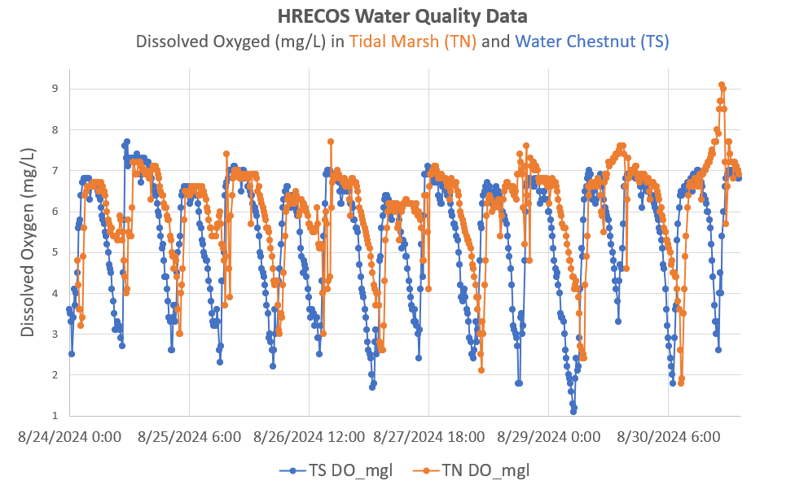
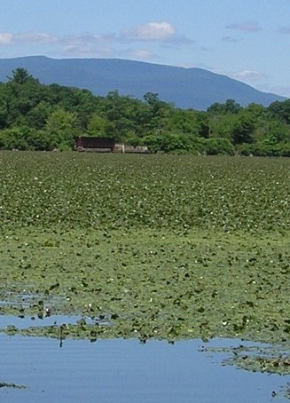
Tidal Marsh
Tivoli North Bay
Water Chestnut
Tivoli South Bay

Slide 22
Tidal Marsh
Tivoli North Bay
Water Chestnut
Tivoli South Bay
Tidal Marsh habitat has higher peaks in dissolved oxygen (>7mg/L).
Water Chestnut habitat has lower dips in dissolved oxygen (<3mg/L).
Both habitats experience a range in dissolved oxygen across the tidal cycle.

Slide 23
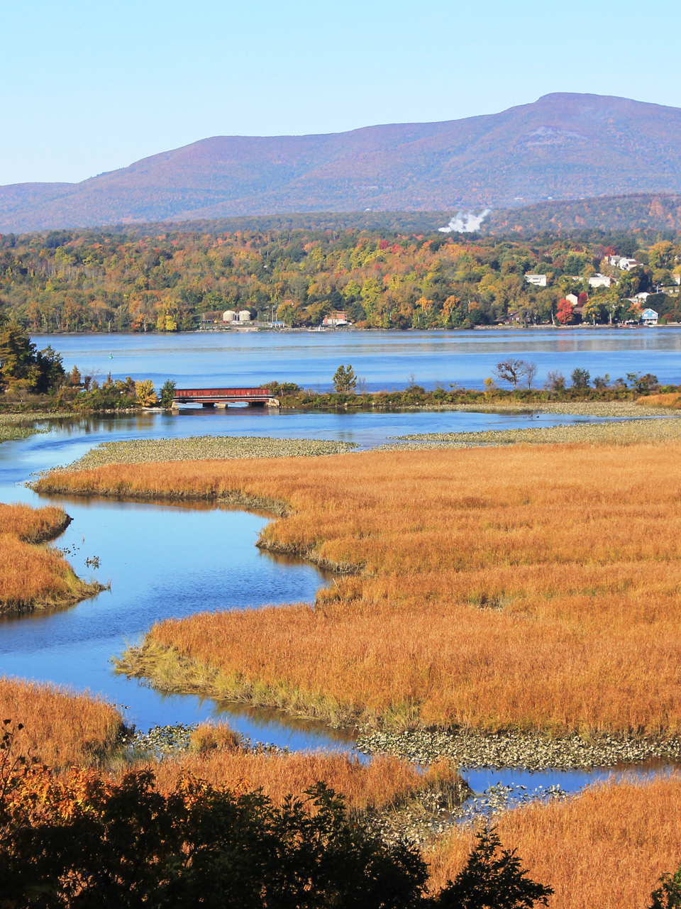
Thank You
Funding provided by:
NERRS funding for Monitoring HREP funding for Mapping
Questions?
Sarah H. Fernald
Manager
Hudson River National Estuarine Research Reserve
256 Norrie Point Way
Staatsburg, NY 12580
Sarah.Fernald@dec.ny.gov
845-889-4745 x111
Connect with us: Facebook: www.facebook.com/NYSDEC Twitter: twitter.com/NYSDEC Flickr: www.flickr.com/photos/nysdec

