Slide 1
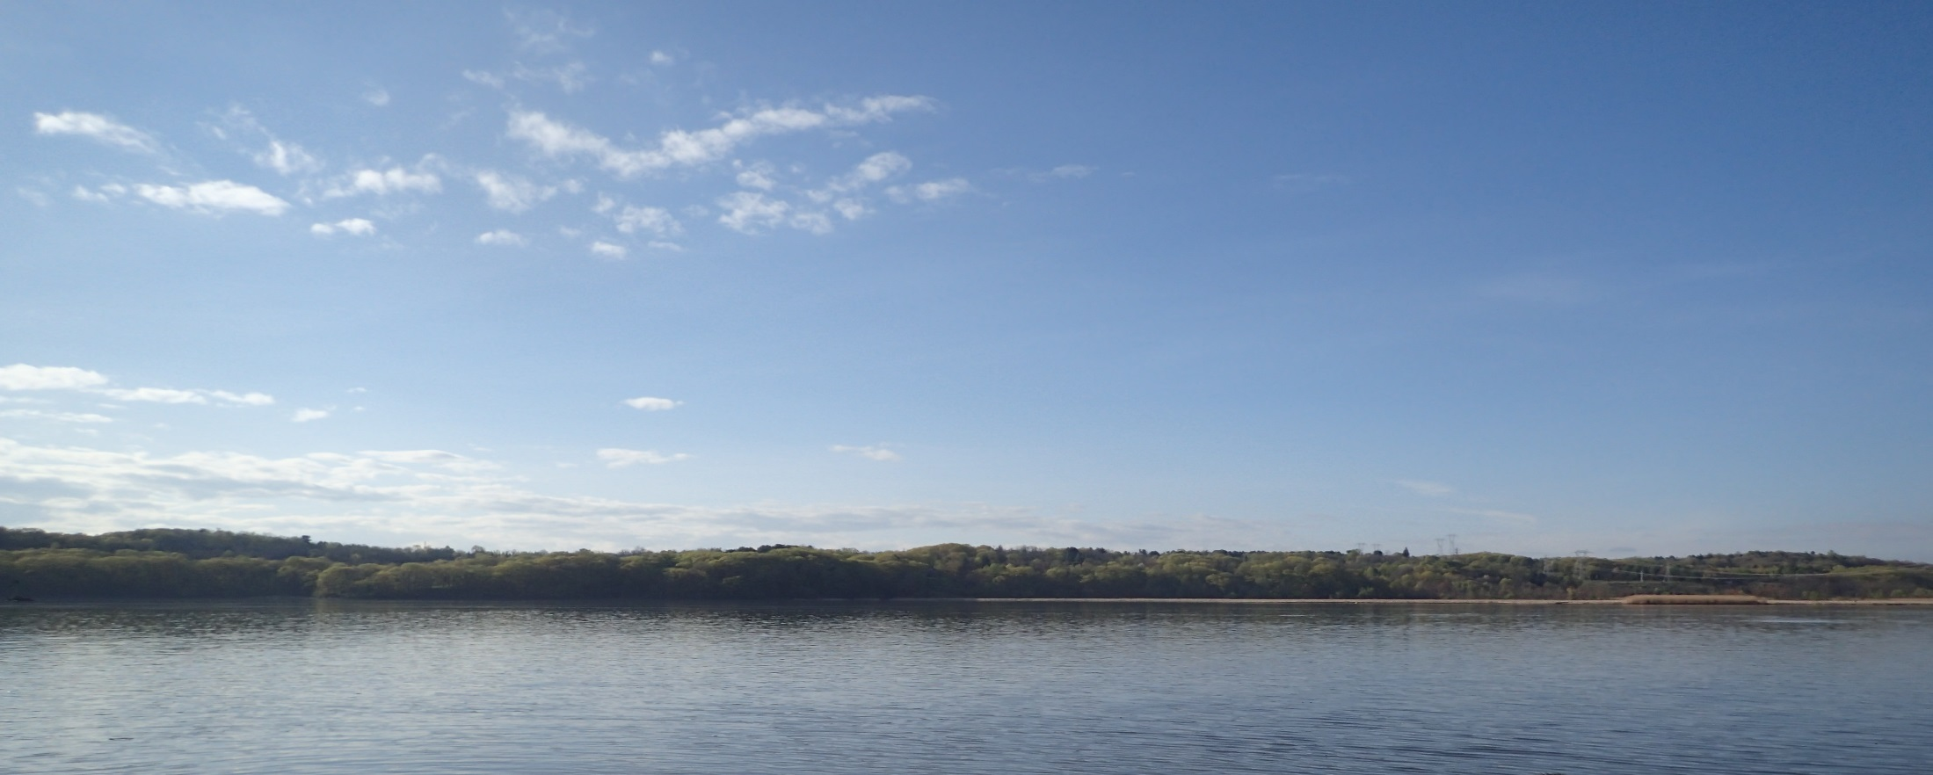
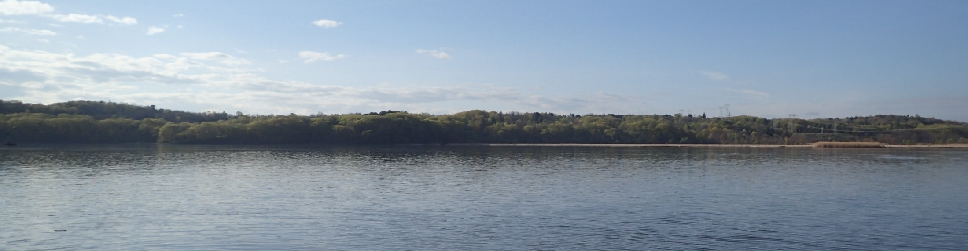
Hudson River Fisheries Surveys and Research
Rich Pendleton, Jessica Best, Wes Eakin, Amanda Higgs, Gregg Kenney, Amanda Simmonds, ElizaBeth Streifeneder
Hudson River Fisheries Unit
Cornell University
Hudson River Programs
Division of Marine Resources
HRES
Oct 8, 2024

Slide 2
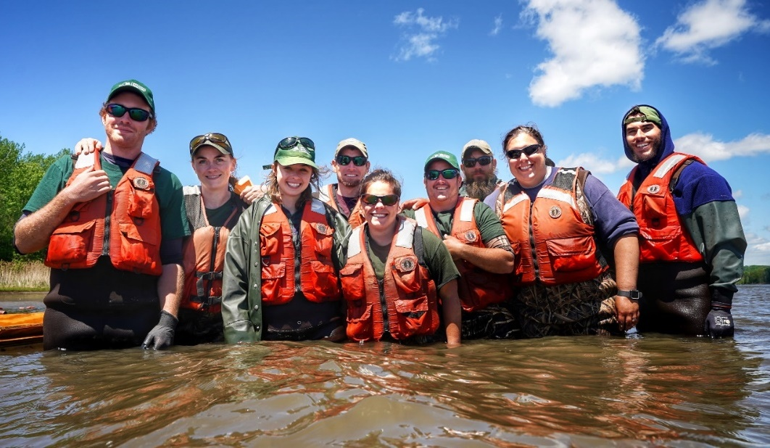
Who we are
NYS Dept. of Environmental Conservation
Cornell University
Hudson River Programs
Division of Marine Resources
Hudson River Fisheries Unit

Slide 3
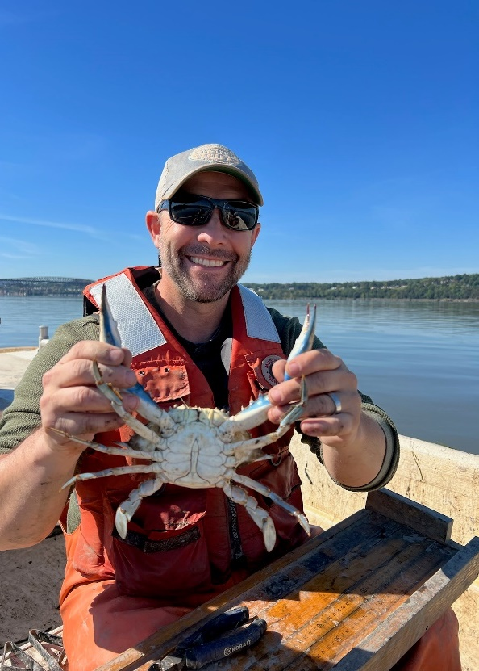
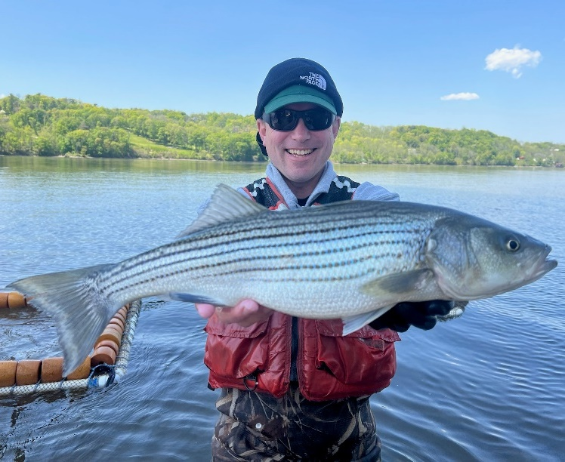
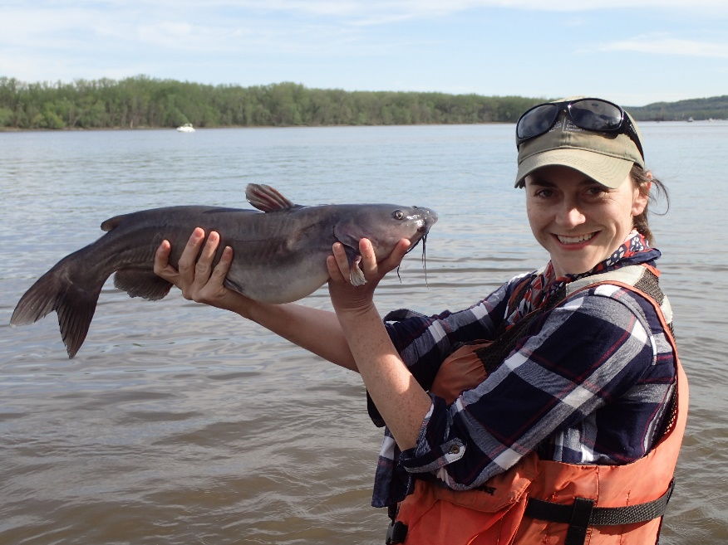
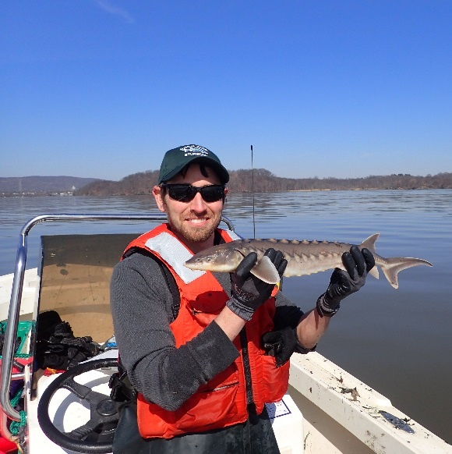
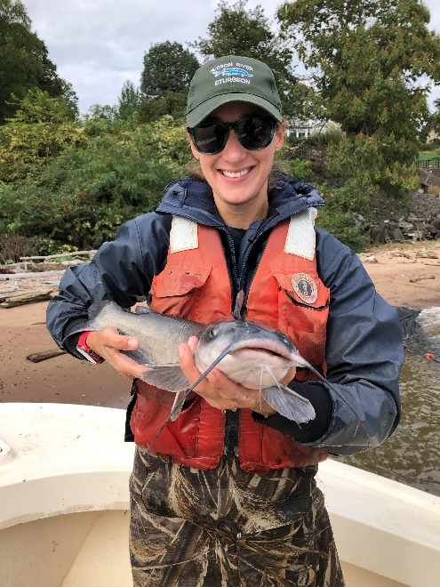
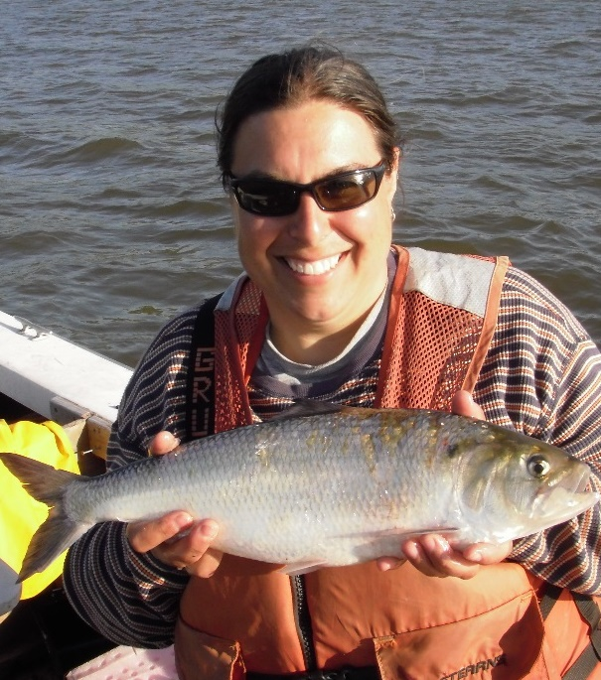
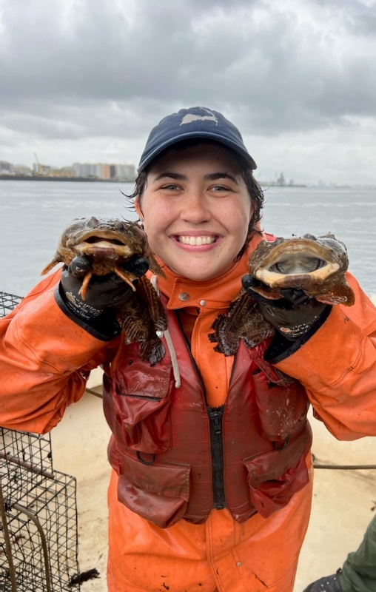
Gregg
Kenney
Wes
Eakin
Jessica
Best
Wes Eakin
Rich
Pendleton
Amanda
Simmonds
Amanda
Higgs
ElizaBeth
Streifeneder

Slide 4
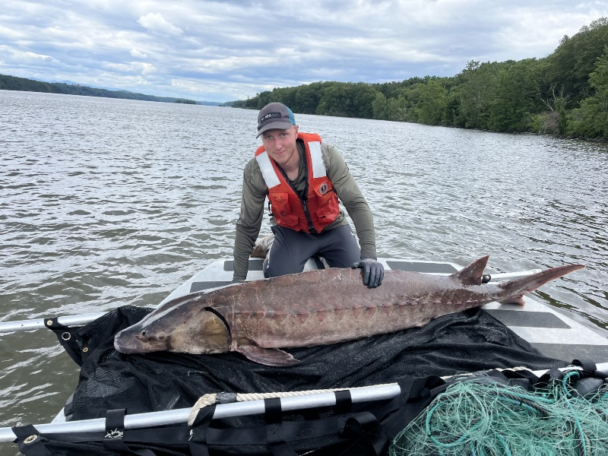
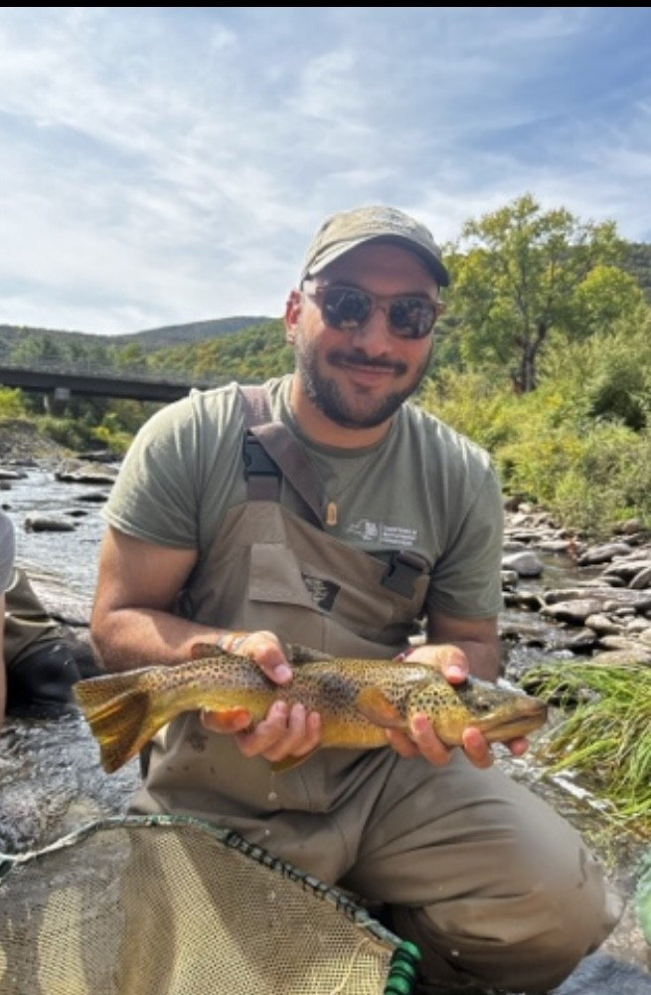
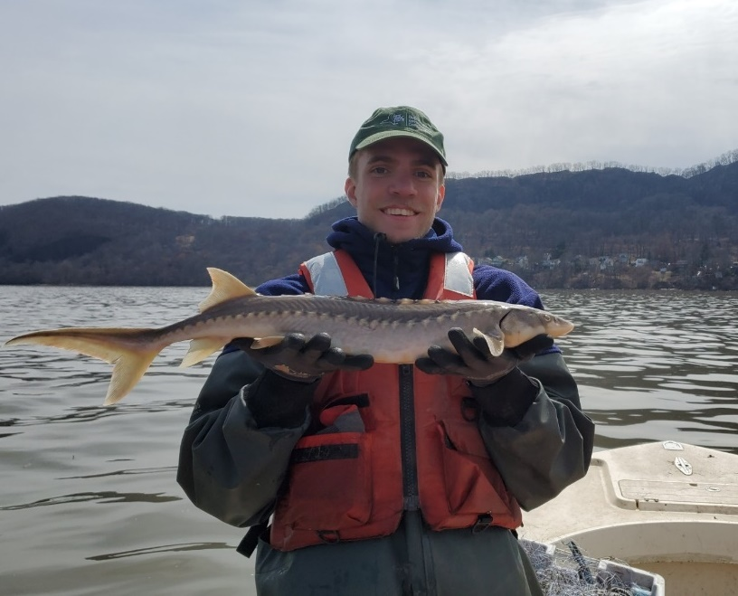
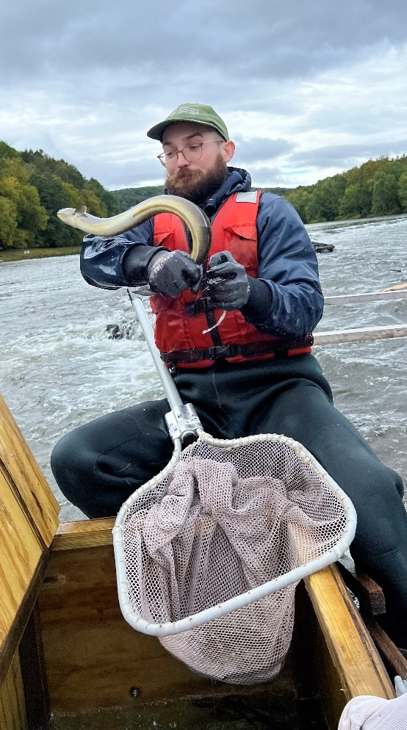
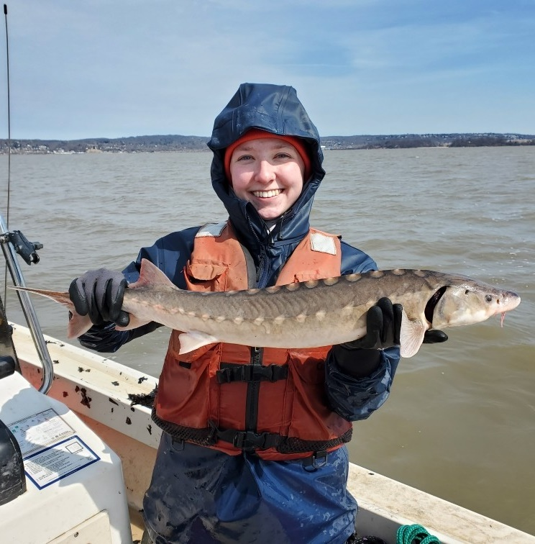
Holly Clark
Dylan Garrabrant
Adam Bonemery
Jack Phillips
Billy Benedict
Courtney Gagne

Slide 5
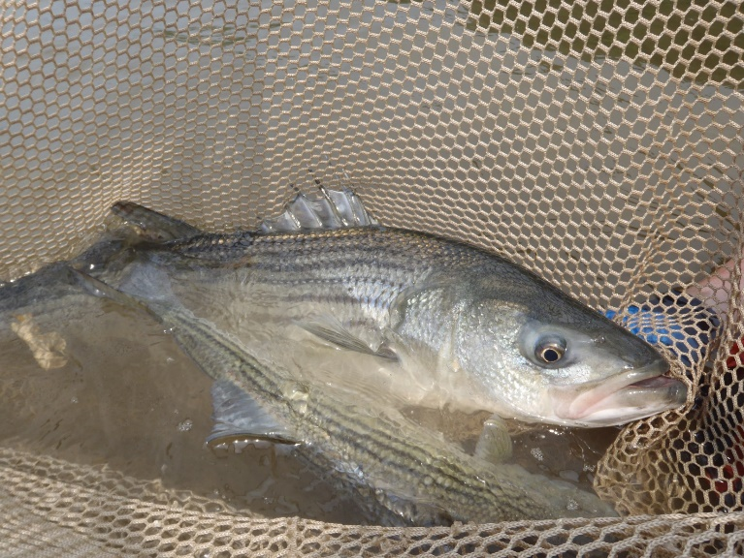
What we do and how we do it
Manage migratory fishes of the sea
  Long-term monitoring
  Research
  Atlantic States Marine Fisheries Commission (ASMFC)

Slide 6
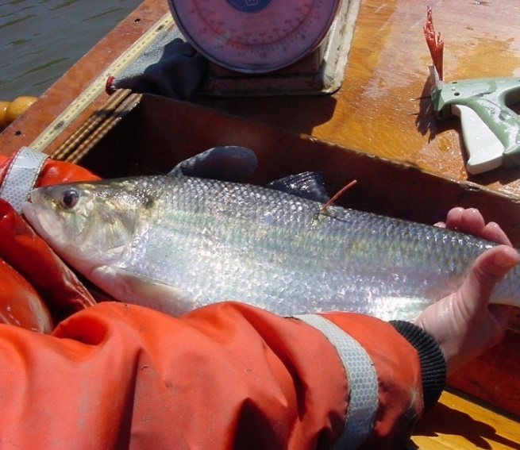
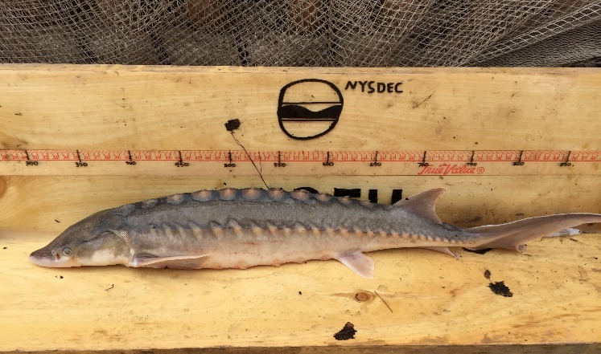
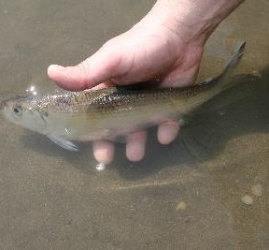
Key species:
alewife
American eel
American shad
Atlantic sturgeon
blue crab
blueback herring
non-native species (round goby, grass carp)
shortnose sturgeon
striped bass

Slide 7
Survey Name
Lead Biologist =
Monitoring
What:
When:
Where:
Who:
Outcomes
Research

Slide 8
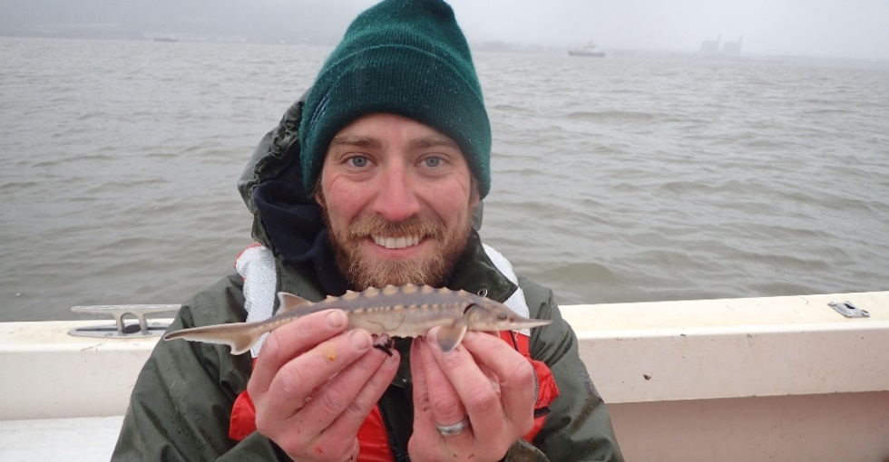
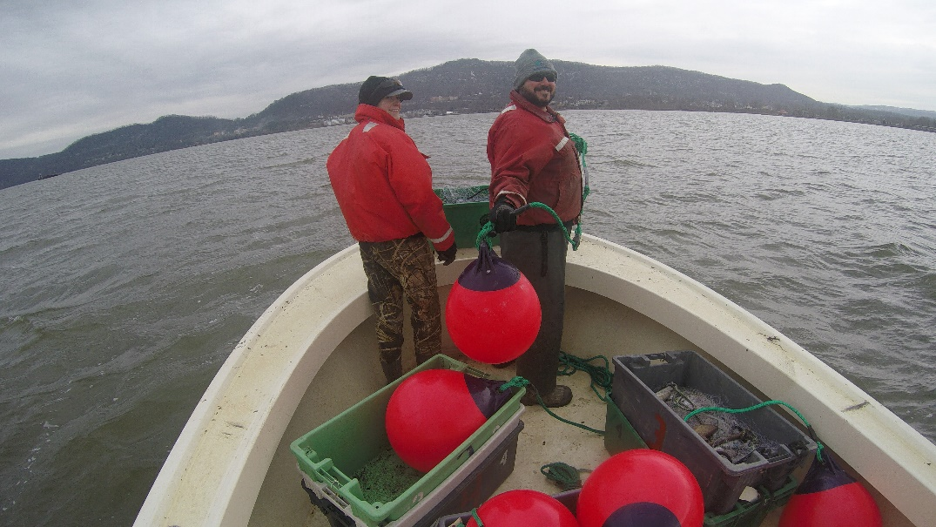
Juvenile Atlantic Sturgeon Survey
Rich Pendleton
-ASMFC Atlantic Herring TC rep
Monitoring
What: gill net survey
When: 2004-present; Feb-April
Where: Haverstraw Bay
Who: Atlantic sturgeon
(bycatch shortnose sturgeon)
Outcomes
Annual index of abundance
Biological characteristics/age structure
Research
Acoustic tagging, genetics

Slide 9
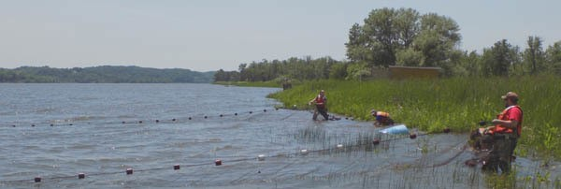
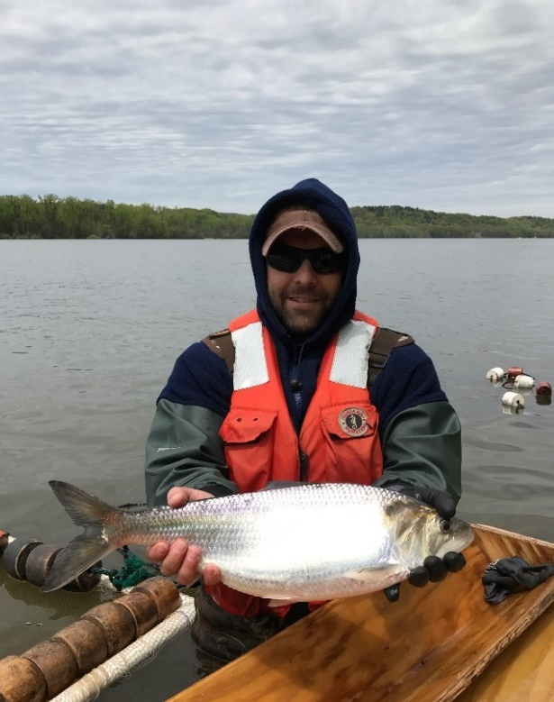
River Herring Spawning
Stock Survey
Wes Eakin
-ASMFC Shad and River Herring TC Chair & SAS
-Delaware River Shad TC rep
-ASMFC Assessment Science Committee
Monitoring
What: 300’ haul seine survey
When: 2012-present; April-May
Where: Kingston, Catskill, Coxsackie, Albany
Who: alewife, blueback herring
(bycatch = shad, bass, white perch)
Outcomes
Annual index of abundance
Biological characteristics/age structure
Research
Acoustic tagging, genetics

Slide 10
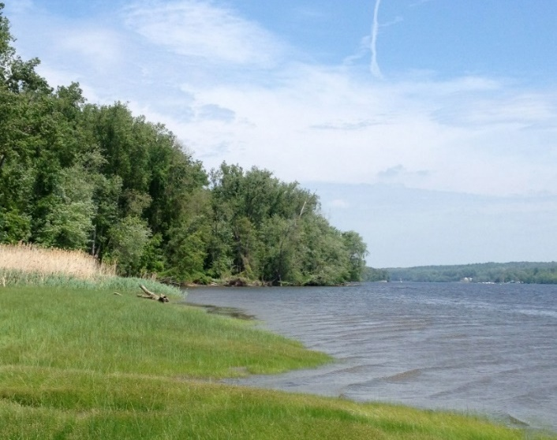
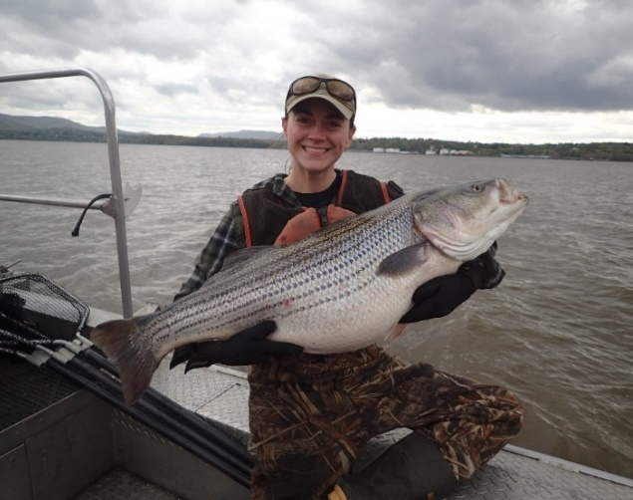
Striped Bass & American Shad
Spawning Stock Survey
Jessica Best
-ASMFC Striped Bass Tagging Sub-Committee
Monitoring
What: 500’ haul seine survey/boat electrofishing
When: 1982-present; April-June
Where: Newburgh to Troy
Who: striped bass & American shad
(bycatch = common carp, white sucker, gizzard shad)
Outcomes
Survival estimates, mortality rates
Biological characteristics/age structure
Research
Mycobacteria, acoustic tagging, microchemistry, genetics, contaminants

Slide 11
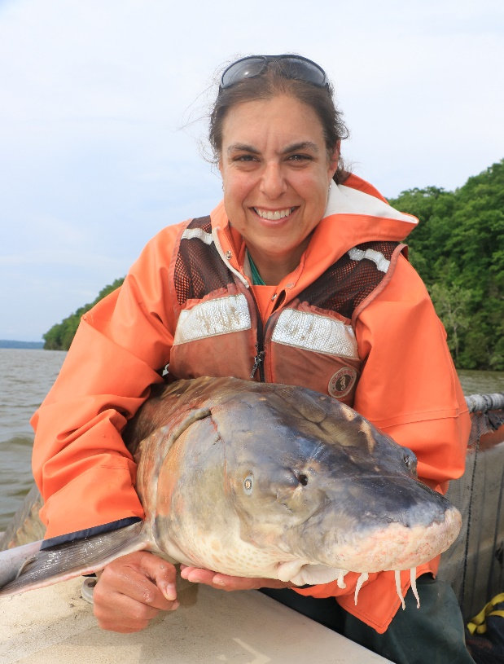
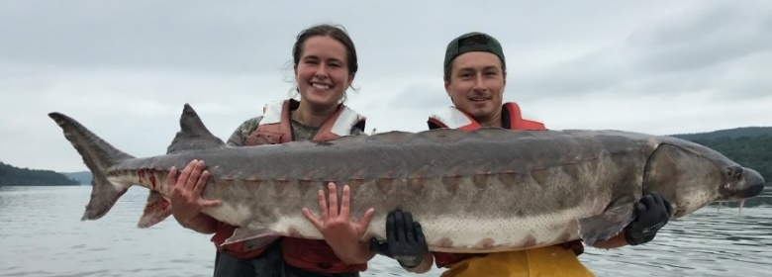
Adult Atlantic Sturgeon
Spawning Stock Survey
Amanda Higgs
-ASMFC Atlantic Sturgeon TC Chair & SAS
Monitoring
What: gill net survey
When: 2006-present; May-June
Where: Hyde Park
Who: Atlantic sturgeon
(bycatch = none)
Outcomes
Annual index of abundance
Biological characteristics
Research
Acoustic tagging, population estimates, genetics

Slide 12
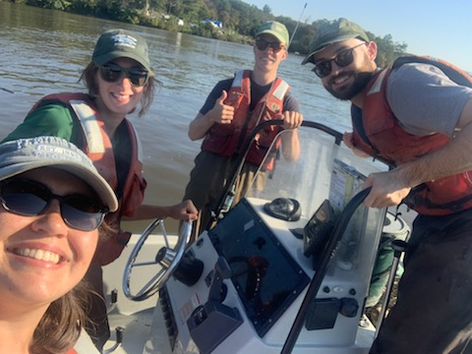
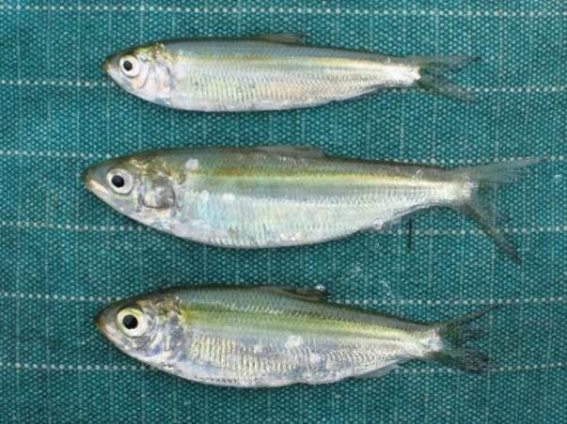
Alosine Beach Seine Survey
ElizaBeth Streifeneder
Monitoring
What: 100’ beach seine survey
When: 1980-present; June-Oct
Where: Newburgh, Poughkeepsie, Coxsackie, Albany
Who: American shad, alewife, blueback herring
(bycatch = spottail shiner, tessellated darter, white perch)
Outcomes
Annual index of abundance (including American eel)
Biological characteristics
Research
Microchemistry, genetics

Slide 13
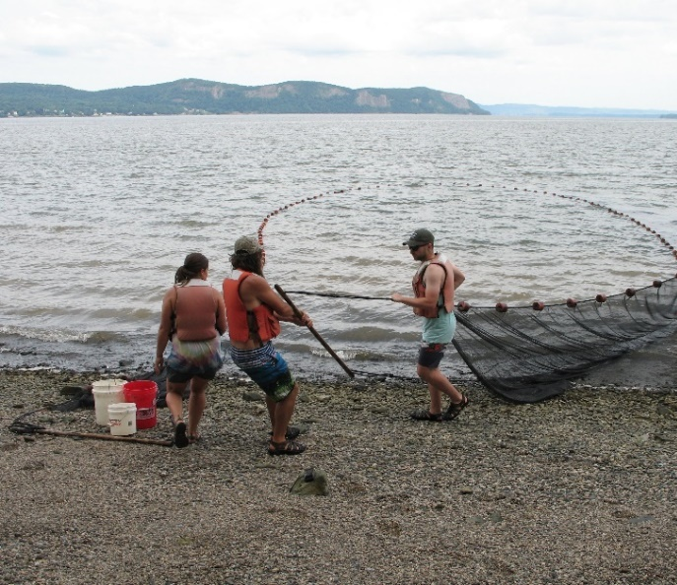
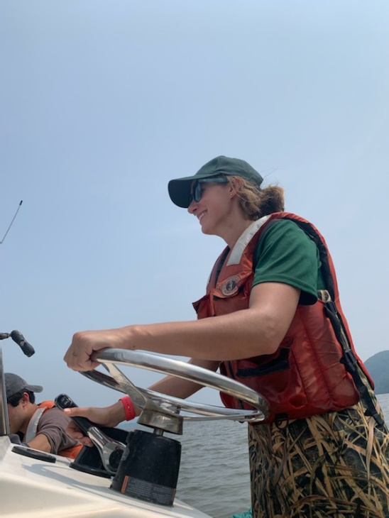
Striped Bass Beach Seine Survey
ElizaBeth Streifeneder
Monitoring
What: 200’ beach seine survey
When: 1979-present; July-Nov
Where: Haverstraw & Tappan Zee
Who: striped bass
(bycatch = Atlantic menhaden, bay anchovy)
Outcomes
Annual index of abundance (including American eel)
Biological characteristics
Research
Microchemistry, genetics

Slide 14
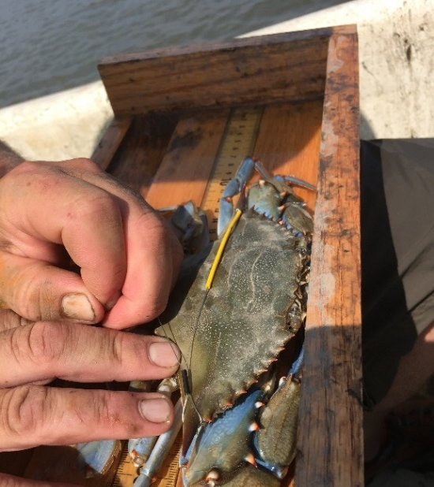
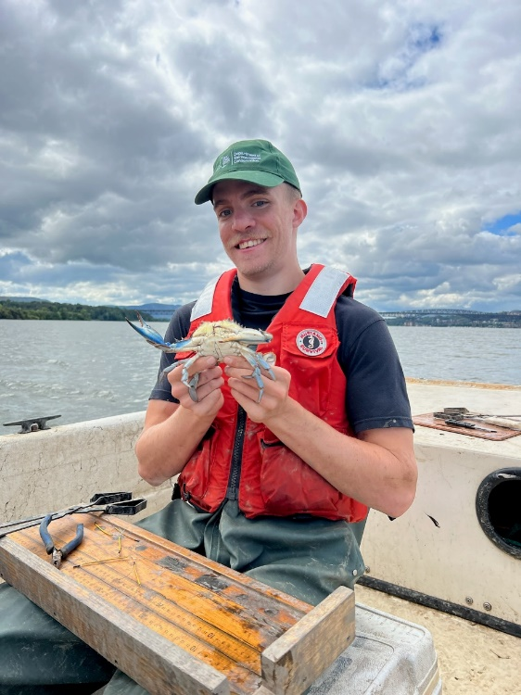
Blue Crab Survey
Jessica Best, Amanda Simmonds
Monitoring
What: baited crab pots
When: 2006-present; June-Oct
Where: Newburgh
Who: blue crab
(bycatch = channel catfish, common carp)
Outcomes
Spatiotemporal movement patterns
Biological characteristics
Research
Contaminants

Slide 15
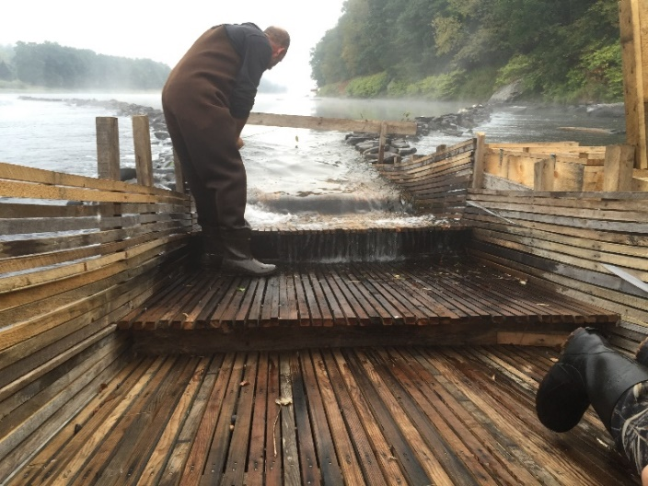
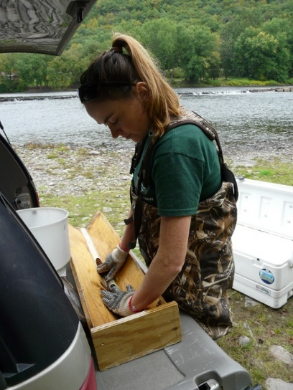
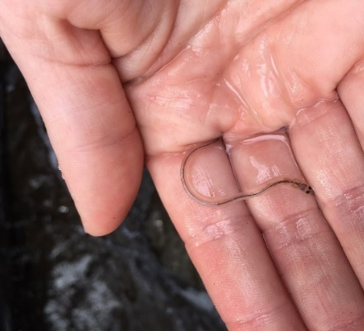
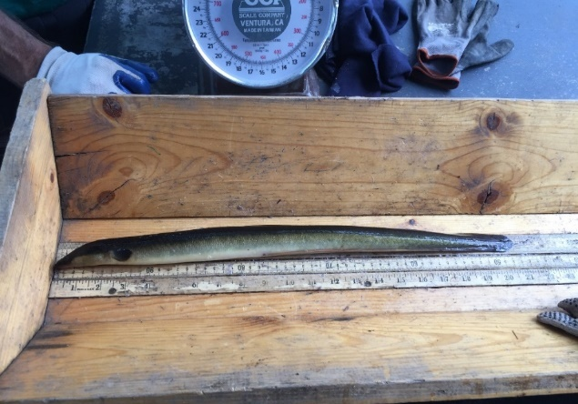
American Eel Monitoring
Jessica Best, Amanda Simmonds
Monitoring
What: cooperative commercial fishers
When: 2013-present; Aug-Nov
Where: Delaware River
Who: American eel
Outcomes
Characterization of fishery
Biological characteristics
Research
Acoustic tagging, community science

Slide 16
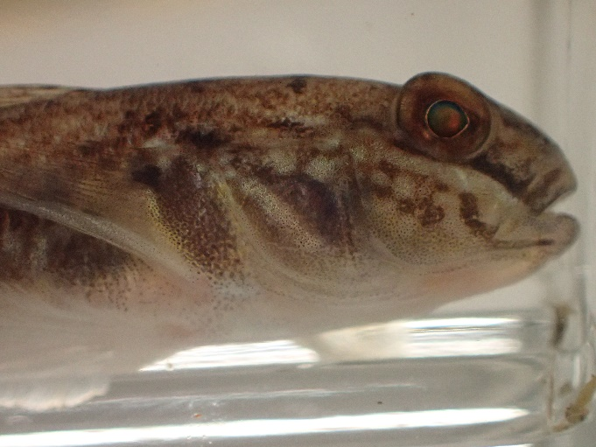
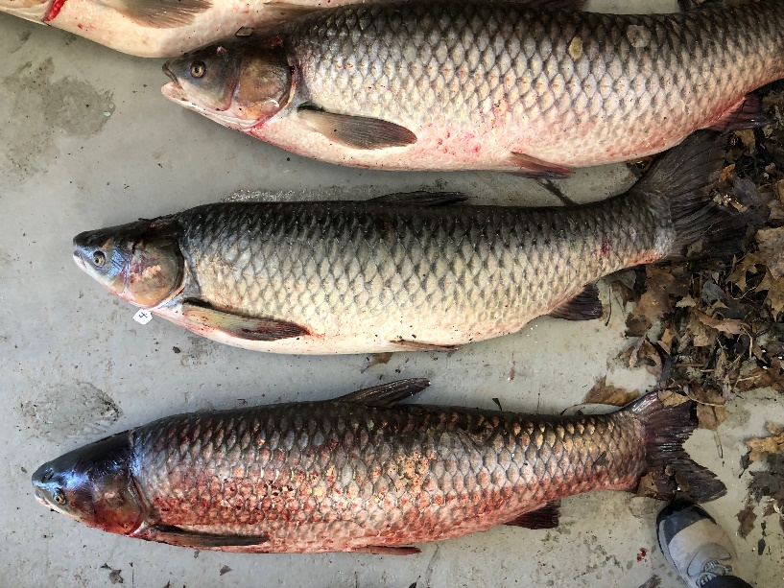
Non-native Species Monitoring
Rich Pendleton, ElizaBeth Streifeneder, Jessica Best
Monitoring
What: eDNA, electrofishing, seining, trawling
When: 2019-present; May-Nov
Where: George Washington Bridge to Troy
Who: round goby, grass carp
Outcomes
Monitor distribution & spread
Evaluating impact
Research
Acoustic tagging, population estimates, diet analysis

Slide 17









Recently completed research projects

Slide 18
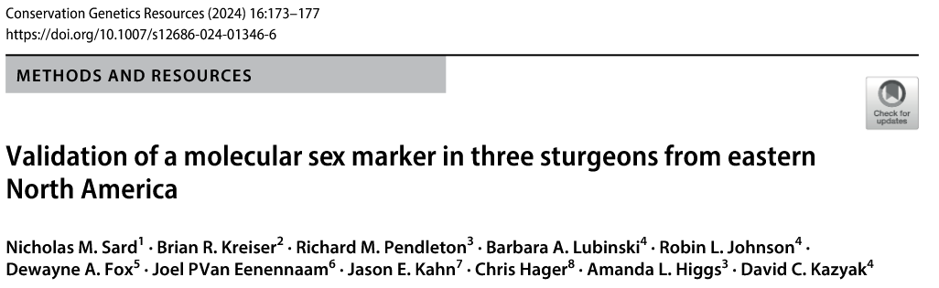
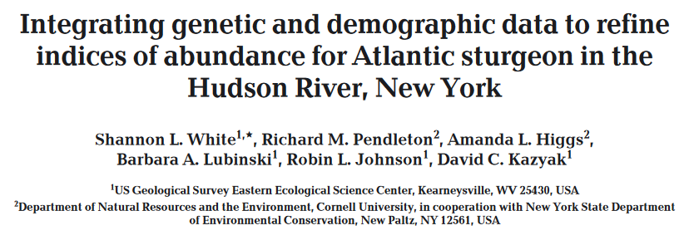
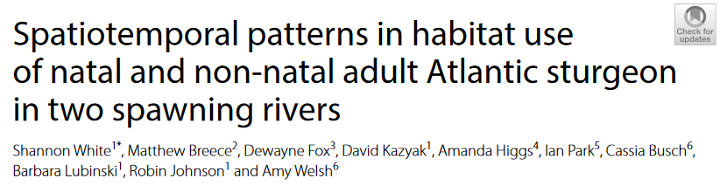
Recently completed research projects

Slide 19
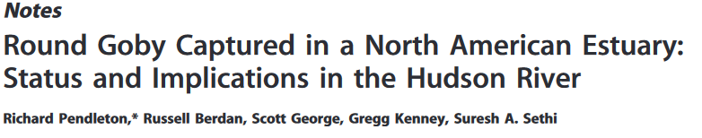
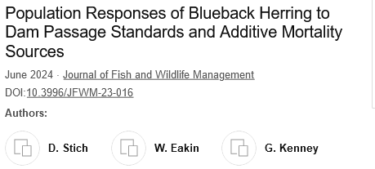
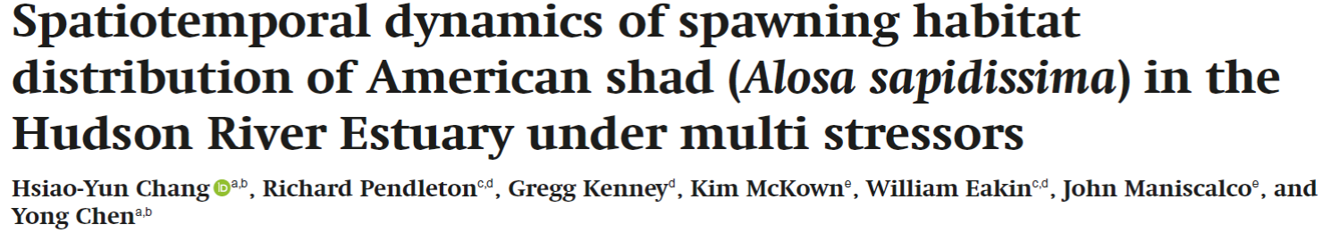

Recently completed research projects

Slide 20

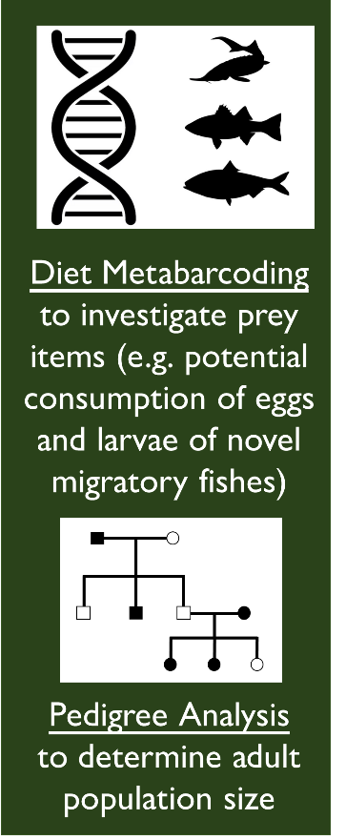
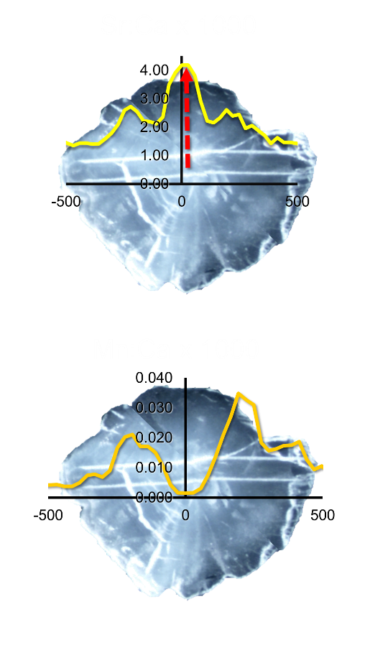


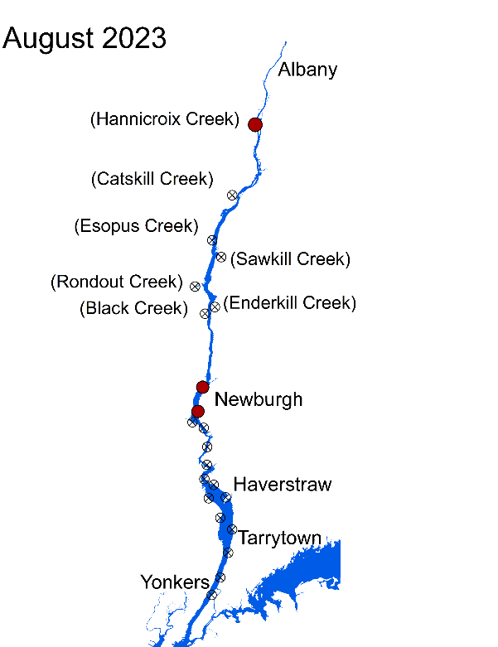
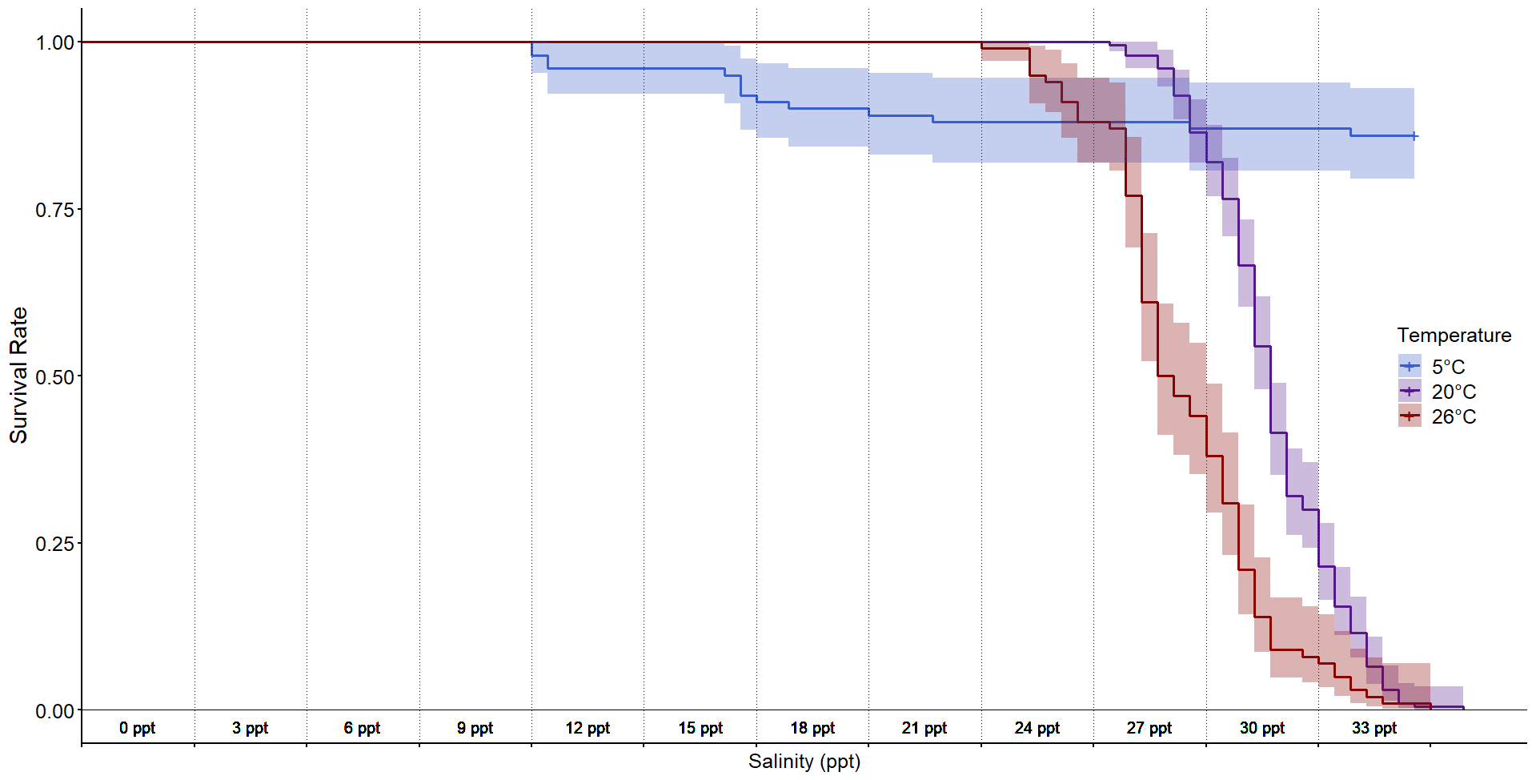
Current research projects (round goby)

Slide 21
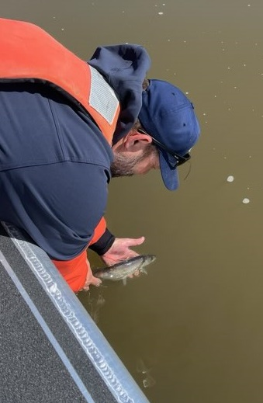


Current research projects (telemetry)

Slide 22


Current research projects (telemetry)

Slide 23
Current research projects (eDNA)
Animal = 32
Plant = 22
rusty crayfish
fish hook flea
silver carp
tubenose goby
black carp
pond loach
western tubenose goby
Chinese mitten crab
mud bithynia
Asian shore crab
tench
Chinese mystersnail
Asiatic clam
spiny waterflea
New Zealand mud snail
sea lamprey
red swamp crayfish
Eurasian ruffe
grass carp
round goby
marbled crayfish
blue catfish
nutria
green crab
quagga mussel
golden mussel
bloody red shrimp
northern snakehead
bighead carp
European rudd
zebra mussel
red eared slider
Carolina fanwort
water violet
Eurasian watermilfoil
starry stonewort
two Horned trapa
curly leaf pondweed
waterwheel
Brazilian elodea
water hyacinth
hydrilla
floating water primrose
marsh dewflower
yellow floating heart
alligatorweed
flowering rush
European frogbit
European water fern
brittle naiad
watercress
sacred lotus/pink lotus
water lettuce
water soldiers

Slide 24



Current research projects (eDNA)
zebra mussel
Eurasian watermilfoil
water chestnut

Slide 25



Current research projects (eDNA)
round goby
grass carp
rusty crayfish

Slide 26


Current research projects (eDNA)

Slide 27


Current research projects (shortnose)
This information is preliminary or provisional and is subject to revision. It is being provided to meet the need for timely best science. The information has not received final approval by the U.S. Geological Survey (USGS) and is provided on the condition that neither the USGS nor the U.S. Government shall be held liable for any damages resulting from the authorized or unauthorized use of the information.

Slide 28
Next Generation Ecosystem Monitoring
HRF contracted Lower Food Web Monitoring
SBU HRBMP metadata and calibration
Focused Research
Data Management Program
HR Environmental Conditions Observing System (HRECOS)
DEC contracted Fall Juvenile Survey
DEC Long-term Surveys

