Slide 1
River-wide Acoustic Array: Monitoring Fish Movement in the Hudson River
Amanda Higgs
NYSDEC Hudson River Estuary Program/Cornell University
Hudson River Fisheries Unit
Dr Dewayne Fox-Delaware State University
Dr Shannon White-USGS
HRES October 8, 2024

Slide 2
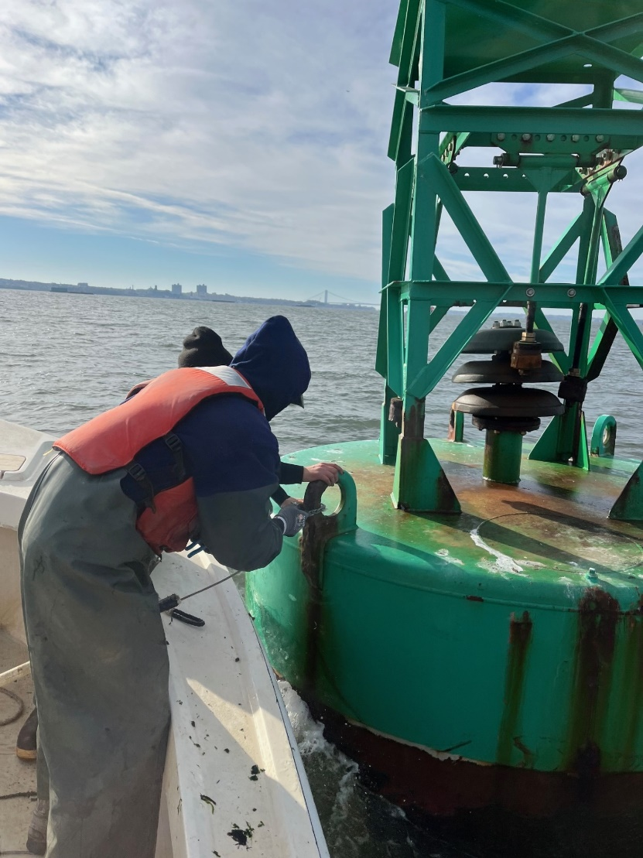
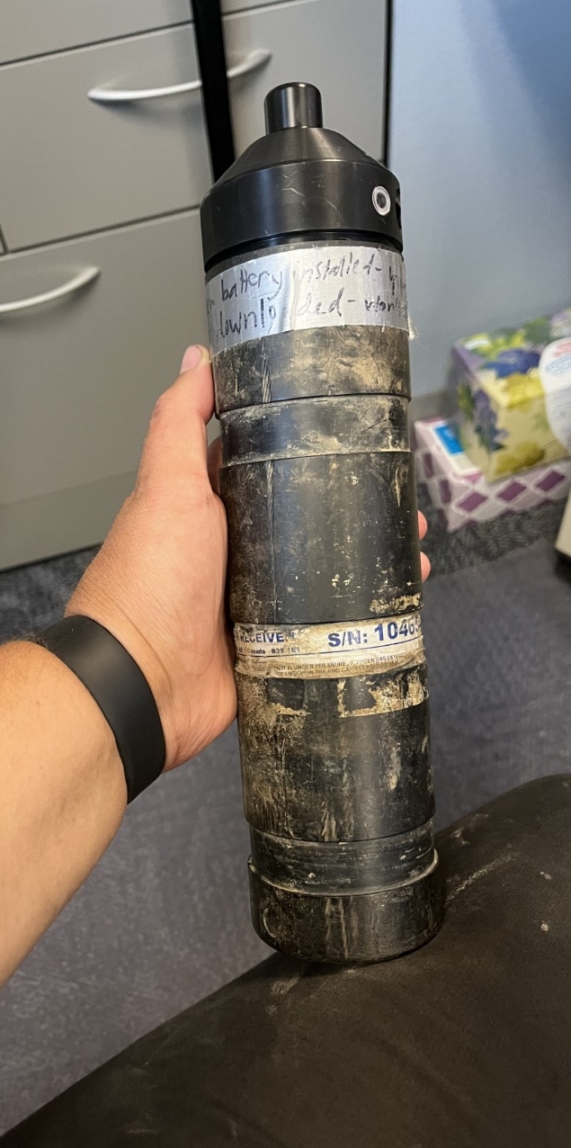
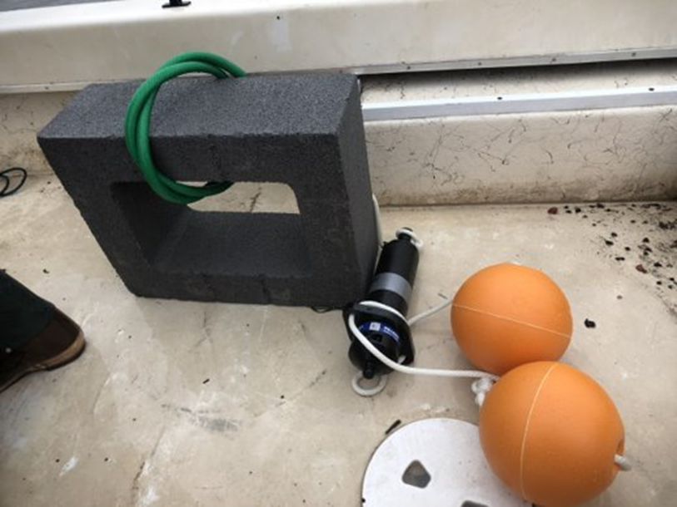
What is an “Acoustic Array”?

Slide 3
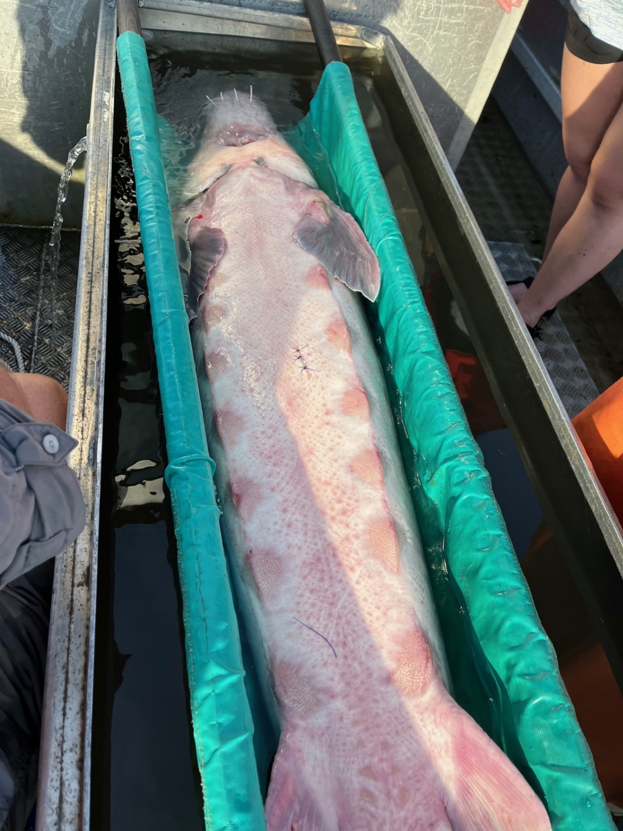
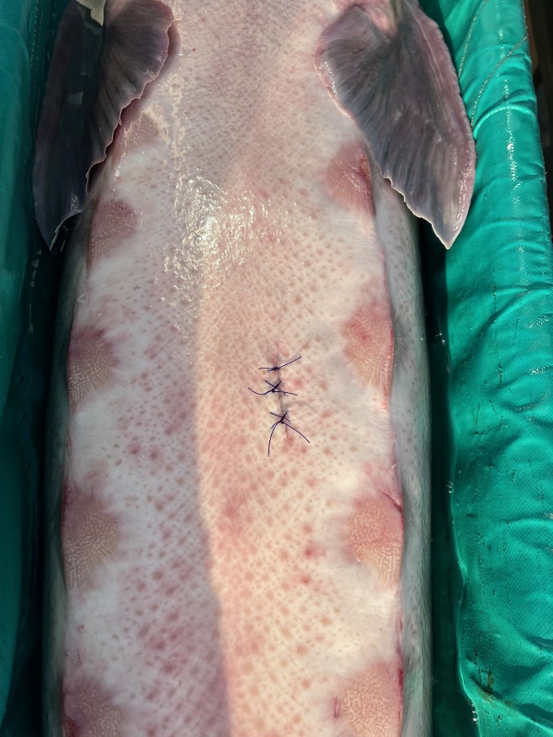
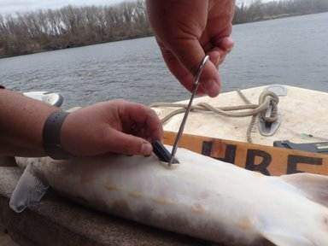
Acoustic telemetry
Deploy tags in fish
Detections as the fish swims past the receiver
Can include depth of the fish at the time of detection
Positioning system: Triangulated locations with
detections on 3 or more receivers

Slide 4
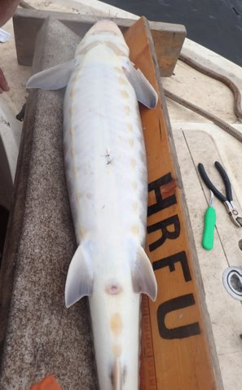
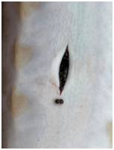
Technology – getting better and better
Tags have a long battery life – lots of data
Detection data can be fed mark recapture models
Develop mortality rates
Develop abundance estimates
Learn about movement and use of the river
Develop work windows
Areas of avoidance

Slide 5
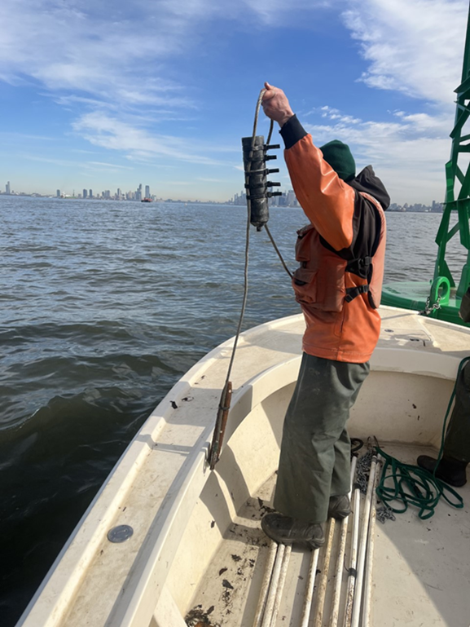
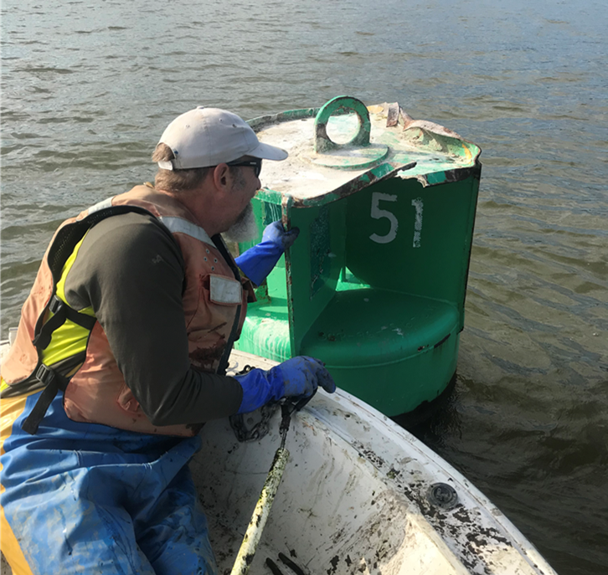
History of the Hudson River Array
Maintained a portion since 2009, collaborated with others (DESU, SBU)
The locations have varied over time, species
Receivers attached to USCG buoy, bridge abutments
Seasonal deployment (April-October)

Slide 6
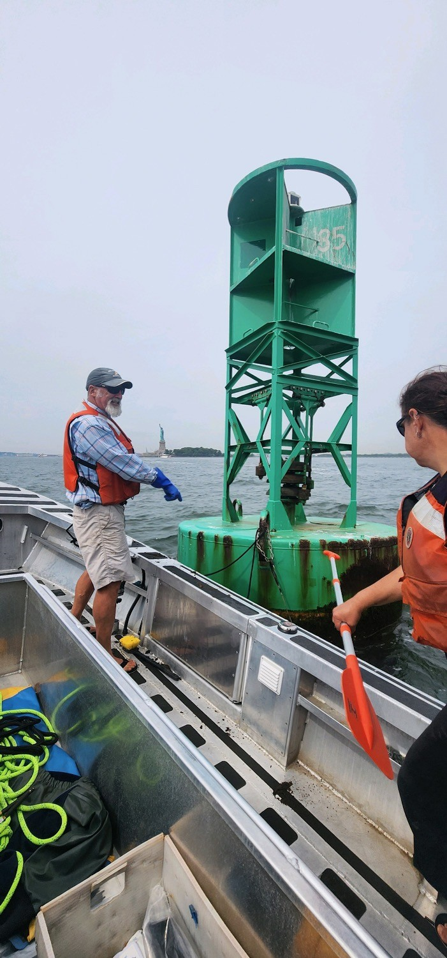
Array….
NY Bay aka NY Harbor
Historically deployed
March 2022, added receivers to NYH (AK, KVK)
Current array 68 receivers, NYH to Troy Dam, tribs
2024- 24 Mohawk receivers, BBH
Winter 2024-2025, array

Slide 7
Map of Locations

Slide 8
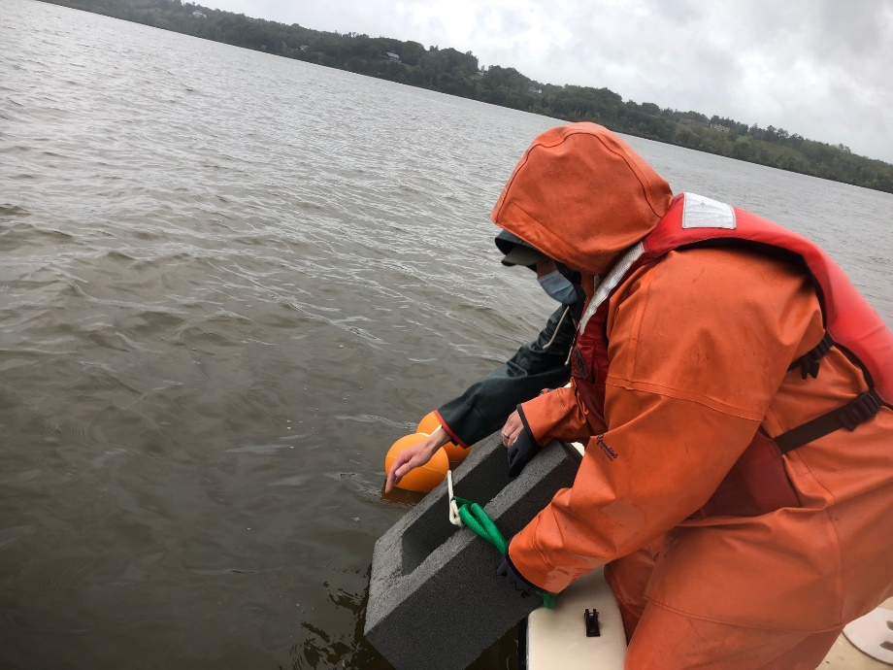
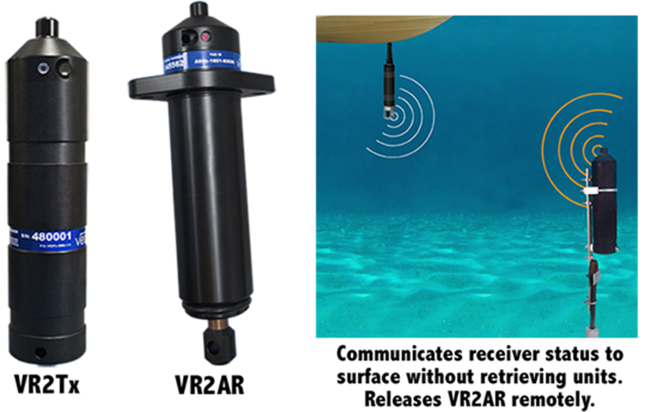
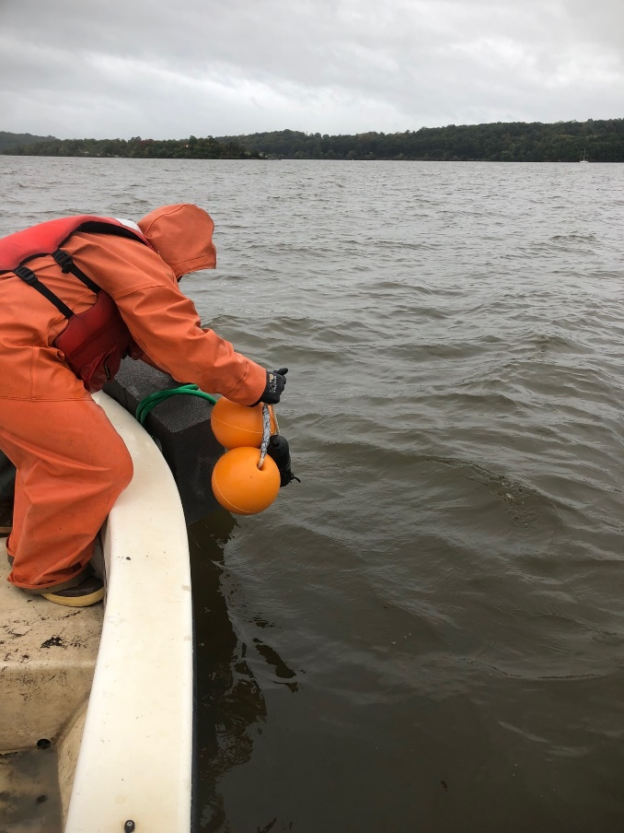
Innovasea https://www.innovasea.com/wp-content/uploads/2023/12/Innovasea-ft-vr2ar.pdf

Slide 9
Challenges , aren’t there always
Detection data belongs to the researcher that tagged the fish
Manuscript authorship
Data sharing

Slide 10
Coast wide data management
- MATOS (Mid-Atlantic Telemetry Observing System)
- Data sharing and management of detections

Slide 11
What are we doing with these data?
Published estimate of abundance for 2014 spawning ATS
Data used in the ASMFC ATS assessment, developed mortality rates
Published non-natal use of the ATS in Hudson/DE Rivers
Develop work windows (internal NYSDEC)

Slide 12
Coming soon….
Coast wide ATS telemetry project, results coming soon
Model ATS locations based on NASA satellite imagery
Juvenile ATS emigration rates and movement in Hav Bay
SNS/ATS residence time/seasonal use of NY Bay
3 year ATS Hudson/DE Rivers abundance estimates
BBH Mohawk River movement and influence of dams
American silver eel emigration and movement
Invasive grass carp movement

Slide 13
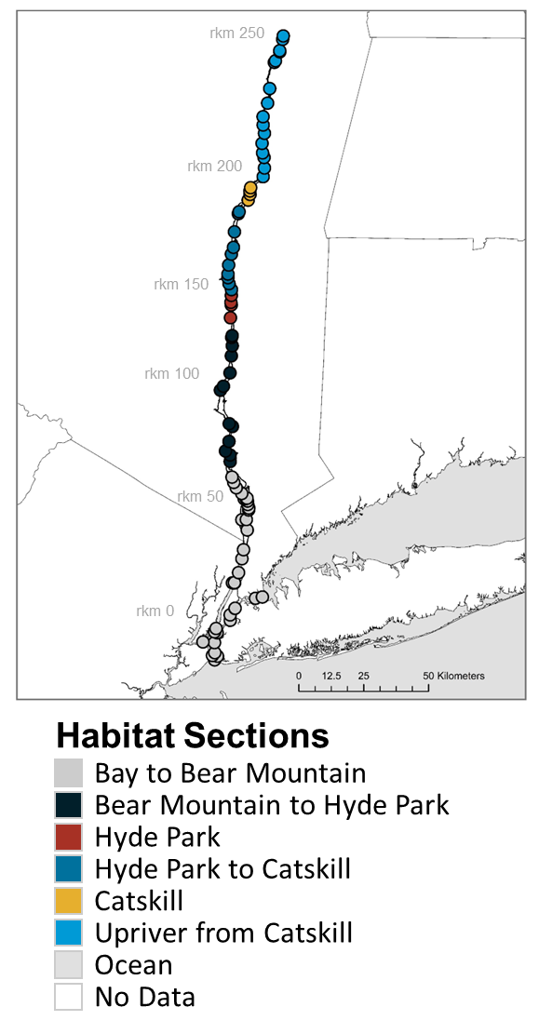
Spawning Atlantic Sturgeon natal/non-natal movement
*
*Potential spawning area

Slide 14
Adult Shortnose Sturgeon movement

Slide 15
All males….

Slide 16
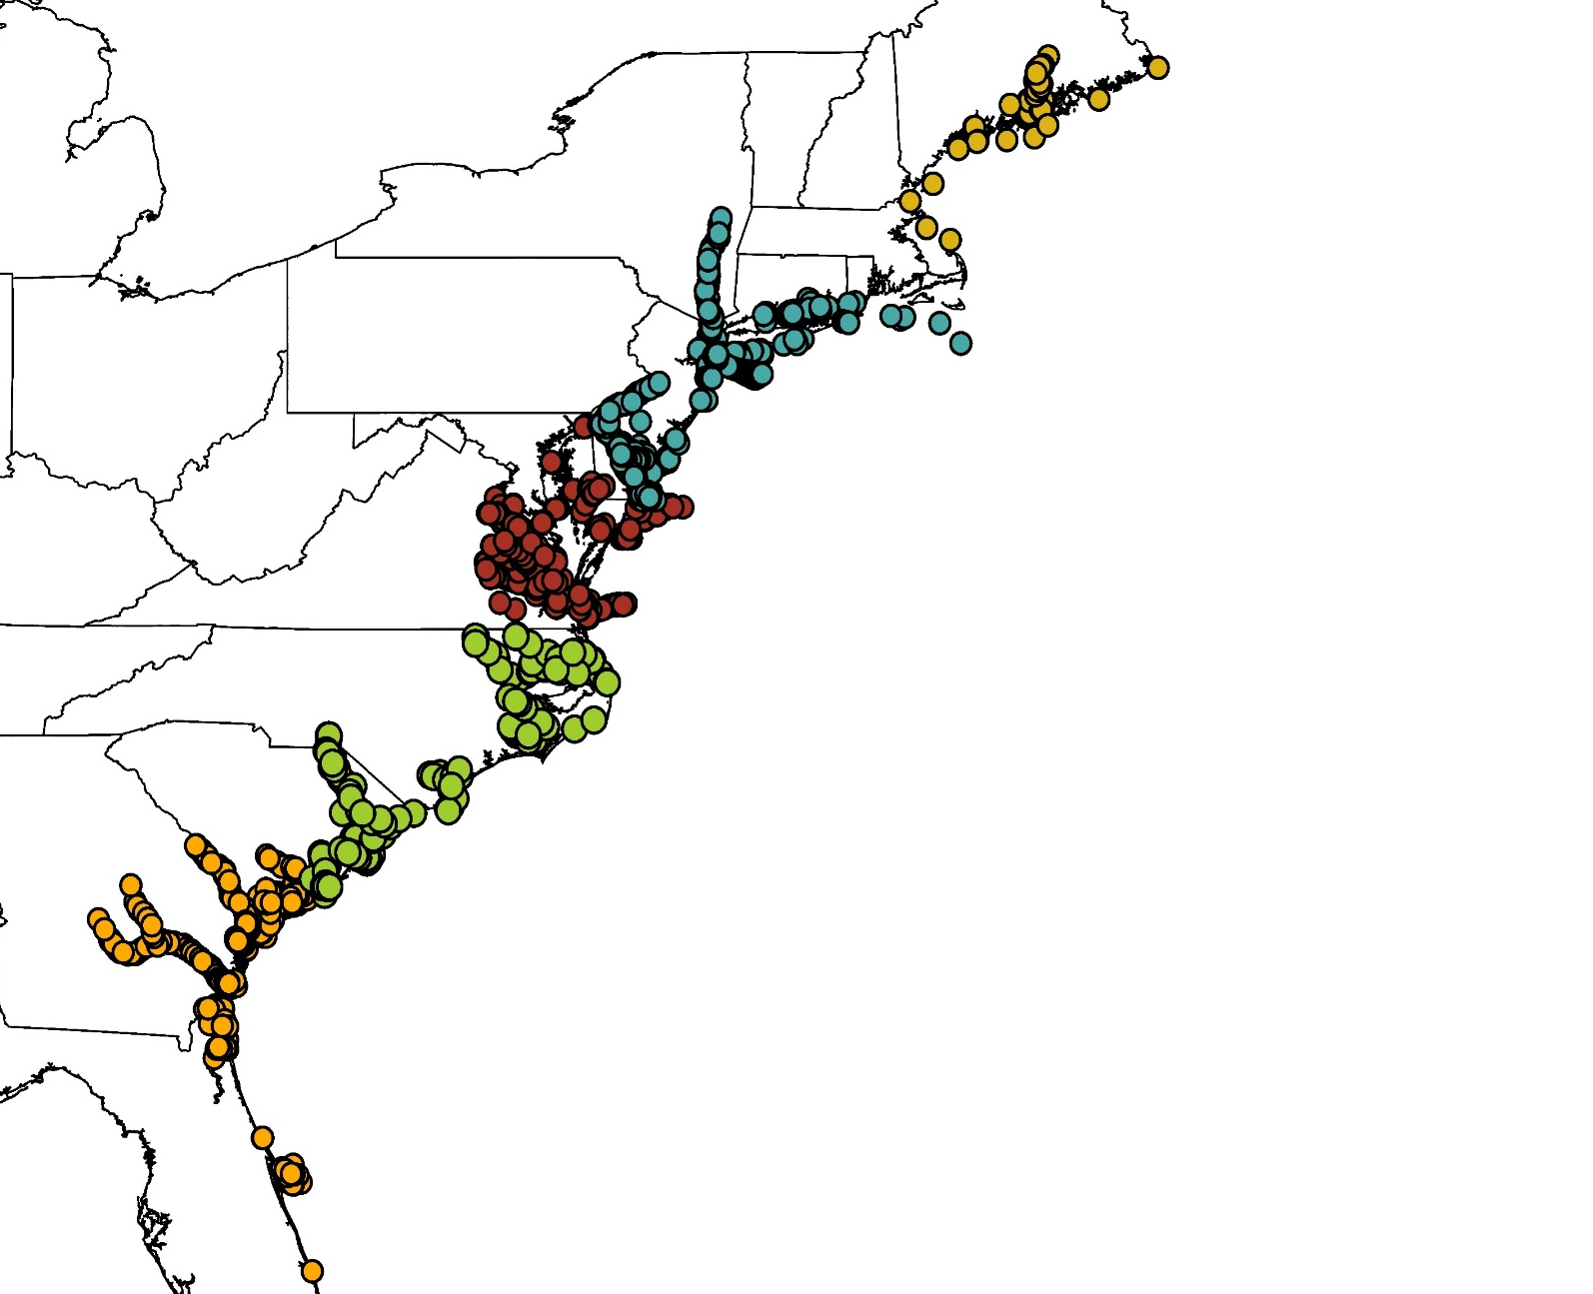
24 institutions contributing data
2,658 acoustically tagged Atlantic sturgeon
Over 32,000,000 from 2007 to 2021
Genetic assignment tests to determine river and DPS of origin
Most individuals genetically sexed

Slide 17
Thanks for your time!
Contact:
Amanda Higgs
Cornell University/NYSDEC
amanda.higgs@dec.ny.gov
Thanks to staff at HR Fish Unit for assisting with maintenance of the array
what is to come.
All fish and collected and tagged under NMFS ESA permit 20340

