Slide 1
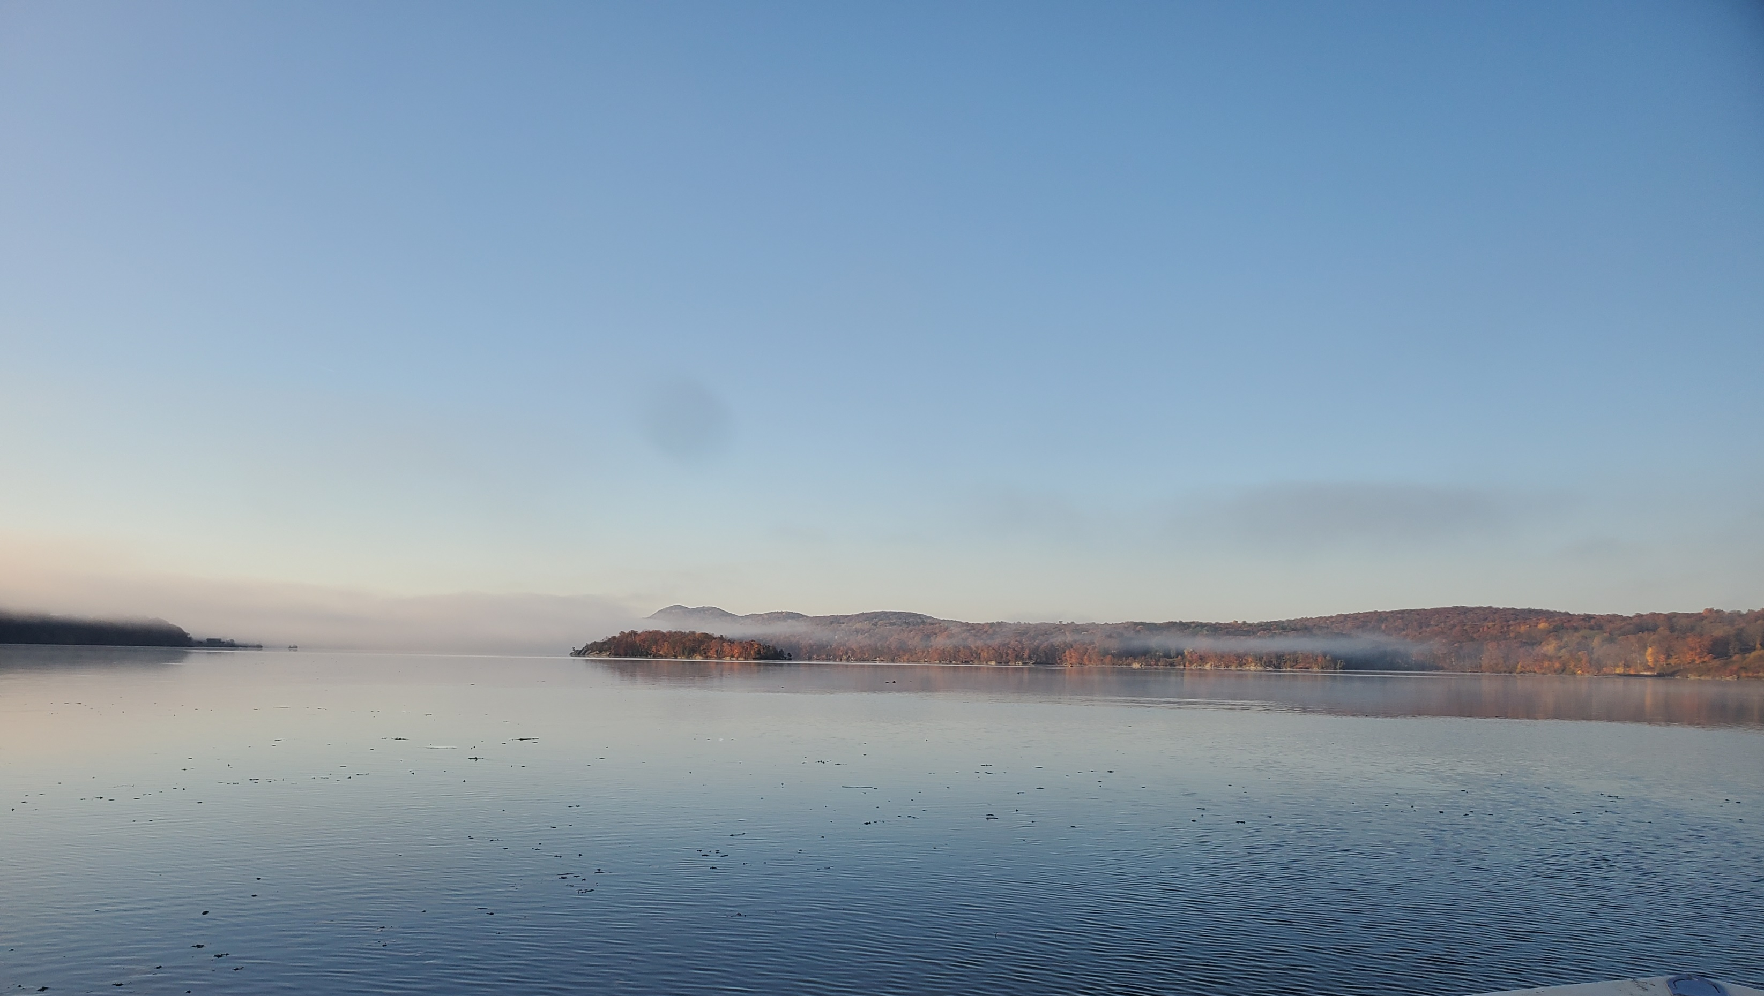





Sounding the Hudson: Applications of Bioacoustics for Ecosystem Monitoring in the Hudson River
Rebecca E. Cohen¹, Patrick Baker², Christopher Bowser^{3,4,5}, Matthew Breece⁶, Alexander S. Flecker⁷, Dewayne Fox⁸, Amanda Higgs^{4,5}, Maija Niemistö^{3,4,5}, Richard Pendleton^{4,5}, Suresh A. Sethi⁹, Shannon White¹⁰, Aaron N. Rice¹
¹ K. Lisa Yang Center for Conservation Bioacoustics, Cornell Lab of Ornithology, Cornell University
² United States Military Academy
³ Hudson River National Estuarine Research Reserve
⁴ New York State Department of Environmental Conservation
⁵ Cornell Water Resources Institute
⁶Marine Science Department, St. Mary’s College of Maryland
⁷ Department of Ecology & Evolutionary Biology, Cornell University
⁸ Department of Agriculture & Natural Resources, Delaware State University
⁹ Department of Earth & Environmental Sciences, CUNY Brooklyn College
¹⁰United States Geological Survey

Slide 2

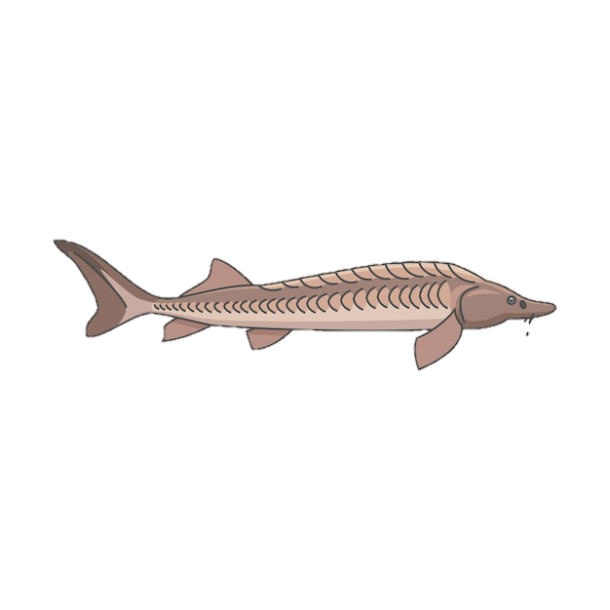


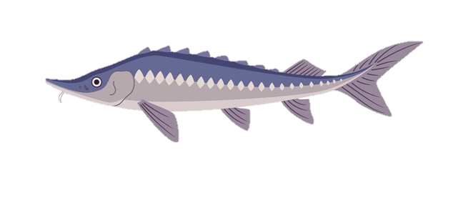

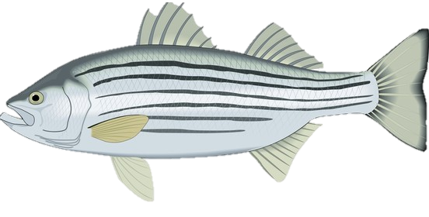
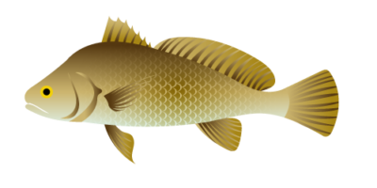
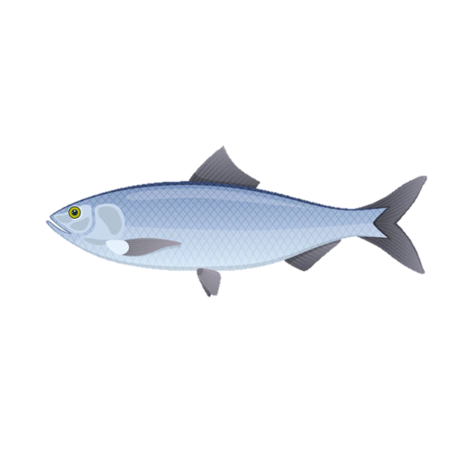
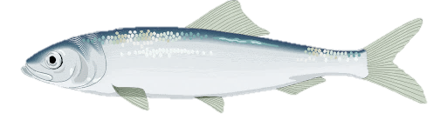
Background
Goals:
Understand how key fish species use Hudson River and HRNERR component site habitats
Monitor protected species in a cost-effective manner while minimizing harm, physical stress, or behavioral response
Foster public engagement and stewardship via science outreach and education tools
www.bioacoustics.cornell.edu
Hudson River Symposium, 8 October 2024, Cary Institute for Ecosystem Studies
Notes:
Funded by NOAA-NERRS to explore applications of bioacoustics for protected fish species & ecosystem monitoring in the Hudson
2 smaller spinoff projects funded by WRI
Species of interest
Why bioacoustics?
Marine background
Sound vs light
Non-invasive

Slide 3
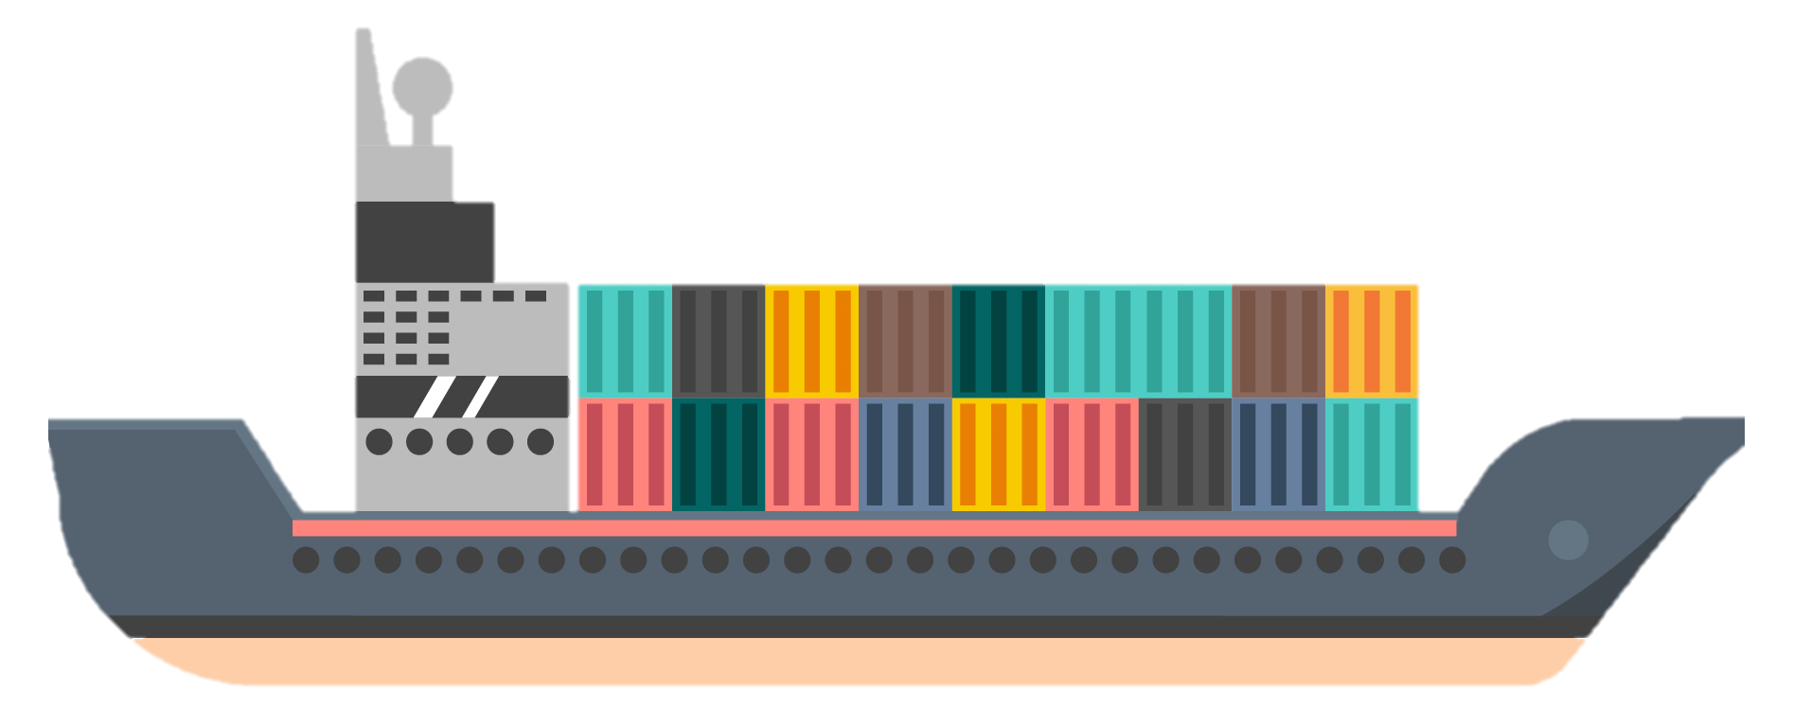
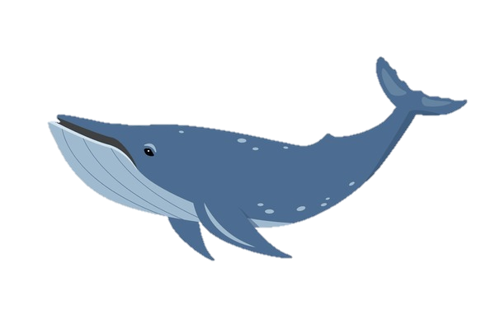
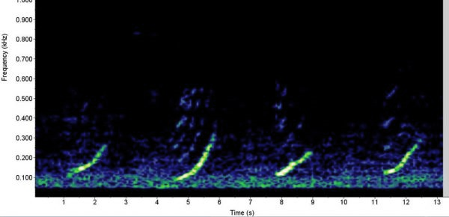




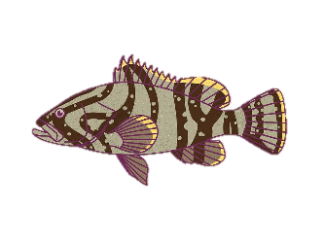
Passive Acoustic Monitoring (PAM)
Entails collection of soundscape data to identify presence of species of interest
Active sound production documented in ~1000 fish species (Looby et al. 2022)
  96% of species still uncharacterized
Sound production likely to be widespread in actinopterygian fish (Rice et al. 2022)
Digitization
Automated Detection/Classification
Species Acoustic Activity Time Series
Soundscape
Characteristics
Soundscape Metric Computation
Broadband Soundscape Recording
Spectrogram Generation
www.bioacoustics.cornell.edu
Hudson River Symposium, 8 October 2024, Cary Institute for Ecosystem Studies
Notes:
How bioacoustics?

Slide 4
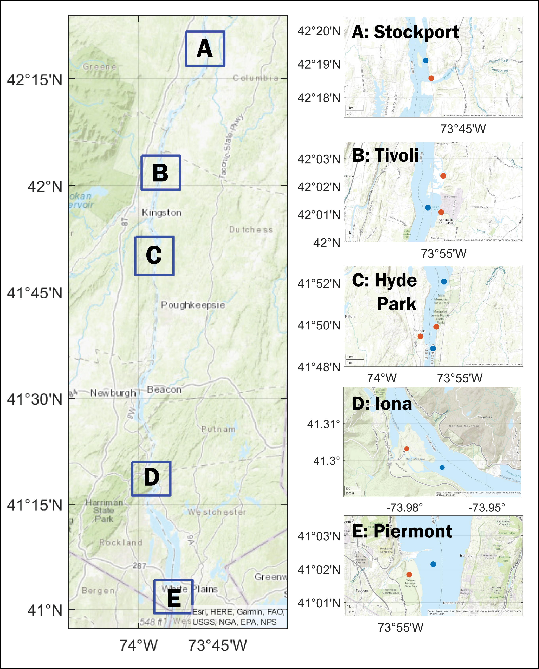
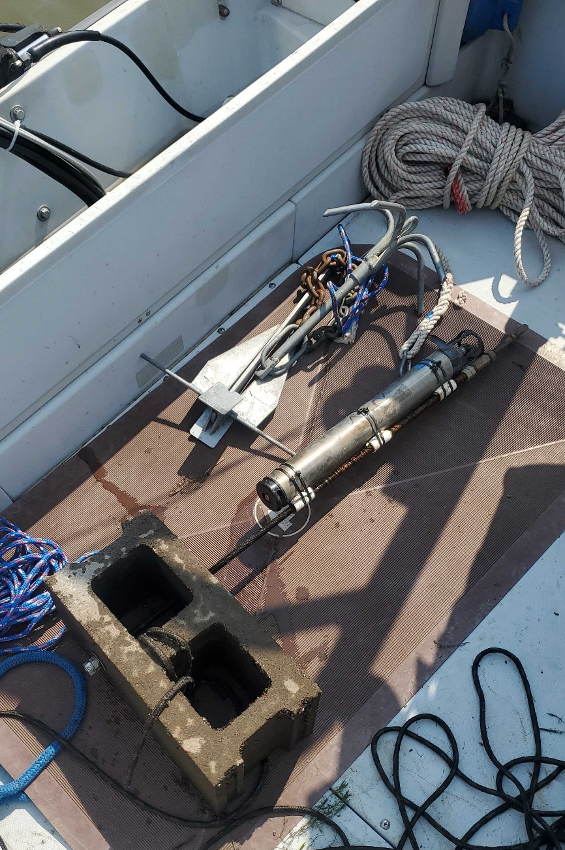
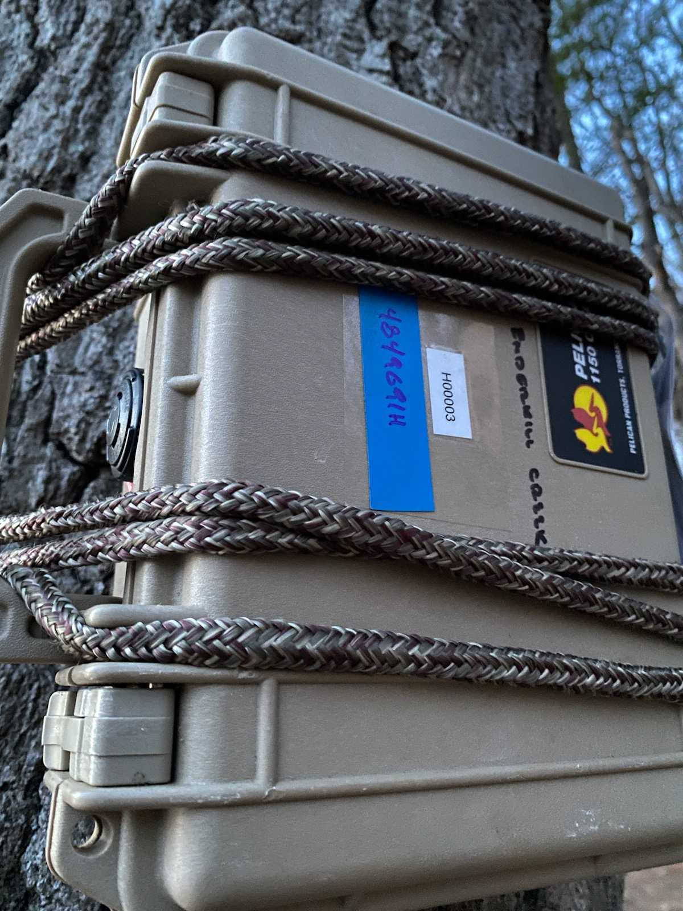
Study Sites: HRNERR Component Sites, plus Hyde Park area
Main channel:
SoundTrap ST600
Tributaries/Wetlands: Swift Recorder w cabled hydrophone
SoundTrap
Swift
www.bioacoustics.cornell.edu
Hudson River Symposium, 8 October 2024, Cary Institute for Ecosystem Studies
Notes:
Have some pilot data from 2020-2022
Broadscale monitoring across region began April 2023
Last year and this year, recorded at NERRS component sites (plus Hyde Park Atl Stur spawning site) from April-Oct
Additional recording locations for each WRI project
Start w WRI project

Slide 5
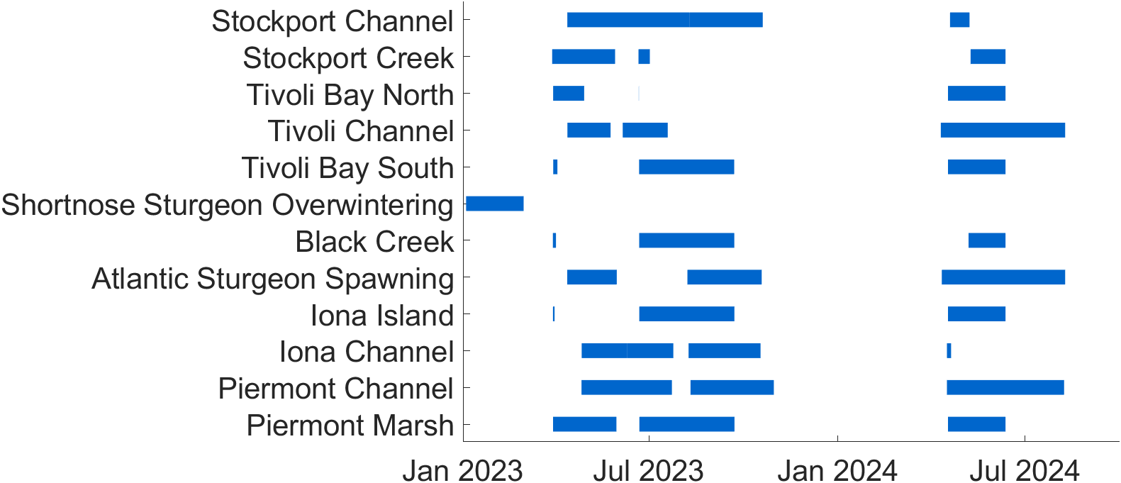
Study Sites: HRNERR Component Sites, plus Hyde Park area
SoundTrap
Swift
www.bioacoustics.cornell.edu
Hudson River Symposium, 8 October 2024, Cary Institute for Ecosystem Studies
Notes:
Does not include last leg of data collection this year
Start with a WRI project

Slide 6
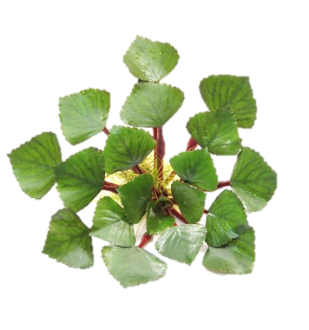
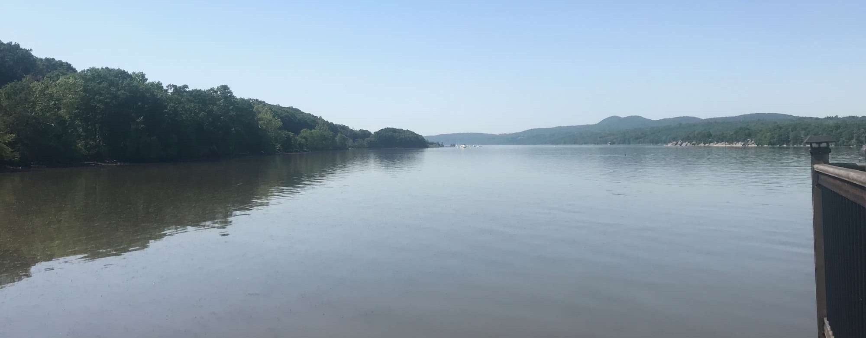
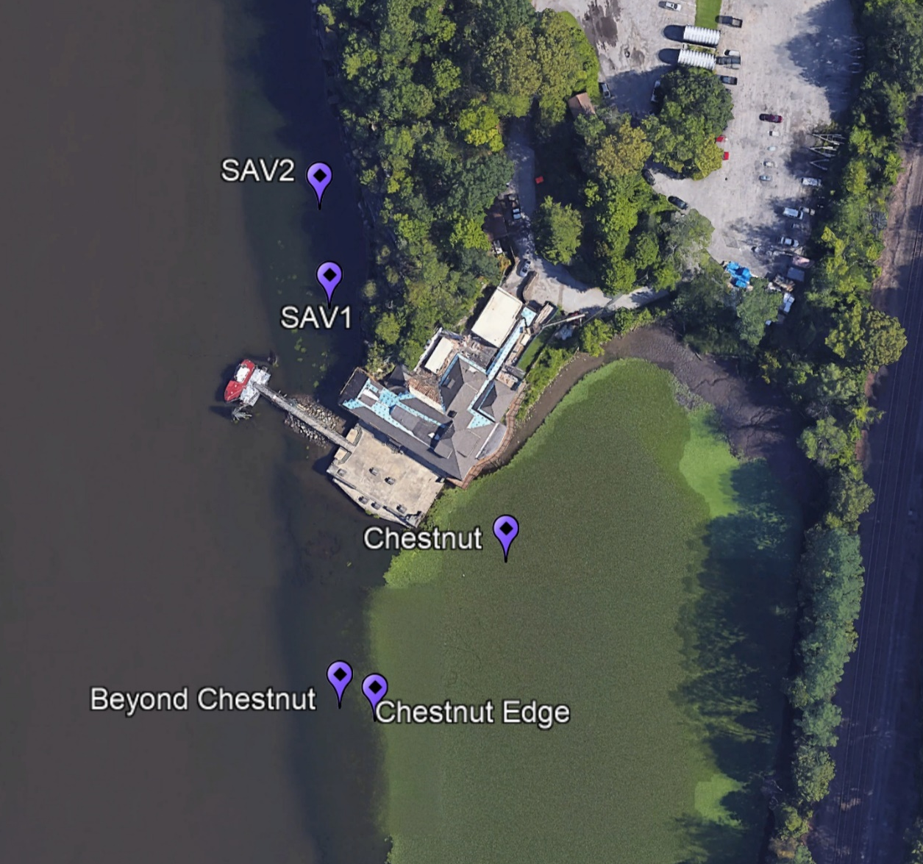
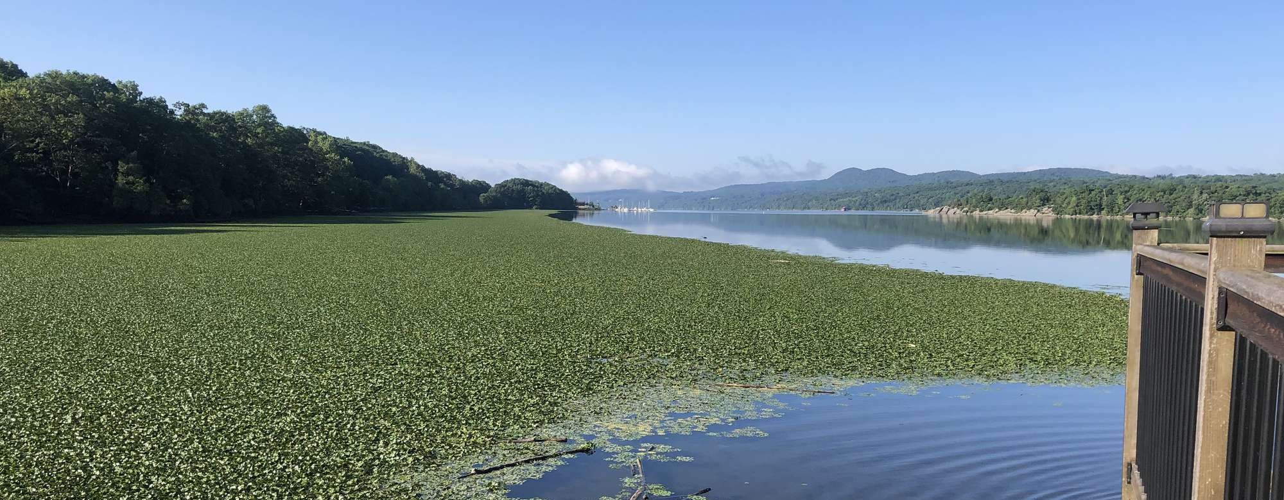

Water Chestnut vs. Submerged Aquatic Vegetation Soundscapes
Trapa natans
31 May, 2022
13 July, 2022
Acoustic Recorder
Oxygen Sensor
www.bioacoustics.cornell.edu
Hudson River Symposium, 8 October 2024, Cary Institute for Ecosystem Studies
Notes:
Estuarine habitats are dynamic, substantial fluctuations in temperature, salinity, vegetation, flow speed & direction on seasonal & tidal cycles
Exemplified by invasive water chestnut growth

Slide 7
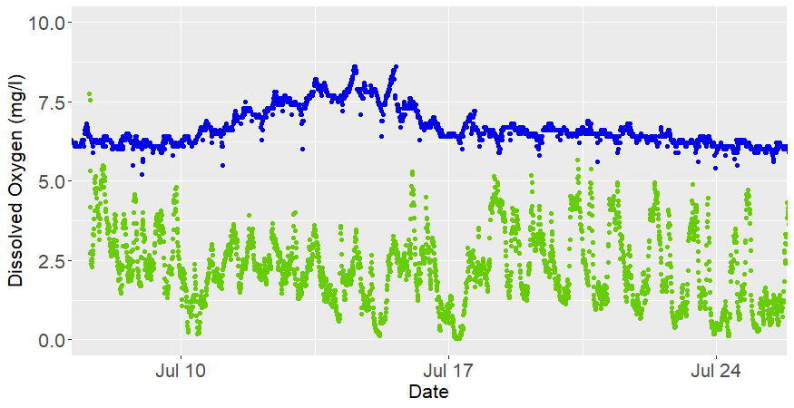
Water Chestnut vs. Submerged Aquatic Vegetation Soundscapes
Trapa natans
SAV Bed
Water Chestnut
Acoustic Recorder
Oxygen Sensor
Invasive water chestnut known to alter the physical and chemical habitat
→ How does invasive vegetation alter Hudson River soundscapes?
www.bioacoustics.cornell.edu
Hudson River Symposium, 8 October 2024, Cary Institute for Ecosystem Studies
Notes:
Know that the chestnut changes physical & chemical habitat, wondered how this affects the soundscape?

Slide 8
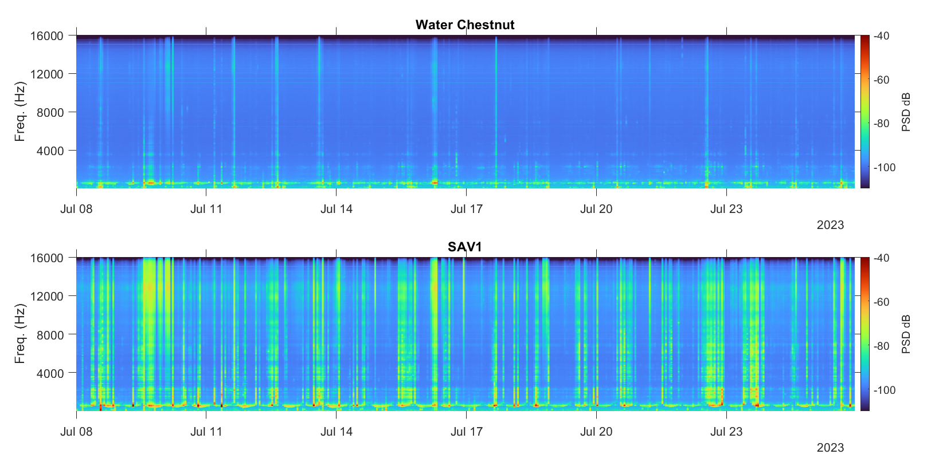
Water Chestnut vs. Submerged Aquatic Vegetation Soundscapes
Trapa natans
Acoustic Recorder
Oxygen Sensor
Sound levels substantially lower in the chestnut bed
Dampened sound propagation? Diminished community? Both?
www.bioacoustics.cornell.edu
Hudson River Symposium, 8 October 2024, Cary Institute for Ecosystem Studies
Notes:
Long-term spectral average – spectrogram for long durations of data
Shown here are two weeks
Time on the x, frequency on the y, acoustic power given by color
Overall, much lower sound levels within chestnut bed, as compared to SAV beds
Data from all devices except the Chestnut one looked like the upper plot

Slide 9
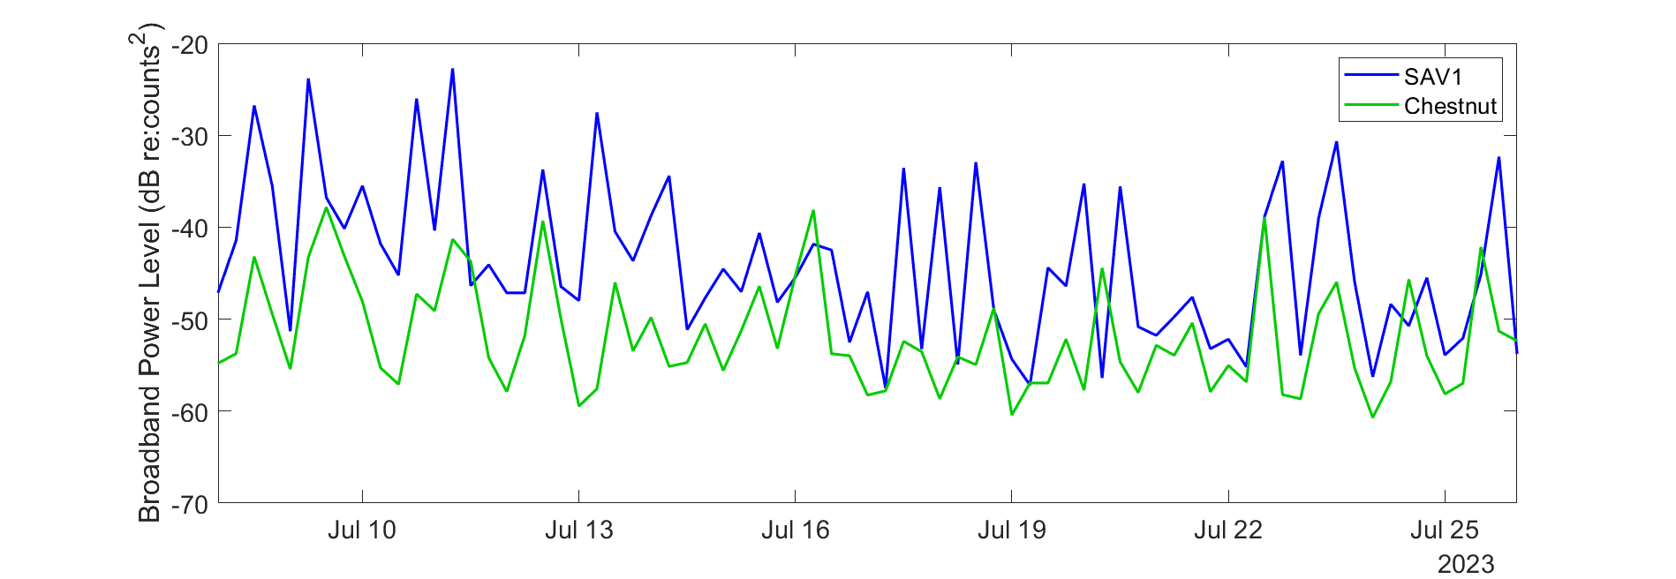
Water Chestnut vs. Submerged Aquatic Vegetation Soundscapes
Trapa natans
Acoustic Recorder
Oxygen Sensor
Sound levels substantially lower in the chestnut bed
Dampened sound propagation? Diminished community? Both?
www.bioacoustics.cornell.edu
Hudson River Symposium, 8 October 2024, Cary Institute for Ecosystem Studies
Notes:
Can also view this more simply as broadband power levels at each site versus time
dB is log scale,
Could be attributed to a few different things:
Physical dampening of sound propagation
Tangled mess of roots and leaves throughout water column
Low O2 environment hostile towards native river species, diminished community within chestnut bed
Impacts:
If due to sound propagation conditions – could reduce acoustic communication space, essential ambient cues used to identify optimal habitat
Poor sound propagation could also provide acoustic refugia from acoustics-based predation

Slide 10
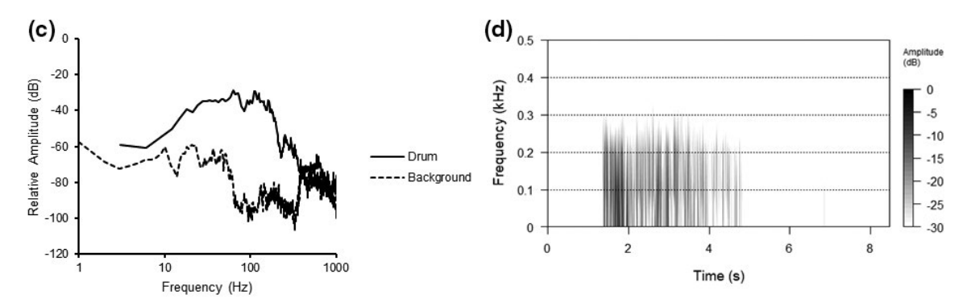
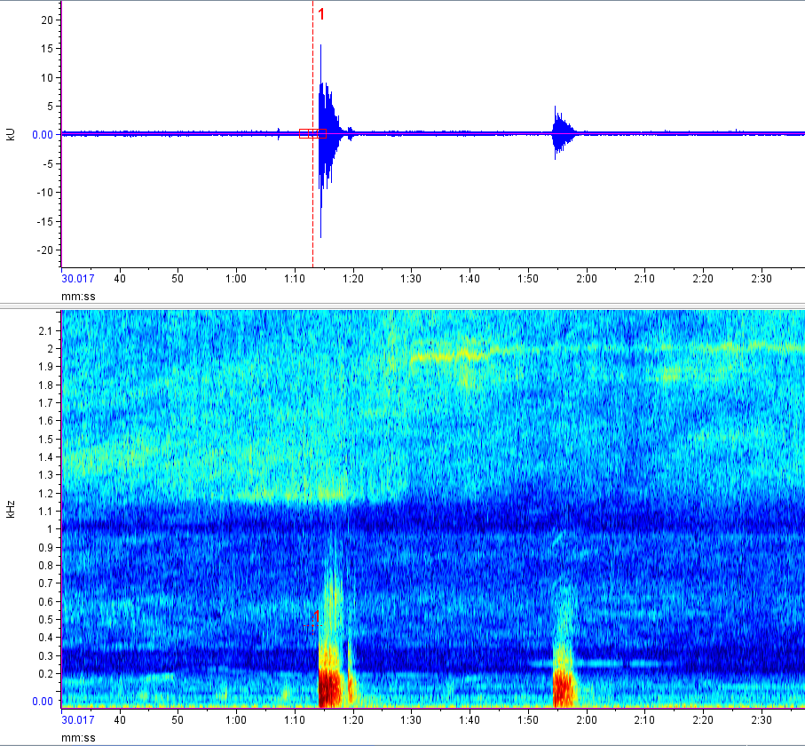
Atlantic Sturgeon
Acipenser oxyrinchus
Related Work – Lake Sturgeon Thunder
Adapted from Fig. 2, Higgs & Beach (2021)
20
10
Amplitude (kU)
0
-10
-20
2
1.5
Frequency (kHz)
1
0.5
00:30
01:00
01:30
02:00
02:30
Time (mm:ss)
Data shared by D. Higgs
www.bioacoustics.cornell.edu
Hudson River Symposium, 8 October 2024, Cary Institute for Ecosystem Studies
Notes:
Priority species: Atl Stur
4 of 5 DPS listed as endangered
Many data gaps due to difficulty of observing this highly mobile species, strict regulations on sampling due to protected status
Good candidate for bioacoustics monitoring, based on reports of sound production in closely-related species (mostly lake sturgeon, also pallid & shovelnose, maybe 5 Russian species)
Spawning sounds reported for lake sturgeon, provided starting point
Spectrum, grayscale spectrogram, waveform, color spectrogram

Slide 11
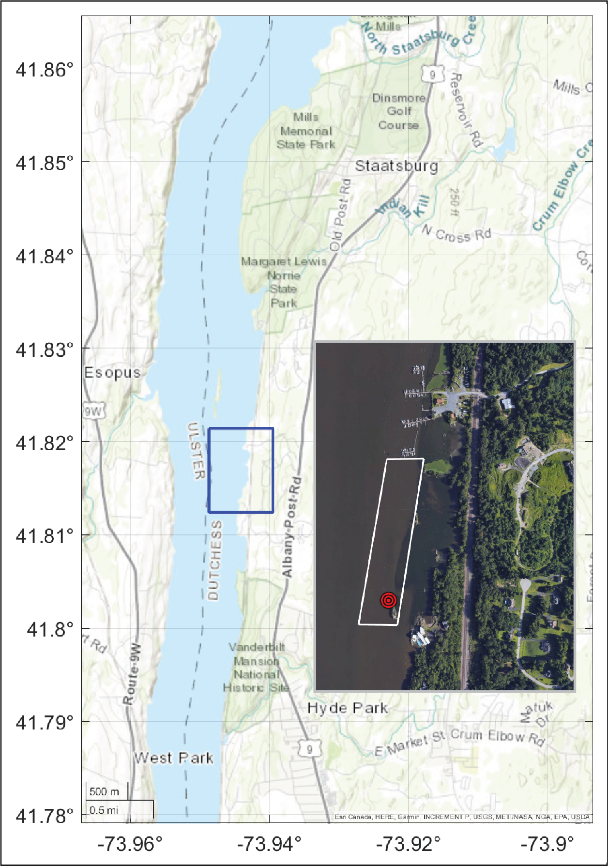
Atlantic Sturgeon
Acipenser oxyrinchus
Related Work – Lake Sturgeon Thunder
Adapted from Fig. 2, Higgs & Beach (2021)
20
10
Amplitude (kU)
0
Atlantic Sturgeon Spawning Aggregation
-10
-20
2
Recorder
Location
1.5
Frequency (kHz)
1
0.5
00:30
01:00
01:30
02:00
02:30
Time (mm:ss)
Data shared by D. Higgs
www.bioacoustics.cornell.edu
Hudson River Symposium, 8 October 2024, Cary Institute for Ecosystem Studies
Notes:
Recorder just south of Poughkeepsie Yacht Club, started with few weeks of recording from 2021
Known site of Atl Stur spawning,
Looked for signals similar to lake sturgeon thunder

Slide 12
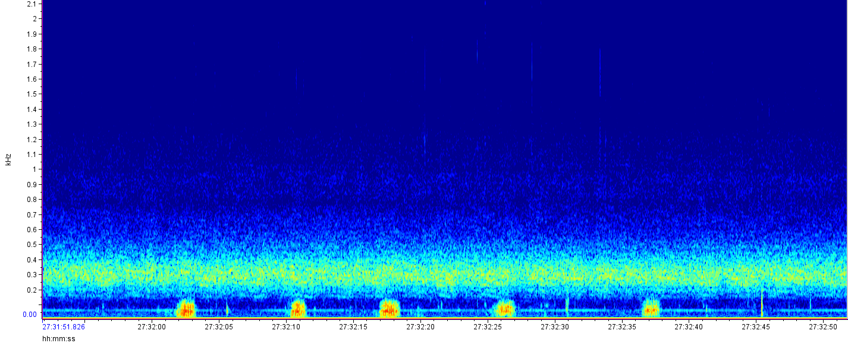
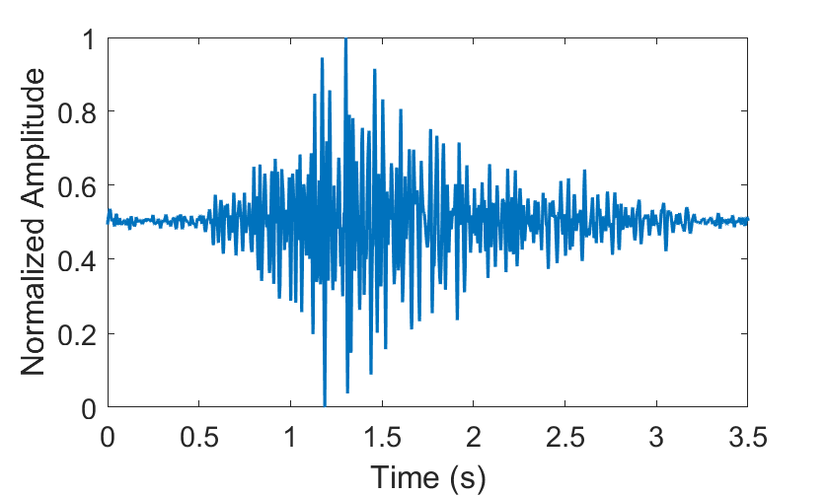
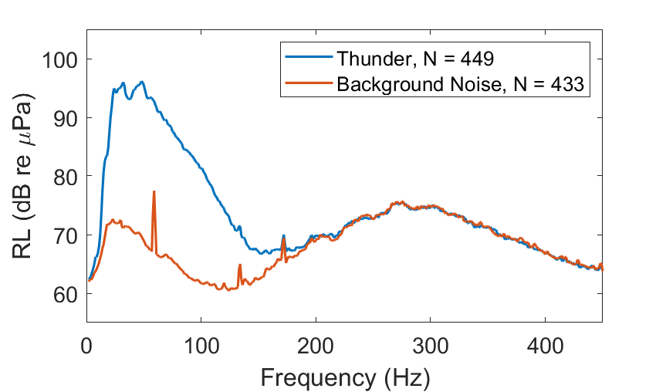

Atlantic Sturgeon
Acipenser oxyrinchus
Related Work – Lake Sturgeon Thunder
New Findings – Atlantic Sturgeon Thunder?
2
1.5
Frequency (kHz)
Adapted from Fig. 2, Higgs & Beach (2021)
1
20
0.5
10
Amplitude (kU)
0
-10
27:32:00
27:32:10
27:32:20
27:32:30
27:32:40
27:32:50
-20
Time (hh:mm:ss)
2
1.5
Frequency (kHz)
1
0.5
00:30
01:00
01:30
02:00
02:30
Time (mm:ss)
Data shared by D. Higgs
www.bioacoustics.cornell.edu
Hudson River Symposium, 8 October 2024, Cary Institute for Ecosystem Studies
Notes:
During period of known Atl stur spawning (based on gill netting, acoustic telemetry tags, egg mats), found similar thunders
Visible on spectrogram (white boxes)
Average waveform and spectrum shown below (w noise spectrum for comparison)
Quite numerous throughout late May & June, not present earlier in the spring or later in the summer

Slide 13
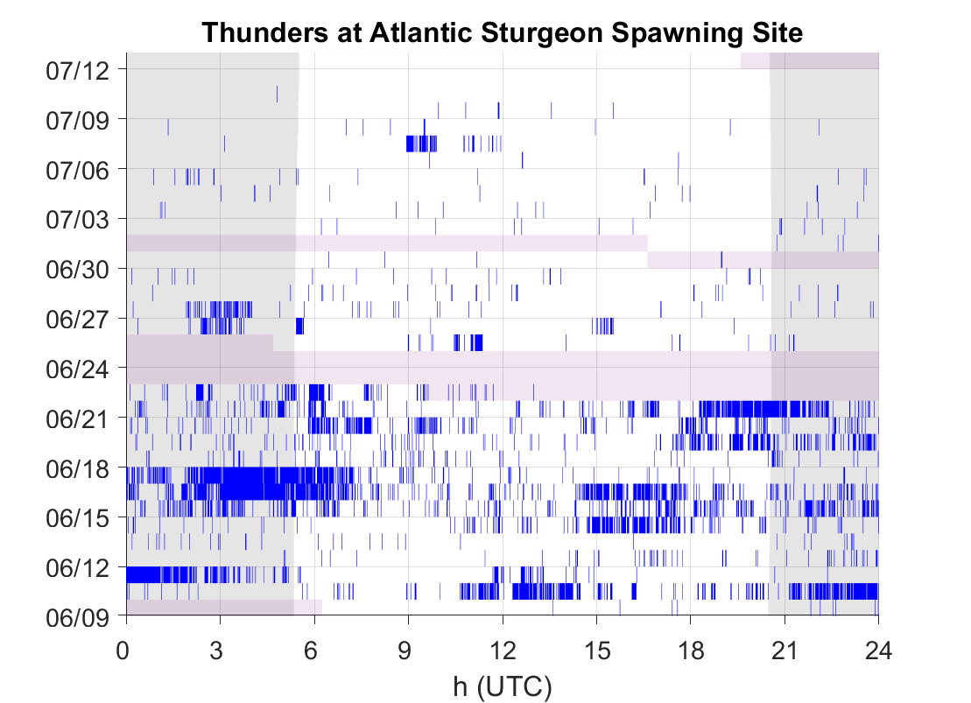
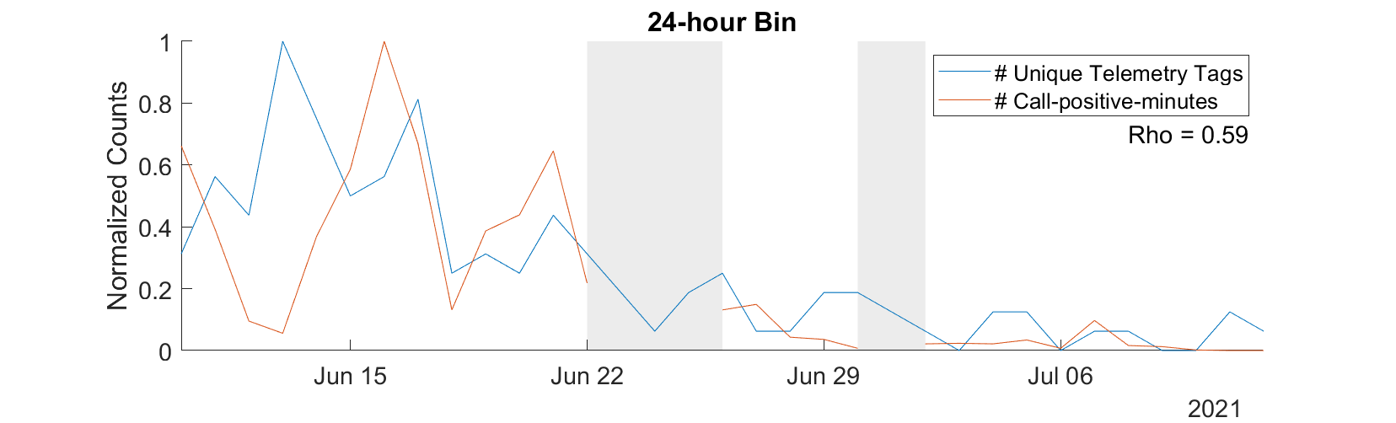
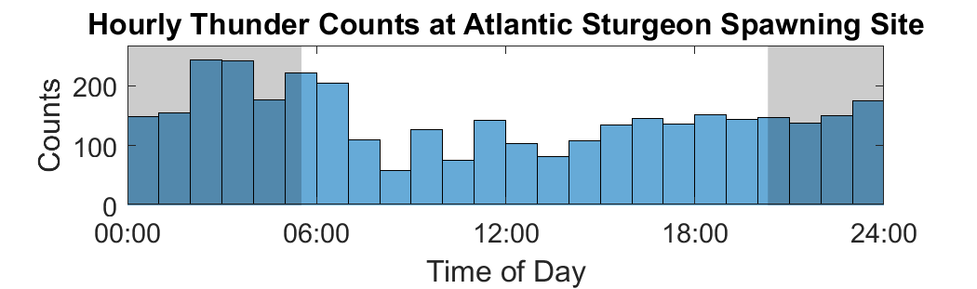
Atlantic Sturgeon
Acipenser oxyrinchus
No Strong Diel Periodicity
Thunder Occurrence Well-correlated with Presence of Telemetry Tagged Sturgeon
www.bioacoustics.cornell.edu
Hudson River Symposium, 8 October 2024, Cary Institute for Ecosystem Studies
Notes:
No consistent diel pattern in sound production
Top left – date on y, hour of day on x, shaded regions show nighttime, blue shows presence of thunders in 1-min bins
Very episodic in occurrence
Collapsed across all days of the 2021 data collection period, histogram below shows counts of calls in each hour of the day
Slightly higher occurrence of calls in hours prior to and just after dawn, but again, not consistent across the recording period
Daily presence tightly correlated with presence of telemetry-tagged fish at nearest receiver (1.8km north; 26 tagged individuals detected during this time; max of 18 on any given day)
Going to look into correlation btwn thunder occurrence & demographics, though sample size is small
This summer, recorded at Bears Bluff; one spawning event in our tank
Waiting to see that data to hopefully provide validation of this sound-species assignment

Slide 14
Freshwater Drum
Aplodinotus grunniens
2
1.5
Frequency (kHz)
1
Continuous band of sound energy from many simultaneously-calling Freshwater Drum
0.5
27:32:00
27:32:10
27:32:20
27:32:30
27:32:40
27:32:50
Time (hh:mm:ss)
www.bioacoustics.cornell.edu
Hudson River Symposium, 8 October 2024, Cary Institute for Ecosystem Studies
Notes:
May have noticed another strong signal in the spectrogram with the putative Atlantic Sturgeon thunder
Known signal – chorusing of Freshwater Drum
Family Sciaenidae, many species commonly called Drums or Croakers

Slide 15
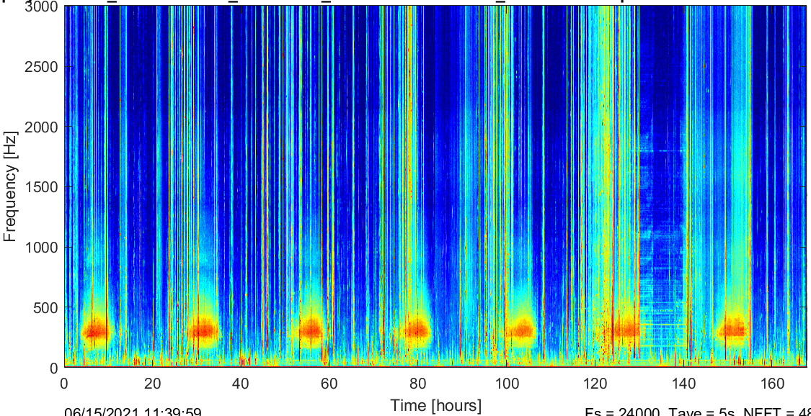
Freshwater Drum
Aplodinotus grunniens
2
1.5
Frequency (kHz)
1
0.5
27:32:00
27:32:10
27:32:20
27:32:30
27:32:40
27:32:50
Time (hh:mm:ss)
Chorusing events dominate the soundscape for hours each day
www.bioacoustics.cornell.edu
Hudson River Symposium, 8 October 2024, Cary Institute for Ecosystem Studies
Notes:
Chorusing is a daily event during spawning season (mid-May – Aug)
One week of data shown on LTSA to the right, daily drum chorus evident in the 200-400 Hz band
Non-native in the Hudson River, thought to have entered via NYS canal system in the 80’s
Extent of colonization not well characterized
Wanted to look at drum presence across our sites, which span ~100 mi (river mile 25 – 125)
Rodney Rountree & Francis Juanes observed that freshwater drum are likely the “dominant biological contributors to the underwater soundscape throughout their range, with few other organisms producing sounds of similar magnitude of the drum chorus”

Slide 16
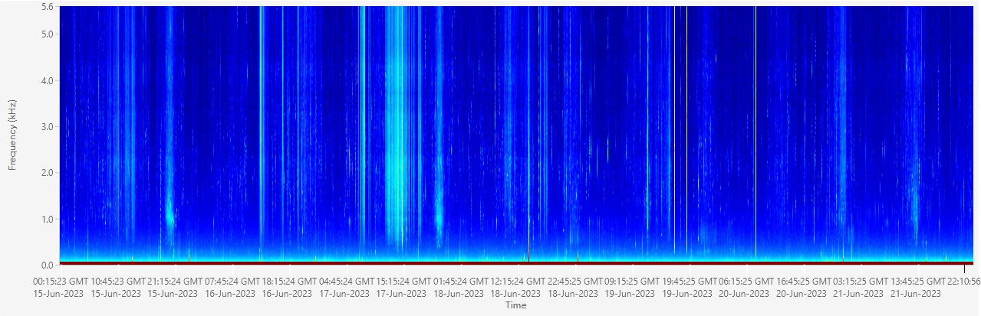
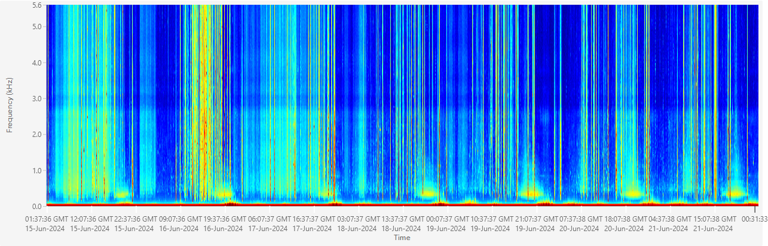
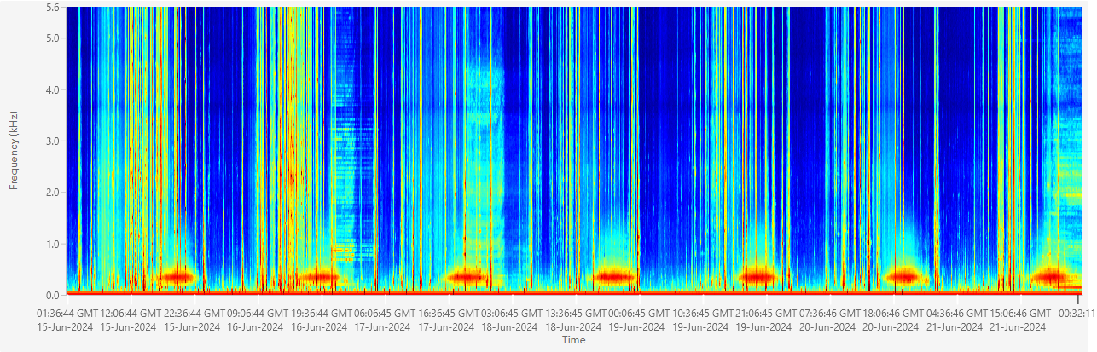
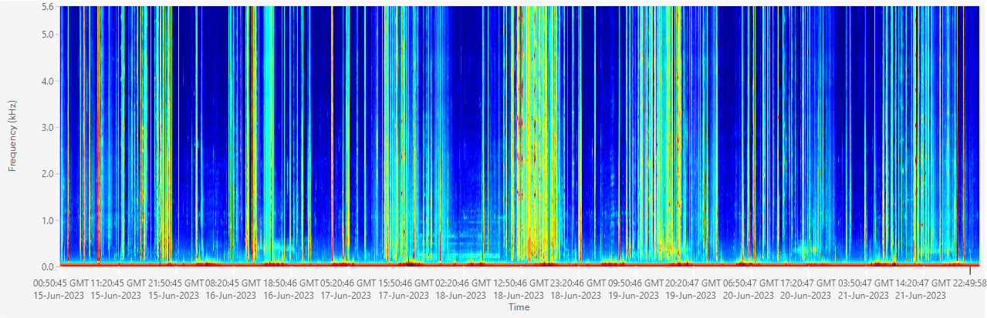
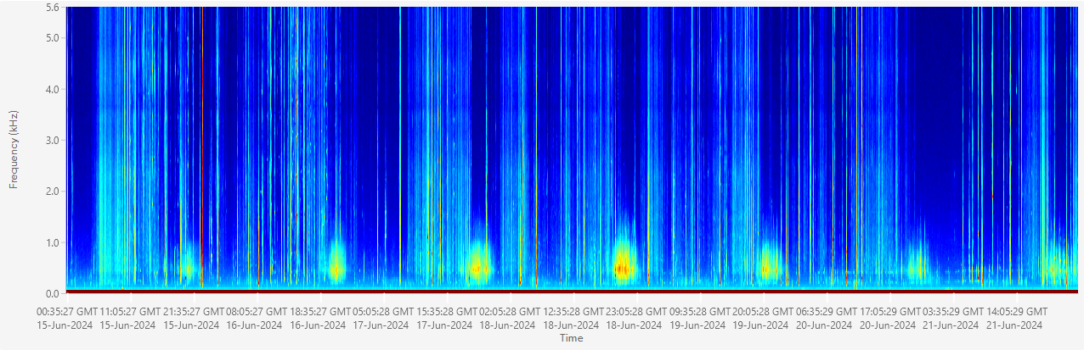
Stockport
Freshwater Drum
4
2
Aplodinotus grunniens
0
Tivoli
4
2
0
Hyde Park
4
2
Frequency (kHz)
0
Iona
4
2
0
Piermont
4
2
0
16 Jun
17 Jun
18 Jun
19 Jun
20 Jun
21 Jun
www.bioacoustics.cornell.edu
Hudson River Symposium, 8 October 2024, Cary Institute for Ecosystem Studies
Notes:
LTSAs from each river channel site for 6/15-6/21 period
Very different noise conditions across sites
Drum really dominate at Hyde Park (Atl Stur spawning site)
Surprisingly, still chorusing as far south as Piermont, which is typically below the salt front
Low levels of acoustic activity at Iona, not hearing them at all at Stockport
Next steps are to look at relationship between drum chorusing and environmental factors (e.g. salinity, depth, water temp, substrate)

Slide 17
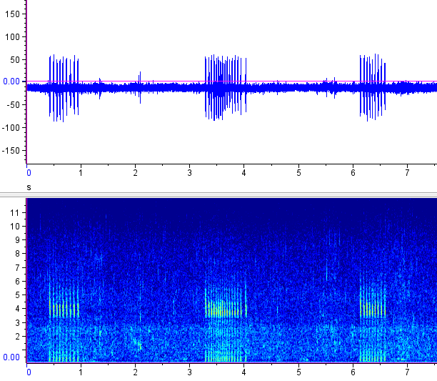
Shortnose Sturgeon
Acipenser brevirostrum
Lots of funny sounds, no strong ID (yet!)
www.bioacoustics.cornell.edu
Hudson River Symposium, 8 October 2024, Cary Institute for Ecosystem Studies
Notes:
Share un-ID’d weird plinky sounds

Slide 18
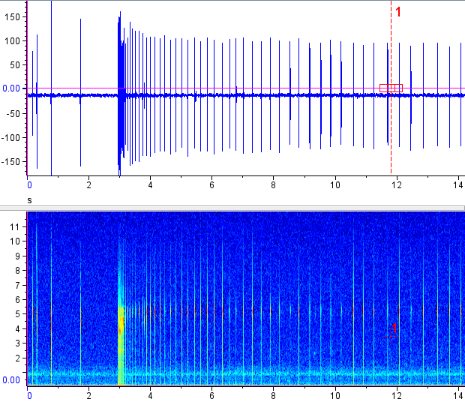
Shortnose Sturgeon
Acipenser brevirostrum
Lots of funny sounds, no strong ID (yet!)
www.bioacoustics.cornell.edu
Hudson River Symposium, 8 October 2024, Cary Institute for Ecosystem Studies
Notes:
Share un-ID’d weird plinky sounds

Slide 19
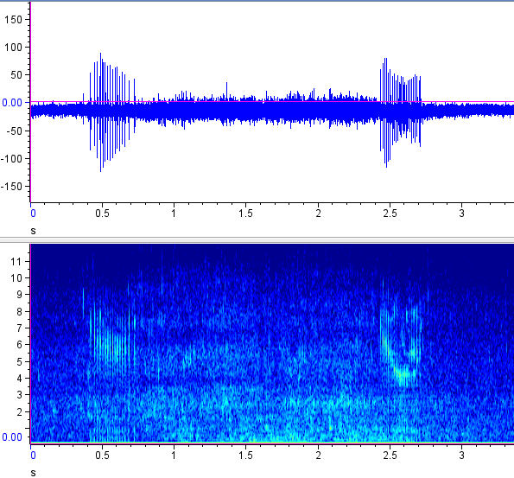
Shortnose Sturgeon
Acipenser brevirostrum
Lots of funny sounds, no strong ID (yet!)
www.bioacoustics.cornell.edu
Hudson River Symposium, 8 October 2024, Cary Institute for Ecosystem Studies
Notes:
Share un-ID’d weird plinky sounds

Slide 20
River Herring
Alosa pseudoharengus
Alosa aestivalis
Weir deployed in Black Creek in 2020 & 2021
Damaged by high flow events in 2022 & 2023, not deployed in 2024
Very little acoustic data overlap
Hourly weir Counts
2021
No sounds yet, stay tuned..
www.bioacoustics.cornell.edu
Hudson River Symposium, 8 October 2024, Cary Institute for Ecosystem Studies
Notes:
Cite Staples 2022 herring splash paper
Challenges of identifying new sounds
Current work w GoPro footage in Black Creek

Slide 21

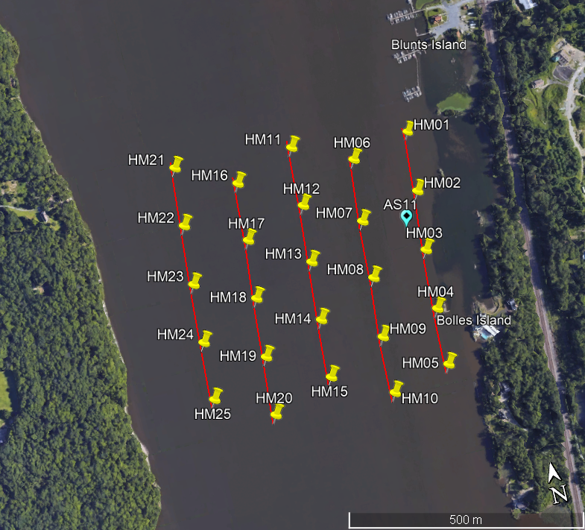
Ongoing Analysis
In Progress:
Atlantic Sturgeon thunder occurrence/phenology across sites
Hudson river soundscapes
Across salinity gradient
Main channel vs tributaries/wetlands
Atlantic Sturgeon & Freshwater Drum sound mapping
500m
www.bioacoustics.cornell.edu
Hudson River Symposium, 8 October 2024, Cary Institute for Ecosystem Studies

Slide 22
Acknowledgements
Funding Sources:
Many thanks to:
Norrie Point Environmental Center
Dan Miller (NYSDEC, HRNERR)
Dennis Higgs (University of Windsor)
Ella Agoos (Norrie Point)
Nicholas Pauley (West Point)
Contact:
Rebecca Cohen
r.cohen@cornell.edu
https://www.birds.cornell.edu/ccb/rebecca-cohen-ph-d/
www.bioacoustics.cornell.edu
Hudson River Symposium, 8 October 2024, Cary Institute for Ecosystem Studies

Slide 23
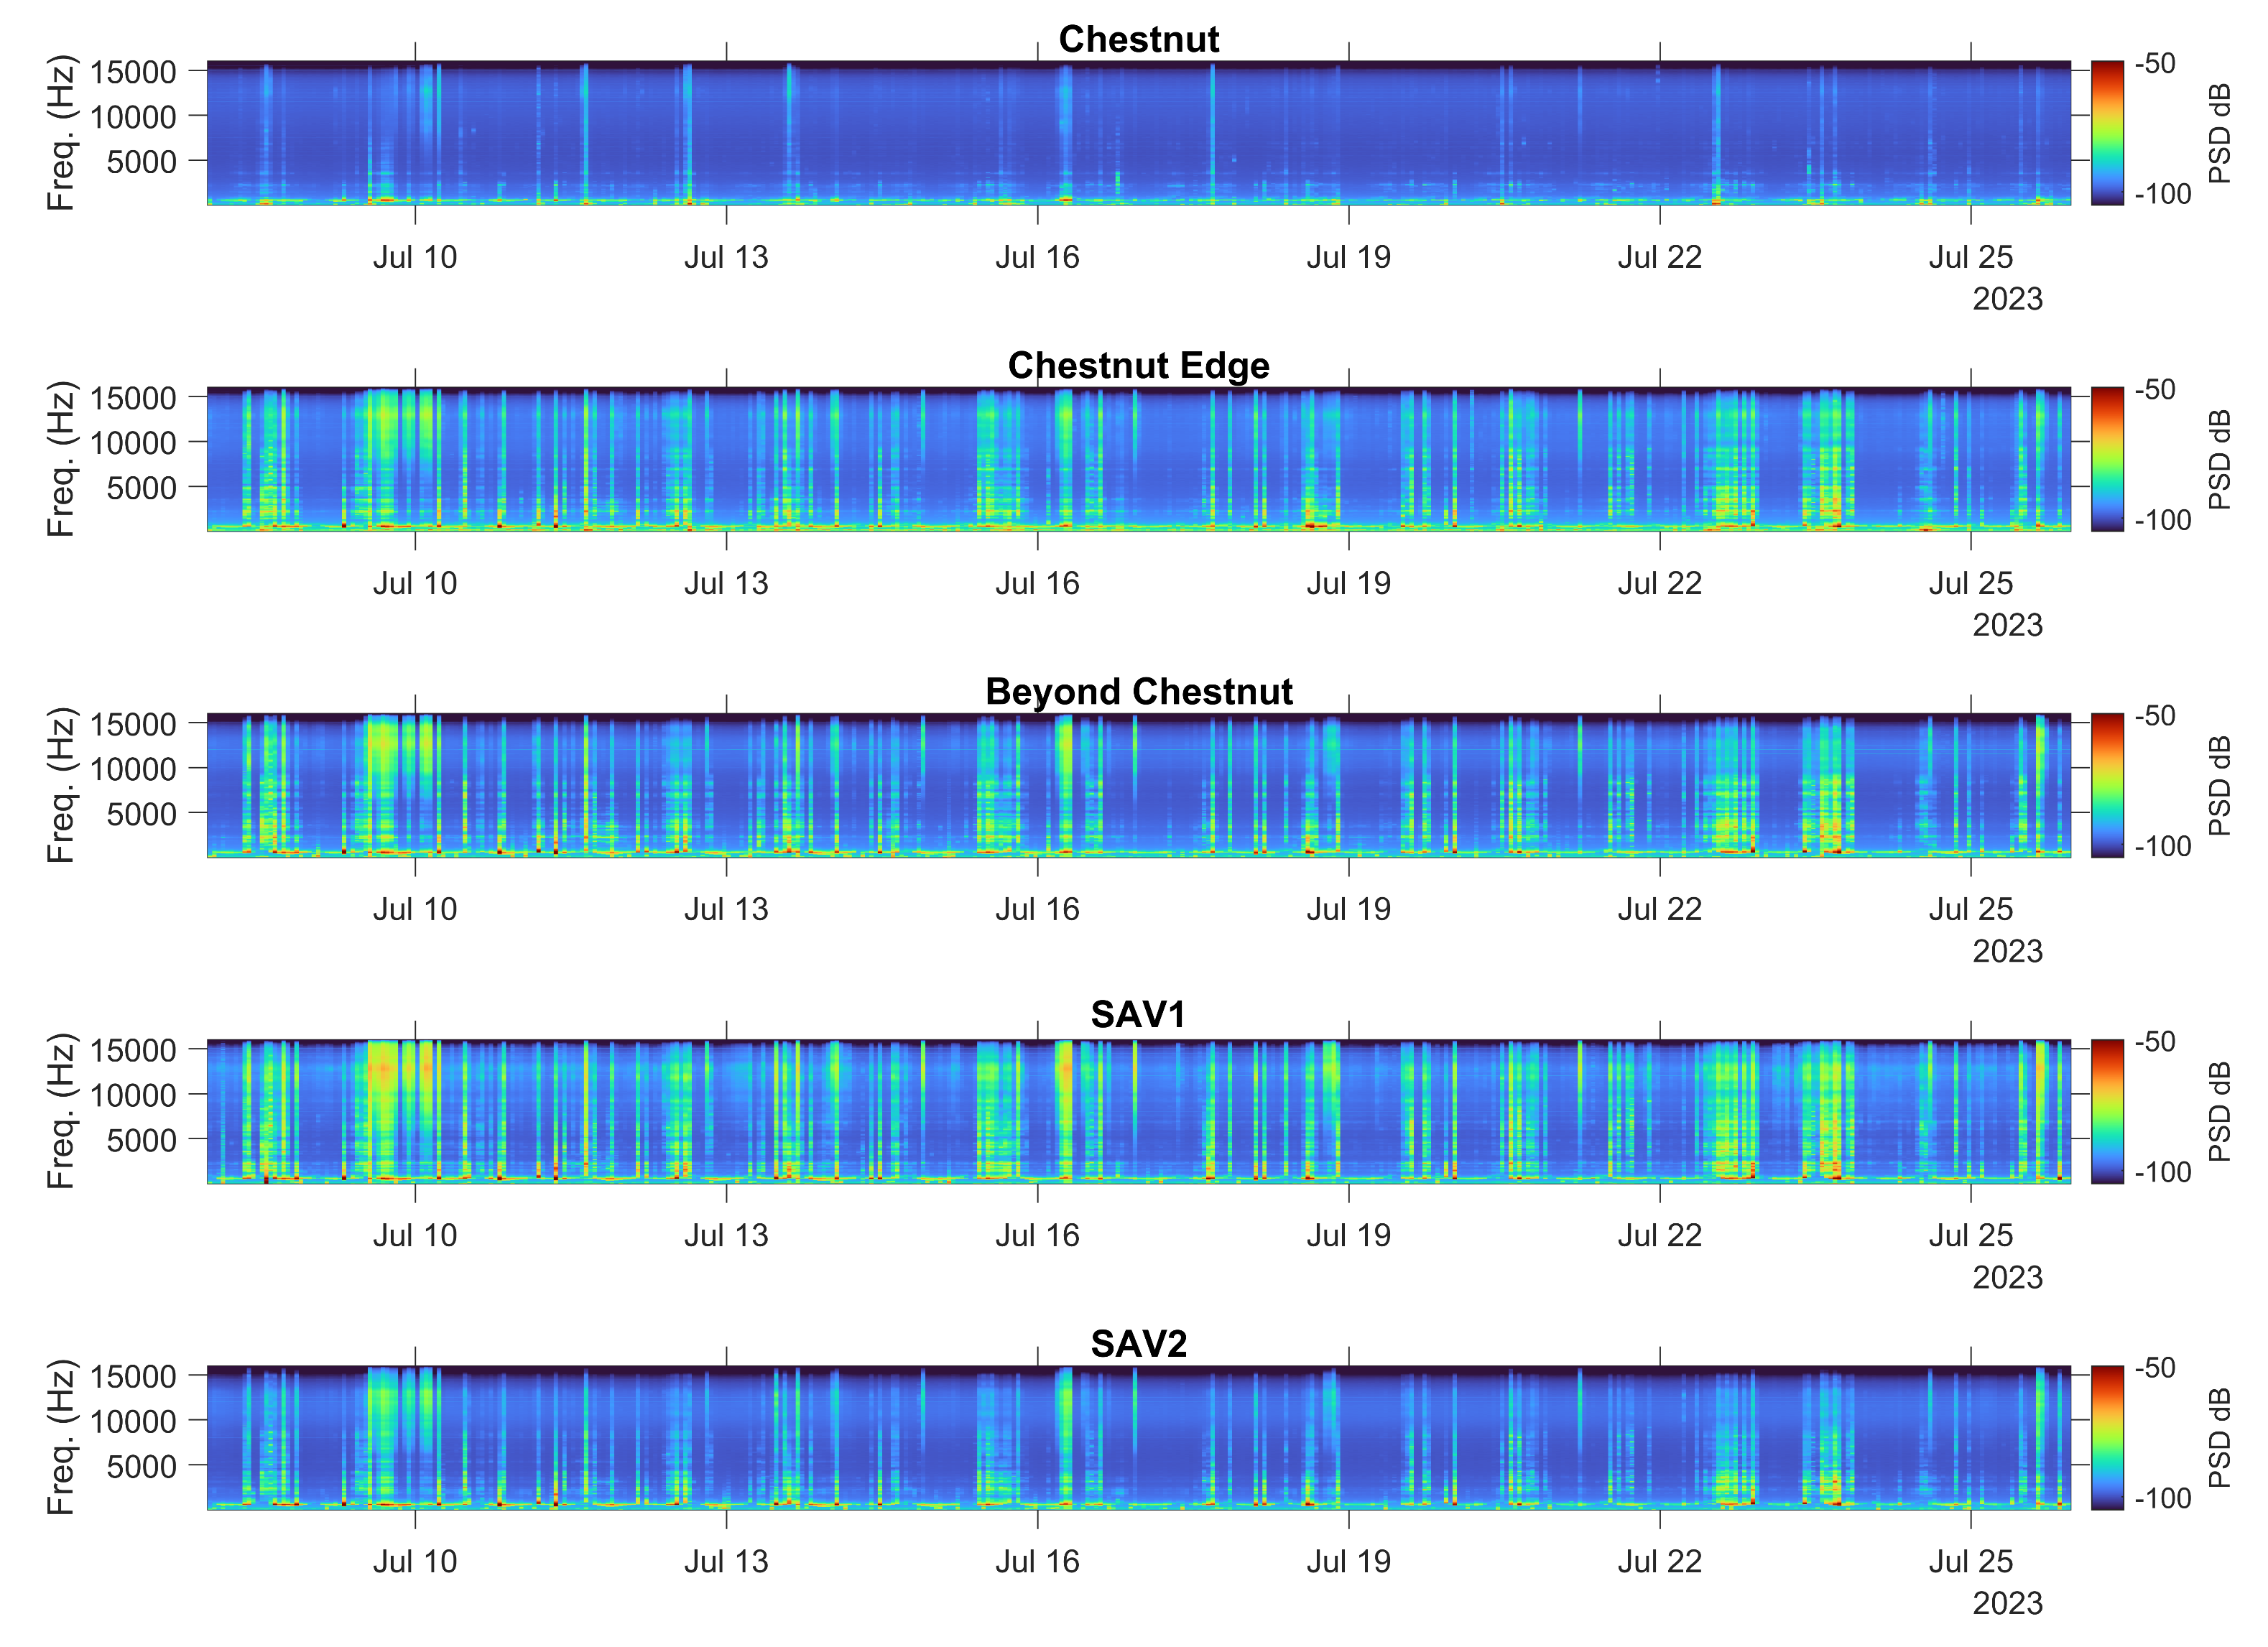
Water Chestnut vs. Submerged Aquatic Vegetation Soundscapes
www.bioacoustics.cornell.edu
Hudson River Symposium, 8 October 2024, Cary Institute for Ecosystem Studies
Notes:
Sensitivity highly variable across frequencies and Hydromoths, but water chestnut device not noticeably lower sensitivity across the board than the others

