Slide 1



Biological Monitoring with environmental DNA (eDNA)
David M. Lodge
Francis J. DiSalvo Director | Cornell Atkinson Center for Sustainability
Professor | Dept. Ecology & Evolutionary Biology, Cornell University
2024 Hudson River Symposium
Cary Institute of Ecosystem Studies
8 October 2024

Slide 2
Cornell Atkinson Center for Sustainability
Notes:
Talking Points:
I emphasize the left end of this diagram--how we are situated within the university and the importance of connections across units

Slide 3
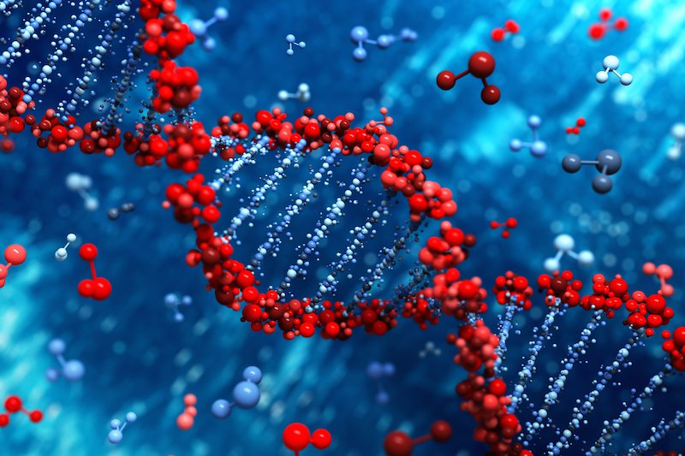
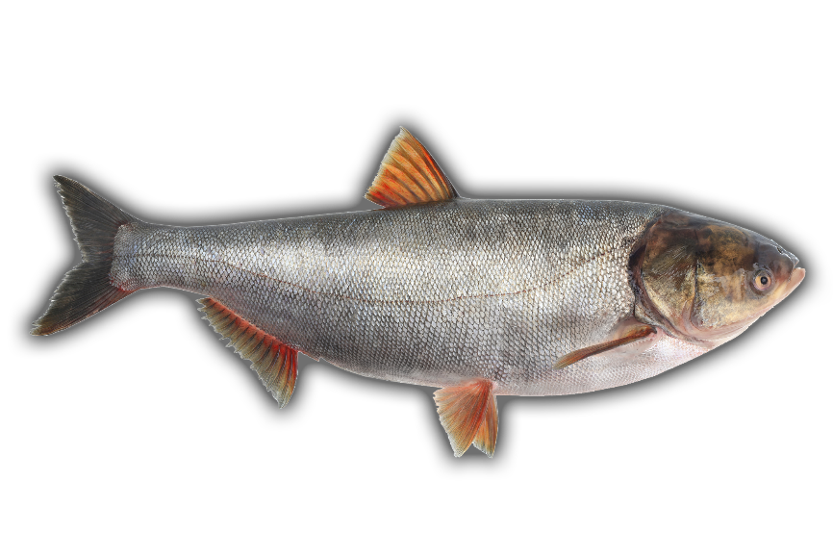
Environmental DNA (eDNA)
Lodge 2024. Lessons learned from eDNA adoption in the management of bigheaded carps in Chicago IL USA Area Waterways. Environmental DNA. https://onlinelibrary.wiley.com/doi/10.1002/edn3.528

Slide 4
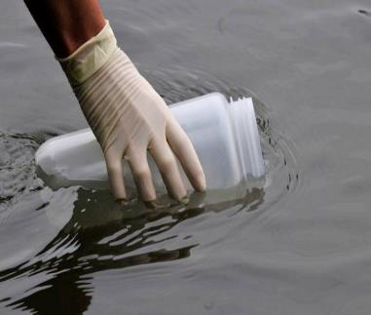
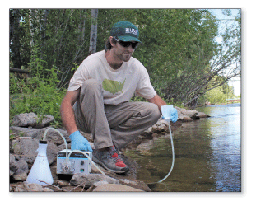
Environmental DNA Overview
1
Collect water sample
Notes:
UND/CAC Photo of gel being loaded

Slide 5
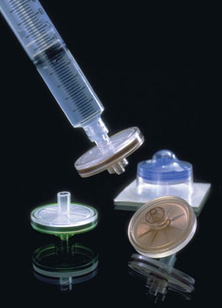
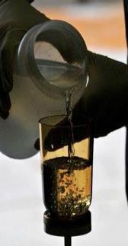
Environmental DNA Overview
1
2
Collect water sample
Filter water sample
Notes:
UND/CAC Photo of gel being loaded

Slide 6
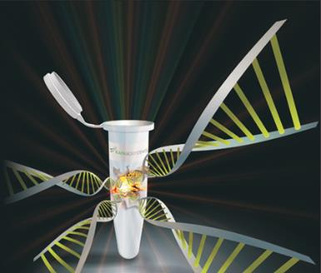
Environmental DNA Overview
1
2
3
Collect water sample
Filter water sample
Extract all DNA
Notes:
UND/CAC Photo of gel being loaded

Slide 7
Environmental DNA Overview
1
2
3
4
Collect water sample
Filter water sample
Extract all DNA
Amplify target DNA
1. Design primers for target DNA
2. Polymerase Chain Reaction (PCR)
  Quantitative PCR
  Digital Droplet PCR
Notes:
UND/CAC Photo of gel being loaded

Slide 8
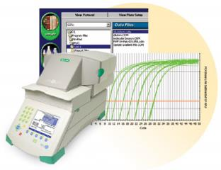
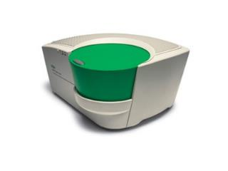
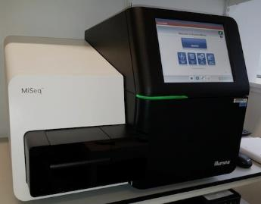
Environmental DNA Overview
1
2
3
4
5
Visualize DNA presence
Collect water sample
Filter water sample
Extract all DNA
Amplify target DNA
Digital readout for
qPCR and ddPCR
Sequencing for metabarcoding
Notes:
UND/CAC Photo of gel being loaded

Slide 9
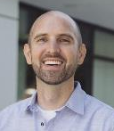

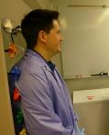


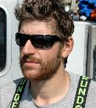
Management-ready eDNA
Single species detection using species specific primers and qPCR or ddPCR.
Multiplex approach, e.g., many targeted species per sample
“All” species detection using primers with much broader taxonomic coverage, sequencing, and bioinformatics analysis, i.e., metabarcoding.
Abundance (with any of the 3 approaches above)
For many applications, eDNA is faster, cheaper, more accurate
(Gantz et al. 2015 J Great Lakes Res.)
Notes:
And indeed that turned out to be true. With a few water samples scooped from the Illinois River, we easily detected the presence of the carp. And then with the support of state and federal agencies, we sampled up and down the river and up to the Great Lakes. Our initial euphoria at a surprisingly easy scientific success turned into alarm when we discovered that the species were much closer to Lake Michigan than previously thought. But the alarm sounded by our envinromental DNA or eDNA results prompted many management actions that have reduced the risk that the fish will invade the Great Lakes. We developed the environmental protection equivalent of forensic science.

Slide 10
Single Species Detection:
Bigheaded (formerly Asian) Carps
Lodge 2024. Lessons learned from eDNA adoption in the management of bigheaded carps in Chicago IL USA Area Waterways. Environmental DNA. https://onlinelibrary.wiley.com/doi/10.1002/edn3.528

Slide 11
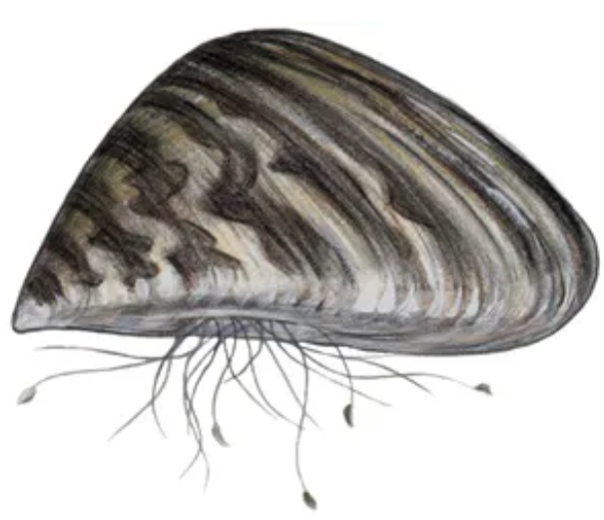
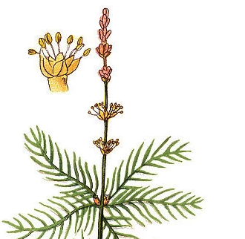
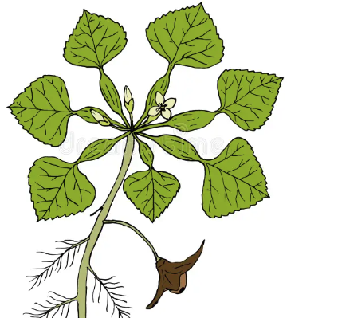
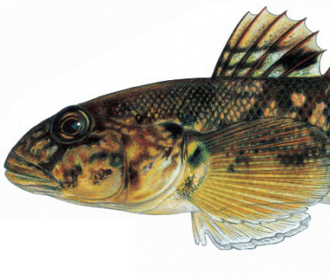
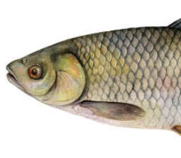
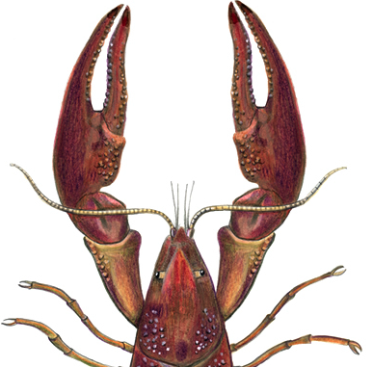
Multiplex Detection of Hudson River Aquatic Invasive Species
Jose Andres
Zebra Mussel
Eurasian Watermilfoil
Water Chestnut
Round goby
Grass Carp
Rusty Crayfish
Co-detection of invasive of plant, invertebrates and vertebrate species the the Hudson River watershed

Slide 12
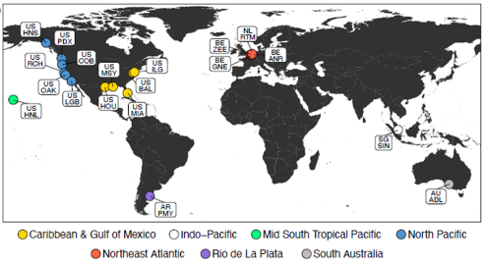
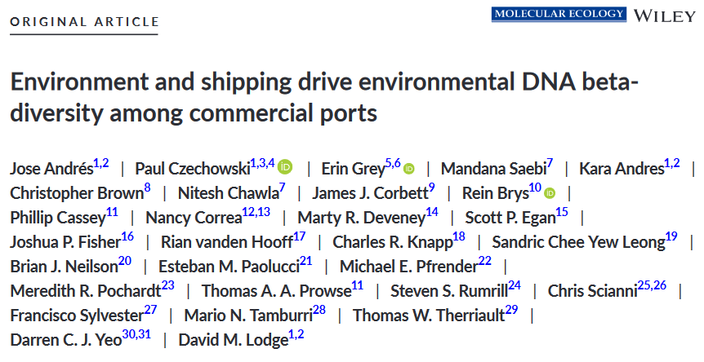
Metabarcoding for Ship-borne Invasions
2022
https://onlinelibrary.wiley.com/doi/full/10.1111/mec.16888

Slide 13
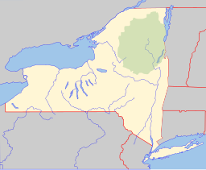
For metabarcoding detection of all fishes, eDNA is
more accurate, cheaper, and faster
Oneida Lake

Slide 14
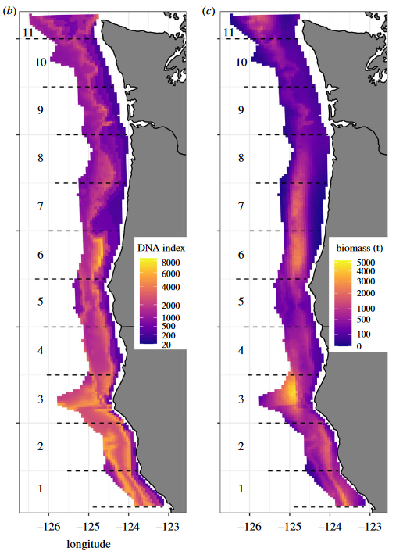
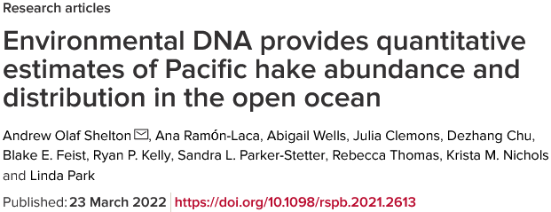

Estimating Abundance of Pacific NW Hake with eDNA
eDNA index
Acoustic index (NOAA)
https://royalsocietypublishing.org/doi/full/10.1098/rspb.2021.2613
Notes:
Emphasize future power of combinations of tools: eDNA, remote sensing, including acoustics; autonomous sampling; traditional tools.

Slide 15
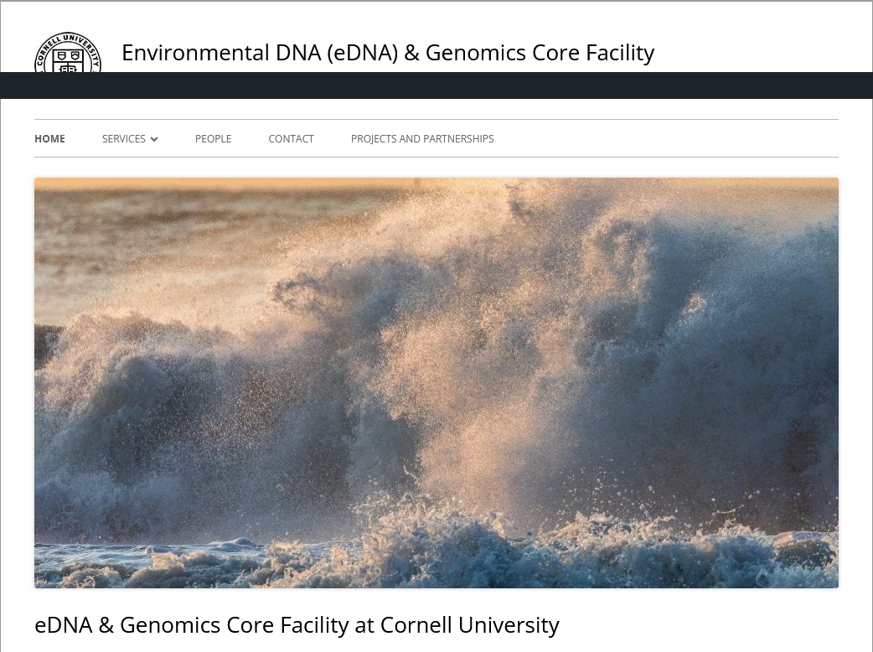
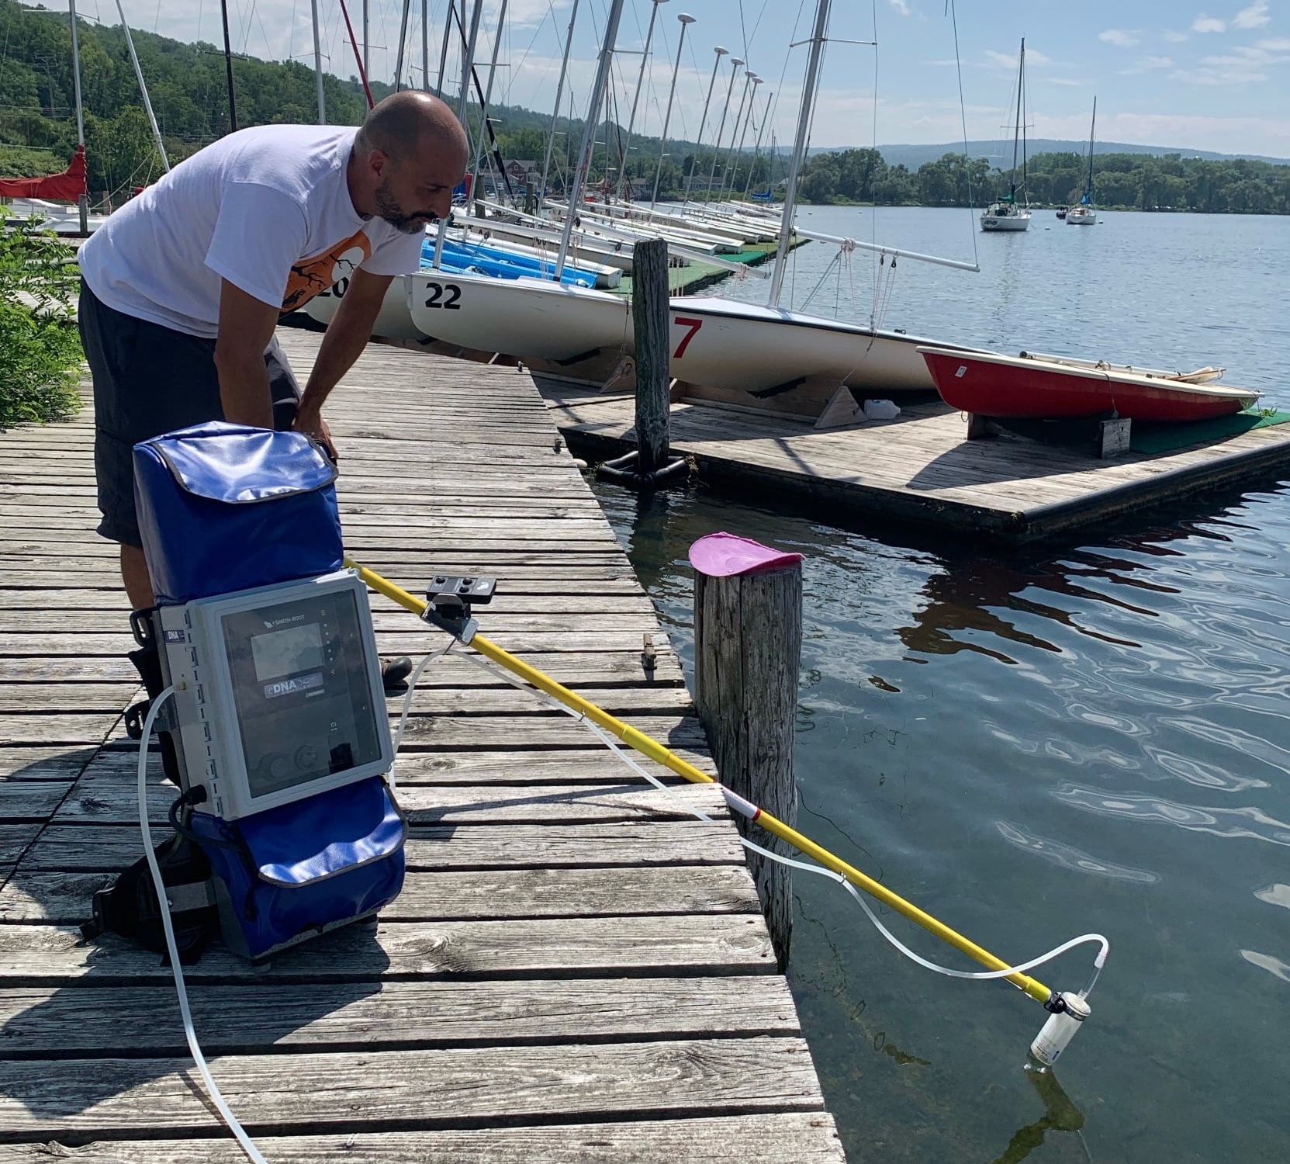
Jose Andres

Slide 16
https://esajournals-onlinelibrary-wiley-com.proxy.library.cornell.edu/doi/10.1002/fee.2563

Slide 17
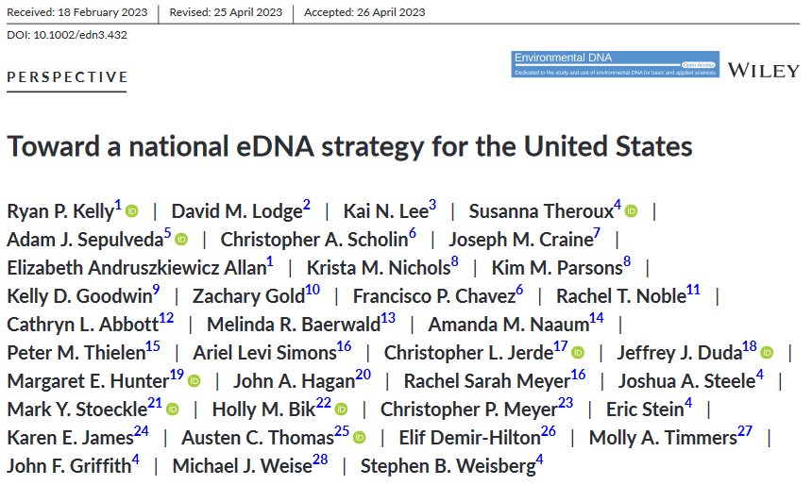
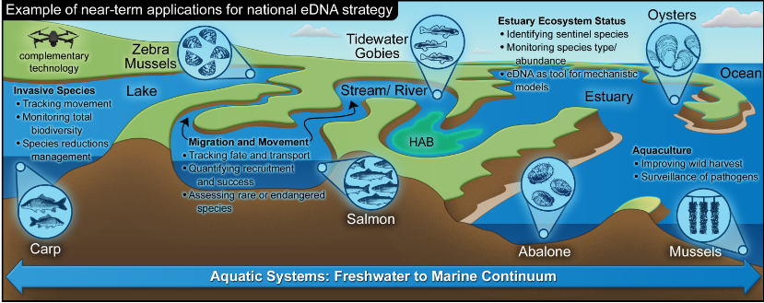

Slide 18
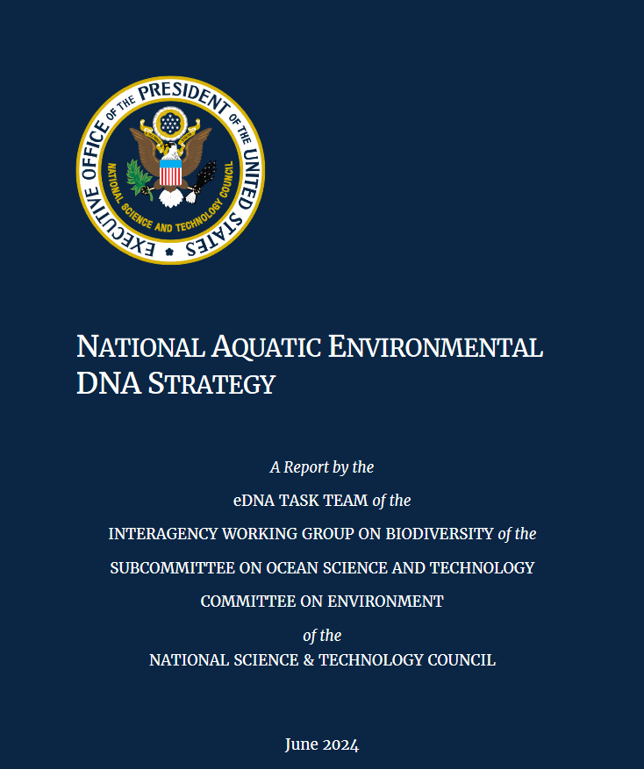
Goal 1: Coordinate across sectors to facilitate integration of aquatic eDNA into decision making.
Goal 2: Build the human capacity, infrastructure, and research enterprise needed to employ eDNA technology at large-scales.
Goal 3: Advance coordinated eDNA observations to aid comprehensive assessments in US waters.
https://www.whitehouse.gov/wp-content/uploads/2024/06/NSTC_National-Aquatic-eDNA-Strategy.pdf
Notes:
Add $10M investment by CA, NERRS monitoring, offshore wind, etc
Regulatory, e.g., NEPA, ONR, NOAA fisheries, USFWS, USDA

Slide 19
Potential Hudson River Applications?
Prevention and early detection of invasive species, including standardization of invasive species monitoring in the pathways that deliver species, and in the river and ports.
Fisheries monitoring, leveraging the feasibility of more frequent and extensive sampling.
Routine monitoring of aquatic biodiversity, potentially including Clean Water Act compliance
Notes:
And indeed that turned out to be true. With a few water samples scooped from the Illinois River, we easily detected the presence of the carp. And then with the support of state and federal agencies, we sampled up and down the river and up to the Great Lakes. Our initial euphoria at a surprisingly easy scientific success turned into alarm when we discovered that the species were much closer to Lake Michigan than previously thought. But the alarm sounded by our envinromental DNA or eDNA results prompted many management actions that have reduced the risk that the fish will invade the Great Lakes. We developed the environmental protection equivalent of forensic science.

