Slide 1

Interim Lower Food Web Monitoring Survey
(ILFWS)
Chris Solomon, Heather Malcom, David Fischer

Slide 2
Origin of ILFWS
Hudson River Biological Monitoring Workgroup
  Define new goals for monitoring the Hudson ecosystem
  Design efficient, cost-effective monitoring programs
2020
2021
2022
2023
2024
2025

Slide 3
Origin of ILFWS
Hudson River Biological Monitoring Workgroup
  Define new goals for monitoring the Hudson ecosystem
  Design efficient, cost-effective monitoring programs
Expert panel
  Design ILFWS
  Define needs for designing Next Generation Hudson River Ecosystem Monitoring Program
2020
2021
2022
2023
2024
2025

Slide 4
Origin of ILFWS
Hudson River Biological Monitoring Workgroup
  Define new goals for monitoring the Hudson ecosystem
  Design efficient, cost-effective monitoring programs
Expert panel
  Design ILFWS
  Define needs for designing Next Generation Hudson River Ecosystem Monitoring Program
ILFWS
2020
2021
2022
2023
2024
2025

Slide 5
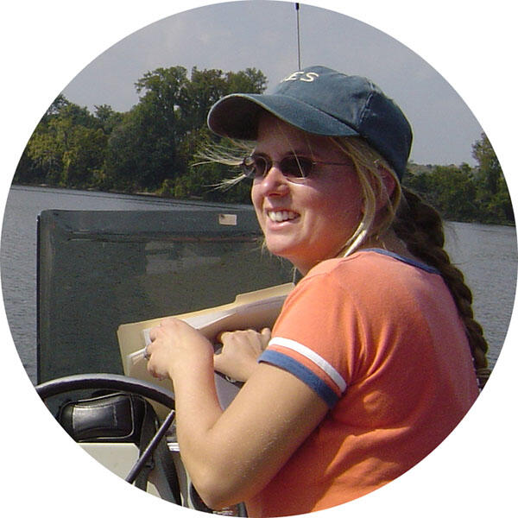


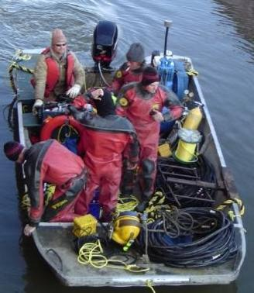



ILFWS Team
Heather Malcom
David Fischer
Chris Solomon
Gina Kehoe
Andrew Brainard
Tim Joslyn, Jamie Wallbank

Slide 6
ILFWS Design
Troy
2025-2027, year-round
Components
  Water chemistry, phytoplankton, and zooplankton
  eDNA
  Zoobenthos
Pier 84

Slide 7
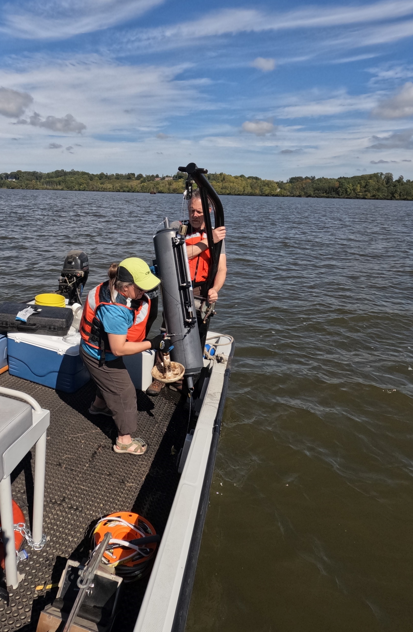
Water chemistry, phytoplankton, zooplankton
Monthly; surface and deep
Light extinction and Secchi depth
Current speed and direction
Temperature, dissolved oxygen, conductivity
Alkalinity, DIC, DOC, DIN, TN, SRP, TP
Phytoplankton biomass (chla)
Seston DM and AFDM
Microzooplankton – IDs, abundance, biomass
Macrozooplankton – IDs, abundance, biomass

Slide 8
eDNA
Quarterly; surface and deep
2 L through 1.5 μm filter, stored

Slide 9

Zoobenthos
(soft substrates)
Annually
Shallow and deep
Sieved at 2.8 and 0.5 mm
IDs, abundance, sediment type
USGS

Slide 10
Zoobenthos
(hard substrates)
June and August
Randomly selected rocks
Dreissenid ID, abundance, size distribution
Seaway Divers
Notes:
Allows calculation of biomass, filtering rate

Slide 11
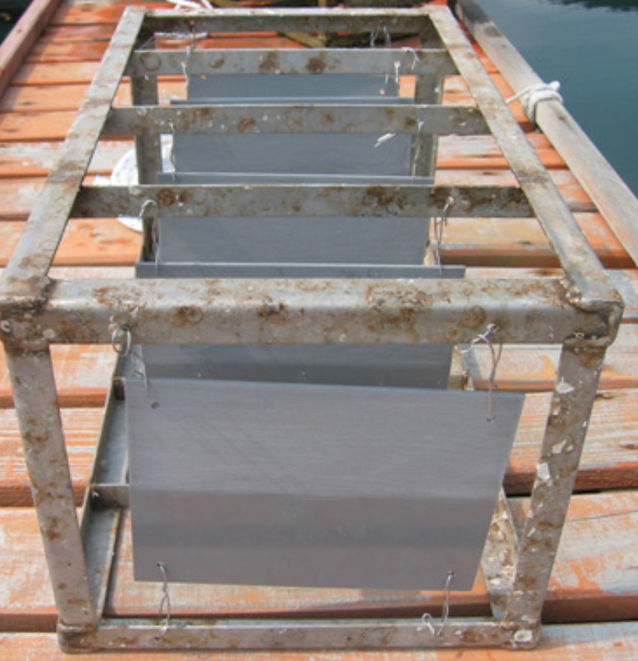
Zoobenthos
(settling plates)
Annually
Deployed 60 or 150 days
IDs, abundance
Choi et al. 2011

Slide 12
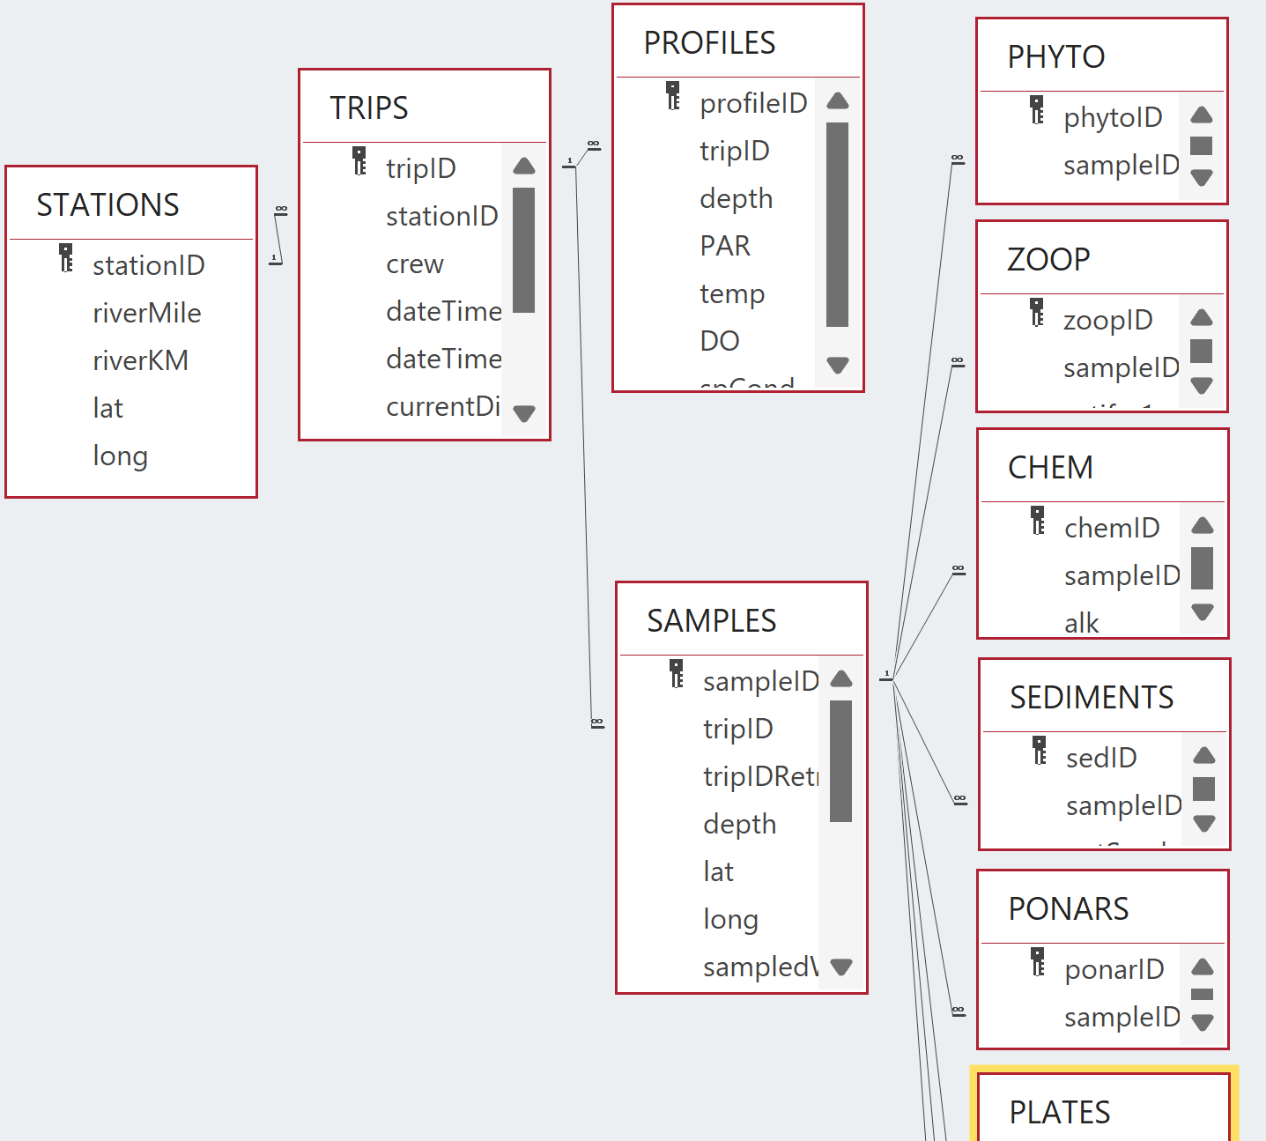
Data
Relational database
Open source, open access

Slide 13
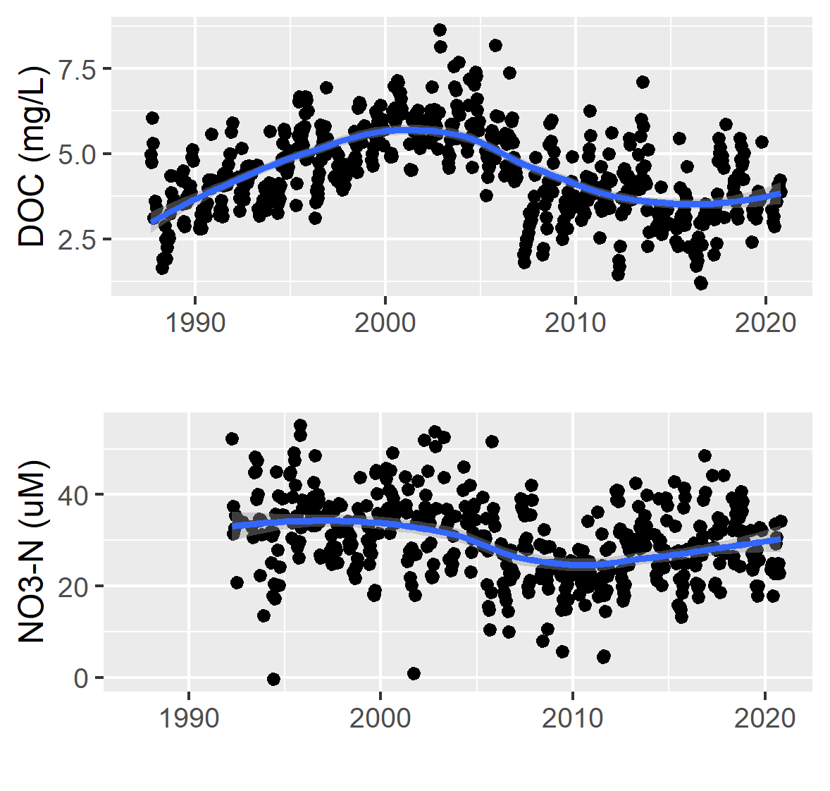
Using the ILFWS
Notes:
30 uM NO3-N is ~ 1.9 mg NO3/L

Slide 14
Using the ILFWS
Strayer et al. 2020

Slide 15
Using the ILFWS
Strayer et al. 2019

Slide 16
Using the ILFWS
Nieman et al. 2021
Notes:
The different series on this figure are different species of fish.
Question asked here: How does level of sampling effort influence magnitude of change in fish population the is detectable?

Slide 17
Using the ILFWS
?

Slide 18


Thanks!
Workgroup and panel: Y. Chen, M. Frisk, G. Jackman, K. Limburg, E. Schultz, D. Secor, D. Strayer, P. Sullivan, N. Therkildsen, J. Waldman, B. Weidel
Hudson research and management community
HRF and NYSDEC: G. Kenney, J. Kramer, J. Lodge, L. Logozzo, R. Pendleton

