Slide 1
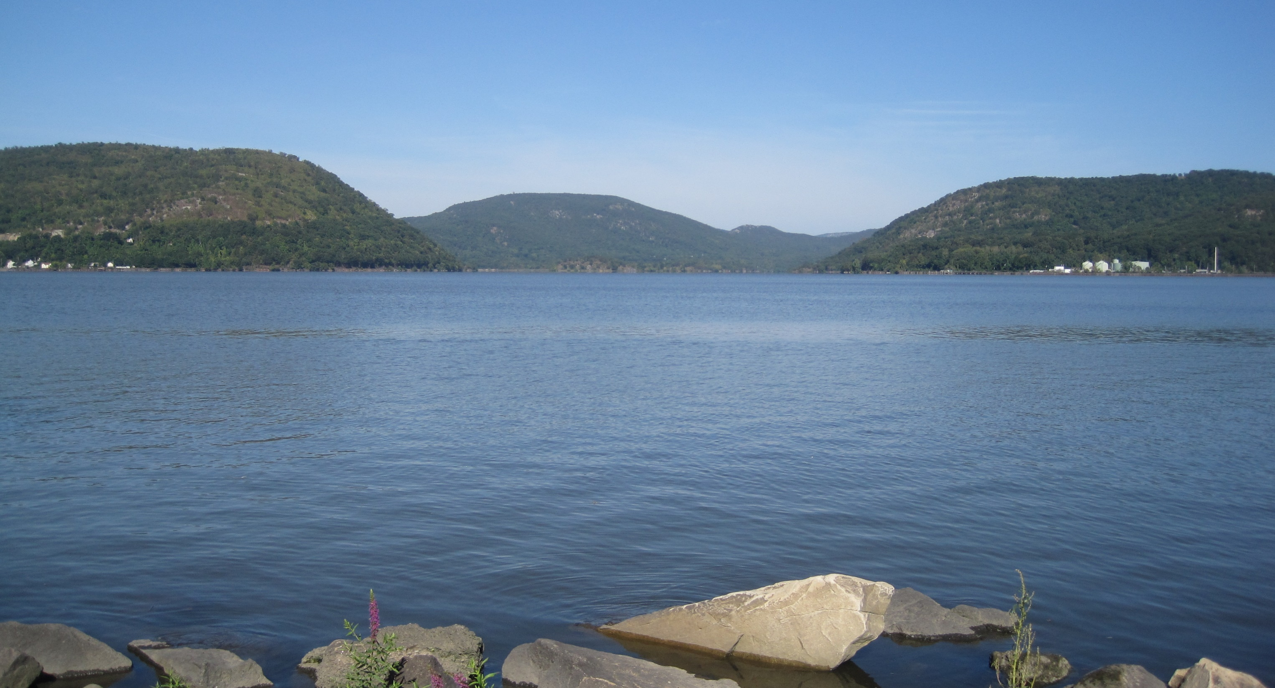
Monitoring the Hudson River ecosystem: insights from past programs
Dave Strayer, Cary Institute of Ecosystem Studies, October 2024
Thanks to John Young, Mark Mattson, Chris Solomon, the Hudson River Biological
Monitoring Program Panel, and my colleagues at Cary
D. Strayer

Slide 2
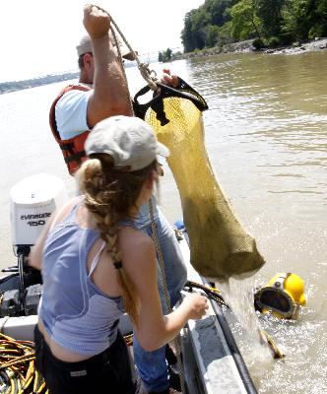
Outline
Briefly review past ecological monitoring programs on the Hudson, focusing on the utilities’ programs and Cary’s work
Consider the various goals of ecological monitoring, using examples from the Hudson
Review some elements of program design and operation that might contribute to success or failure, based on experience on the Hudson
Cary Institute

Slide 3
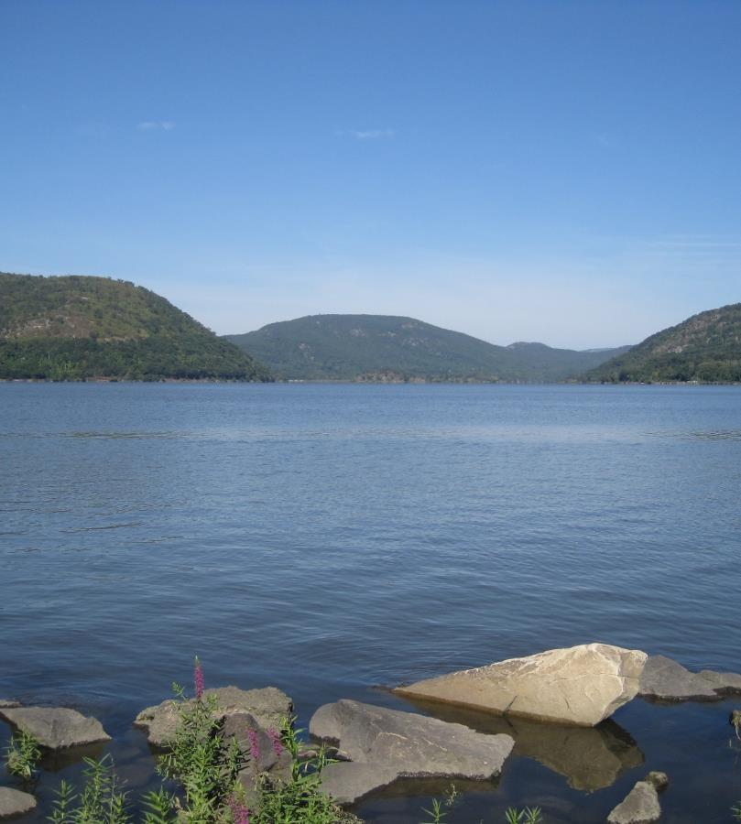
1. Many programs have monitored the Hudson ecosystem
The “utilities” programs
Cary’s program
NYS DEC Fisheries Program
Many others (HRECOS, HRNERR, NYCDEP, USGS stream gages, NOAA Weather Service and tides, …)
  if not directly ecological, they provide critical supporting information to ecologists
D. Strayer

Slide 4
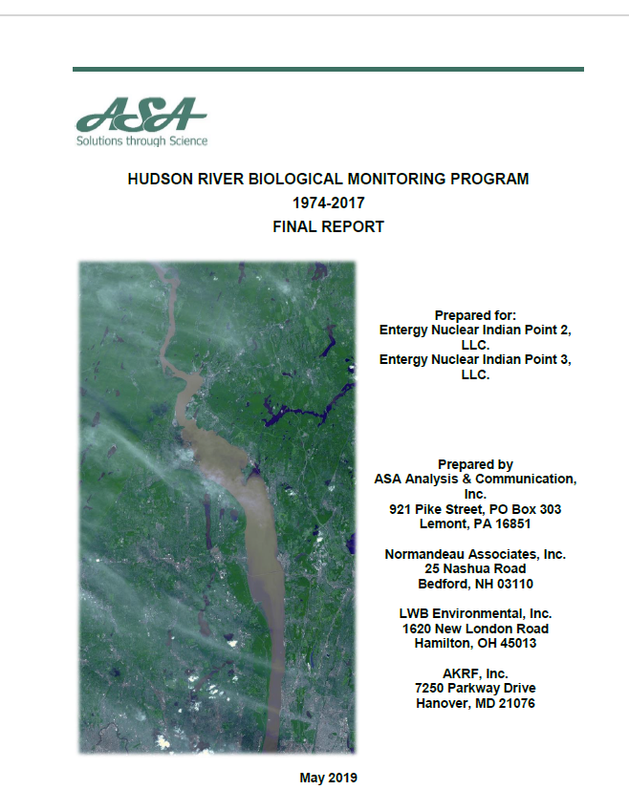
The utilities program
Motivated by concern about power-plant effects on fish
  “Evaluate the effectiveness of mitigation measures included in the settlement, specifically the flow reductions and outages intended to reduce entrainment, barrier net and screening technology, and Striped Bass stocking.
  Monitor impingement and entrainment abundance and survival at Bowline Point, Roseton, and Indian Point.
  Monitor the status of Hudson River fish populations as ichthyoplankton, juveniles, and adults.”
  Shifted towards a ecological fundamental assessment
Ran from 1974 until 2017 or 2019 (44-46 years), with some design and gear changes over time; extensive QA/QC
At least $2 million/yr (in 1981 $$)
Focused on fish (especially striped bass), but also collected water-quality data
Run by contractors, overseen by multiple regulatory agencies
Notes:
Followed on earlier studies (e.g., HRFI, NYU, and others) going back into the 60s; Hudson River Settlement Agreement of 1981 was key

Slide 5
Details of the utilities program
5 core components
  Long-river survey (LRS) of ichthyoplankton, 100-200 samples/week, spring-summer
  Beach-seine survey (BSS), 100 samples/fortnight
  Fall juvenile survey (FJS), 100-200 samples/fortnight, many gear and design changes
  Atlantic tomcod stock assessment
  Water-quality survey (DO, temperature, conductivity), 59 stations x 2-3 depths
  +several other studies of shorter duration, including gear studies
Stratified (stratified-random for LRS, BSS, FJS), whole-estuary design
Numbers, sizes, species, and some other biological characteristics of fish

Slide 6
Products of utilities monitoring
Annual reports
Large SAS data sets
~200 scientific publications
  Biology of Hudson fishes
  Gear studies
  Power plant impacts and mitigation
  Many analyses done by scientists outside the utilities and their contractors
12 million fish specimens + many more in unsorted samples
  data and specimens were not always available

Slide 7
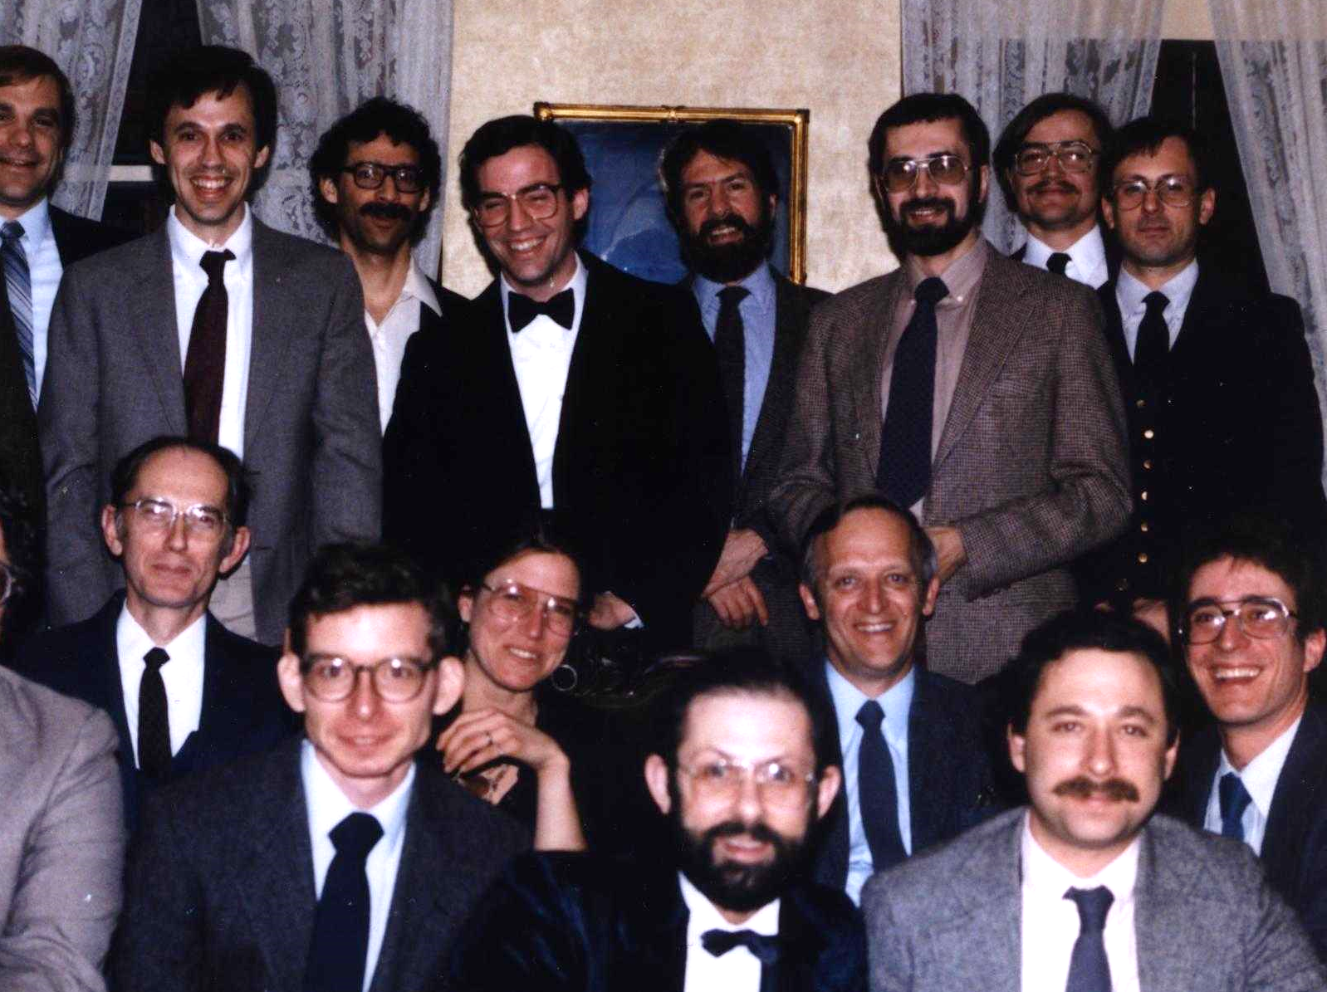
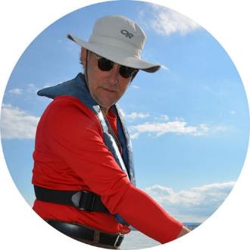
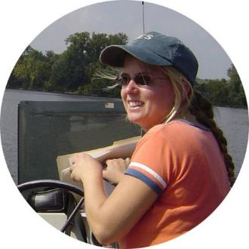
Cary’s program
Began as short-term studies of the lower food web in 1986, ended in 2017-2020
Purposes, design, and methods evolved over time, especially in response to zebra mussel invasion
  Broad goal was scientific understanding of the river
  Multiple, specific goals, which changed over time
  Part of a broader Cary Hudson research program
Funded by a series of 1- to 5-year grants from Hudson River Foundation and National Science Foundation (total ~$4.1 million = $120K/yr)
Run by a core group of 5 scientists (with no clear leader) + collaborators + key support people
Cary Institute

Slide 8
Details of the Cary program
Many variables
  Temperature, DO, conductivity, pH, Secchi transparency, light extinction
  Seston, POC, DOC, DIC, N and P (forms and concentration)
  Phytoplankton biomass (and sometimes composition), bacterial numbers and production, zooplankton numbers and composition, benthic animal numbers and composition (sporadic), populations of zebra mussels and native mussels
Spatial and temporal coverage
  Pelagic variables: every other week at Kingston and every other month at 6 sites between Castleton and Haverstraw
  Benthic animals: once or twice a year from Troy to Newburgh
Findlay et al. 1996, Estuaries

Slide 9

Products of Cary’s program
>100 scientific publications
  Zebra mussel invasion and its impacts
  Microbial ecology, including phytoplankton
  Carbon and nitrogen dynamics
  Basic ecology of the Hudson ecosystem
Widely used in education (Cary educators and others), management, and policy-making through key partners
Most data are freely available
  https://caryinstitute.figshare.com/articles/dataset/Hudson_River_data_Kingston_and_cardinal_survey_stations/8454041
A few specimens freely available in museums, many samples still at Cary (long-term fate undetermined)

Slide 10
2. What is monitoring and why do we do it?
To observe or measure something for a [long] period of time
  To track condition of an ecosystem or the dynamics of an ecological process, often to trigger management actions
  To understand how an ecosystem works
  To assess the effect of an intervention or event
  To raise questions or generate hypotheses
  To improve the design of future scientific studies, including monitoring
  More?
Notes:
Medical analogy for first goal

Slide 11
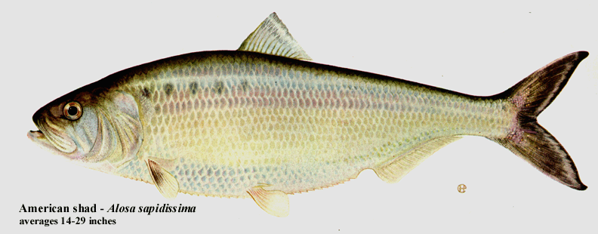
A. Tracking the ecosystem
Barnthouse and Heimbuch, n.d.

Slide 12
B. Understanding the ecosystem
The spawning dates of American shad and striped bass are changing as the climate warms
(Nack et al. 2019, Marine and Coastal Fisheries, based on utilities data)
Notes:
Chris Nack

Slide 13
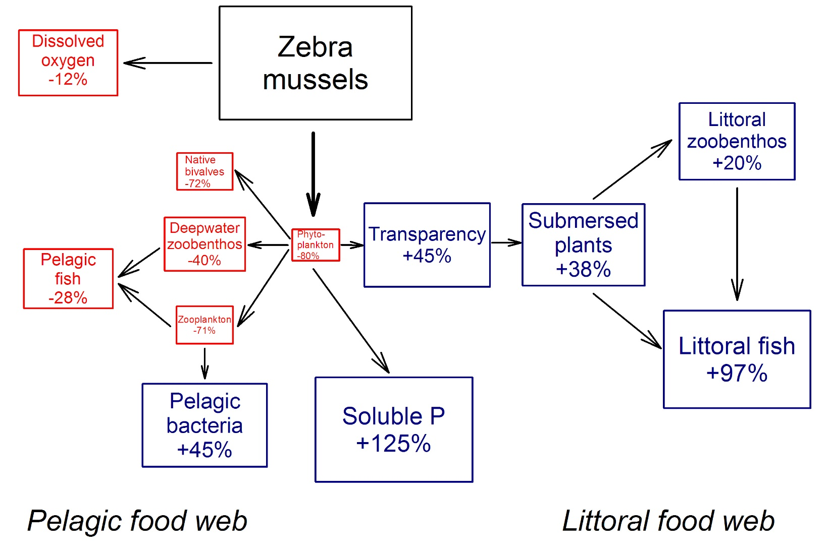
C. Assessing the effect of an event
Zebra mussel invasion had large, far-reaching effects
  Withering of planktonic food web
  Flourishing of littoral food web
Continued monitoring showed that
  Body size of zebra mussels fell as a result of increased predation
  …which moderated their effects
Strayer 2009, Front. Ecol. Environ., based on multiple Cary studies
Notes:
Other examples: hurricanes

Slide 14
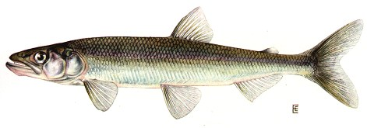
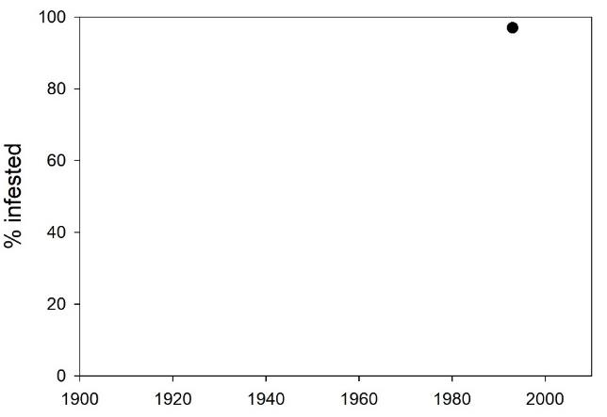
D. Raising questions: What caused smelt to disappear from the Hudson?
Rising temperature?
Glugea?
Mattson, Hudson River Biological Monitoring Program, Seekell and Pace, 2011, J. Environ. Mon.
Notes:
Glugea is a microsporidian (unicellular fungi or sister to fungi)

Slide 15
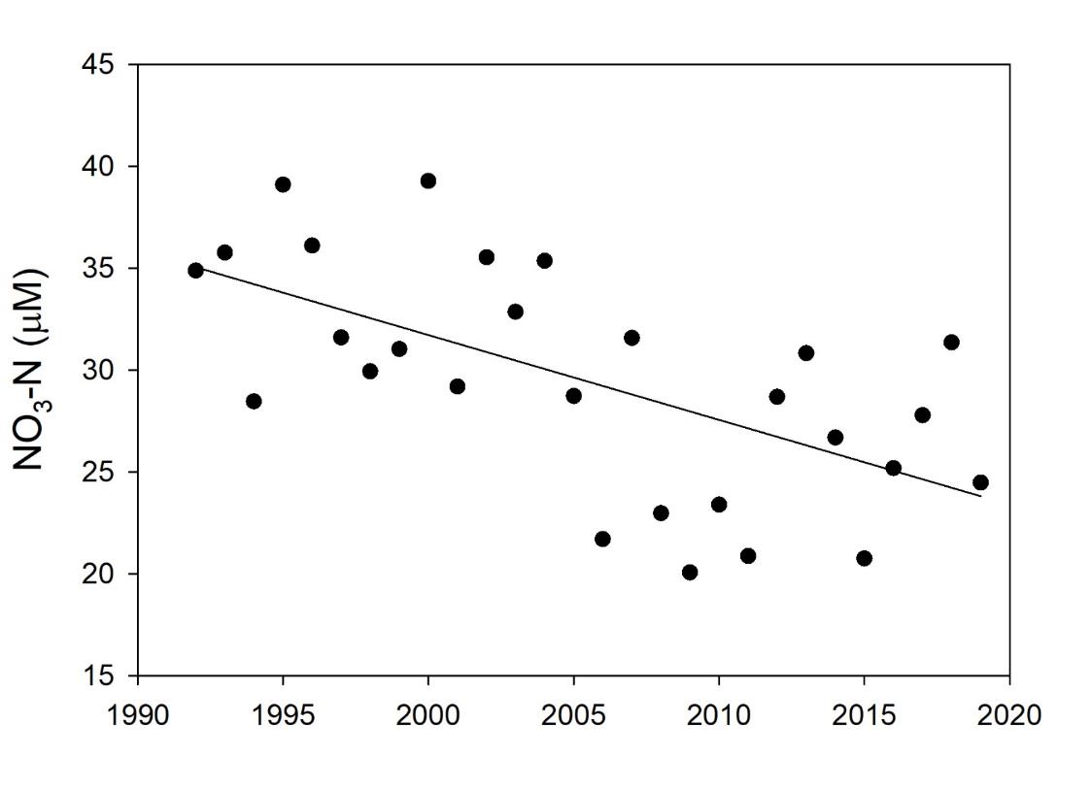
D. Raising questions: Why has nitrate been declining in the Hudson?
Nitrate didn’t decline in tributaries (USGS)
Declines occurred mostly during summer
What is the cause?
Is this occurring in other rivers and estuaries?
Strayer et al., 2014, BioScience
Notes:
Growing season means

Slide 16
E. Improving the design of future scientific studies
Nieman, Pendleton, Kenney, Solomon, 2021,
Ecol. Indicators, based on utilities data
Notes:
Plots show, for each of the focal species, the minimum decline in young-of-year abundance over 10 years that is reliably detectable, given a survey conducted at sampling intensities ranging from 100% (left end of x-axis) to 25% (right end of x-axis) of the historical level

Slide 17
Monitoring the Hudson ecosystem has made diverse contributions
  Tracking the condition of the ecosystem or the dynamics of ecological processes, triggering management actions
  Understanding how the ecosystem works
  Assessing the effects of interventions and events
  Raising questions and generating hypotheses
  Improving the design of future scientific studies, including monitoring
  Many more examples than I discussed

Slide 18
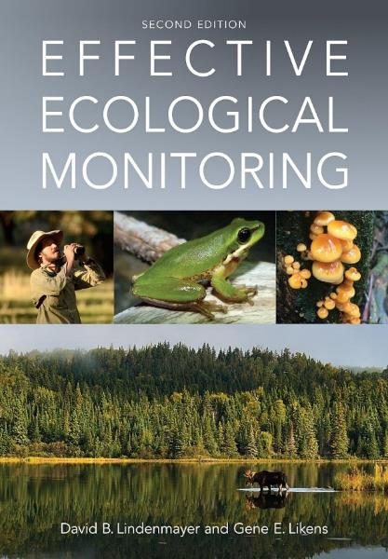

3. How do you make a successful monitoring program?
Don’t expect an easy answer (alas)
  Multiple kinds of goals and products
  The best design is highly context-dependent
Good monitoring programs need careful thought and sustained attention (just like any other kind of science or management), not a cookie-cutter approach
There are helpful resources
I’ll discuss nine things that I think matter, and are worth considering

Slide 19
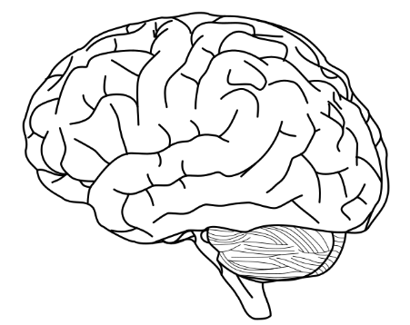
Match the design to your situation
Goals: What is my goal?
Budget: How many samples can I afford to take?
(budget, people, technology)
Constraints: What are the constraints of the site
(and societal system)?
A good monitoring design
Wikimedia Commons
Notes:
If any of the controls change (goals, resources, system), the optimal design changes

Slide 20

Test the design before commencing, and modify or discard it if necessary
Is the design likely to meet the goals?
If not:
Strayer 1991, Can. J. Fish. Aquat. Sci., Caraco et al. 1997, Ecology

Slide 21
Adopt a strong, specific initial design
The initial design should have a clear purpose or answer a specific question (or small number of questions)
  “it should be possible a priori to write down how data that are proposed to be gathered in a monitoring program can be used [to test well formulated hypotheses]” (Lindenmeyer and Likens, 2018)
Conceptual or quantitative models of the system can be very helpful in formulating questions and matching designs to questions
Vague goals may lead to unfocused, weak designs of low value
Try to build flexibility into the initial design (like having 12 stations, 6 of which could be discarded)

Slide 22
Be prepared to change the program
Your goals and resources, technology, the focal ecosystem and societal context, and knowledge about the ecosystem are likely to change
  Since I arrived at Cary in 1983, many new analytical methods have become available, >30 nonnative species have become established in the basin, the shad and sturgeon fisheries closed, we have vastly more information about spatial and temporal variation of variables, our conceptual model of how the ecosystem works has changed, the uses of the river have changed, …
Consequently, you may want to change the design and operation of the program to increase its benefits
Adaptability requires frequent examination of the data, consultation with users, and thought
  Are you taking enough samples? Too many?
  Do the results suggest new questions?
  Does the scientific literature suggest new questions or new uses of your data?
  Are there changing uses of the river, or new problems that threaten it?
  Have you answered your original question? If not, is it still important to answer?
There may be strong trade-offs between consistency and adaptation
  Not always easy to know when to change vs. when to stay the course (and you will make choices that will turn out to be wrong – I wish we had added predator-exclusion cages to our long-term work on zebra mussels)
  Calibrate new methods against old (Chang, H. Y., Sun, M., Rokosz, K., & Chen, Y. (2023). Evaluating effects of changing sampling protocol for a long-term ichthyoplankton monitoring program. Frontiers in Marine Science, 10, 1237549)

Slide 23
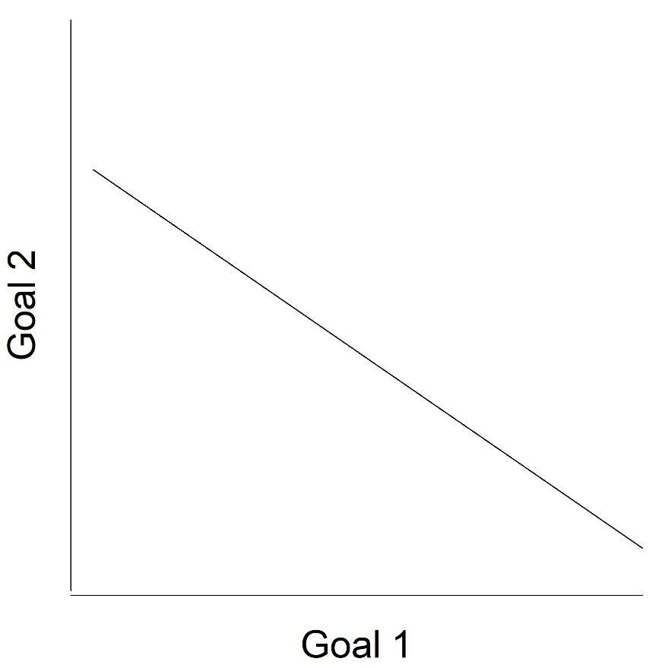
Expect tradeoffs, and assess them as best you can
Trade-offs are common
  Sharply focused vs. broad goals
  Specific vs. general designs
  Number of variables vs. number of sampling sites vs. number of sampling times
  Centralized vs. distributed project management
  Starvation vs. complacency from too much/too little funding
  Too much vs. too little oversight
Model tradeoffs where you can, aggressively using existing data
Keep in mind the relative importance of different goals

Slide 24

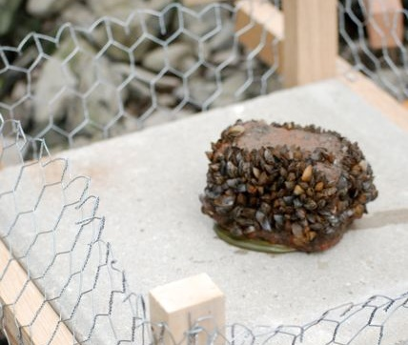
Embed monitoring in a broader program of research
Monitoring by itself may be unable to prove causation
  Adding experiments, models, and cross-system comparisons can strengthen understanding of causation
Monitoring by itself may provide only a lagging indicator of conditions
  Models and detailed data on leading indicators (e.g., age structure, demographic parameters, biomarkers) can allow projections into the future
Lab studies and models may lack realism; monitoring provides an essential link to reality
Scientific understanding
Theory
Long-term
monitoring
Cross-system
comparisons
Experiments
Kurtkaiser, CC0, via Wikimedia Commons; Carlsson et al., 2011, Freshw. Biol.

Slide 25
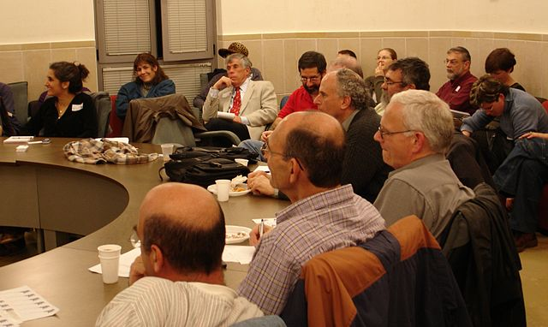
… and management
If monitoring is disconnected with management, you risk:
  Collecting irrelevant data
  Not getting relevant results into the hands of managers
  Wasting management resources
  Delaying learning about effects of management actions
  Damaging natural resources (e.g., non-target effects)
Unclefeet, CC BY-SA 3.0 <https://creativecommons.org/licenses/by-sa/3.0>, via Wikimedia Commons

Slide 26

The data should be made as available as possible
Data may be used more widely, including for unexpected uses
Data are less likely to be permanently lost
May reduce time and effort of finding data
Fulfills a duty (if supported by public funds)
Data may be misused or misinterpreted
It is costly and burdensome to provide datasets to public
Outside users may scoop the scientists who collected the data
Publication credit may not be given to data collectors
If you’re worried about your results being misinterpreted, get out of science!
Provide adequate funding for data curation and posting (15-25% of project costs?)
Embargo data for a year or two, if necessary
Published data sets can (and should) be cited and considered in promotion reviews, proposal reviews, etc.
Vectorized by Wallu2, CC BY-SA 4.0 <https://creativecommons.org/licenses/by-sa/4.0>, via Wikimedia Commons

Slide 27
Try to allow for resources to pursue important new questions that arise
A weakness of past programs on the Hudson (e.g., smelt, nitrate)
Someone needs to pay attention to unexpected results
Someone needs to feel responsible for pursuing unexpected results
There needs to be money/bandwidth to pursue unexpected findings
A problem for scientists, managers, and funders

Slide 28
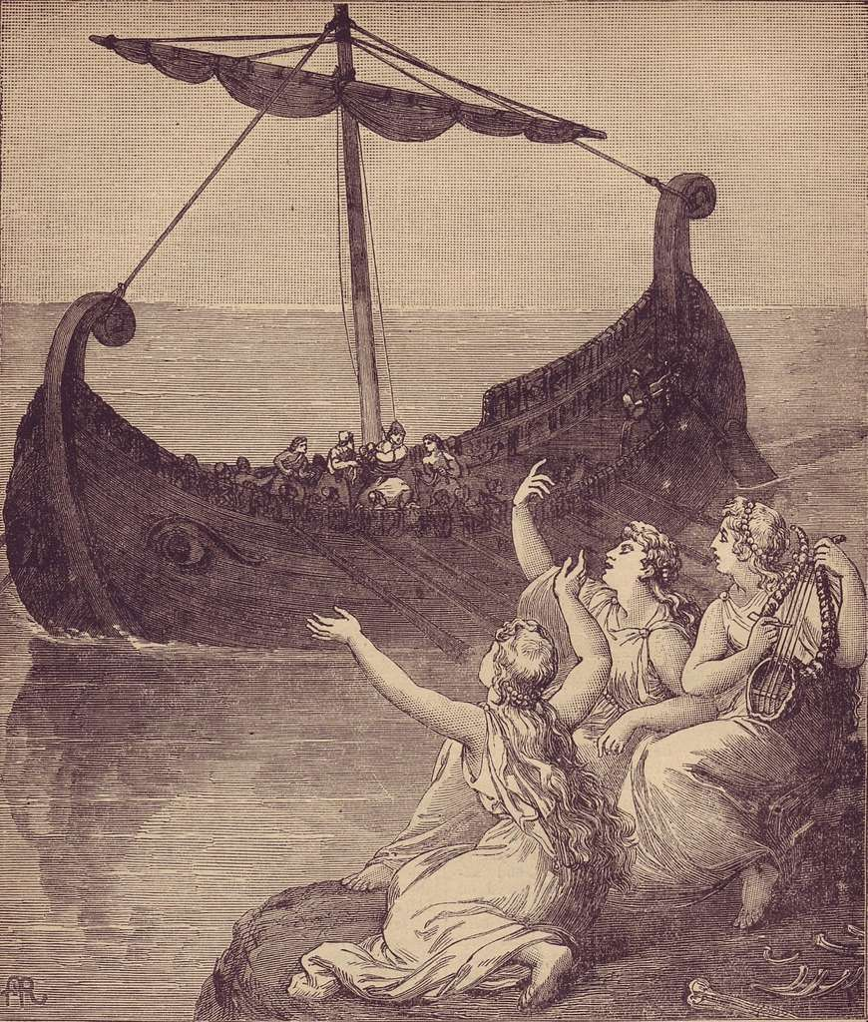
Beware the seduction of easy measurements
Public domain

Slide 29
X₃
Focal variable
X₁
X₂
(easy to measure)
(hard to measure)
X₄
X₁ and X₂ are equally important in determining the value of the focal variable

Slide 30
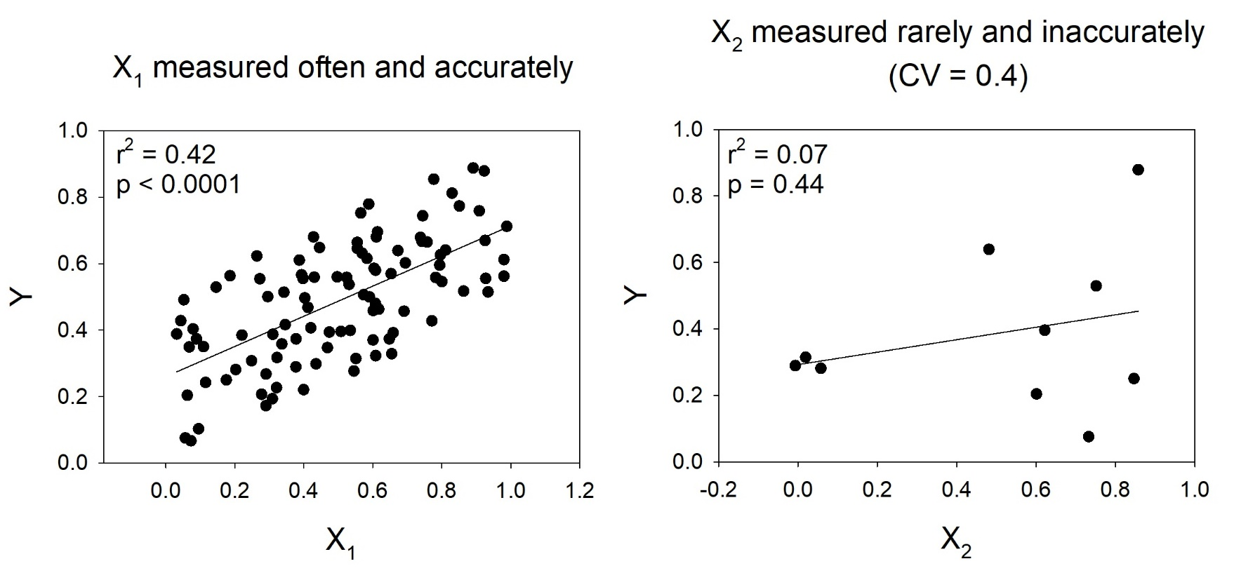
Measurement error may distort your understanding
Measurement error reduces r² and the slope
Fewer points reduces statistical power
Can lead you to overvalue easily measured variables and overlook hard-to-measure variables

Slide 31
X₃
Focal variable
X₁
X₂
(easy to measure)
(hard to measure)
X₄
X₁ and X₂ are equally important in determining the value of the focal variable,
But you may conclude that the hard-to-measure variable is unimportant
Notes:
…leading to a pernicious positive feedback loop

Slide 32
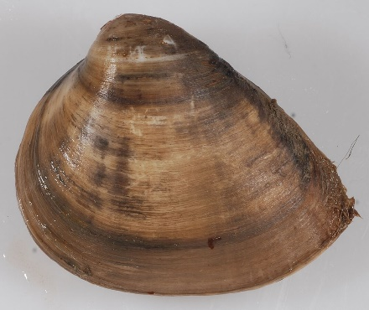
We overlook hard-to-measure variables in the Hudson
For decades, we attributed the loss of smelt to rising temperatures rather than a non-native parasite, because it was easy to measure temperature
We haven’t monitored Rangia populations in the Hudson
  Most abundant benthic invertebrate between West Point and Nyack (>600/m² in 2000-2001)
  This shallow section of the river ought to be sensitive to benthic grazing
  May have caused large changes when it appeared in 1988, and may be an important control on the ecosystem
  We’ve ignored it because it’s hard to measure
As more variables can be measured automatically, we must be careful not to overestimate the importance of those variables, at the expense of variables that are harder to measure
Smithsonian Environmental Research Center, CC BY 2.0 <https://creativecommons.org/licenses/by/2.0>, via Wikimedia Commons

Slide 33

Someone needs to lose sleep over the program
Should we adopt new methods?
Do the data offer new insights?
Are we keeping up with analyzing data, writing papers, posting data?
How is the ecosystem changing? Will our program detect these changes?
Do we have funding for next year?
Do we need new personnel or collaborators? Are existing workers doing a good job?
Have the needs of managers and stakeholders changed?
How do new findings from other sites affect how we should monitor the Hudson?
…etc.
Maybe some of this can be automated in the future, but we’re probably not there yet
https://www.myupchar.com/en, CC BY-SA 4.0 <https://creativecommons.org/licenses/by-sa/4.0>, via Wikimedia Commons

Slide 34
Conclusions
  The Hudson has been extraordinarily well monitored, which has led to deeper scientific understanding and allowed for more intelligent management than for many ecosystems
  The Hudson will face many challenges in coming decades (climate change, sea-level rise, new biological invasions, changing uses, etc.), so it will be important to continue good monitoring
  It will be neither easy nor routine to run a good monitoring program on the Hudson ecosystem, and will require creativity, analysis, constant oversight, and communication with broader communities
D. Strayer

