Slide 1




Hudson River Environmental Society
October 25, 2025

Slide 2

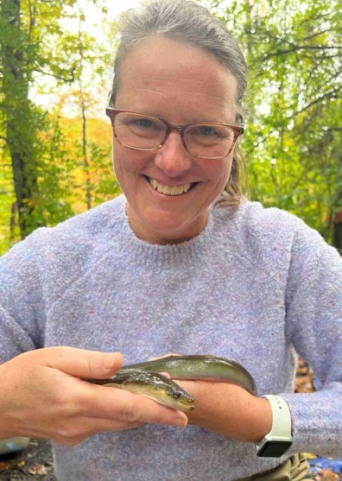
Rob
Heather

Slide 3
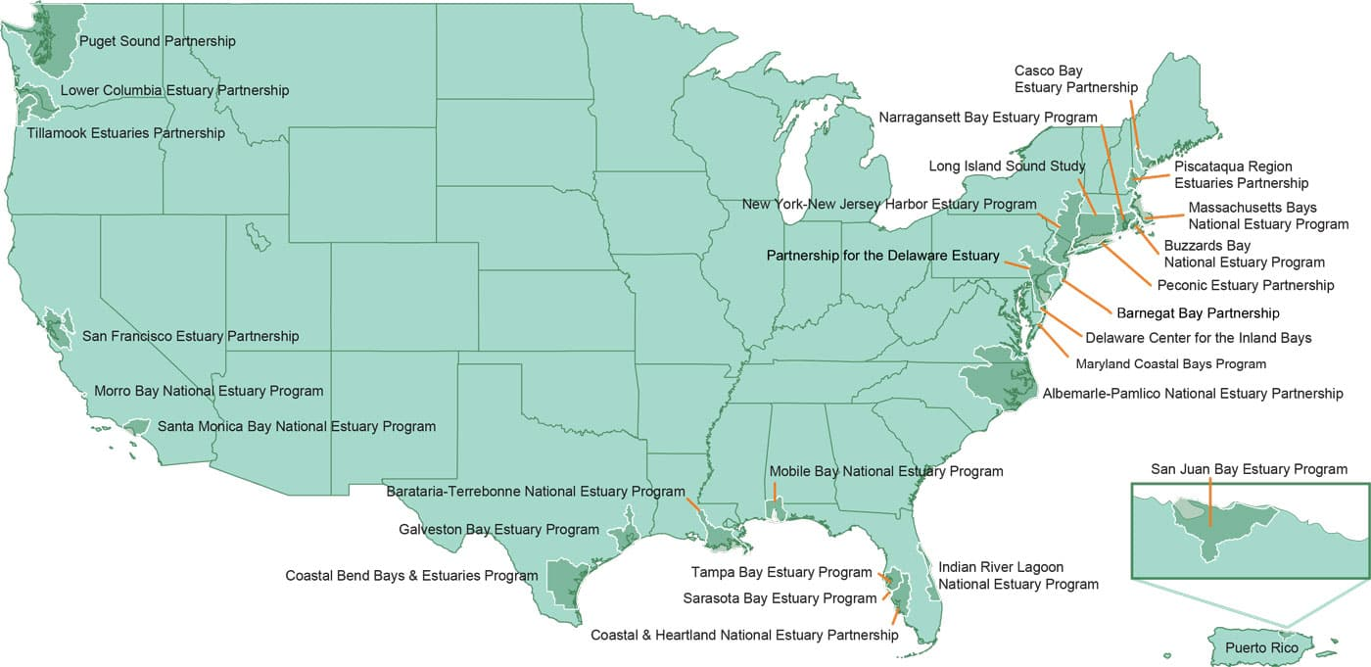
National Estuary Program

Slide 4
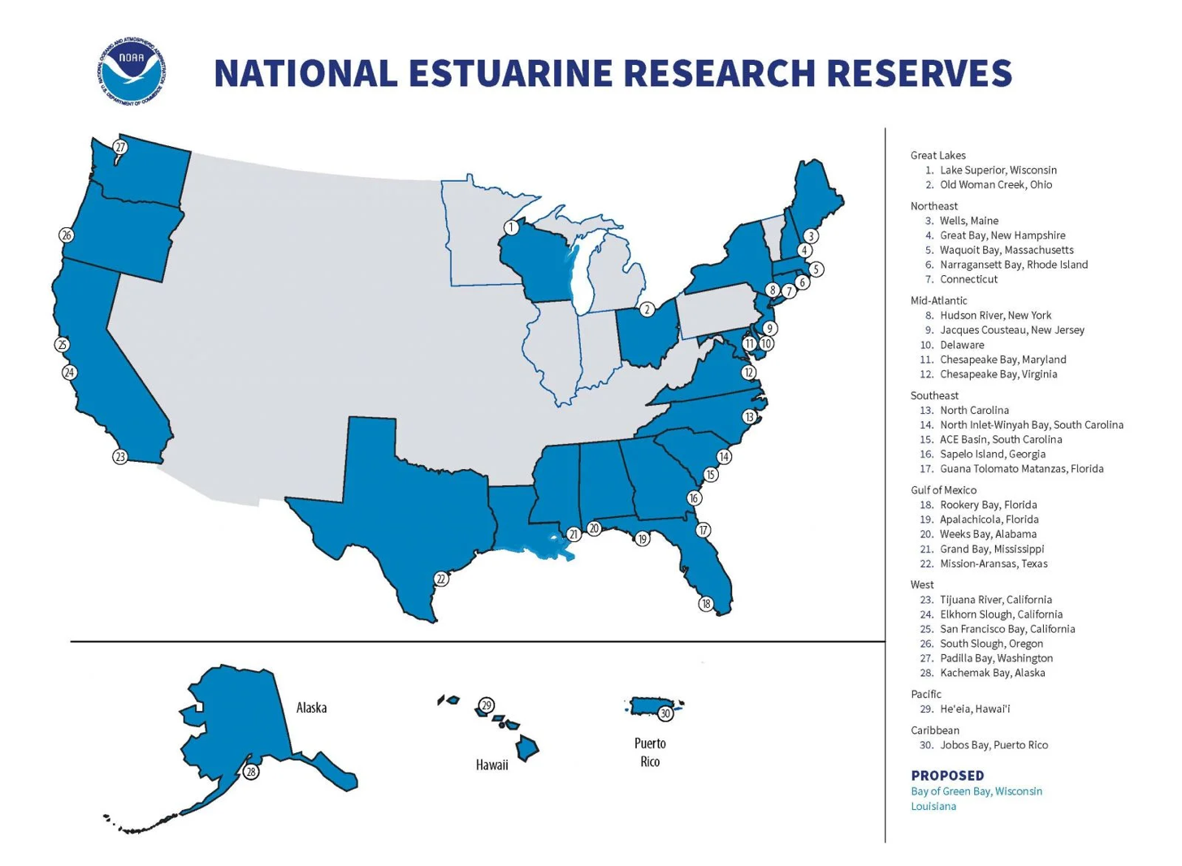
Notes:
ADD NERRS MAP (or we can put on same slide as previous?

Slide 5
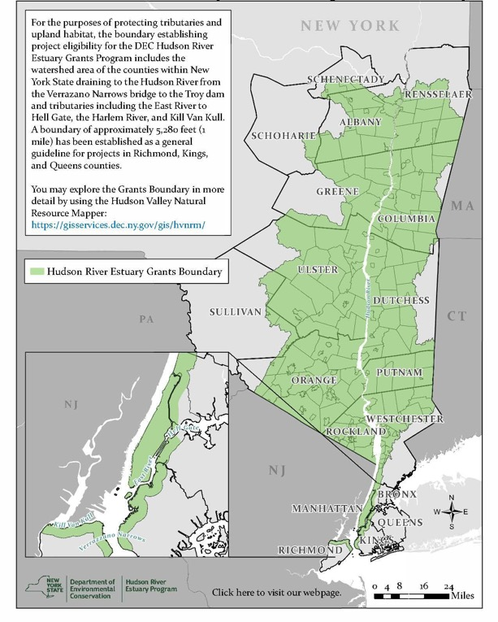
Hudson River Estuary Management Program
Created by New York State Law
•Establishes the Hudson River Estuary Management Advisory Committee (HREMAC) and a Coordinator position
•Recognizes the “estuarine district” as the Tidal Hudson from the Troy Dam to the Verrazano Bridge
•Funding primarily from NYS Environmental Protection Fund
Notes:
The right map is our grant eligibility map… and the Hudson River estuary area we focus our work on

Slide 6
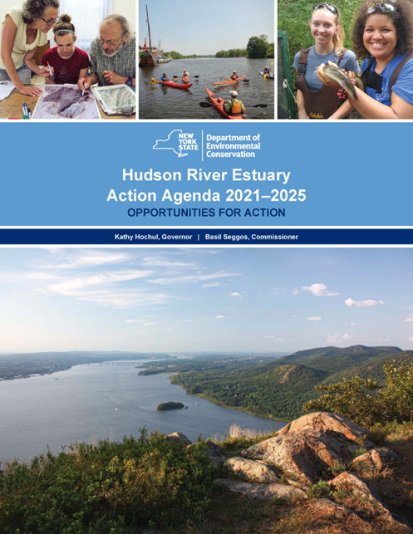
Mission: to protect, preserve and, where possible, restore and enhance the Hudson River estuarine district
A Vital Estuary Ecosystem
• Sustainable Estuarine Fisheries
• Robust River Habitats
• Clean Hudson River Water
A Thriving and Resilient Watershed
• Healthy Tributaries
• Climate-Adaptive Communities
• Conserved Natural Areas
People Living Well with Nature
• An Informed and Engaged Public
• An Accessible Hudson River for People of All Ages and Abilities

Slide 7
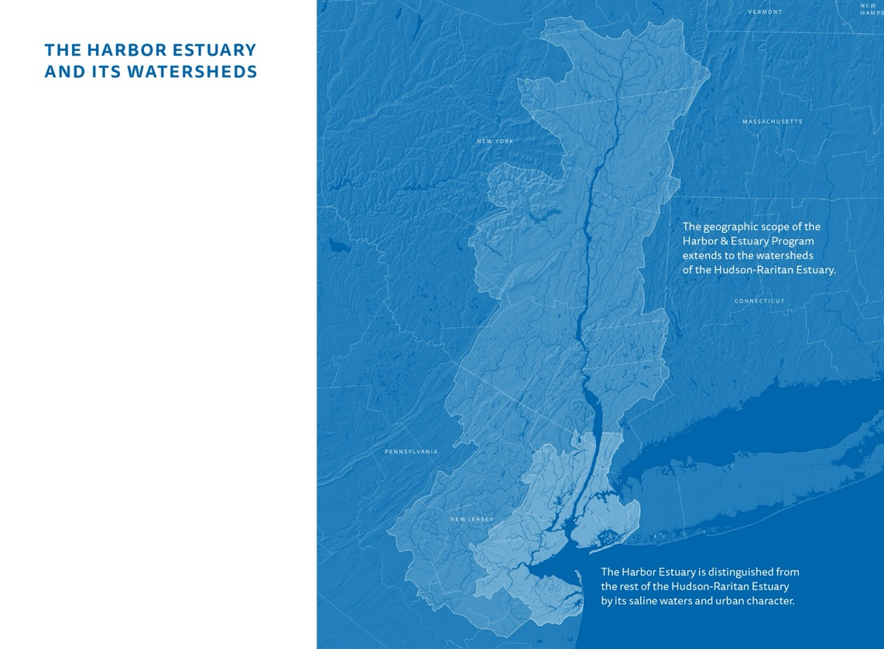



One of the nation’s 28 national estuary programs.
HEP is an ongoing effort to develop and implement a consensus driven plan to protect, conserve and restore the estuary.
Our mission: Engaging people, partners, and communities to collaboratively advance understanding, improve stewardship, and enhance our shared waters and watersheds
Notes:
The NY-NJ Harbor & Estuary Program is one of the national estuary programs. Not to be confused with our sister State estuary program, the Hudson River Est. Prog. We are bi-state organization, that covers the entire lower Hudson and Raritan river watersheds in NJ. We do tend to focus more on the salty more urban part of the estuary. We are a part of the Hudson River Foundation.

Slide 8
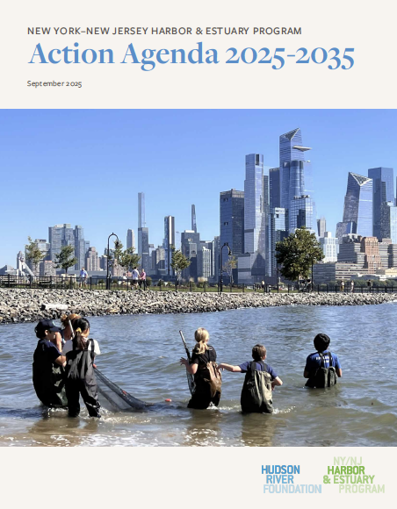
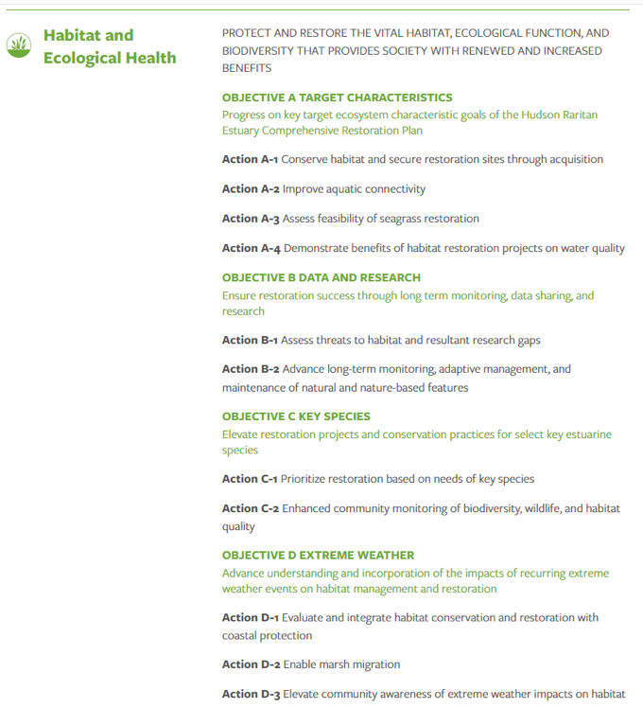

Slide 9
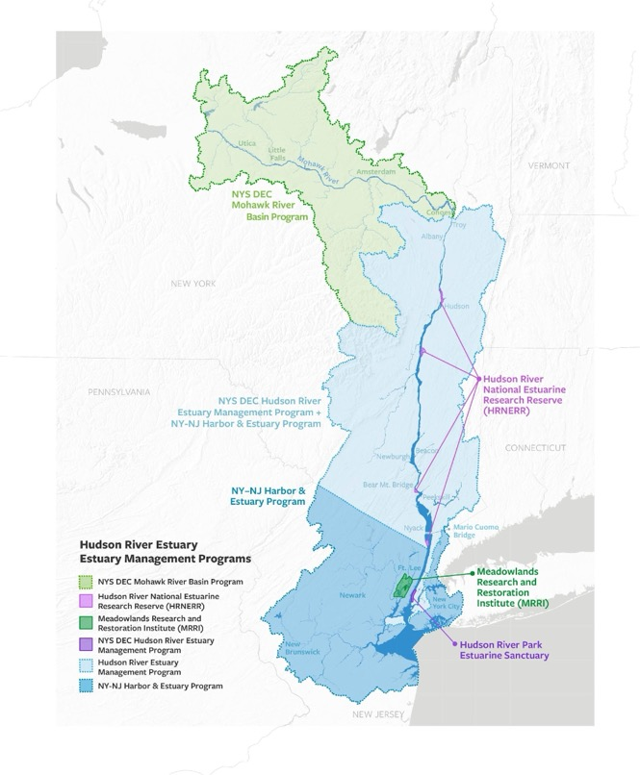
Notes:
We work closely together and we are both using this map to show readers of our action agendas that we are working closely together.

Slide 10
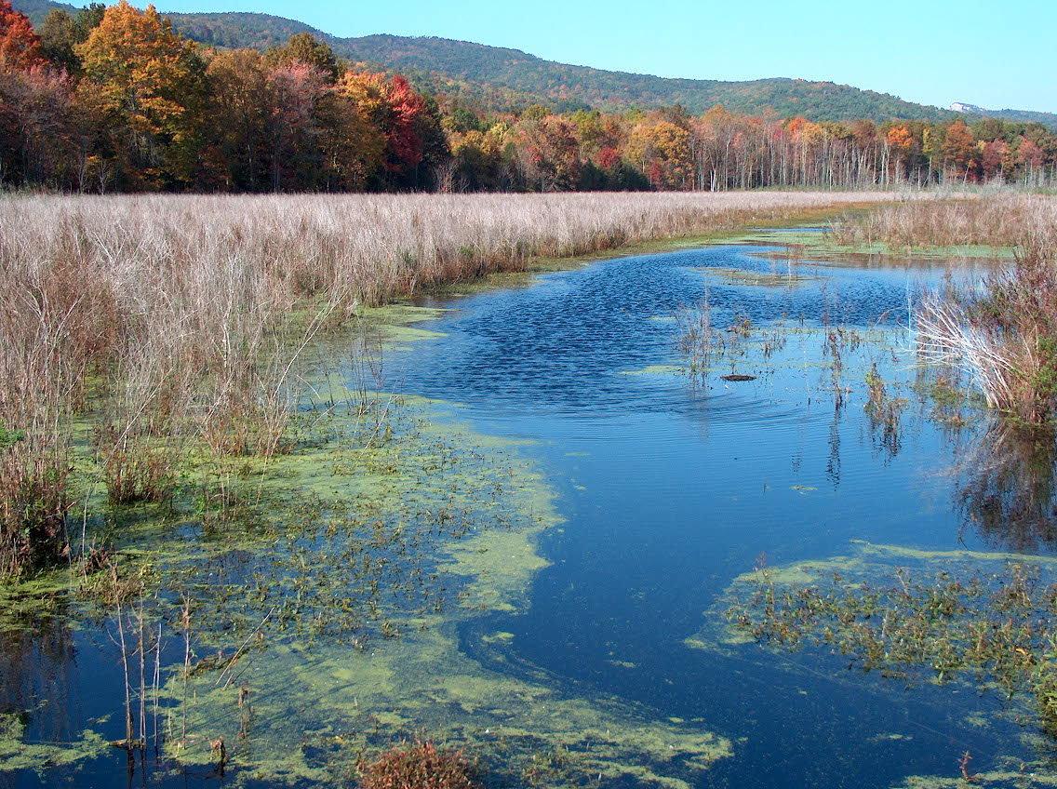



The State of the Estuary 2025
Photo: NYSDEC

Slide 11
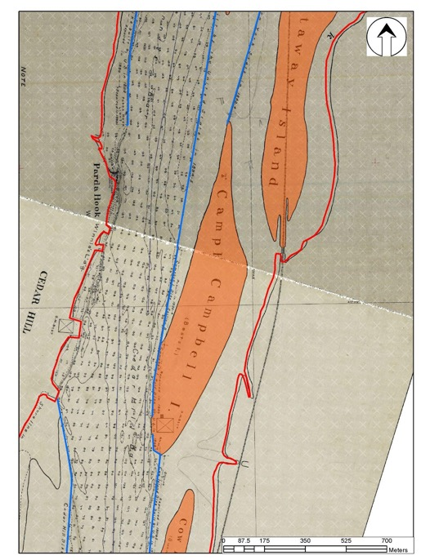
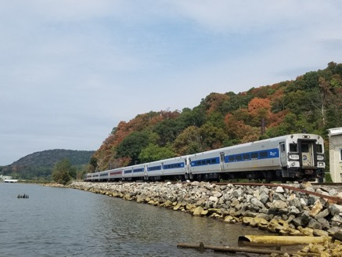
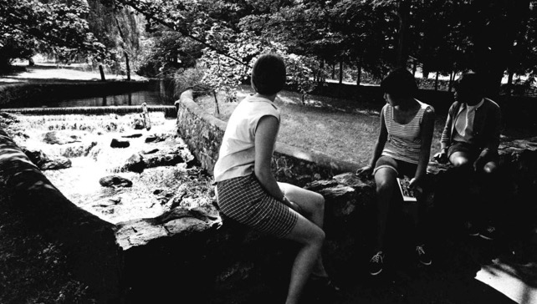
Why Focus on Restoration? River Has Been Manipulated
Dredging and railroad for transportation
Dams for recreation
Contaminants from industry
Wikipedia- MTA
Notes:
We have manipulated the tributaries to expand recreation - examples above are daming tributaries to expanding swimming opportunities but the cost was cutting off migration routes for eels and other species while also holding back sediment that is vital for productive fish habitat down stream
The River was Dredged by the ACOE for commercial navigation
Railroad track on both sides for commercial and passenger trains
industry discharged PCBs and other contaminants into the River and now classified as a Clean up site by EPA, Hudson River Cleanup | US EPA
We

Slide 12
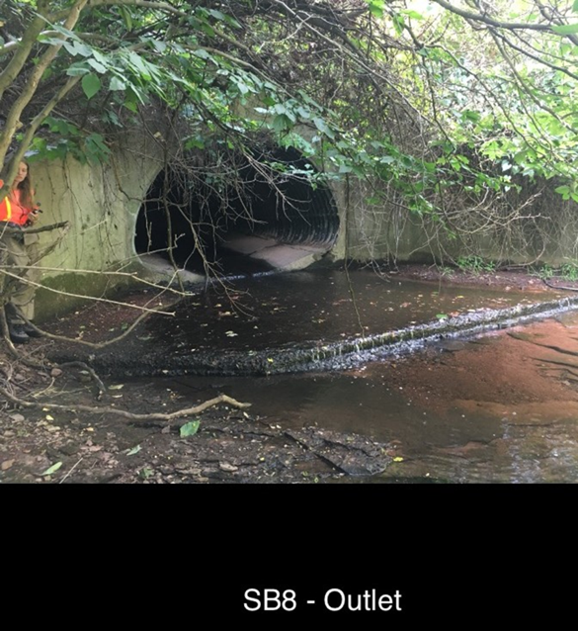
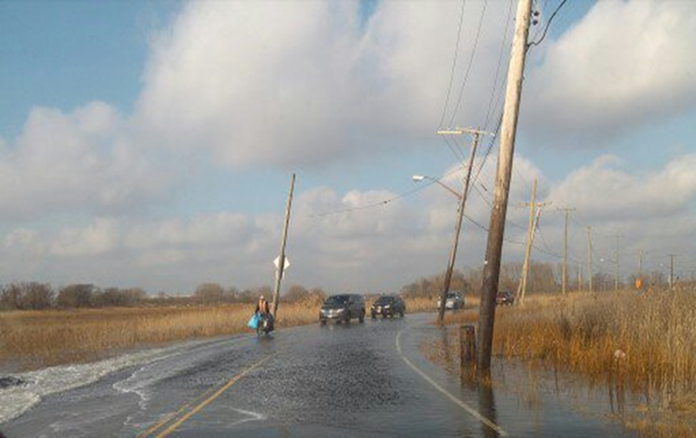
Why Focus on Restoration? River Has Been Manipulated
Filling wetlands and open water for roads and real estate
Altering stream hydrology
Wikipedia- MTA
Notes:
We have manipulated the tributaries to expand recreation - examples above are daming tributaries to expanding swimming opportunities but the cost was cutting off migration routes for eels and other species while also holding back sediment that is vital for productive fish habitat down stream
The River was Dredged by the ACOE for commercial navigation
Railroad track on both sides for commercial and passenger trains
industry discharged PCBs and other contaminants into the River and now classified as a Clean up site by EPA, Hudson River Cleanup | US EPA
We

Slide 13
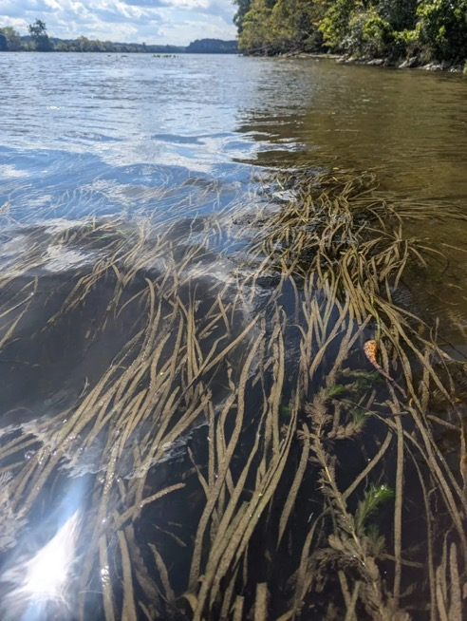
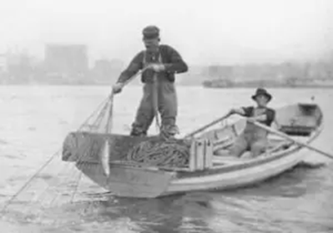
Why Focus on Restoration: Habitats Have Been Impacted
Hudson River Valley labor History Project
Notes:
Submerged Aquatic Vegetation is critical for the quality of the Hudson River water but the balance between Native water celery to Invasive water chestnut is changing
the fisheries populations used to be robust enough to support commercial fishing and today we the Shad population is depleted : American Shad - Atlantic States Marine Fisheries Commission and the sturgeon species are considered endangered species

Slide 14
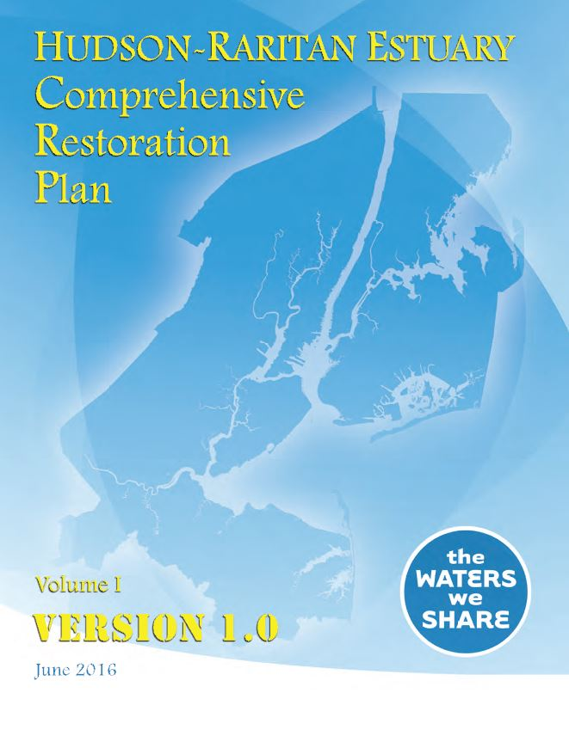
Hudson Raritan Estuary Comprehensive Restoration Plan (CRP)
Developed by the USACE and PANYNJ in partnership with the Hudson River Foundation and many other partners
Adopted by the HEP and its Restoration Work Group
Sets targets and identifies opportunities
Basis for USACE Feasibility Study and federal funding
HEP has been tracking success since 2009

Slide 15
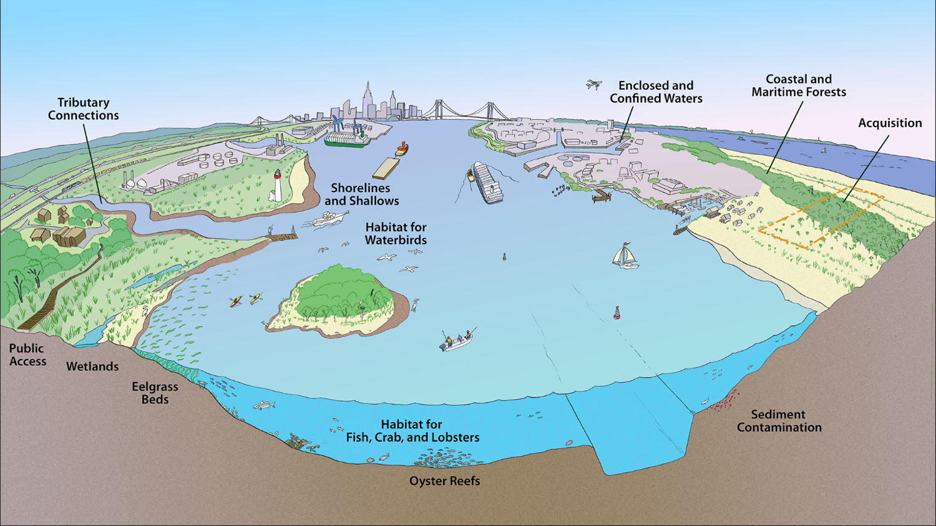
12 Target Ecosystem Characteristics
Notes:
Historic Photos

Slide 16
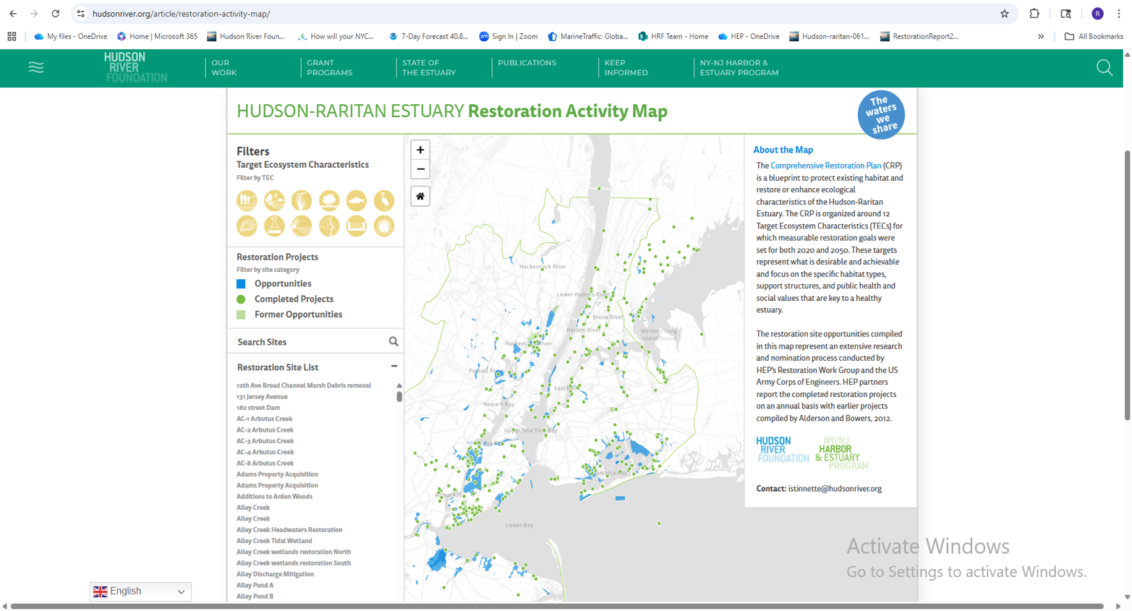
https://hudsonriver.org/article/restoration-activity-map/

Slide 17
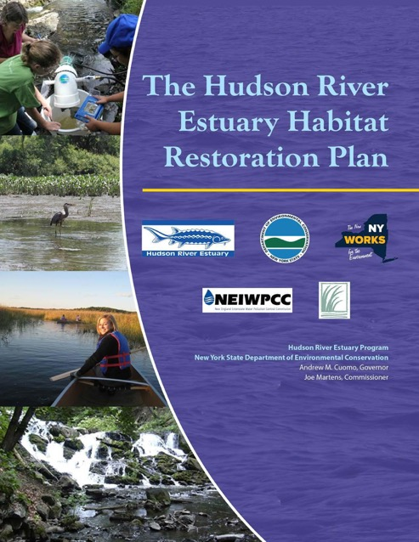
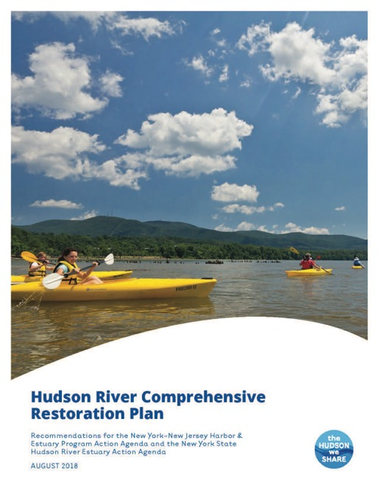
Hudson River Restoration Plans
Notes:
WE have two plans that cover the Hudson River and they are good starting points… in addition the HREMP is working across programs and partners to come up with examples of restoration… such as side channels, SAV restoration, barrier removals, sustainable shoreline BMP demonstration TNC18011_Hudson_River_Report_Final_727.indd
The Hudson River Estuary Habitat Restoration Plan
Based on this research, four priority habitats for restoration were identified: intertidal habitats, shallow water, shorelines, and tributary habitats. Although these habitat types do not represent all those that have been lost or degraded, they do represent significant and feasible opportunities to improve habitats and the health and resiliency of the Hudson River Estuary ecosystem. To restore these habitats, five restoration actions were identified:
Preservation of existing estuary habitat, including protection of buffer lands that will be inundated in the future as sea level continues to rise;
Implement side channel restoration, including tidal wetlands, vegetated shallow waters, back waters and intertidal habitats;
Promote and implement fish passage, dam removal & culvert right-sizing in tributaries to the Hudson;
Promote and implement use of ecologically enhanced shoreline structures where shoreline stabilization is required to protect property, infrastructure or other economic assets;
Implement programs to control and prevent introduction of invasive plant and animal species
01 Catalyze innovative collaboration in support of project planning and implementation.
02 Integrate natural resource management opportunities into regional planning and implementation.
03 Leverage increasingly diverse sources of capacity, expertise and funding.
04 Provide a platform for adaptive management.
05 Enable comprehensive reporting on progress.

