Slide 1
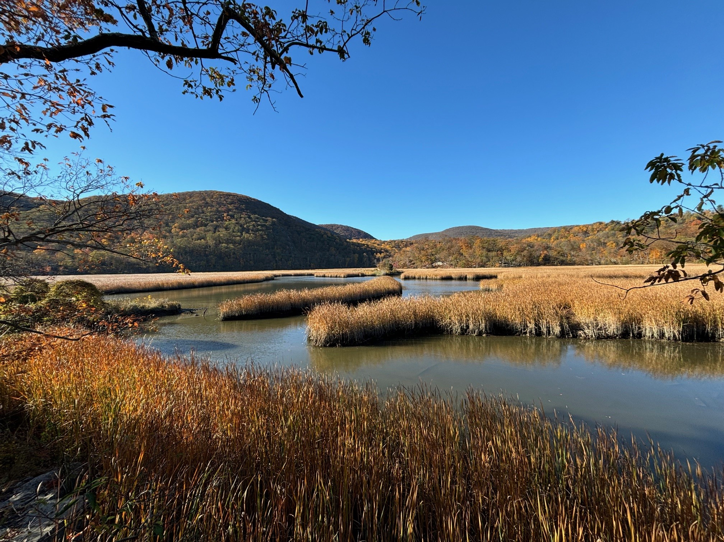


Iona Marsh Restoration: 2008-2025
Ed McGowan
NY State Office of Parks, Recreation, and Historic Preservation
Names of Presenters, Titles, Contact Info, etc.

Slide 2
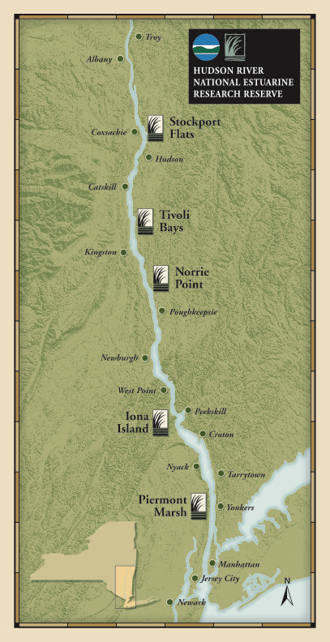

Iona Marsh
Management partners

Slide 3
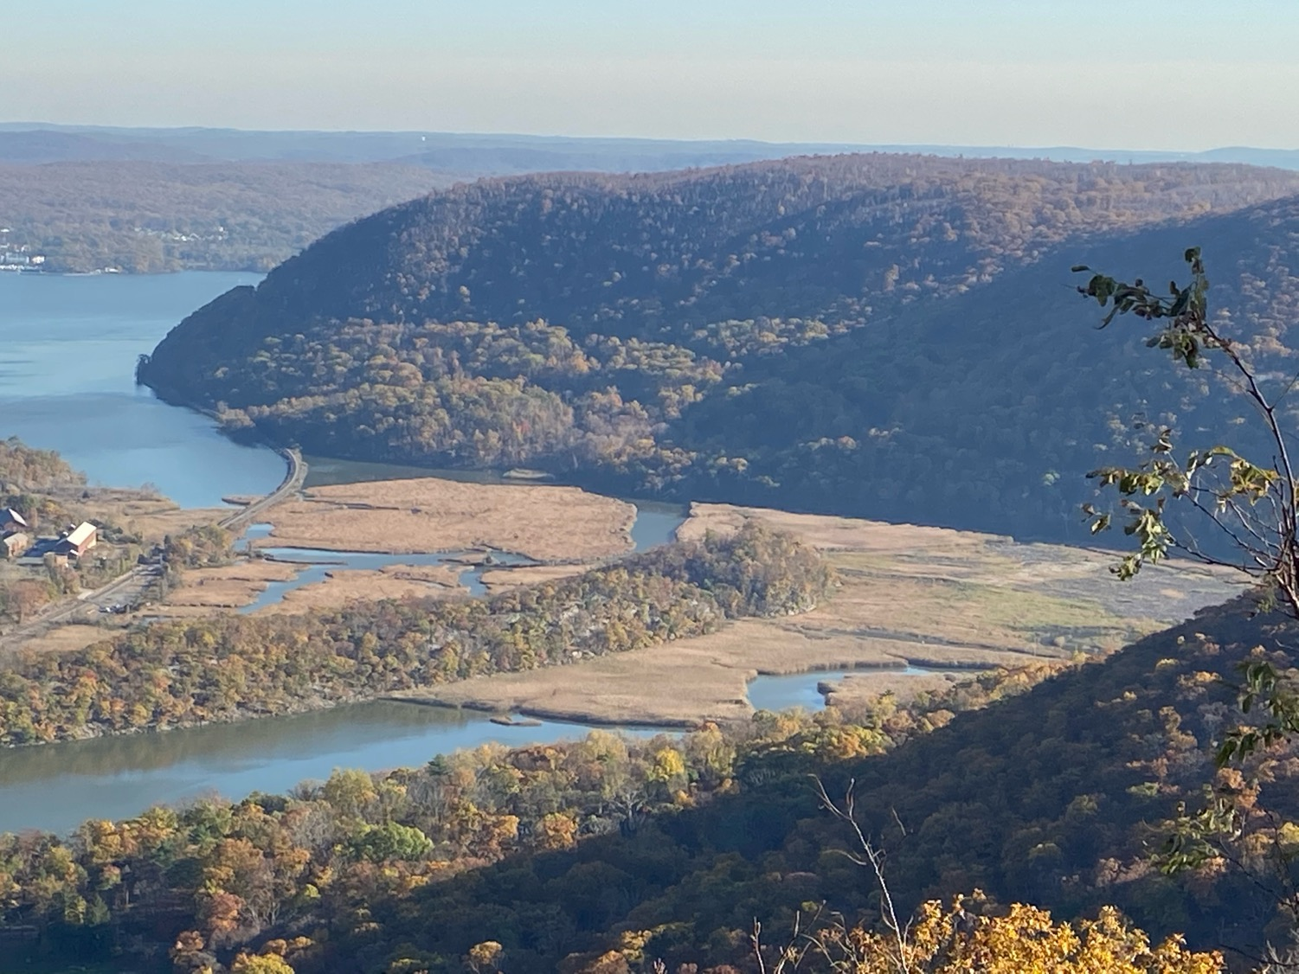
Iona island sits an elbow in Hudson, water slows and eddies, depositing silt for last 6000 years, plus two upland streams, RR track in 1850s. 100ft peaty sediment

Slide 4
Iona Marsh
Brackish Conditions
Salt Front
About 40 miles south of here, same distance as Iona to NYC.
Look up salt concentration there – ppm or ppb?

Slide 5
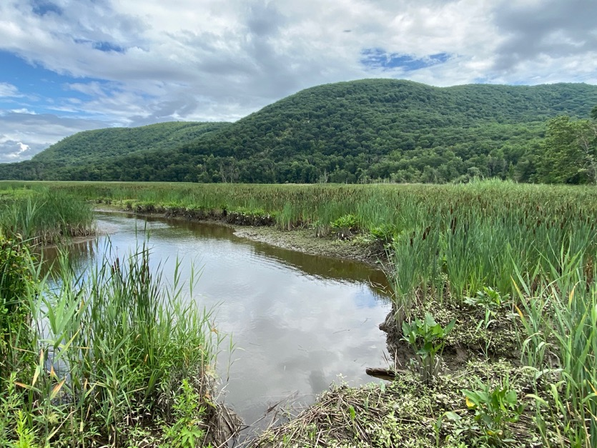
Ecological Communities of Statewide Significance
B
Brackish Tidal Marsh
  152 acres
Brackish Intertidal Mud Flats
  15 acres
Freshwater Tidal Marsh
  8 acres
Sets the conditions for it to support ecol communites of statewide significance.

Slide 6
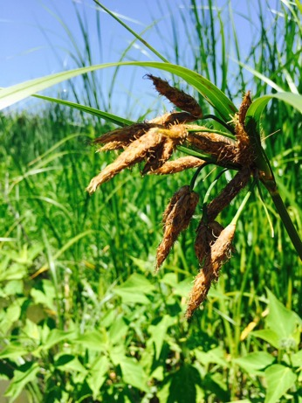
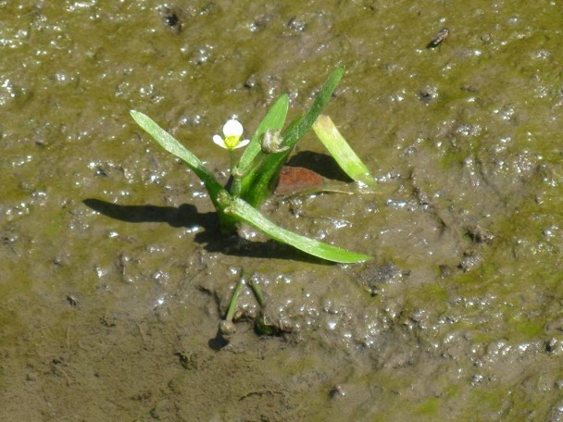
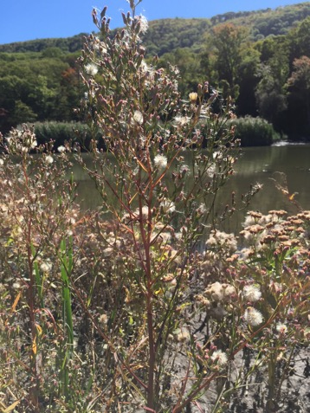
State Rare Plants
New England Bulrush
State Endangered
Annual Saltmarsh Aster
State Threatened
Spongy Arrowhead
State Threatened

Slide 7
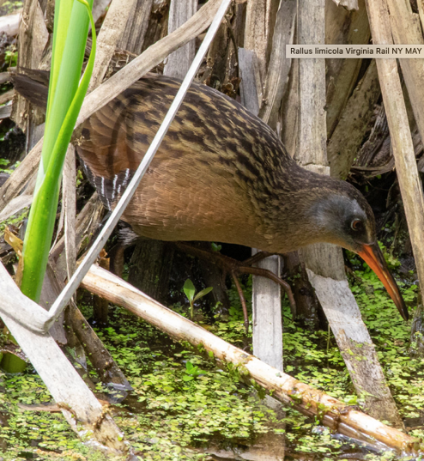
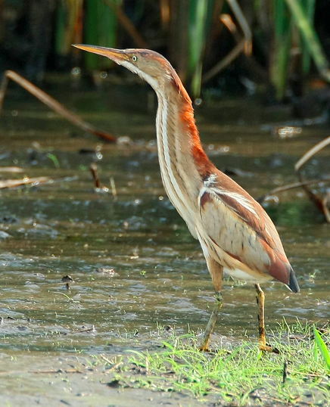
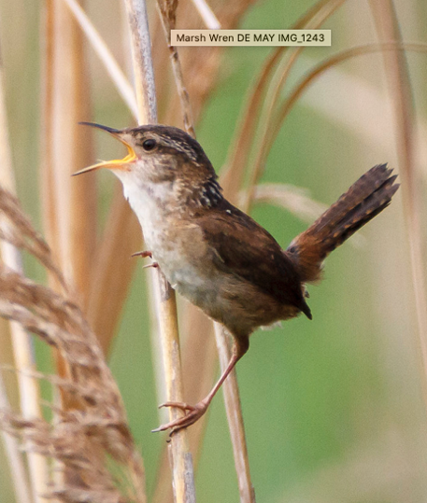
Marsh Dependent Breeding Birds
VV
A. Wells
A. Wells
A. Wells
Virginia Rail
Least Bittern
State Threatened
Marsh Wren

Slide 8
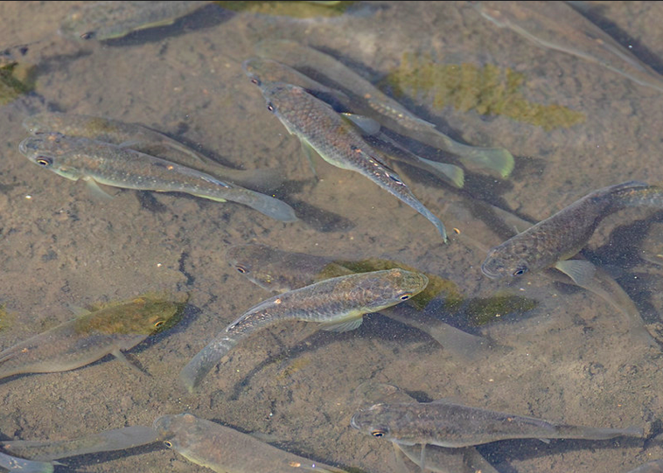
Fish Habitat
Mummichog
A. Wells
”Fish watching”, look up group they belong to – killifishes? And origin of the name

Slide 9
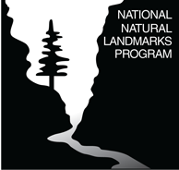
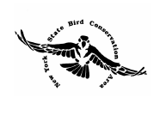
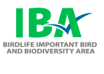
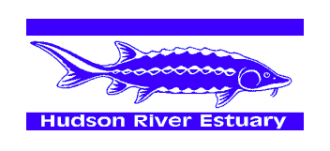
Iona Marsh
Designations
Anadromous Fish Concentration Area

Slide 10
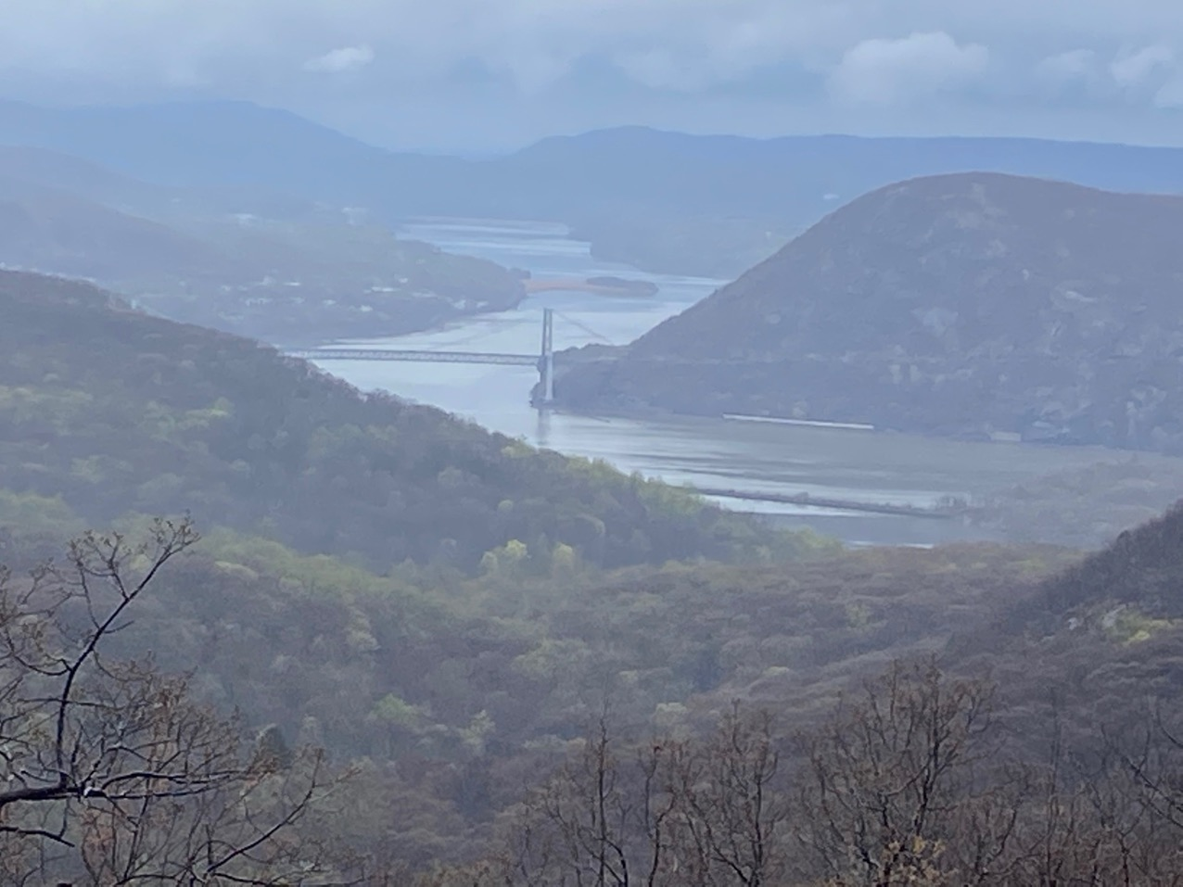
Hudson Highlands Scenic Area of Statewide Significance

Slide 11
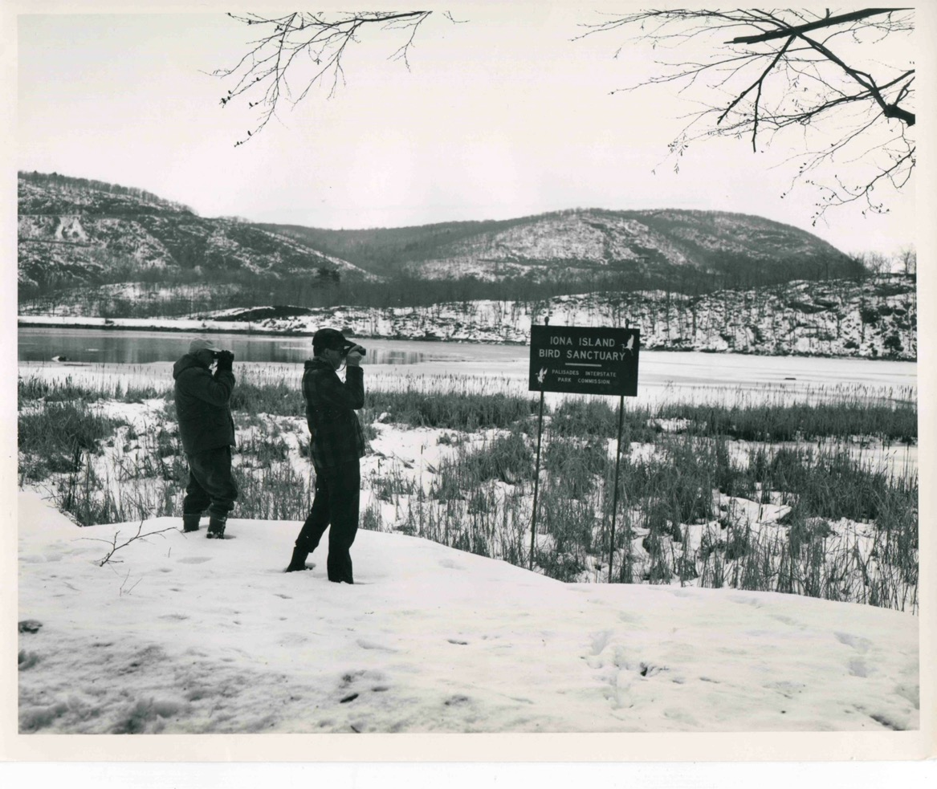

Slide 12
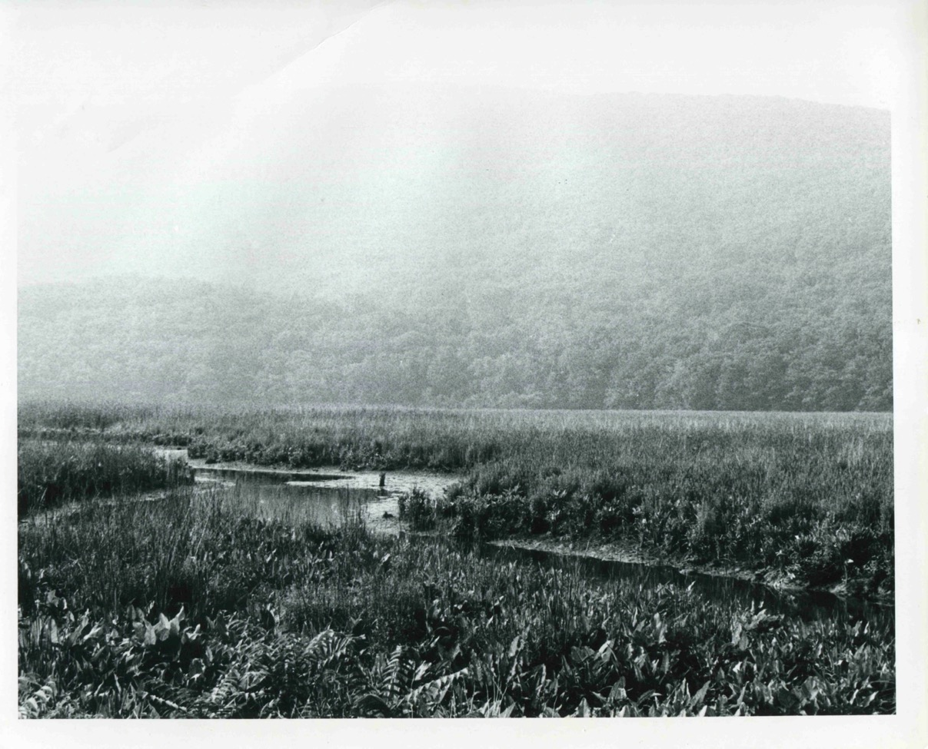

Slide 13
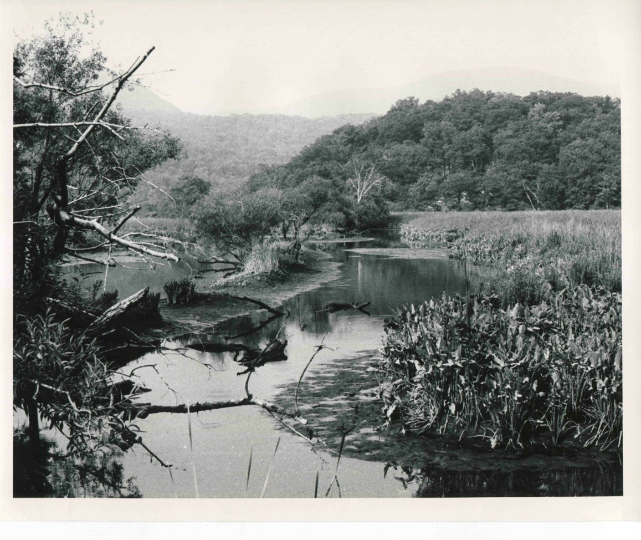

Slide 14
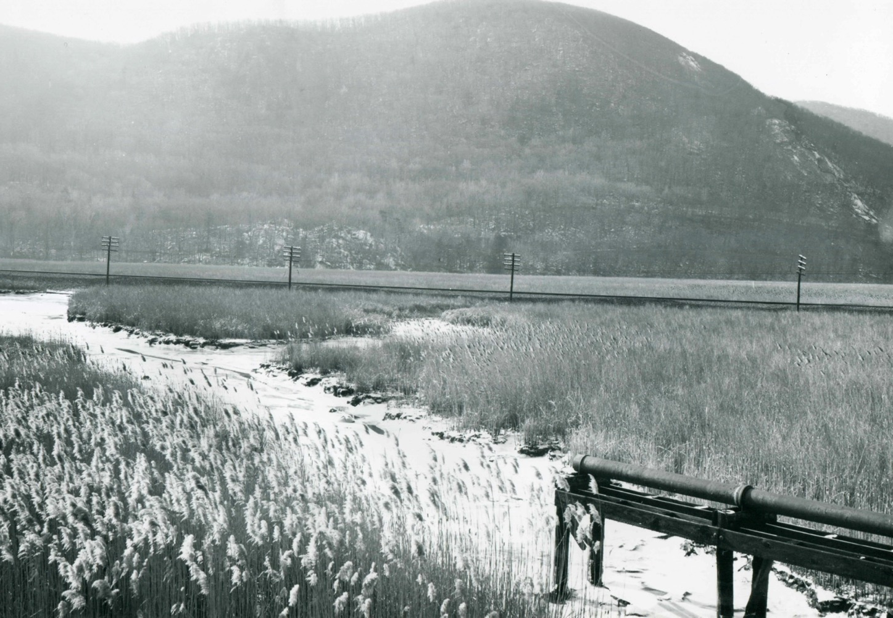

Slide 15
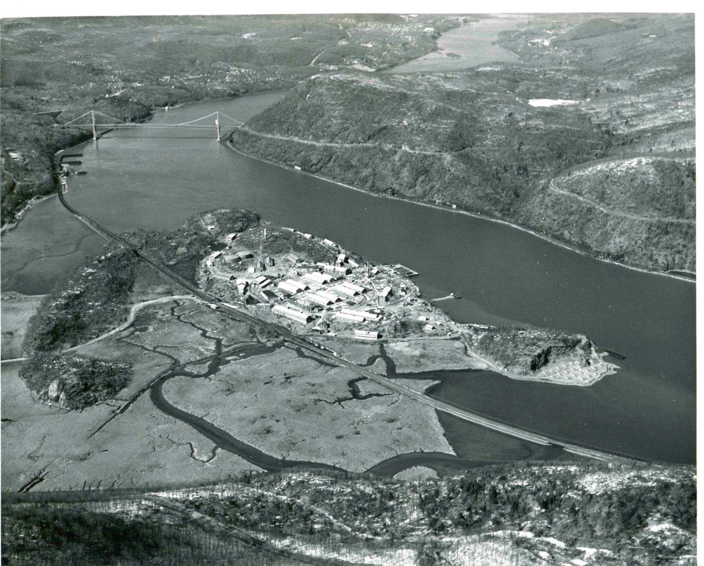

Slide 16
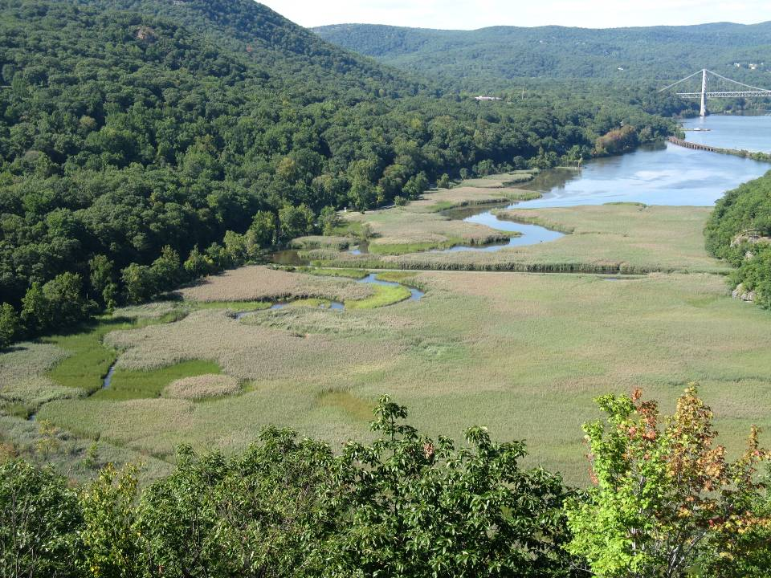
10% phrag by 1985s (check Wells paper) and 90% by 2005

Slide 17
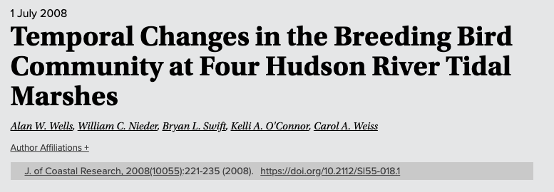
Biodiversity Research at Iona Marsh

Slide 18
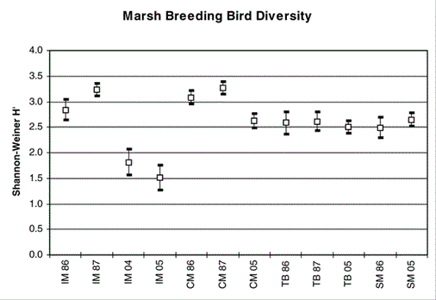
Iona
Constitution
Tivoli
Stock
Comparison of mean Shannon Diversity (±95% CI) for Iona Island Marsh (IM), Constitution Marsh (CM), Tivoli North Bay (TB), and Stockport Flats Marsh (SM) for 1986, 1987, 2004, and 2005.

Slide 19
Iona
Constitution
Tivoli
Stock
Comparison of mean Shannon Diversity (±95% CI) for Iona Island Marsh (IM), Constitution Marsh (CM), Tivoli North Bay (TB), and Stockport Flats Marsh (SM) for 1986, 1987, 2004, and 2005.

Slide 20
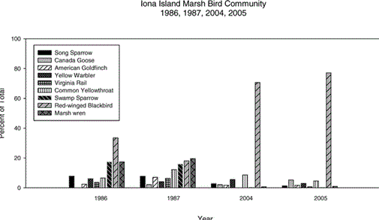
Dissapearance of Marsh wren, once at 20% , and Virginia rail, allow never common

Slide 21
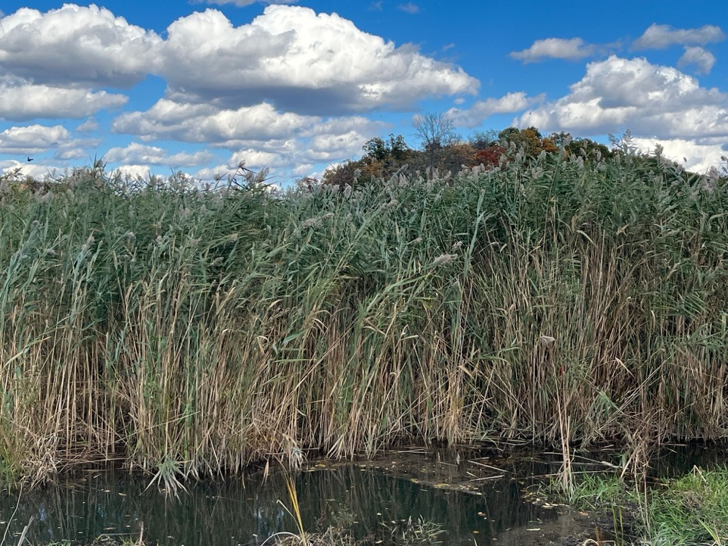
“Proliferation of Phragmites australis appears to be the proximal cause of the avian community changes at Iona Island Marsh. ”
Wells et al. 2008

Slide 22
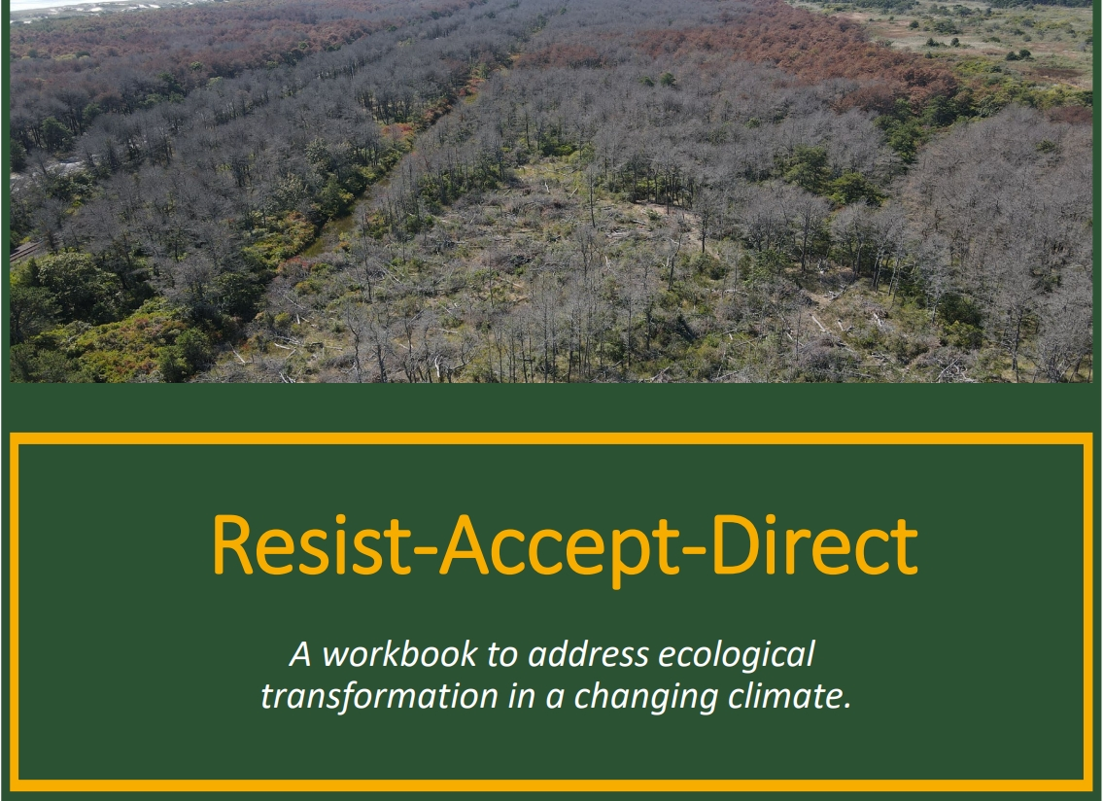

Slide 23
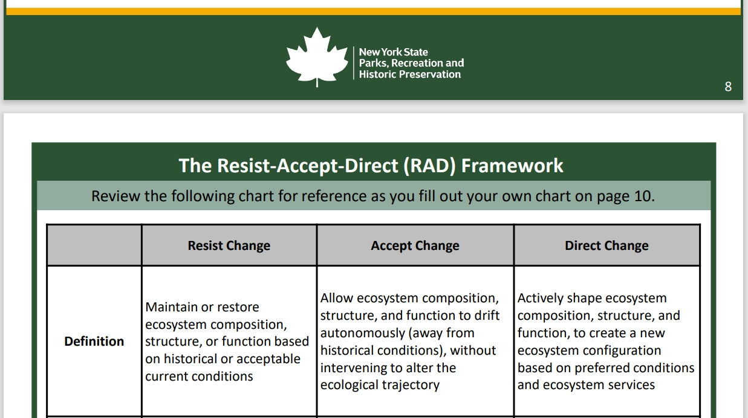

Slide 24
Baseline inventories and monitoring
  Distribution of rare plants
  Breeding bird activity
  Vegetation monitoring (1m plots)
  Sediment Elevation Tables (SET)

Slide 25
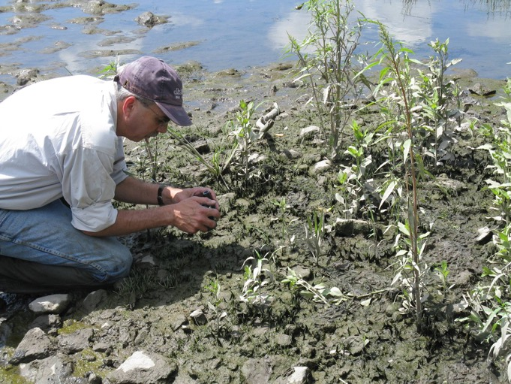
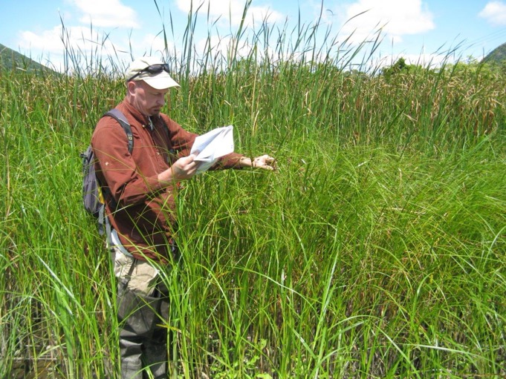
Baseline inventories and monitoring
  Distribution of rare plants

Slide 26

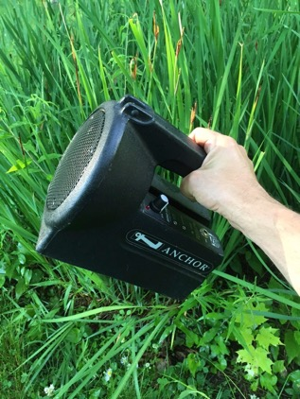
Baseline inventories and monitoring
  Breeding bird activity
A. Wells

Slide 27
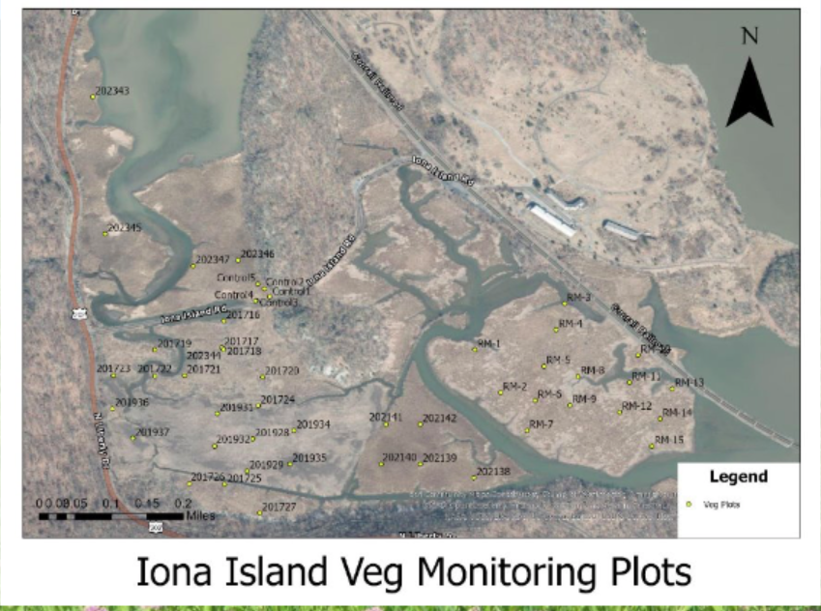
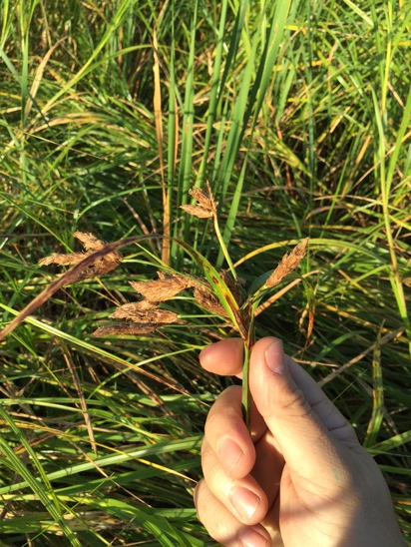
Baseline inventories and monitoring
  Vegetation monitoring (1m plots)

Slide 28
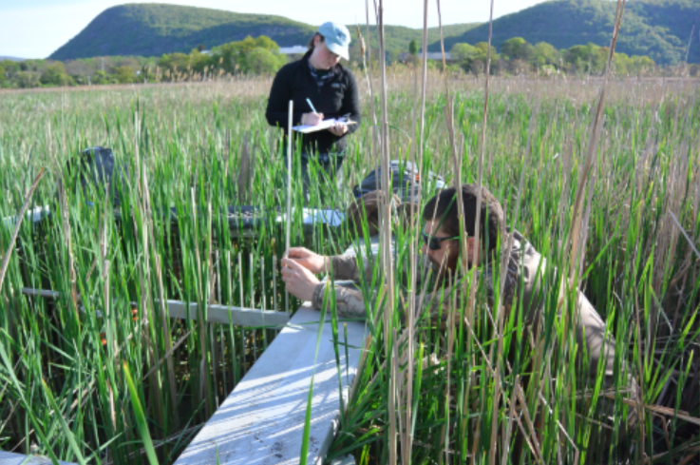
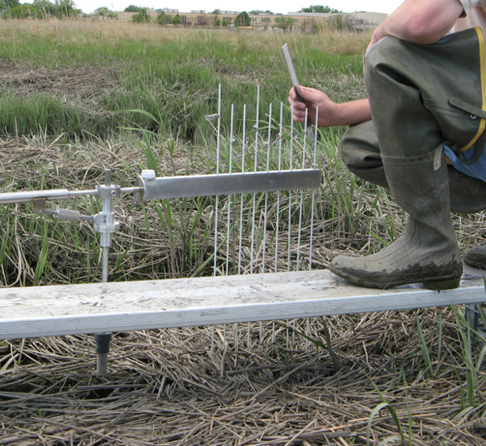
Baseline inventories and monitoring
  Sediment Elevation Tables (SET)

Slide 29
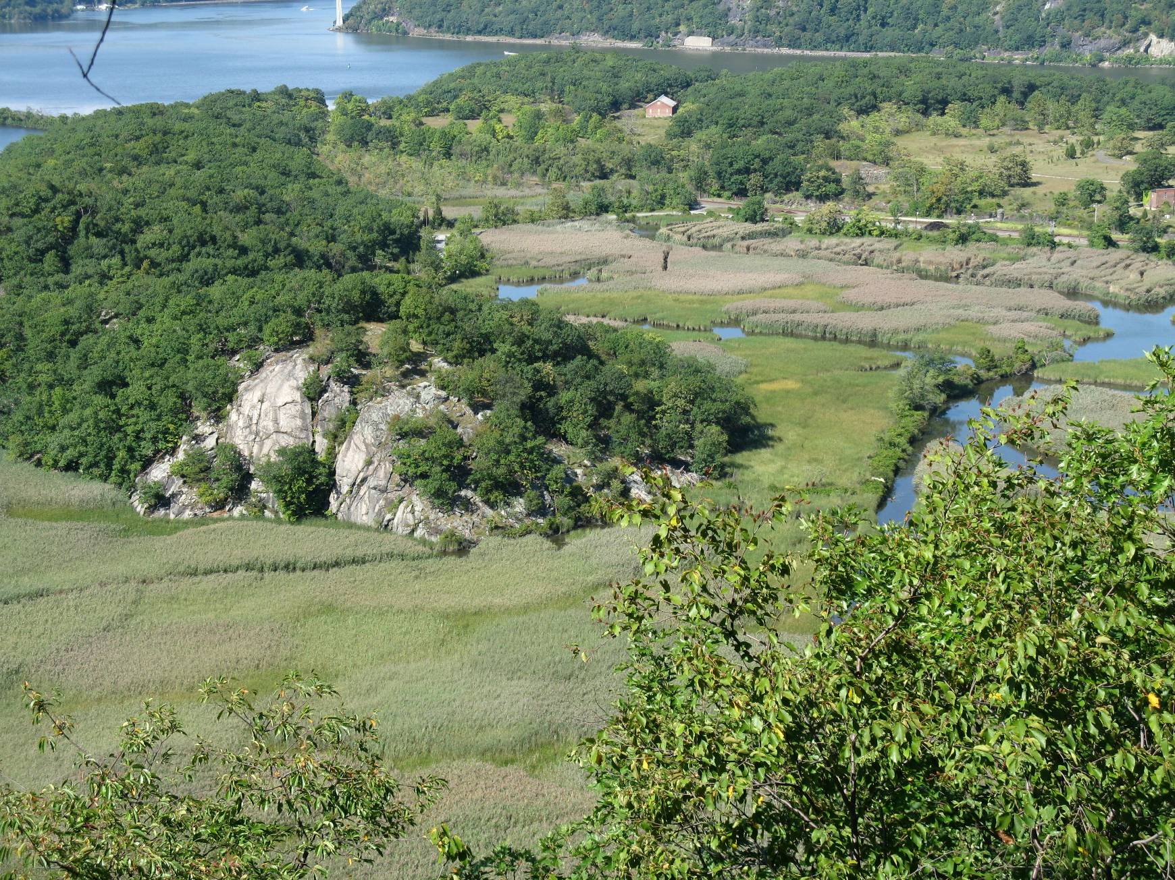

Slide 30
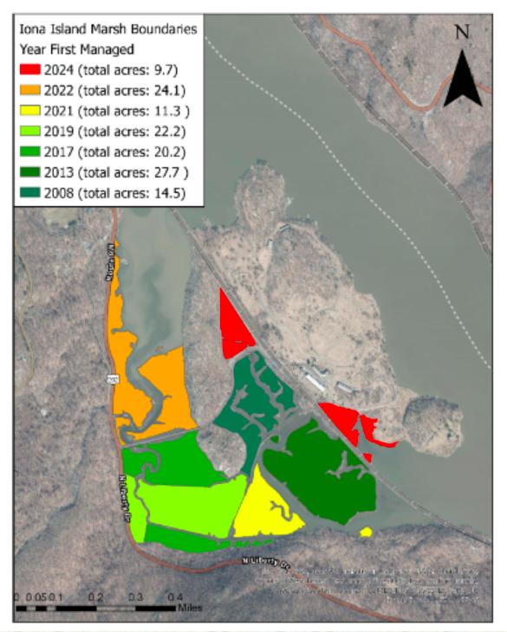
Management Zones
  10-30 acres each
  90% phrag reduction in YR 1
  “Maintenance” levels by YR 3
  7 zones totaling 130 acres by 2024

Slide 31
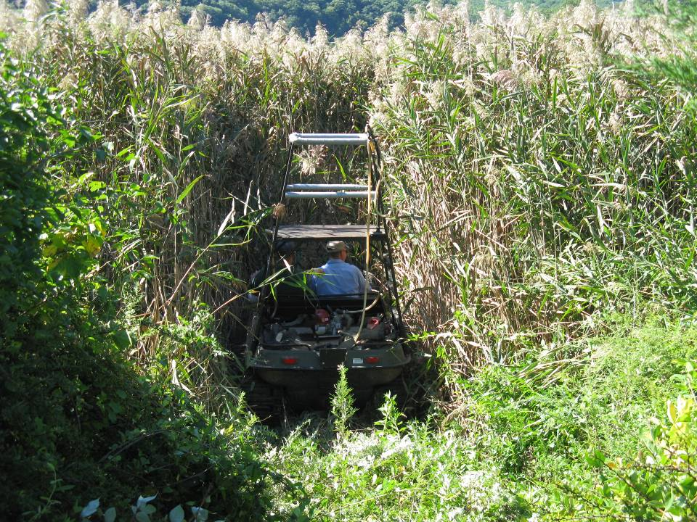
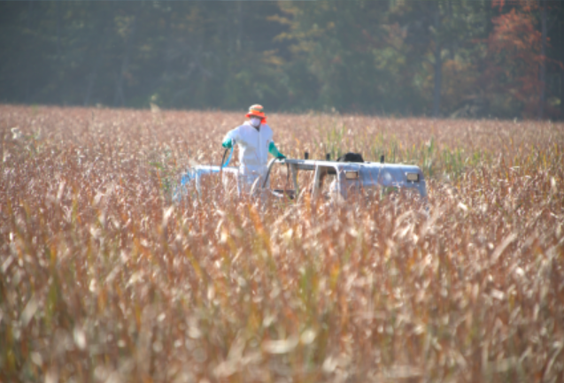
Herbicide Treatment

Slide 32
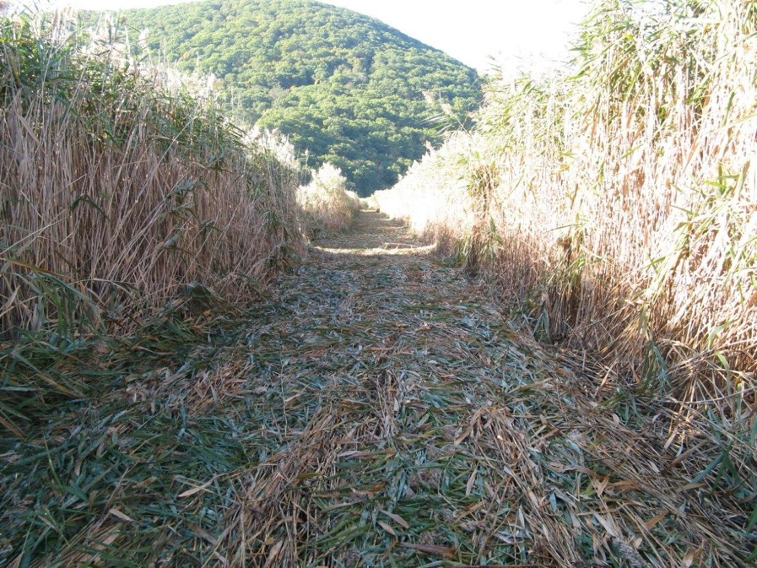
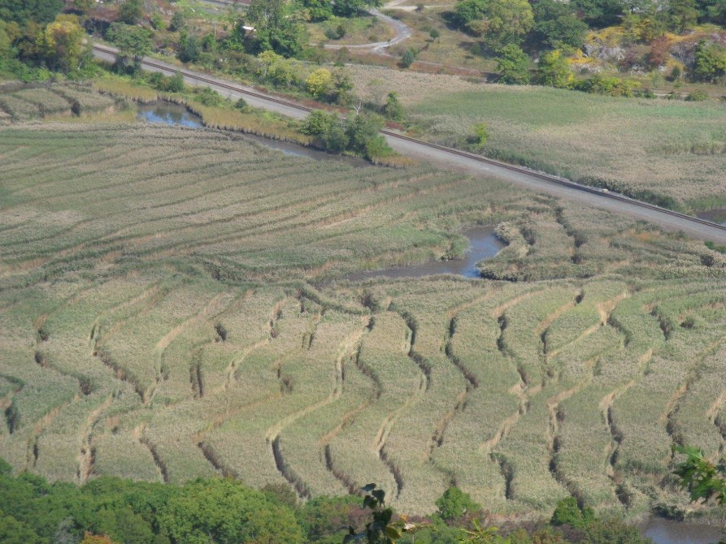
Herbicide Treatment

Slide 33
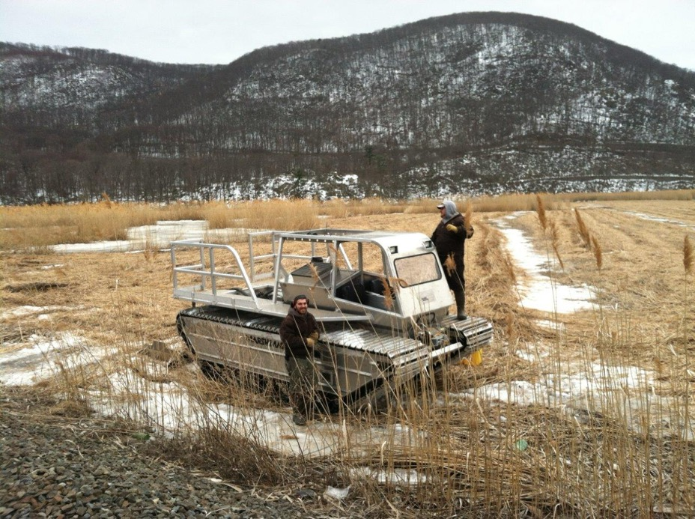
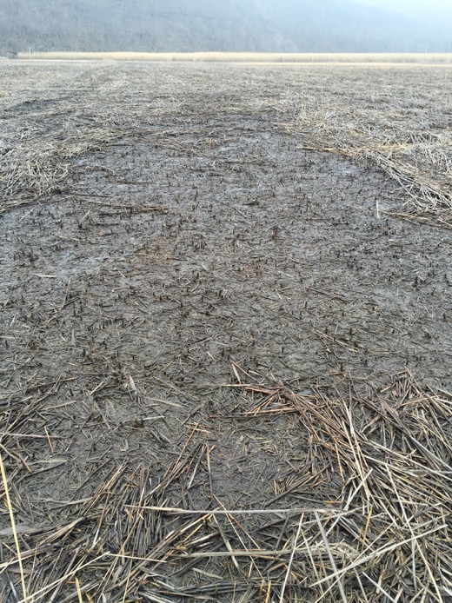
Winter Mowing

Slide 34
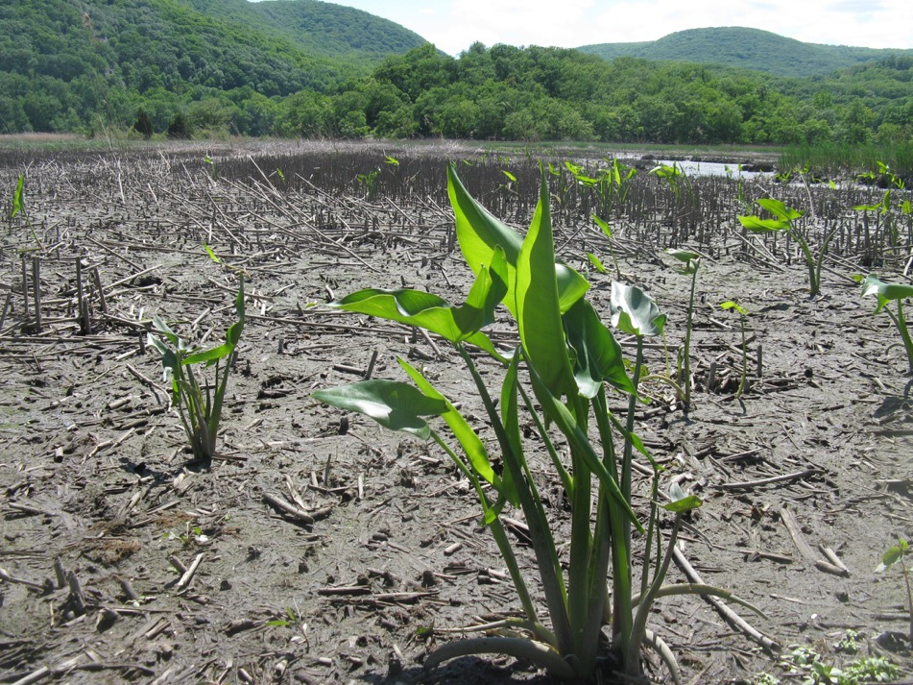

Vegetation Response – Holdovers from rhizomes

Slide 35
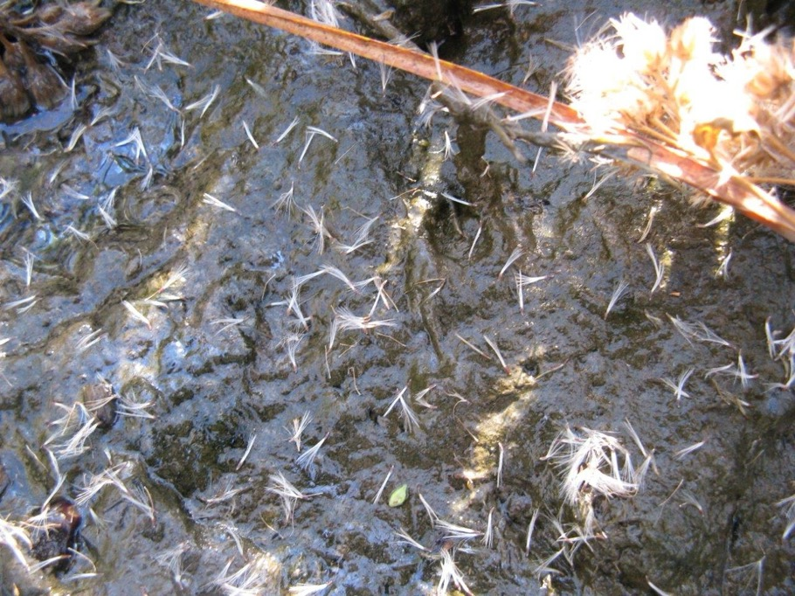
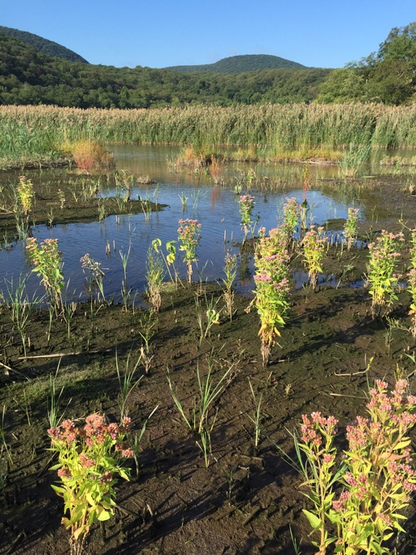
Vegetation Response – Pioneering annuals

Slide 36
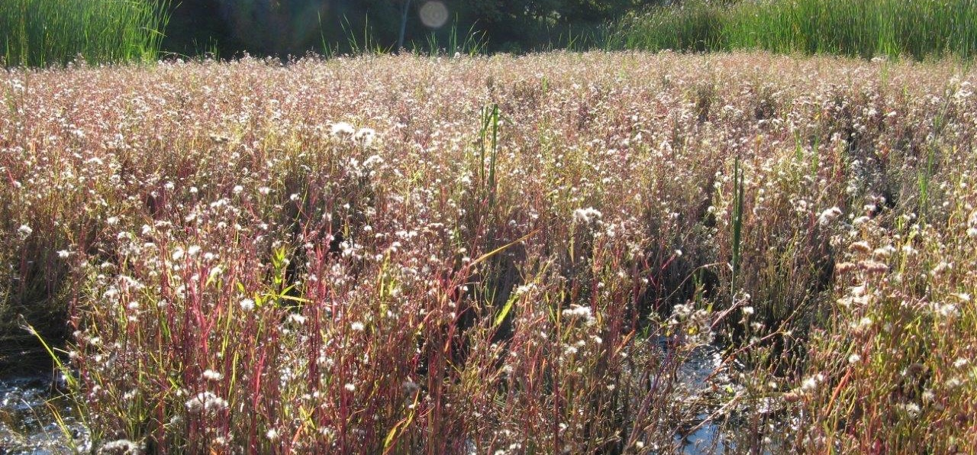
Vegetation Response – Pioneering annuals

Slide 37
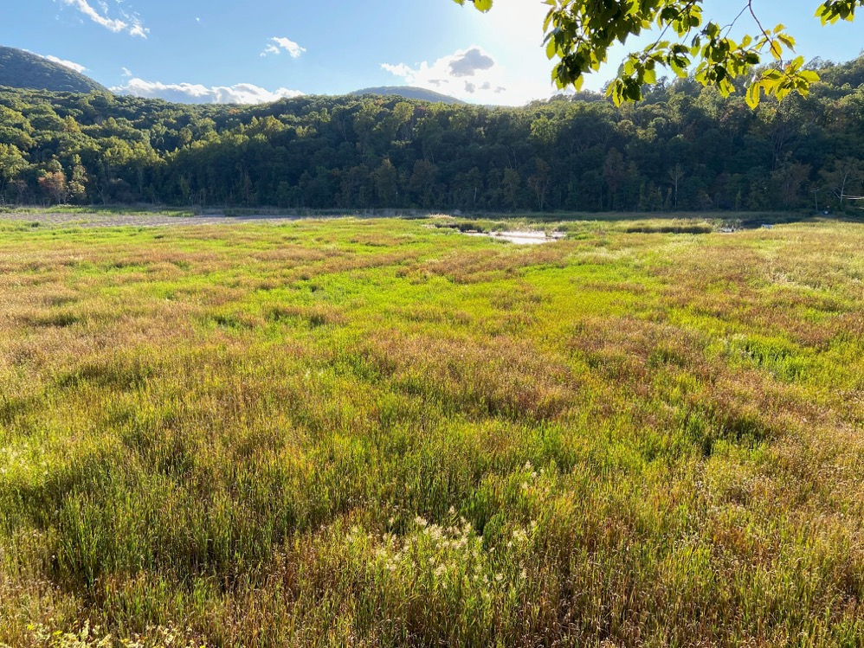
Vegetation Response – Mixed annuals and perennials

Slide 38
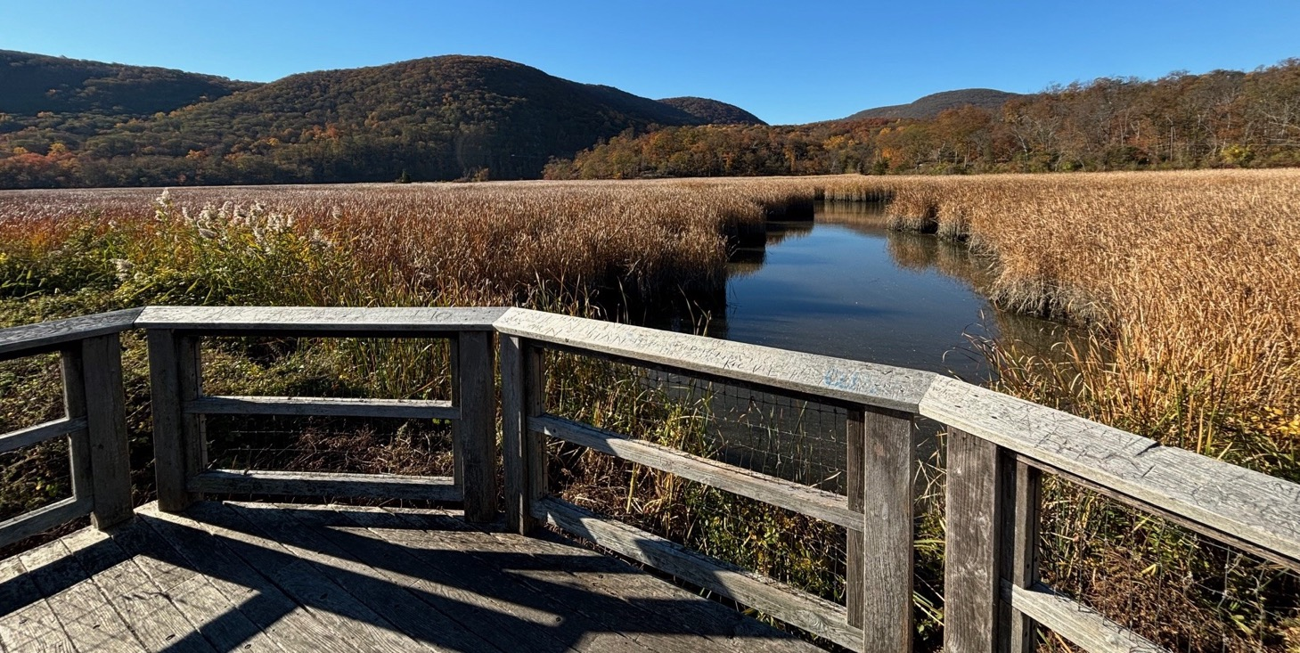
Vegetation Response – Cattail dominance

Slide 39
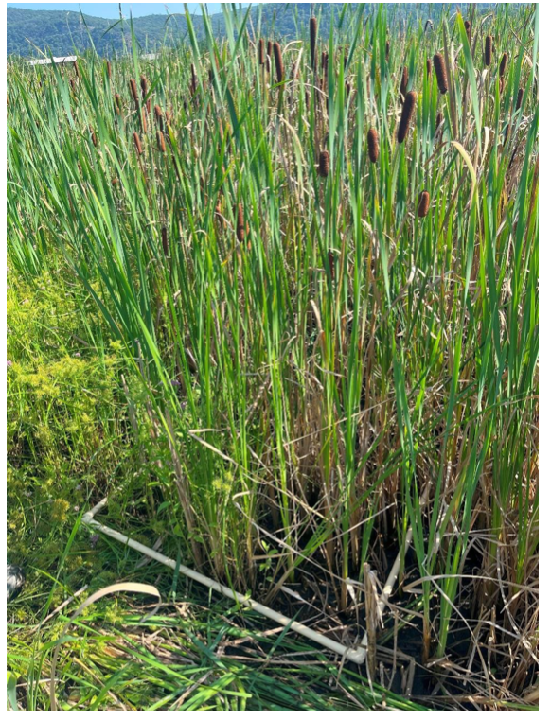

Slide 40


Slide 41

2013 ------------------------------------------
2017----------------------------------2020---------------------------------2024

Slide 43


Slide 44


Slide 45



Target Species Response?
  Rare Plants:
  Salt Marsh Aster – from trace to common
  NE Bulrush – from trace to widespread, multiple colonies in 2024
  Spongy Arrowhead – stable, restricted to channel edges

Slide 46



Target Species Response?
  Marsh Specialist Birds:
  Marsh Wren, Virginia Rail dramatic increase
  Least Bittern, returned and sustained presence at low numbers

Slide 47
What have we learned?
  For phragmites management, early intervention is preferred but large scale restoration is possible with time and resources.
  Build it and they will come: restored habitat can result in natural recolonization by mobile, marsh dependent species.
  Planting is not necessary if seed source/seed bank is present.
  Long-term success requires vigilance and adaptive management.

Slide 48

What is the future of Iona and other Hudson River marshes?
Check out SLAM model, SETS, thin layer deposition, RR tracks?

Slide 49


Slide 50
Acknowledgements
OPRPalisades Interstate Park League of Naturalists: Alan Wells,
OPRHP DESP
Palisades Interstate Park Commission
DEC-HRNERR: Betsy Blair, Dan Miller, Sarah Fernald, Brian DeGasperis, Heather Gierloff
Solitude Lake Management/Tigris Inc.
Trillium ISM, inc.
PIPLON Volunteers, Pat Murray, Carol Weiss, Ken McNichols, Alan Wells
DEC Invasive Species Eradication Grant Program
Rockland Audubon Society
Student Conservation Association - Hudson Valley Corps

Slide 51


